Slide 1
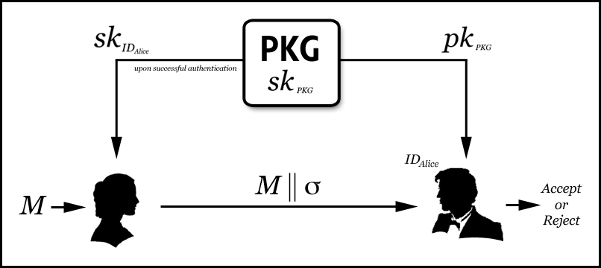
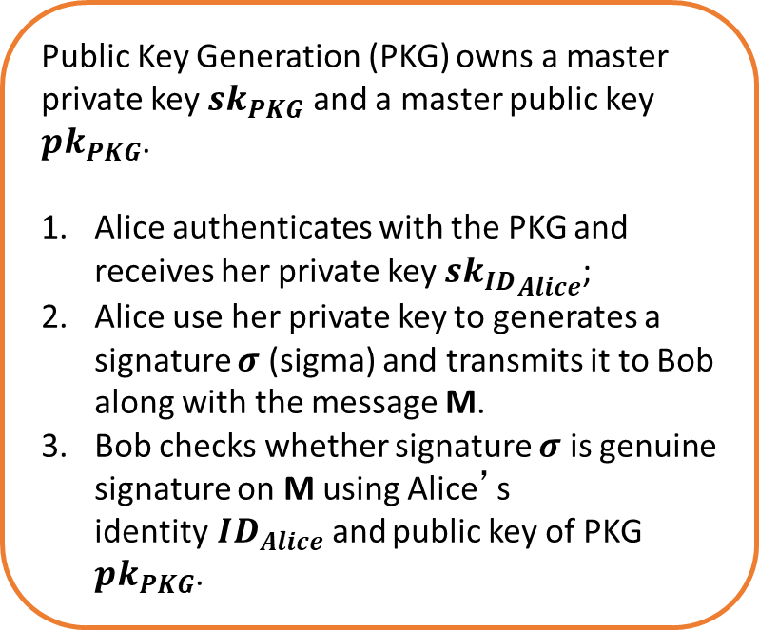
Identity-based Digital Signature
Public Key Generation (PKG) owns a master private key $sk_{PKG}$ and a master public key $pk_{PKG}$.
Alice authenticates with the PKG and receives her private key $s{k_{ID}}_{Alice}$;
Alice use her private key to generates a signature $σ$ (sigma) and transmits it to Bob along with the message M.
Bob checks whether signature $σ$ is genuine signature on M using Alice’s identity$ID_{Alice}$and public key of PKG $pk_{PKG}$.

Slide 2
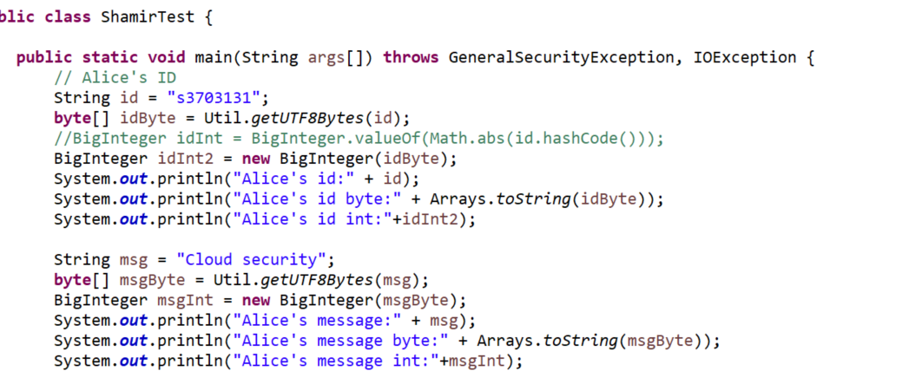
Choose message
Student No.

Slide 3
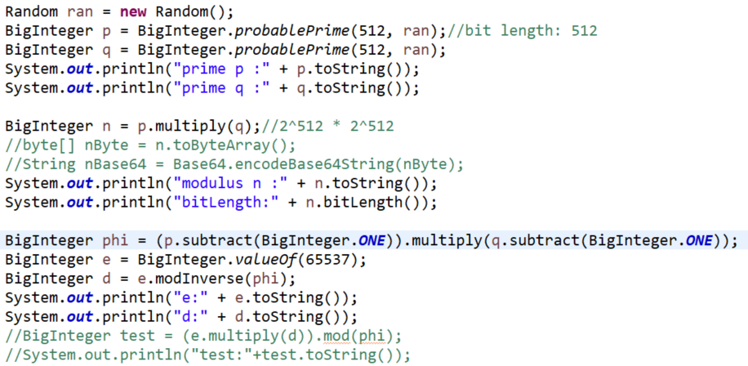
Generate key pair of PKG based on RSA
Choose RSA modulus n=pq;
Choose a pair (e,d) such that gcd(e,(p-1)(q-1))=1 and ed=1 (mod (p-1)(q-1))

Slide 4
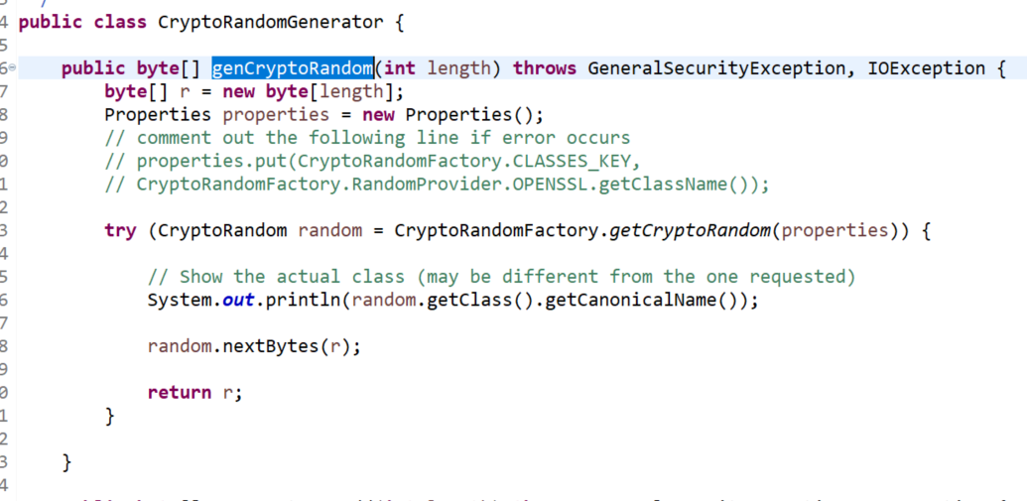
Generate key pair of PKG based on RSA
Choose RSA modulus n=pq;
Choose a pair (e,d) such that gcd(e,(p-1)(q-1))=1 and ed=1 (mod (p-1)(q-1))

Slide 5
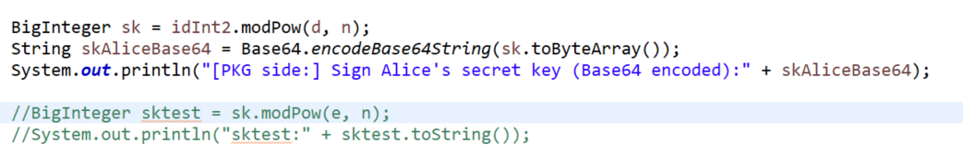
Generate Alice’s secret key given Alice’s ID
Given ID, compute sk=ID^{d}(mod n)//sign
Public parameter: (n,e)

Slide 6
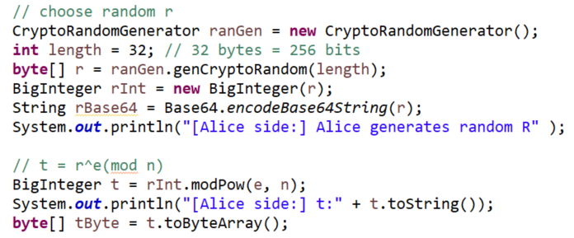
Alice computes signature(s, t).
Choose a random r, Compute t=r^{e} (mod n), s= sk r^{H(t,m)} (mod n)

Slide 7
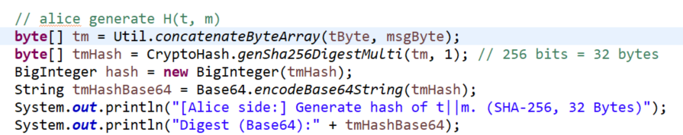
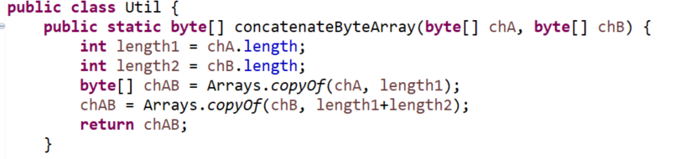
Alice computes signature(s, t).
Choose a random r, Compute t=r^{e} (mod n), s= sk r^{H(t,m)} (mod n)

Slide 8
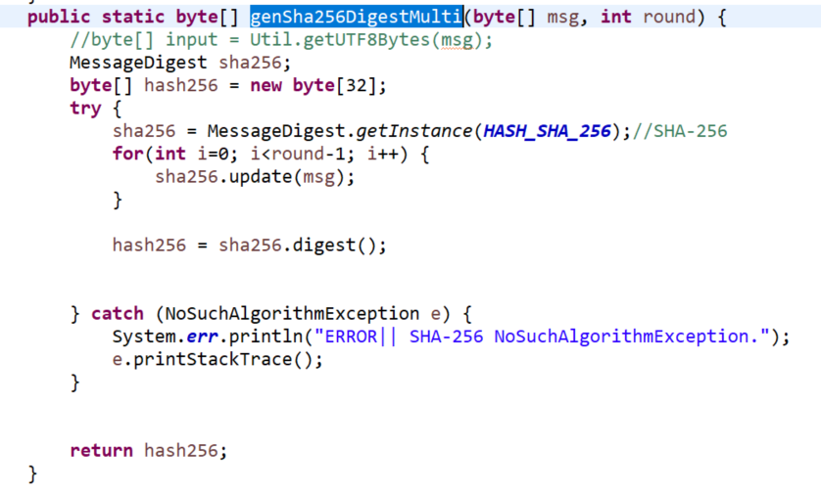
Alice computes signature(s, t).
Choose a random r, Compute t=r^{e} (mod n), s= sk r^{H(t,m)} (mod n)

Slide 9
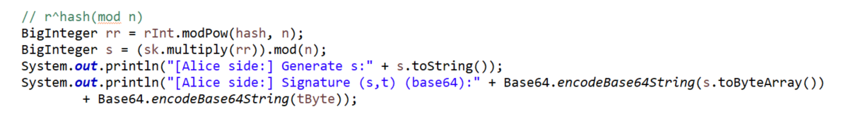
Alice computes signature(s, t).
Choose a random r, Compute t=r^{e} (mod n), s= sk r^{H(t,m)} (mod n)

Slide 10
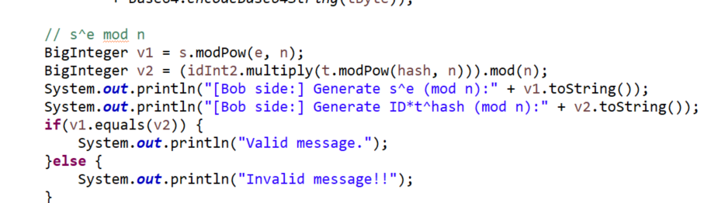
Bob verifies the validity
Given e, n, ID, (s,t), M, verify if s^{e}=ID t^{H(t,m)} (mod n)

