Slide 1
Part Two:
Security Principles
Chapter 2.2
Advanced Encryption Standard

Slide 2
Advanced Encryption Standard
DES cracked, Triple-DES slow: what next?
1997: NIST AES announced, call for algorithms
August 1998: 15 candidate algorithms
August 1999: 5 finalists
October 2000: Rijndael selected
  Two Belgians: Joan Daemen, Vincent Rijmen
May 2001: Comment period ended
Summer 2001: Finalized, certified until ‘06
Notes:
National Institute of Standards and Technology

Slide 3
AES vs. DES
Similar to DES: block cipher (with different modes), but 128-bit blocks
128-bit, 192-bit, or 256-bit key
Mix of permutations, “S-boxes”
S-boxes based on modular arithmetic with polynomials.
Notes:
In cryptography, a Feistel cipher is a symmetric structure used in the construction of block ciphers, named after the German-born physicist and cryptographer Horst Feistel who did pioneering research while working for IBM (USA); it is also commonly known as a Feistel network.

Slide 4
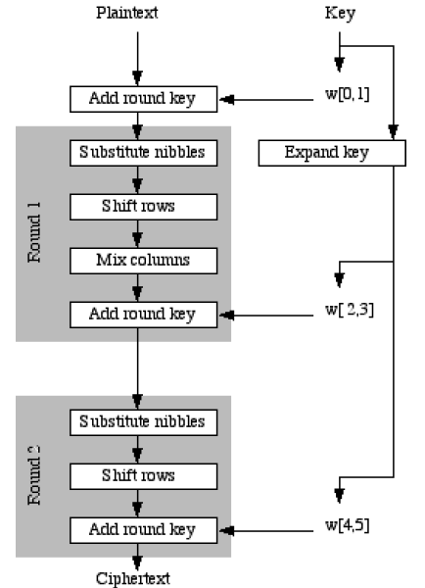
Simplified AES
16 bits
16 bits
16 bits
Notes:
Mohammad Musa, Edward Schaefer, and Stephen Wedig, A simplified AES algorithm and its linear and differential cryptanalyses, Cryptologia 27 (April 2003), 148–177.

Slide 5
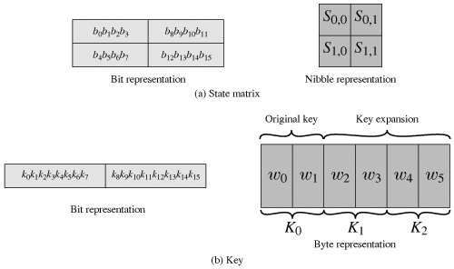
State Matrix and Round Keys

Slide 6
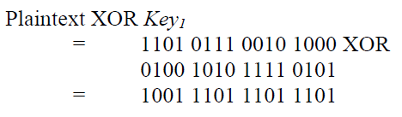
Add Round Key

Slide 7
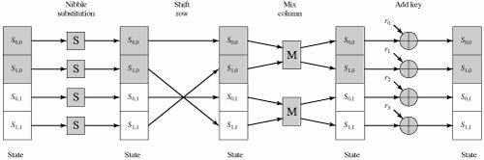
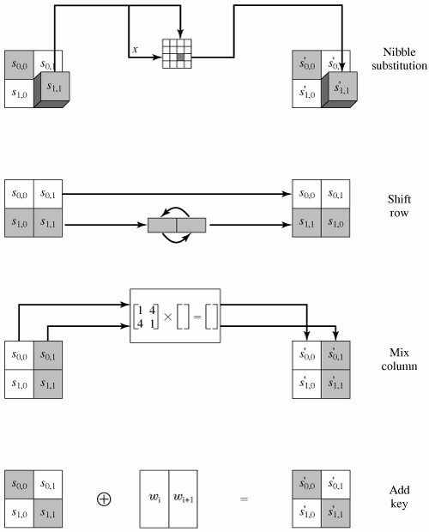
Encryption Round

Slide 8

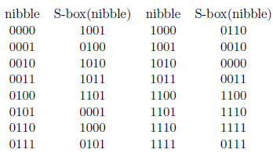

Substitution
Notes:
In computing, a nibble (often nybble or even nyble to match the vowels of byte) is a four-bit aggregation, or half an octet. As a nibble contains 4 bits, there are sixteen (24) possible values, so a nibble corresponds to a single hexadecimal digit (thus, it is often referred to as a "hex digit" or "hexit").

Slide 9
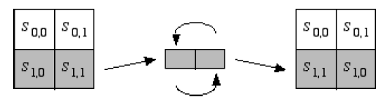

Shift Rows

Slide 10
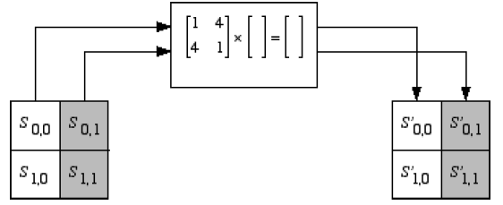

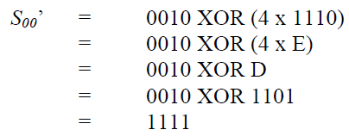
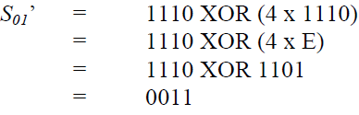

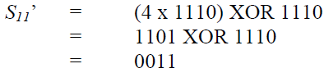
Mix Columns

Slide 11
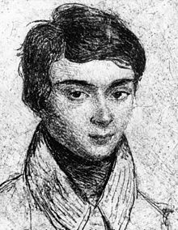
Galois Field
Évariste Galois (French: [evaʁist ɡalwa]) (25 Oct. 1811 – 31 May 1832) was a French mathematician born in Bourg-la-Reine. While still in his teens, he was able to determine a necessary and sufficient condition for a polynomial to be solvable by radicals, thereby solving a long-standing problem. His work laid the foundations for Galois theory and group theory, two major branches of abstract algebra, and the subfield of Galois connections. He was the first to use the word “group” (French: groupe) as a technical term in mathematics to represent a group of permutations. A radical Republican during the monarchy of Louis Philippe in France, he died from wounds suffered in a duel under questionable circumstances at the age of twenty.
Notes:
Duel: a prearranged contest with deadly weapons between two people in order to settle a point of honour.

Slide 12
GF(16)
GF(16)={0, 1, 2, …, 15}
Polynomial representation
0, 1, 2=x, 3=x+1, …, 15=x³+x²+x+1, modulo x⁴+x+1
Addition
a + b = a XOR b, e.g., 1 + 3 = 01 XOR 11 = 10 = 2
a XOR a=0 → a = -a
Multiplication
a*b = polynomial of a * polynomial of b (mod x⁴+x+1)
e.g., 4*14=x²*(x³+x²+x)= x⁵+x⁴+x³
=(x+1)(x⁴+x+1)+(x³+x²+1)=13

Slide 13
Multiplication over GF(2⁴)
a*b = polynomial of a * polynomial of b (mod x⁴+x+1)
e.g., 4*14=x²*(x³+x²+x)
= x⁵+x⁴+x³=(x+1)(x⁴+x+1)+(x³+x²+1)=13
x +1 _
x⁴+x+1 / x⁵+x⁴+x³
x⁵ + x²+x
_____________________________
x⁴+x³+x²+x
x⁴ +x+1
_____________________
x³+x² +1
Notes:
x¹⁺²=x³=1000
X³⁺²=x⁵=x²+x=0110

Slide 14
Addition and Multiplication over GF(16)
Addition: 1 + 3 = 01 XOR 11 = 10 = 2
Multiplication: 3*14 (mod 10011) = ?
3*14=11 x 1110 = 10010 (mod 10011) = 1 = 0001
1110 ____1_
X 11 10011 / 10010
1110 10011
+ 1110__ 1
10010

Slide 15
Matrix Multiplication
https://www.youtube.com/watch?v=Tve-Huc1IRo
Notes:
x¹⁺²=x³=1000
X³⁺²=x⁵=x²+x=0110

Slide 16
Matrix Multiplication over GF(16)
=
1x0010+4x1110 (mod 10011) = 0010+1101=1111
4*1110=100 x 1110 = 111000 (mod 10011) = 1101
1110 ____11
X 100 10011 / 111000
0000 10011
0000 11110
+1110__ 10011
111000 1101
1 | 4
4 | 1
0010
1110
1111
0011

Slide 17
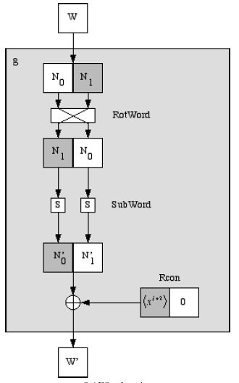
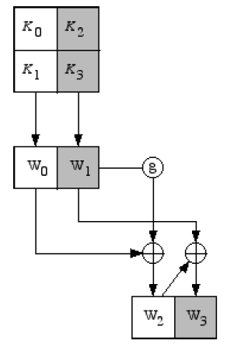
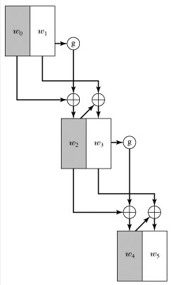
Key Expansion
Notes:
Key expansion is done very similarly to AES. The four nibbles in the key
are grouped into two 8-bit “words”, which will be expanded into 6 words. The first part of the
expansion, which produces the third and fourth words, is shown below. The rest of the expansion
is done in exactly the same way, replacing W0 and W1 with W2 and W3, and replacing W2 and W3
with W4 and W5.
The g function is shown in the next diagram. It is very similar to AES, first rotating the nibbles
and then putting them through the S-boxes. The main difference is that the round constant is
produced using x^{j+2}, where j is the number of the round of expansion. That is, the first time you
expand the key you use a round constant of x3 = 1000 for the first nibble and 0000 for the second
nibble. The second time you use x4 = 0011 for the first nibble and 0000 for the second nibble.

Slide 18
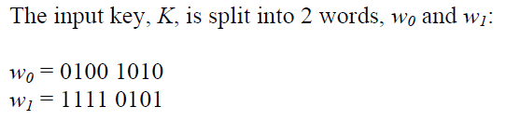


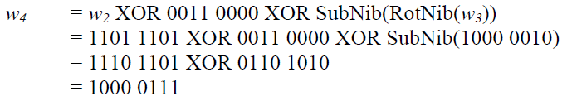

Example

Slide 19
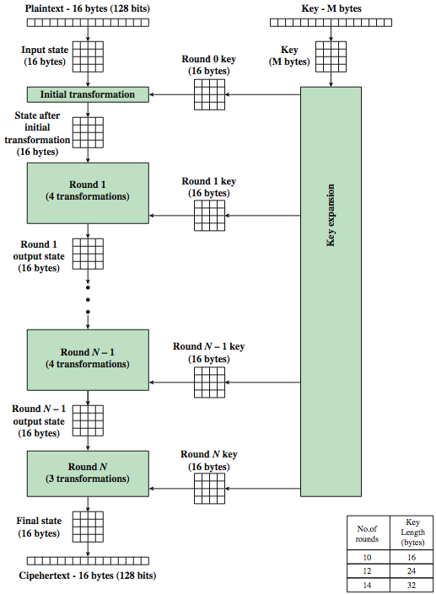
AES Encryption Process
Notes:
19
Stallings Figure 5.1 shows the overall encryption process in AES.

Slide 20
AES Methods
Convert to state array
Transformations (and their inverses)
    AddRoundKey
    SubBytes
    ShiftRows
    MixColumns
Key Expansion

Slide 21
AES Parameters
Nb – Number of columns in the State
  For AES, Nb = 4
Nk – Number of 32-bit words in the Key
  For AES, Nk = 4, 6, or 8
Nr – Number of rounds
  For AES, Nr = 10, 12, or 14
Notes:
Also known as block size

Slide 22
Convert to State Array
Input block:
0
1
2
3
4
5
6
7
8
9
10
11
12
13
14
15
0 | 4 | 8 | 12
1 | 5 | 9 | 13
2 | 6 | 10 | 14
3 | 7 | 11 | 15
=
S_{0,0} | S_{0,1} | S_{0,2} | S_{0,3}
S_{1,0} | S_{1,1} | S_{1,2} | S_{1,3}
S_{2,0} | S_{2,1} | S_{2,2} | S_{2,3}
S_{3,0} | S_{3,1} | S_{3,2} | S_{3,3}

Slide 23
AddRoundKey
XOR each byte of the round key with its corresponding byte in the state array
XOR
S_{0,1}
S_{0,0} | S_{0,1} | S_{0,2} | S_{0,3}
S_{1,0} | S_{1,1} | S_{1,2} | S_{1,3}
S_{2,0} | S_{2,1} | S_{2,2} | S_{2,3}
S_{3,0} | S_{3,1} | S_{3,2} | S_{3,3}
S_{1,1}
S’_{0,1}
R_{0,1}
S_{2,1}
S’_{0,0} | S’_{0,1} | S’_{0,2} | S’_{0,3}
S’_{1,0} | S’_{1,1} | S’_{1,2} | S’_{1,3}
S’_{2,0} | S’_{2,1} | S’_{2,2} | S’_{2,3}
S’_{3,0} | S’_{3,1} | S’_{3,2} | S’_{3,3}
R_{0,0} | R_{0,1} | R_{0,2} | R_{0,3}
R_{1,0} | R_{1,1} | R_{1,2} | R_{1,3}
R_{2,0} | R_{2,1} | R_{2,2} | R_{2,3}
R_{3,0} | R_{3,1} | R_{3,2} | R_{3,3}
S’_{1,1}
R_{1,1}
S_{3,1}
S’_{2,1}
R_{2,1}
S’_{3,1}
R_{3,1}

Slide 24
Substitute Bytes
a simple substitution of each byte
uses one table of 16x16 bytes containing a permutation of all 256 8-bit values
each byte of state is replaced by byte indexed by row (left 4-bits) & column (right 4-bits)
  eg. byte {95} is replaced by byte in row 9 column 5
  which has value {2A}
S-box constructed using defined transformation of values in GF(2⁸)
designed to be resistant to all known attacks
Notes:
24
We now turn to a discussion of each of the four transformations used in AES. For each stage, we mention the forward (encryption) algorithm, the inverse (decryption) algorithm, and the rationale for the design of that stage.
The Substitute bytes stage uses an S-box to perform a byte-by-byte substitution of the block. There is a single 8-bit wide S-box used on every byte. This S-box is a permutation of all 256 8-bit values, constructed using a transformation which treats the values as polynomials in GF(2⁸) – however it is fixed, so really only need to know the table when implementing. Decryption requires the inverse of the table. These tables are given in Stallings Table 5.2.
The table was designed to be resistant to known cryptanalytic attacks. Specifically, the Rijndael developers sought a design that has a low correlation between input bits and output bits, with the property that the output cannot be described as a simple mathematical function of the input, with no fixed points and no “opposite fixed points”.

Slide 25
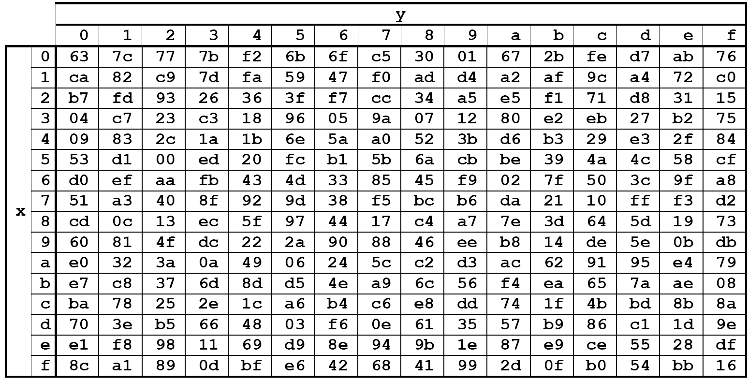
SubBytes
00 | 44 | 88 | CC
11 | 55 | 99 | DD
22 | 66 | AA | EE
33 | 77 | BB | FF
Replace each byte in the state array with its corresponding value from the S-Box
55

Slide 26
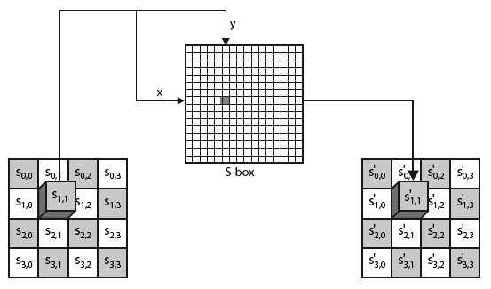
Substitute Bytes
Notes:
26
As this diagram from Stallings Fig 5.5a shows, the Byte Substitution operates on each byte of state independently, with the input byte used to index a row/col in the table to retrieve the substituted value.

Slide 27

Substitute Bytes Example
Notes:
Show an example of the SubBytes transformation from the text.
27

Slide 28
Shift Rows
a circular byte shift in each row
  1st row is unchanged
  2nd row does 1 byte circular shift to left
  3rd row does 2 byte circular shift to left
  4th row does 3 byte circular shift to left
decrypt inverts using shifts to right
since state is processed by columns, this step permutes bytes between the columns
Notes:
28
The ShiftRows stage provides a simple “permutation” of the data, whereas the other steps involve substitutions. Further, since the state is treated as a block of columns, it is this step which provides for diffusion of values between columns. It performs a circular rotate on each row of 0, 1, 2 & 3 places for respective rows. When decrypting it performs the circular shifts in the opposite direction for each row. This row shift moves an individual byte from one column to another, which is a linear distance of a multiple of 4 bytes, and ensures that the 4 bytes of one column are spread out to four different columns.

Slide 29
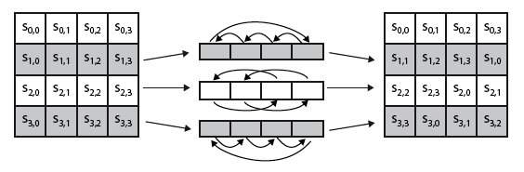

Shift Rows
Notes:
29
Stalling Figure 5.7a illustrates the Shift Rows permutation. Then show an example of ShiftRows from the text.

Slide 30

Mix Columns
each column is processed separately
each byte is replaced by a value dependent on all 4 bytes in the column
effectively a matrix multiplication in GF(2⁸) using prime poly m(x) =x⁸+x⁴+x³+x+1
Notes:
30
The forward mix column transformation, called MixColumns, operates on each column individually. Each byte of a column is mapped into a new value that is a function of all four bytes in that column. It is a substitution that makes use of arithmetic over GF(2^8). Each byte of a column is mapped into a new value that is a function of all four bytes in that column. It is designed as a matrix multiplication where each byte is treated as a polynomial in GF(2⁸). The inverse used for decryption involves a different set of constants.
The constants used are based on a linear code with maximal distance between code words – this gives good mixing of the bytes within each column. Combined with the “shift rows” step provides good avalanche, so that within a few rounds, all output bits depend on all input bits.

Slide 31
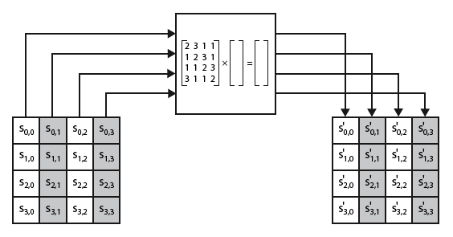
Mix Columns
Notes:
31
Stalling Figure 5.5b illustrates the Mix Columns transformation.

Slide 32
MixColumns
S’_{0,c} = ({02} • S_{0,c}) ⊕ ({03} • S_{1,c}) ⊕ S_{2,c} ⊕ S_{3,c}
S’_{1,c} = S_{0,c} ⊕ ({02} • S_{1,c}) ⊕ ({03} • S_{2,c}) ⊕ S_{3,c}
S’_{2,c} = S_{0,c} ⊕ S_{1,c} ⊕ ({02} • S_{2,c} ) ⊕ ({03} • S_{3,c})
S’_{3,c} = ({03} • S_{0,c}) ⊕ S_{1,c} ⊕ S_{2,c} ⊕ ({02} • S_{3,c}

Slide 33
Finite Fields
AES uses the finite field GF(2⁸)
  b₇x⁷ + b₆x⁶ + b₅x⁵ + b₄x⁴ + b₃x³ + b₂x² + b₁x + b₀
    {b₇, b₆, b₅, b₄, b₃, b₂, b₁, b₀}
Byte notation for the element:
x⁶ + x⁵ + x + 1
  {01100011} – binary
  {63} – hex
Has its own arithmetic operations
  Addition
  Multiplication

Slide 34
Finite Field Arithmetic
Addition (XOR)
    (x⁶ + x⁴ + x² + x + 1) + (x⁷ + x + 1) = x⁷ + x⁶ + x⁴ + x²
    {01010111} ⊕ {10000011} = {11010100}
    {57} ⊕ {83} = {d4}
Multiplication is tricky

Slide 35
Finite Field Multiplication
These cancel
(x⁶ + x⁴ + x² + x +1) (x⁷ + x +1) =
x¹³ + x¹¹ + x⁹ + x⁸ + x⁷ + x⁷ + x⁵ + x³ + x² + x + x⁶ + x⁴ + x² + x +1
= x¹³ + x¹¹ + x⁹ + x⁸ + x⁶ + x⁵ + x⁴ + x³ +1
and
x¹³ + x¹¹ + x⁹ + x⁸ + x⁶ + x⁵ + x⁴ + x³ +1 modulo ( x⁸ + x⁴ + x³ + x +1)
= x⁷ + x⁶ +1.
Irreducible Polynomial

Slide 36

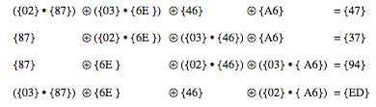
Mix Columns Example
Notes:
Show an example of the MixColumns transformation from the text, along with verification of the first column of this example.
36

Slide 37
Key Expansion
Expands the key material so that each round uses a unique round key
  Generates Nb(Nr+1) words
  AES Rijndael Cipher - Visualization
  https://www.youtube.com/watch?v=mlzxpkdXP58

Slide 38
  AES Rijndael Cipher - Visualization
  https://www.youtube.com/watch?v=mlzxpkdXP58

