Slide 1

Diffie-Hellman Key Exchange
Discovered by Whitfield Diffie and Martin Hellman
Diffie and Hellman won the 2015 Turing Award (the Nobel Prize of computing), “for fundamental contributions to modern cryptography”.
Applications
Secure Sockets Layer (SSL)/Transport Layer Security (TLS)
Secure Shell (SSH)
Internet Protocol Security (IPSec)
Public Key Infrastructure (PKI)

Slide 2
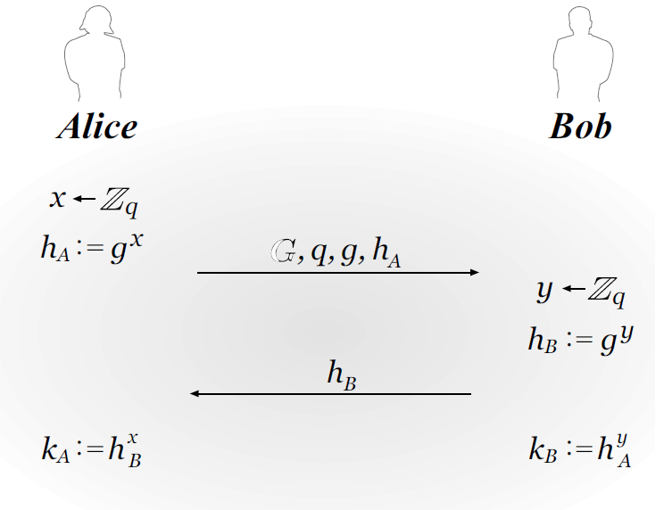
Protocol overview
Overview the protocol step-by-step
Two large numbers q and g (publicly available):
q is a prime number;
g is the primitive root modulo q.
Users pick private values x and y.
Both compute public values:
h_{A} = g^{x} mod q,
h_{B} = g^{y} mod q.
Public values h_{A} and h_{B} are exchanged.
k_{A} = k_{B} = g^{xy}
Notes:
(Number Theory).
Y = g^x (mod q)
Gcd(y,q)=1

Slide 3
Implementation overview
With the previous protocol overview in mind…
Functions we need to implement:
Key generation: public keys, private keys.
Alice’s pubKey = h_{A}, priKey = x
Bob’s pubKey = h_{B}, priKey = y
Exchange public keys.
Compute the shared secret k_{A} , k_{B.}
Verify if k_{A} = k_{B.}
If so, they can use it as their shared encryption key to encrypt data, network packages, etc.
Notes:
(Number Theory).
Y = g^x (mod q)
Gcd(y,q)=1

Slide 4
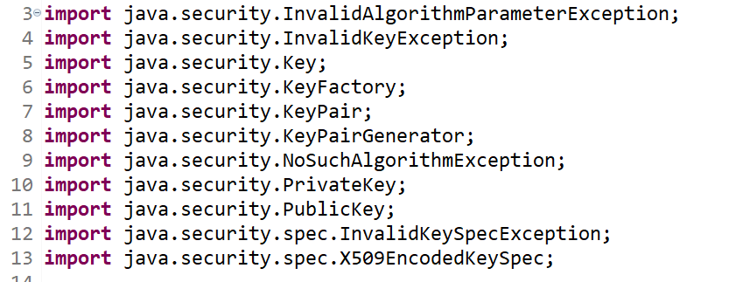
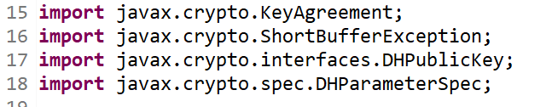
Java packages for key generation
java.security
javax.crypto

Slide 5
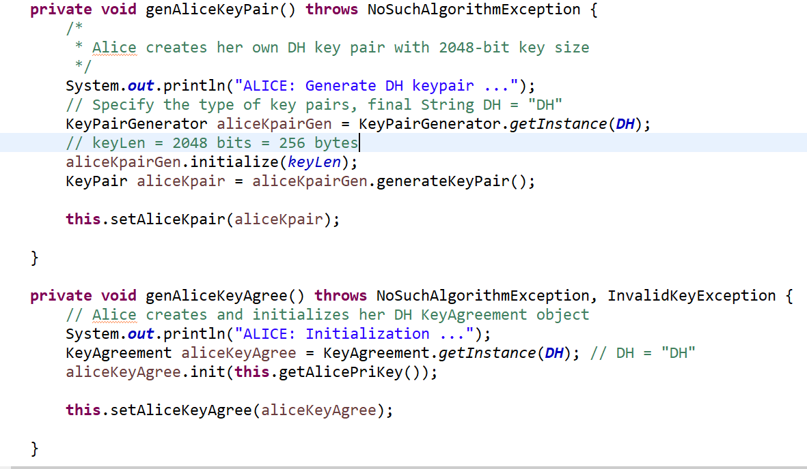
Atomic functions to generate Alice’s key pair
We need to specify the KeyPairGenerator instance is used for Diffie-Hellman key exchange.
Be aware that we use 2048 bits keys.
We need to initialize Alice’s KeyAgreement, so that Alice can agree Bob’s public key and generate the shared secret.

Slide 6
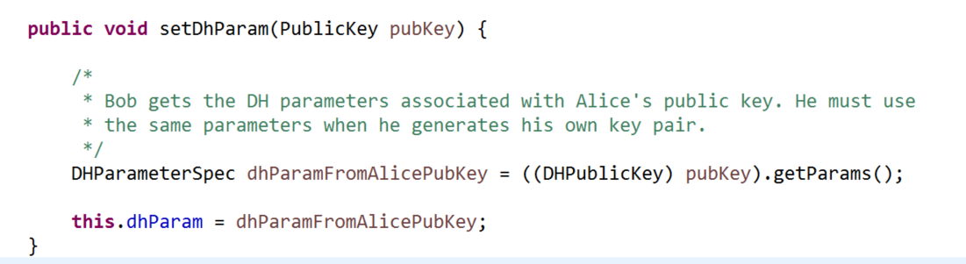
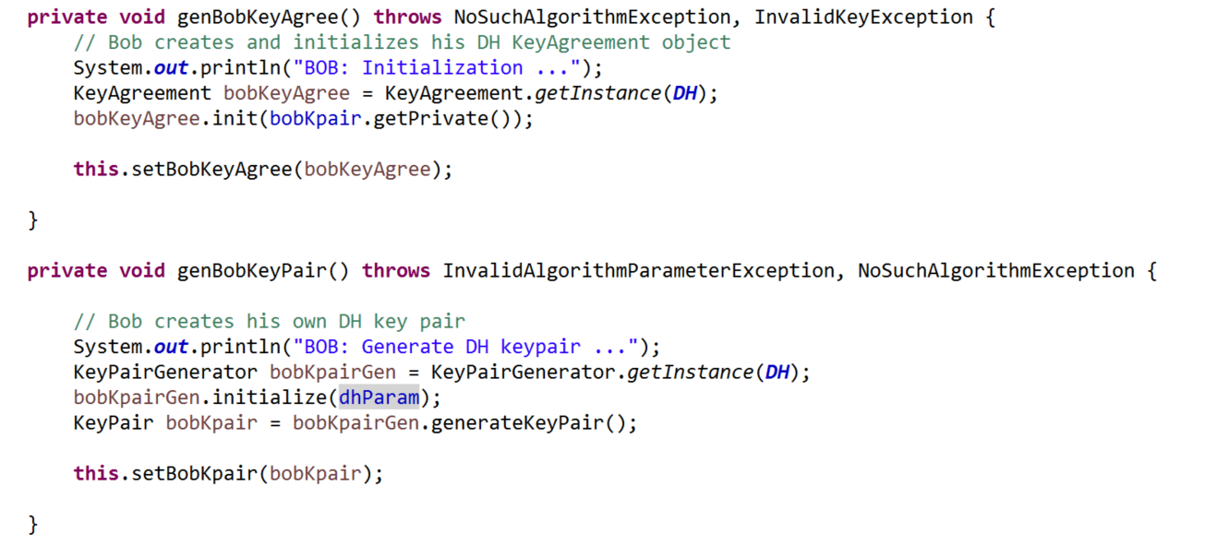
Atomic functions to generate Bob’s key pair
First, Bob needs to get the Diffie-Hellman parameters.
Afterwards, Bob generates his key pair. Unlike Alice, Bob uses DH parameters to initialize his key pair.

Slide 7
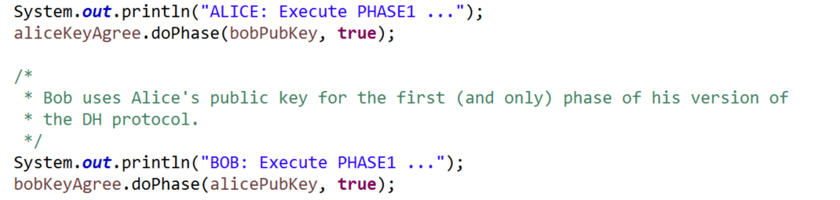
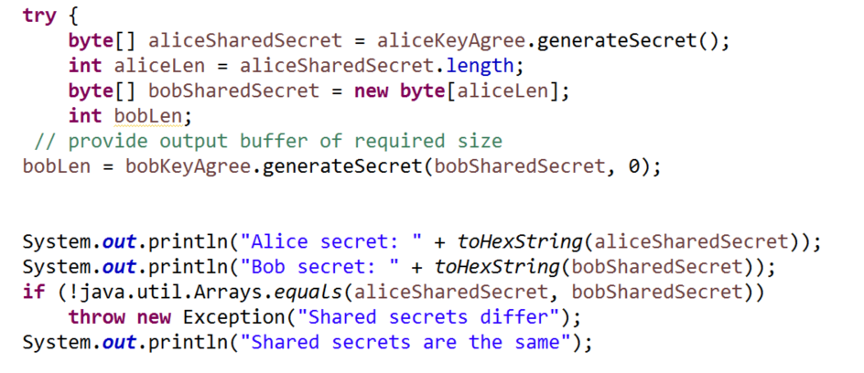
Generating the shared secret
Alice and Bob need to do Key Agreement.
Based on the agreed keys, Alice and Bob generate the shared secret.

Slide 8
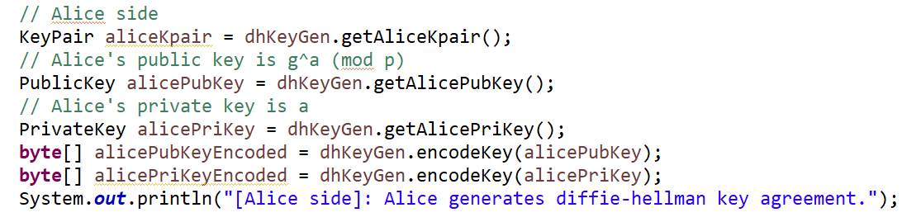
Encode the keys as byte[] and Base64 String
Originally, Alice’s key pair is two objects in PublicKey and PrivateKey formats.
We need to convert them to byte arrays.
To print out the byte array, we can encode the array as a String in Base64 format, or other formats as you may choose.

