Slide 1
Kerberos network authentication protocol
Kerberos is a network authentication protocol,
Provides reliable authentication over open and insecure network.
Use secret-key cryptography,
e.g., AES;
A client can prove its identity to a server (and vice versa).
Afterwards, encrypt all of their communications to assure privacy and data integrity as they go about their business.

Slide 2
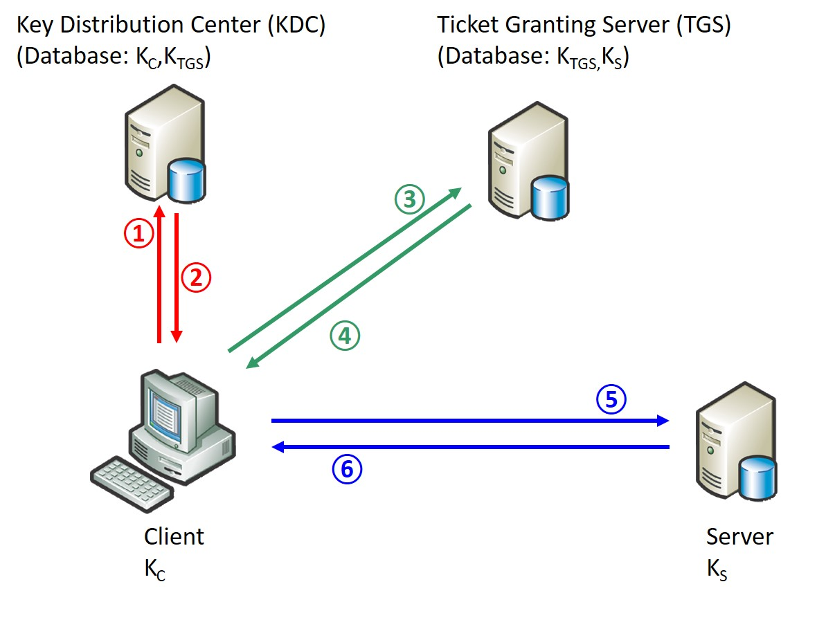
Phases Kerberos protocol
Three phases:
Phase 1
client gets a Ticket-Granting Ticket (TGT) from the KDC;
Phase 2
client uses the TGT to get a Ticket for server;
Phase 3
client communicates with server.
Following the completion of 3 phases, the client and server are able to establish a trustworthy connection, and encrypted communication if required.
Id is 0011
Id is 0100
Id is 0001
Id is 0010

Slide 3
Secret keys
Secret keys - 64 hex digits (32 hex bytes, or 256 bits) derived from your student no.
e.g., student no. = s3701234 → F3701234
K_{C}:
F3701234F3701234F3701234F3701234F3701234F3701234F3701234F3701234
K_{TGS}:
1234F3701234F3701234F3701234F3701234F3701234F3701234F3701234F370
K_{S}:
4321073F4321073F4321073F4321073F4321073F4321073F4321073F4321073F

Slide 4
Session keys
Session keys - 64 hex digits (32 hex bytes, or 256 bits)
Session key K_{C,TGS}:
0123456712345678234567893456789a0123456712345678234567893456789a
Session key K_{C,S}:
a9876543987654328765432176543210a9876543987654328765432176543210
Session key sk:
0123456701234567012345670123456701234567012345670123456701234567
Timestamp ts:
1536755037

Slide 5
Tickets
Ticket T_{C,TGS} = {K_{C,TGS}, C}:
0123456712345678234567893456789a0123456712345678234567893456789a0001
Ticket T_{C,S} = {K_{C,S}, C}:
a9876543987654328765432176543210a98765439876543287654321765432100001

Slide 6
Phase 1 of Kerberos protocol
Tag ①: Client sends a request to the KDC for a “ticket-granting ticket” (TGT);
C, TGS, Lt, n_{C}
Tag ②: KDC responds to client.
{K_{C,TGS}, TGS, Lt, n_{C}}K_{C} ,{T_{C,TGS}}K_{TGS}
where T_{C,TGS} ={K_{C,TGS}, C, Lt …}
Session key
Encrypt ticket with key

Slide 7
Phase 2 of Kerberos protocol
Tag ③: Client requests a ticket to communicate with server from the ticket-granting service (TGS);
{ts …}K_{C,TGS} , {T_{C,TGS}}K_{TGS}, S, Lt, n_{C}
Tag ④: TGS returns a ticket for client to talk to server.
{K_{C,S}, S, Lt, n_{C}}K_{C,TGS},{T_{C,S}}K_{S}

Slide 8
Phase 3 of Kerberos protocol
Tag ⑤: Client sends the ticket to server along with an authenticator to establish a shared secret;
{C, ts, sk}K_{C,S}, {T_{C,S}}K_{S}={K_{C,S}, C}K_{S}
Tag ⑥: Server decrypts the ticket to obtain the K_{C,S} and replies to client with proof of possession of the shared secret
{ts, sk}K_{C,S}

Slide 9
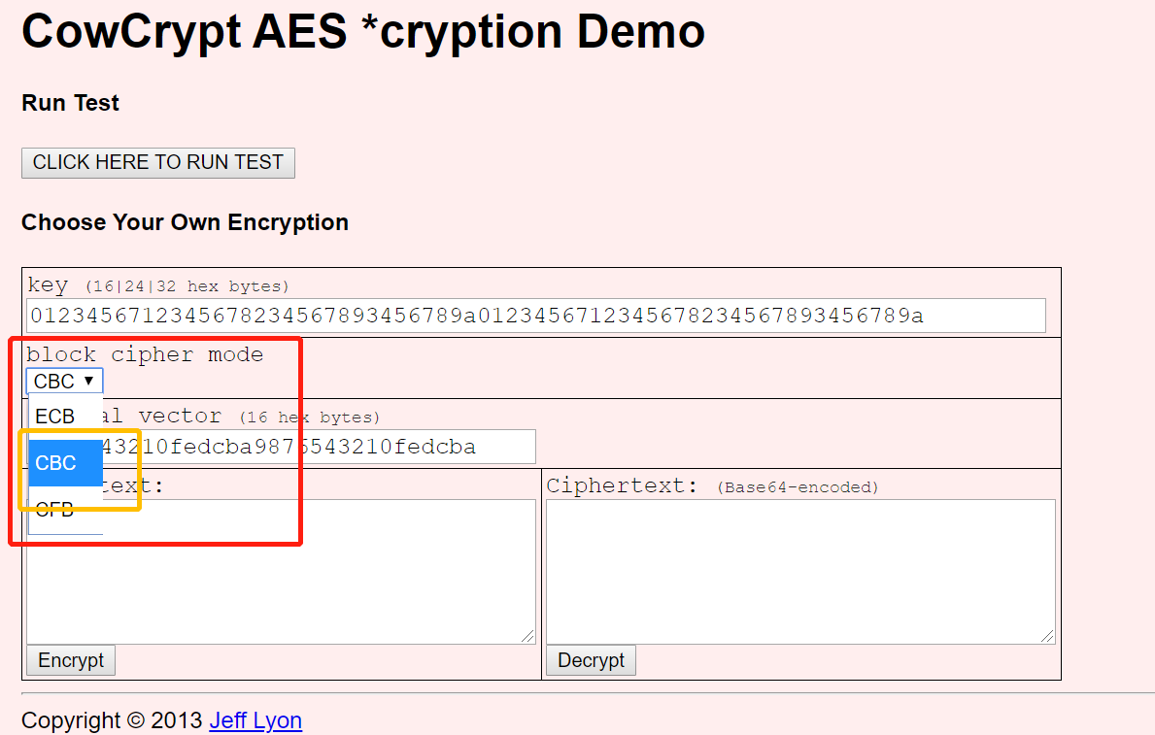
Online AES encryption to demo Kerberos
Choose CBC mode for AES

Slide 10
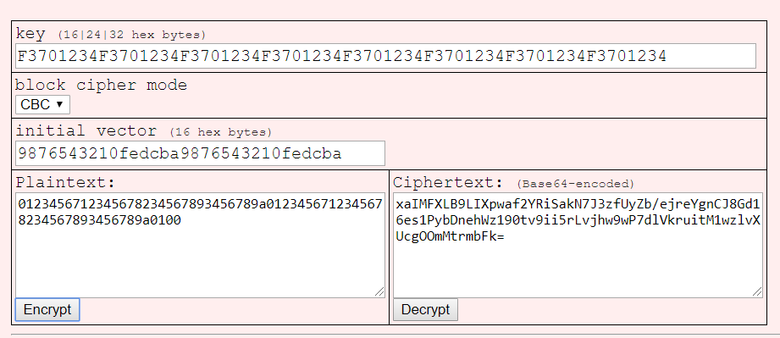
Example
{K_{C,TGS}, TGS}K_{C}= {0123456712345678234567893456789a0123456712345678234567893456789a0100}K_{C}
=xaIMFXLB9LIXpwaf2YRiSakN7J3zfUyZb/ejreYgnCJ8Gd16es1PybDnehWz190tv9ii5rLvjhw9wP7dlVkruitM1wzlvXUcgOOmMtrmbFk=}
K_{C}
K_{C,TGS}, TGS

