Slide 1
Mutual authentication with secret key
The mutual authentication protocol
allow both parties in a communication link authenticate each other;
the server will grant access to legitimate users;
Venerable to the reflection attack.

Slide 2
Mutual authentication with secret key
Alice
Bob
I’m Alice
R1
E(R1,K)
R2
E(R2,K)

Slide 3
More efficient version
Alice
I’m Alice, R2
Bob
R1, E(R2,K)
E(R1,K)

Slide 4
Reflection attack
I’m Alice, R2
Bob
Trudy
Doesn’t know the key so can’t send E(R1,K)
R1, E(R2,K)
D(R1,K)=R1
Trudy
I’m Lily, R1
Bob
Now use E(R1,K) in above attempt
R3, E(R1,K)
E(R1,K)

Slide 5
Lab 9 – reflection attack
Java
Apache crypto library
AES encryption/decryption
Example: https://commons.apache.org/proper/commons-crypto/xref-test/org/apache/commons/crypto/examples/CipherByteBufferExample.html
Crypto random generator
Base64 encoding/decoding

Slide 6
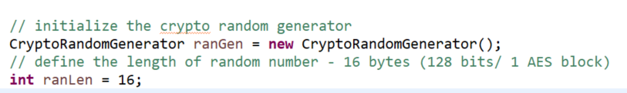
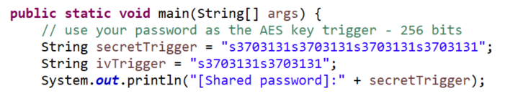
Parameters
Random numbers
Challenges R1, R2, R3;
Length 16 bytes (128 bits).
Secret key K
Student no. repeated 4 times;
E.g., s1234567s1234567s1234567s1234567;
Length 32 bytes (256 bits AES encryption key).
Initial vector (iv)
Student no. repeated twice;
Length 16 bytes.
AES mode - CBC

Slide 7
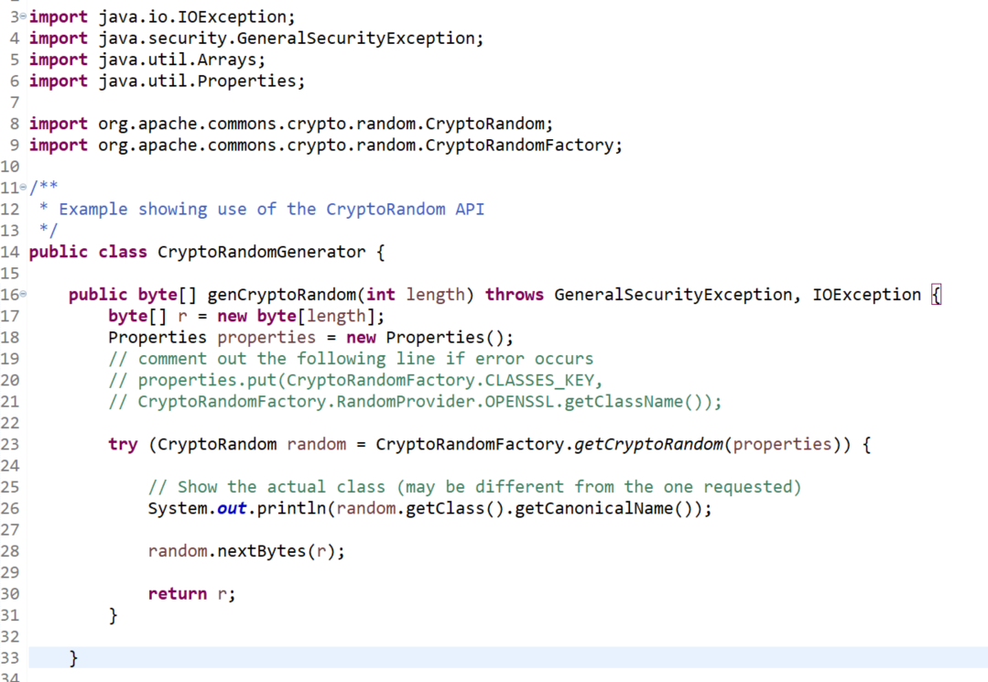
Generate cryptographic random numbers

Slide 8
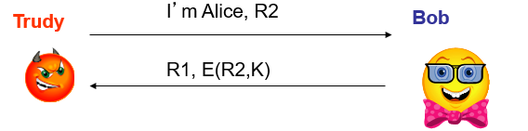
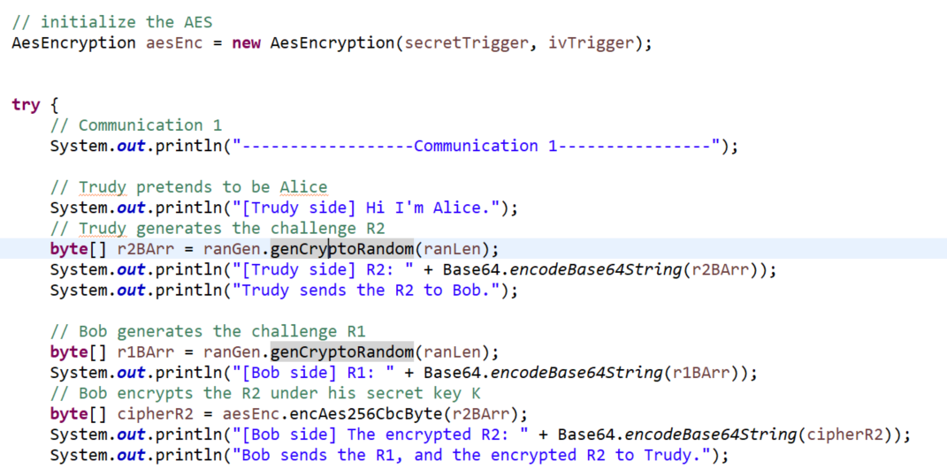
Communication 1
Replace with the given AES encryption example

Slide 9
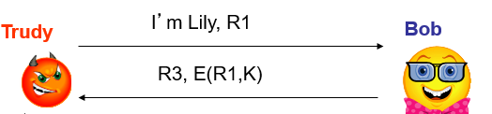
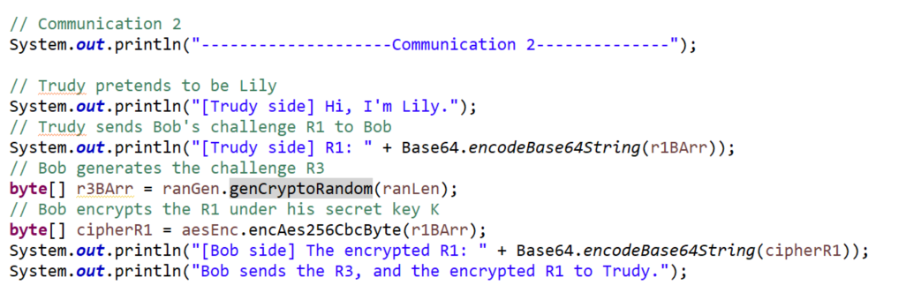
Communication 2
Replace with the given AES encryption example

Slide 10
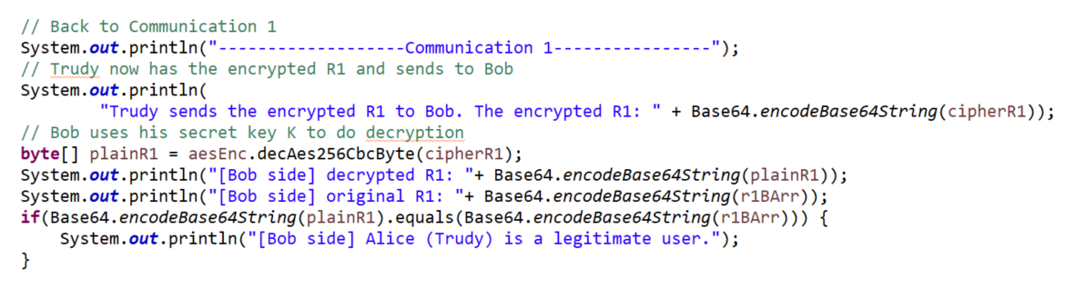
Back to communication 1

Slide 11
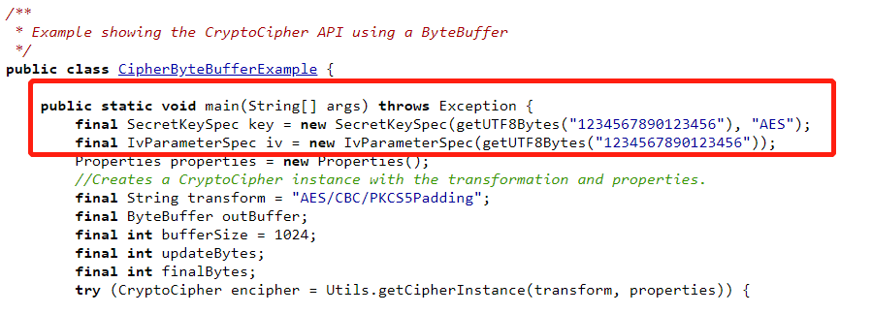
Given example of AES encryption

Slide 12
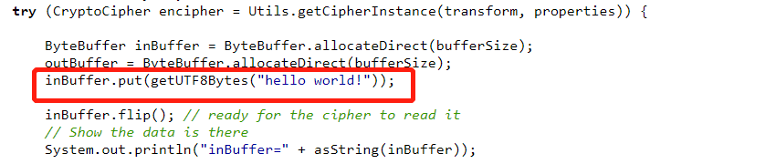
Given example of AES encryption
Replace with the plaintext (R1/R2/R3) to be encrypted in reflection attack

