Slide 1
HSWET ESP32 Turbine Controller + Web Server
Quick Walkthrough Guide
Huanying (Joy) Yeh
Updated 04/17/2024

Slide 2
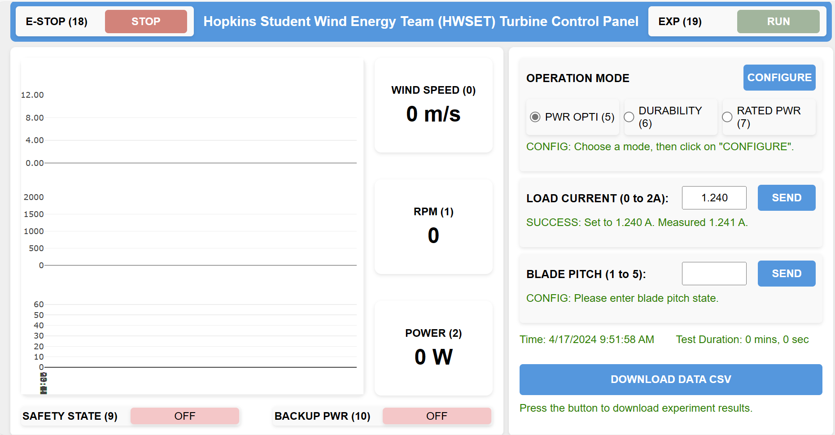
Digital pin 18
Digital pin 19
Analog pin 0
Digital pin 5, 6, 7
Analog pin 1
Analog I2C: SDL and SCA (need to check)
Pin 4 (not sure what to do w. this
Analog pin 2
This downloads data report when EXP (19) is clicked for “RUN”
Digital pin 9
Digital pin 10

Slide 3
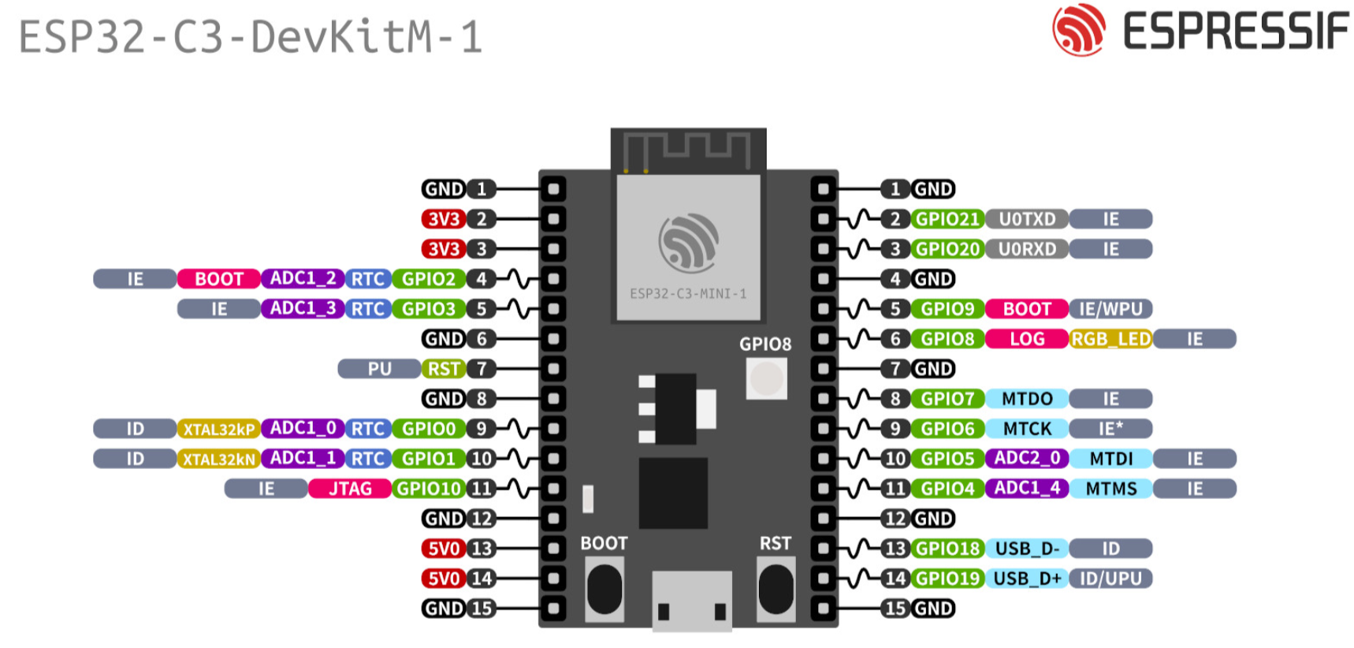
Helpful Links
https://docs.espressif.com/projects/esp-idf/en/latest/esp32c3/hw-reference/esp32c3/user-guide-devkitc-02.html

Slide 4
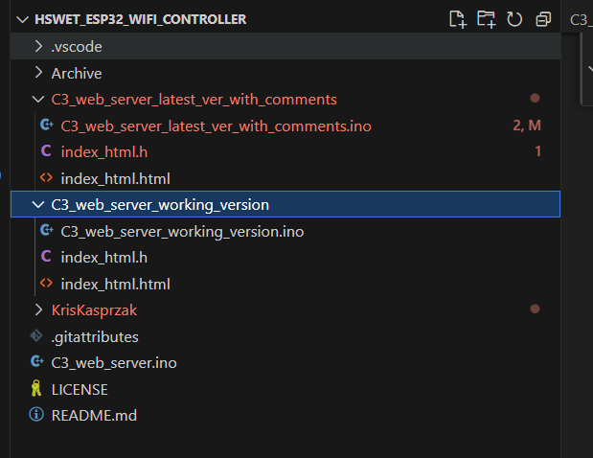
GitHub Code Structure
This is updated on 04/17, has code STUBS on where to edit (look up [TODO] tags in the comments
Not sure if it’ll break, but that’s the vision
This is updated on 04/16, all the pins implemented work as intended (analog, digital, etc) Tested on a breadboard with LED’s
This is the original YouTube tutorial guy’s code, comments are pretty informative YouTube link: https://youtu.be/pL3dhGtmcMY?si=xcNU9Rw6TDi6aoWB

Slide 5
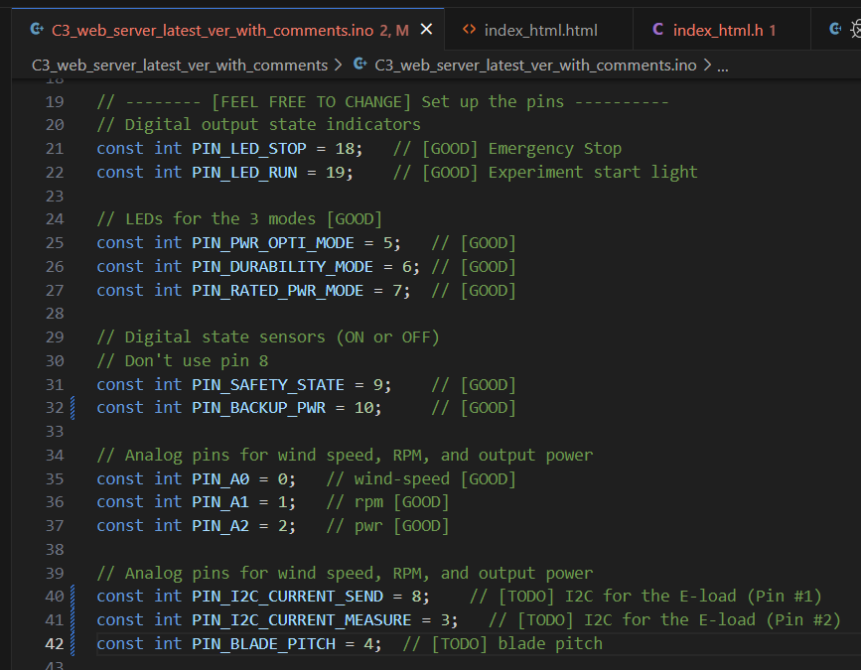
TODO List
Don’t worry about this (only for the web server)
Interface all of these stuff with existing Arduino Code
Then, get the E-load I2C communications. They’re in PIN_I2C_CURRENT_SEEND and “…MEASURED”. But we need to look up which pins they actually are

Slide 6
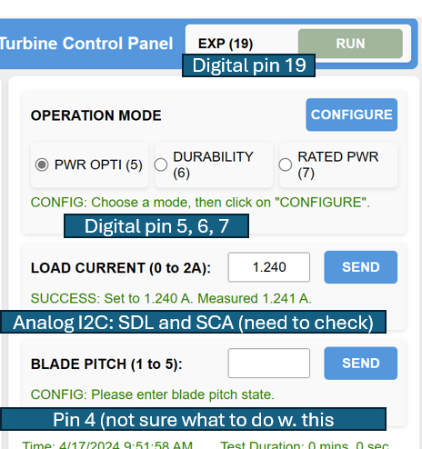
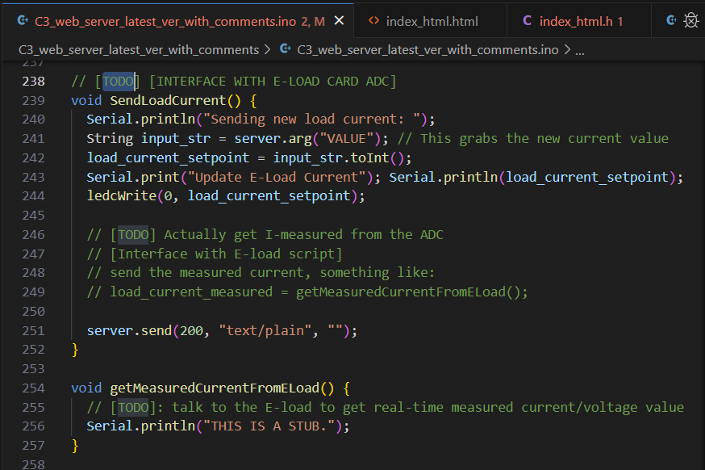



Where’s the E-Load Code
Then, index_html.html will take care of displaying. You only need to edit the .ino file Maybe use a smaller script to do this, or implement a dummy function on line 255 fist (like sending math.randn() all the time and check that it updates

