Slide 1
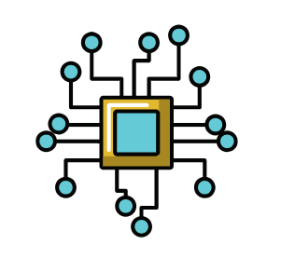
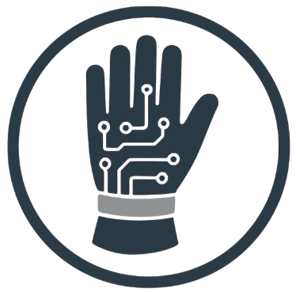

oT)
HandNav: An IoT-Based Smart Navigation Glove for Visually Impaired People
Joya Rani Saha, Rawnak Mahzabin Jyoti, Takia Yasmin,
Saurav Chandra Das, Md. Morshed Ali and Md. Torikur Rahman
IoT
Wearable device
Alert system

Slide 2
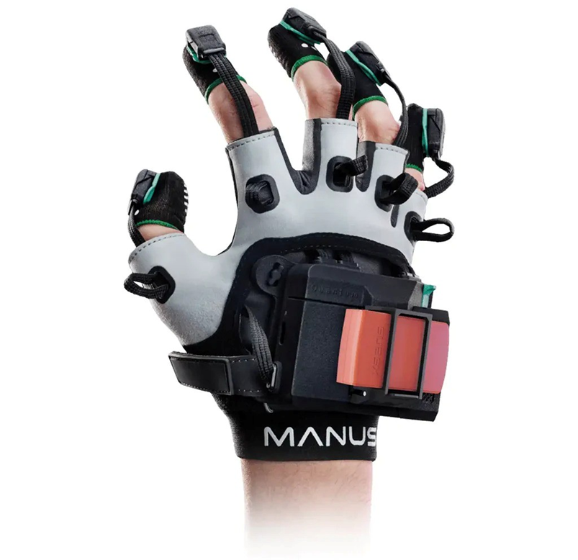
Introduction
Visually impaired people face challenges in safe navigation.
Traditional assistive tools have limited functionality.
Real-time obstacle and hazard detection is essential for user safety.
IoT technology enables smart wearable assistance.
HandNav Smart Glove provides obstacle detection, fire detection, GPS tracking, and emergency alerts.
HandNav: An IoT-Based Smart Navigation Glove for Visually Impaired People | PECCII 2026
Joya et al.

Slide 3
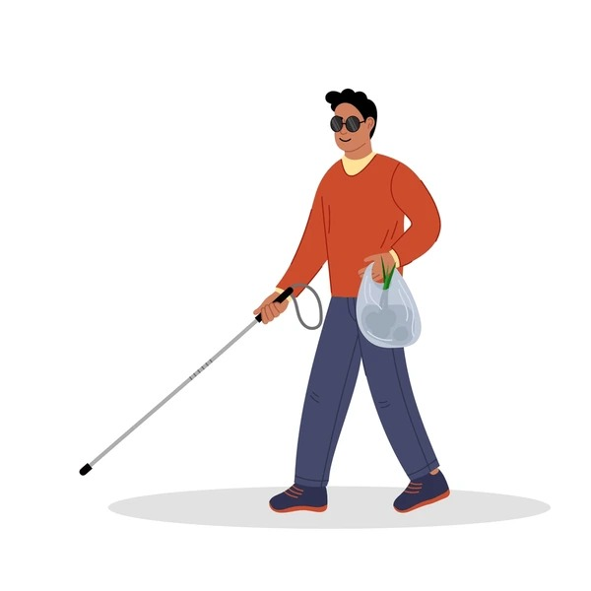
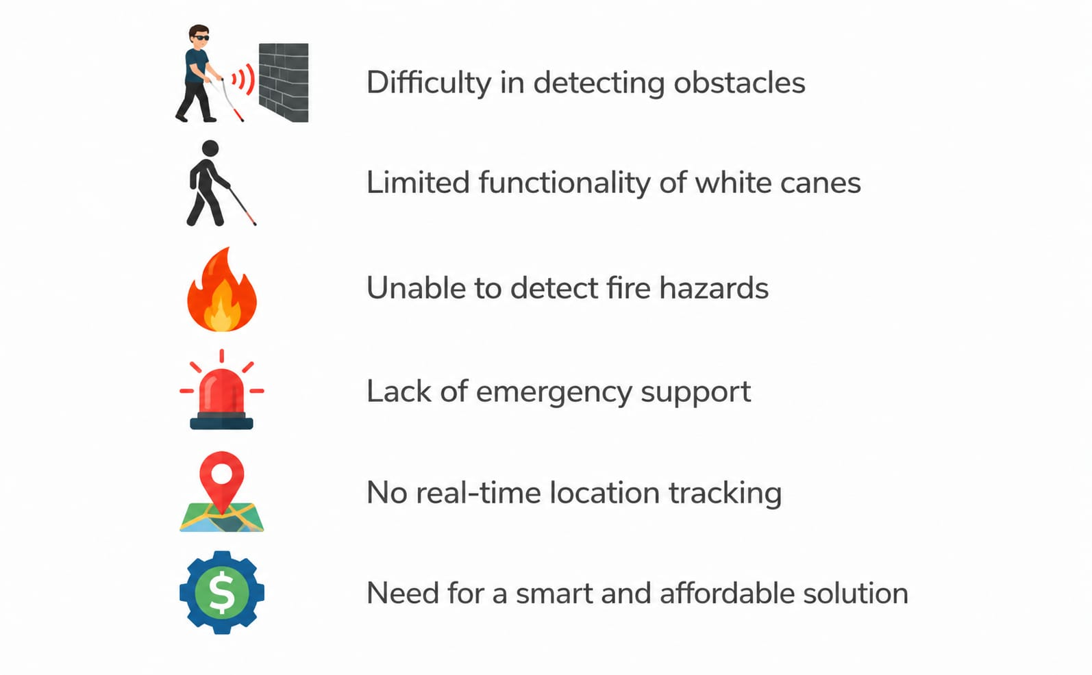
Problem Statement
Fig. 1: Challenges Faced by Visually Impaired People
HandNav: An IoT-Based Smart Navigation Glove for Visually Impaired People | PECCII 2026
Joya et al.

Slide 4
Related Work- Navigation & Obstacle Detection Focus
Hummadi et al. (2024)
Contribution: Real-time obstacle detection using ultrasonic sensors
Limitation: No GPS tracking or emergency support
Difference: Our system integrates GPS tracking and emergency alerts
Rozali et al. (2021)
Contribution: Distance-based obstacle alerts for blind people
Limitation: No IoT integration and location tracking
Difference: Our system provides IoT connectivity and GPS monitoring
Ketcham & Ganokratanaa (2023)
Contribution: Obstacle detection with GPS location sharing
Limitation: High system complexity
Difference: Our design is simpler and more affordable
HandNav: An IoT-Based Smart Navigation Glove for Visually Impaired People | PECCII 2026
Joya et al.

Slide 5
Related Work – Smart Glove & Assistive Systems
Vijay et al. (2024)
Contribution: IoT-based smart glove for gesture communication
Limitation: No navigation or obstacle detection
Difference: Our system focuses on navigation assistance and safety
Raj et al. (2022)
Contribution: Healthcare monitoring and emergency communication
Limitation: Not designed for navigation assistance
Difference: Our system combines navigation, safety, and emergency support
Beri et al. (2024)
Contribution: High-accuracy object recognition using Camera and CNN
Limitation: High cost and power consumption
Difference: Our system is low-cost and energy efficient
HandNav: An IoT-Based Smart Navigation Glove for Visually Impaired People | PECCII 2026
Joya et al.

Slide 6
Research Gap & Our Contribution
What Existing Studies Lack
What Our Study CONTRIBUTES
Most existing systems focus on a single functionality only.
GPS tracking and emergency support are often missing.
Fire hazard detection is rarely integrated.
Some solutions are expensive and complex to implement.
Limited real-time monitoring for user safety.
Real-time obstacle detection using ultrasonic sensors.
Fire hazard detection for enhanced safety.
GPS-based location tracking and monitoring.
Emergency alert system for quick assistance.
Bluetooth communication for real-time connectivity.
Low-cost and wearable design suitable for daily use.
HandNav: An IoT-Based Smart Navigation Glove for Visually Impaired People | PECCII 2026
Joya et al.

Slide 7
Research Questions
Research Questions
How can real-time obstacle detection improve the safety of visually impaired people?
RQ1
RQ2
How can fire hazard detection and emergency alerts enhance user protection?
RQ2
RQ3
RQ3
How can GPS tracking and IoT connectivity support independent navigation and monitoring?
HandNav: An IoT-Based Smart Navigation Glove for Visually Impaired People | PECCII 2026
Joya et al.

Slide 8
Research Objectives
01
03
Design a real-time obstacle detection system
Provide GPS tracking and emergency assistance
02
04
Implement fire hazard detection and alert mechanism
Enhance safety and independent navigation for visually impaired users
HandNav: An IoT-Based Smart Navigation Glove for Visually Impaired People | PECCII 2026
Joya et al.

Slide 9
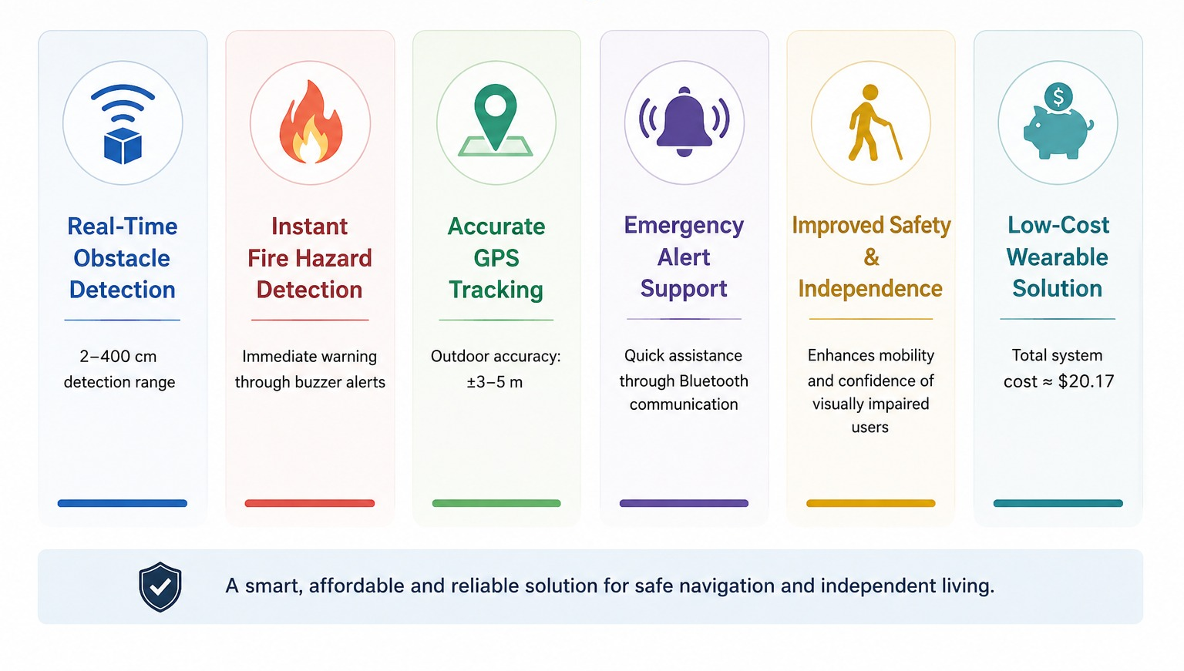
Outcomes & Impact
HandNav: An IoT-Based Smart Navigation Glove for Visually Impaired People | PECCII 2026
Joya et al.

Slide 10
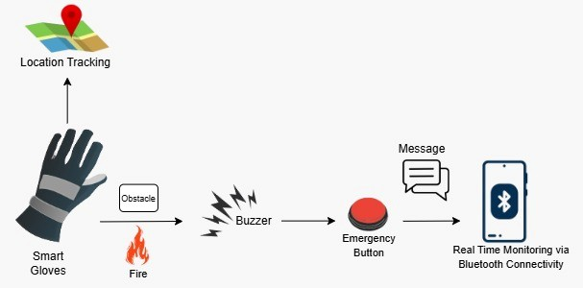
System Architecture
Fig. 2: System Architecture of the Smart Glove
HandNav: An IoT-Based Smart Navigation Glove for Visually Impaired People | PECCII 2026
Joya et al.

Slide 11
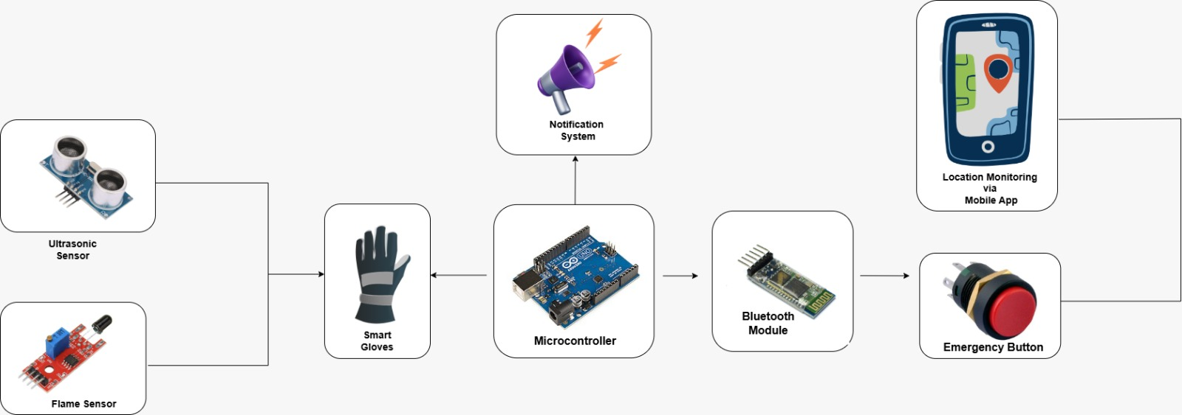
Methodology
Fig. 3: Overall Methodology of the Proposed Smart Glove System
HandNav: An IoT-Based Smart Navigation Glove for Visually Impaired People | PECCII 2026
Joya et al.

Slide 12
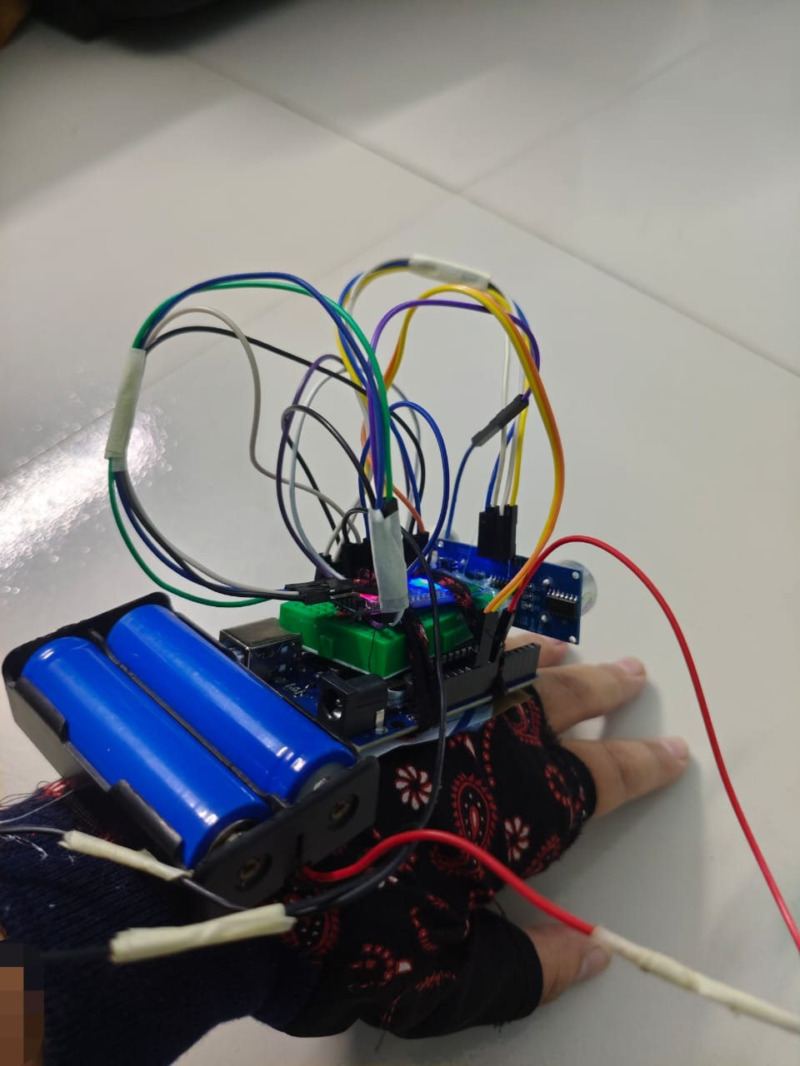






Component
Experimental Setup
Hardware Components:
Arduino UNO
Ultrasonic Sensor
Flame Sensor
GPS Module
Bluetooth Module
Buzzer
Emergency Button
Fig. 4: Prototype Implementation of the Proposed Smart Glove System
HandNav: An IoT-Based Smart Navigation Glove for Visually Impaired People | PECCII 2026
Joya et al.

Slide 13
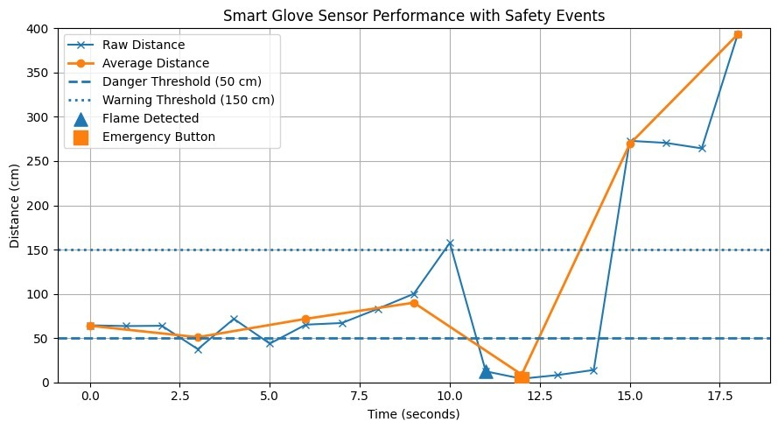
| Parameter | Result || --------------- | -------- || Detection Range | 2–400 cm || GPS Accuracy | ±3–5 m || Bluetooth Range | ~10 m || Response Time | <1 s || Fire Detection | Instant |
Experimental Results & Performance Analysis
Parameter | Result
Detection Range | 2–400 cm
GPS Accuracy | ±3–5 m
Bluetooth Range | ~10 m
Response Time | < 1 s
Fire Detection | Instant
Fig 5: Ultrasonic sensor distance versus time with safety thresholds and emergency events.
HandNav: An IoT-Based Smart Navigation Glove for Visually Impaired People | PECCII 2026
Joya et al.

Slide 14
Integrate AI-based object recognition for better obstacle identification🔹 Add camera and advanced sensors for improved navigation accuracy🔹 Implement voice guidance system for real-time navigation assistance🔹 Introduce vibration-based feedback for use in noisy environments
Future Work
AI-Based Object Recognition
Voice Guidance System
Integrate artificial intelligence techniques to improve obstacle detection and recognition accuracy.
Implement real-time voice assistance to help users navigate safely and independently.
Advanced Sensor Integration
Mobile Monitoring Application
Add cameras and enhanced sensors to provide more reliable navigation and environmental awareness.
Develop a mobile app for caregiver tracking, emergency alerts, and user status monitoring.
HandNav: An IoT-Based Smart Navigation Glove for Visually Impaired People | PECCII 2026
Joya et al.

Slide 15
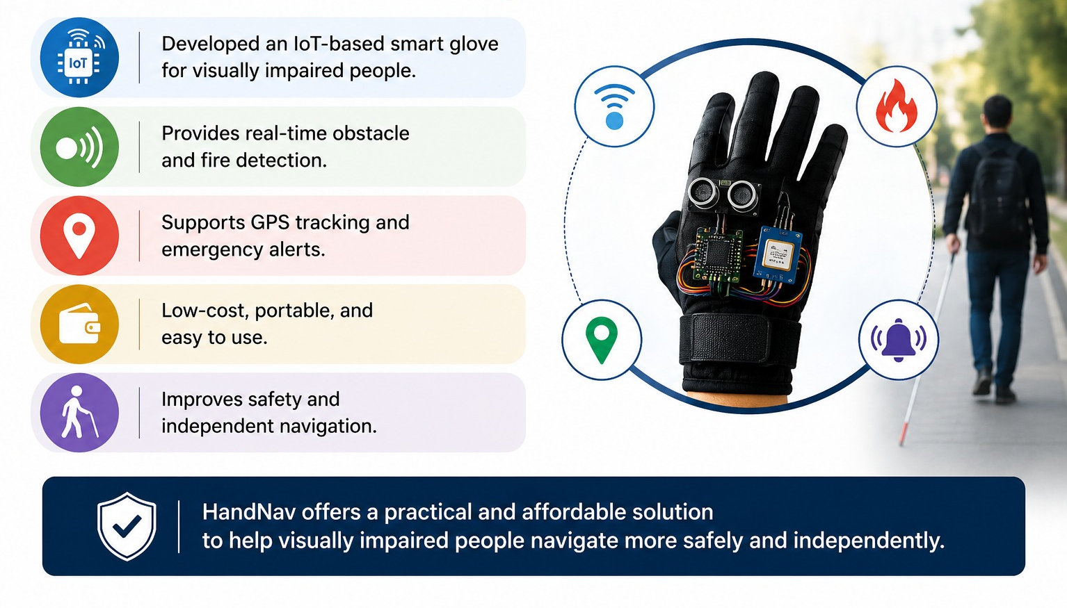
Conclusion
HandNav: An IoT-Based Smart Navigation Glove for Visually Impaired People | PECCII 2026
Joya et al.

Slide 16
Reference
[1] Latif et al., “VisionFree Obstacle Detection and Alert System Using Smart Knee Gloves,” Spectrum of Engineering Sciences, 2025.
[2] Hummadi et al., “Arduino-Based Sensor System for Safe Mobility of People with Visual Impairments,” FRUCT, 2024.
[3] Vijay et al., “IoT Enabled Smart Gloves Design Using ESP8266 WiFi Assisted Controller,” ACCAI, 2024.
[4] Beri et al., “Review of Smart Glove Technologies for Visual Impairment Assistance,” EmergIN, 2024.
[5] Ketcham and Ganokratanaa, “Intelligent Gloves for Assisting Individuals with Visual Impairment,” IJOE, 2023.
[6] Raj et al., “Smart Glove: A Monitoring System for Disabled Patients,” IJAIOTCC, 2022.
[7] Rozali et al., “Development of Smart Glove System for Blind People,” IJEEAS, 2021.
[8] Sai Sumanjali et al., “Arduino Based Smart Glove for Visually Impaired,” ICECA, 2021.
HandNav: An IoT-Based Smart Navigation Glove for Visually Impaired People | PECCII 2026
Joya et al.

Slide 17
Thank you!

