Slide 1
Divvy Bike-Share Analysis Case Study
Converting Casual Riders into Annual Members
Analyst: Joyal Susilan
Last Updated: July 22th,2025

Slide 2
Table of contents:
Purpose Statement
Tell Your Story (with Data)
Marketing Strategy Recommendations
Conclusion & Appendix

Slide 3
Objective
Maximize the number of annual memberships by understanding how casual riders and subscribers use Divvy bikes differently, and use those insights to design targeted marketing strategies that convert casual riders into loyal members.

Slide 4
Prepare: Understanding the Data
Source: Divvy Bike-Share system, publicly available from Chicago’s Open Data Portal
Data Range: January to March (Quarter 1) of both 2019 and 2020
Records Used: Approximately 700,000 plus cleaned ride records
Fields: Ride ID, start/end time and start/end location and its ID, user type (customer = casual, subscriber = member),Ride length & Day of week .

Slide 5
Process: Cleaning and Organizing Data
Standardized column names and formats across datasets
Converted timestamps to extract ride duration, day of week, and month
Removed nulls, duplicates, and extreme outliers like negative durations and duration more than a day
Filtered dataset to focus on casual vs. subscriber usage trends

Slide 6
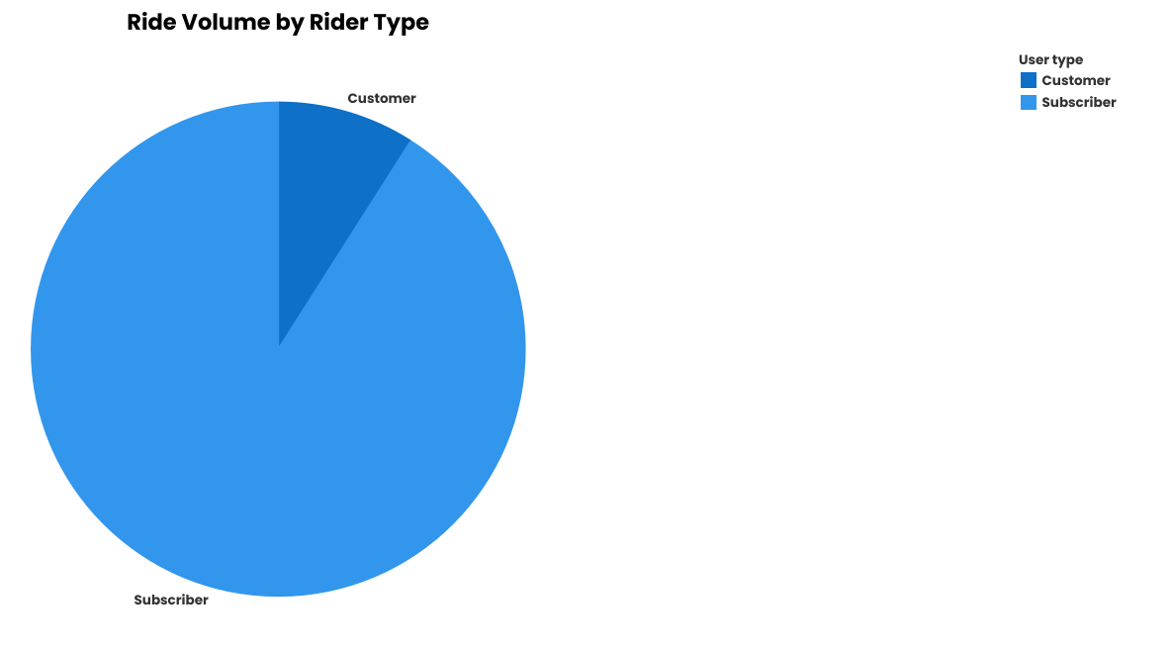
User Ride Volume
Subscribers consistently take more rides than casual customers
Subscribers show a slight dip in February (likely weather-related), with a moderate increase in March
Customers’ rides gradually increase from January to March, indicating seasonal leisure usage

Slide 7
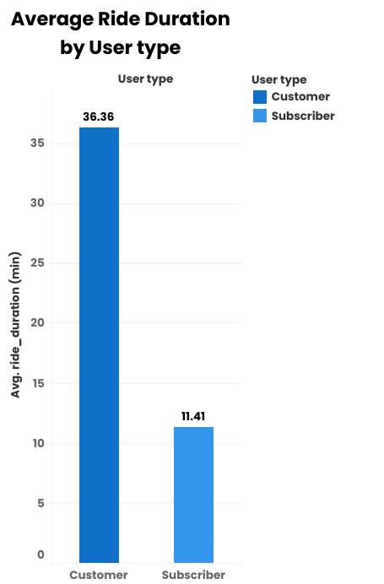
Average Ride Duration
Casual riders have a longer average ride duration than subscribers
Suggests casual riders likely use bikes for leisure trips
Subscribers may be using them for commuting, hence shorter rides

Slide 8
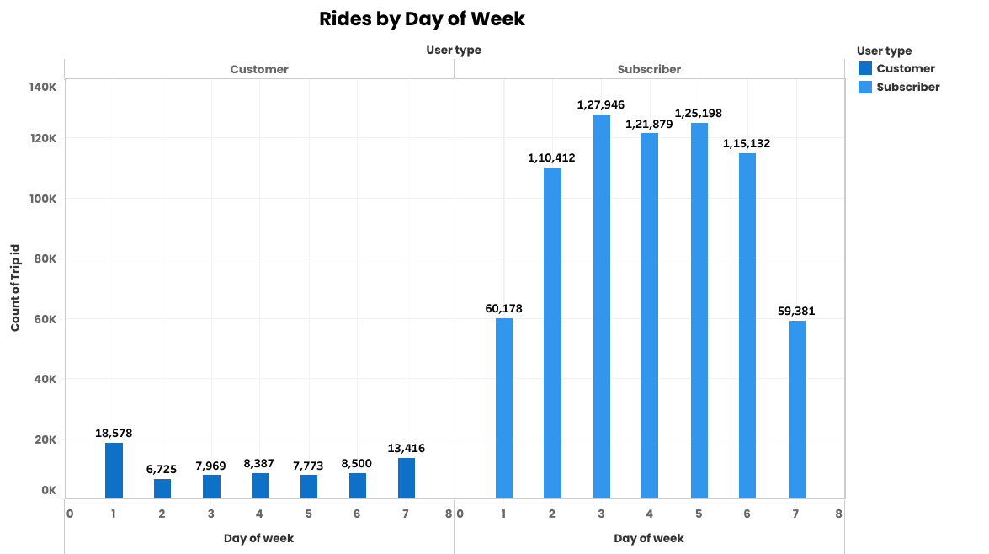
Weekly Ride Patterns
Casual Riders: Peaks on weekends (Saturday & Sunday)
Subscribers: Higher usage on weekdays (especially Tuesday), with a drop on weekends
Suggests subscribers are mostly weekday commuters

Slide 9
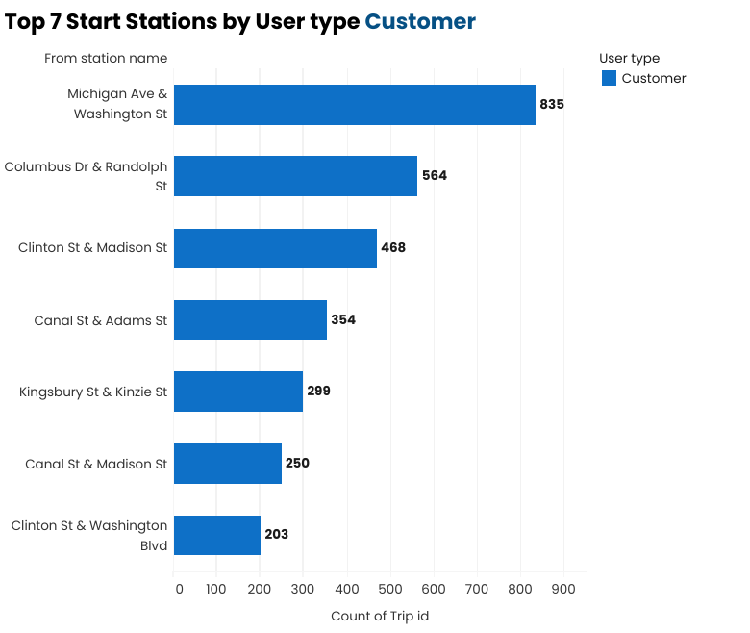
Top Stations by Customer Type
Top five start stations for casual riders (based on frequency):
Michigan Ave & Washington St
Columbus Dr & Randolph St
Clinton St & Madison St
Canal St & Adams St
Kingsbury St & Kinzie St
Canal St & Madison St
Clinton St & Washington Blvd
These are mostly tourist-heavy or high-traffic areas, further confirming casual riders’ preference for popular or leisure routes.

Slide 10
Act: Recommendations
Strategy #1: Weekend Loyalty Offers
Target casual riders on weekends with “3-weekend pass = 1 free” or discounted trial memberships
Promote through email, push notifications, and in-app offers
Strategy #2: Commute-Focused Membership Trials
Highlight benefits of annual memberships for weekday commuting (e.g., cost savings, convenience)
Offer 1-month free trials to casual users during weekday campaigns
Strategy #3: Location-Based Campaigns
Focus on marketing in top casual start stations
Use QR codes on docking stations, geo-targeted ads near tourist hubs
Strategy #4: Duration-Based Membership Nudges
If a casual rider exceeds a certain ride time or frequency, trigger a prompt suggesting membership benefits

Slide 11
Conclusions
This analysis reveals clear behavioral differences between casual riders and subscribers, notably:
When and how long they ride
Where they typically start their rides
These insights directly inform targeted marketing strategies to convert casual riders—already aware and engaged—into profitable annual members. With the right messaging and campaigns, Cyclistic can significantly boost its membership base and long-term revenue.
*Regular evaluation is crucial to maintain the success of these strategies over time.
* Without regular checks, strategies may fail. Keep updating to stay effective.

Slide 12
Appendix
References & Sources
Cleaned Dataset (by Joyal susilan):
[https://www.kaggle.com/datasets/joyalsusilan/divvy-bike-trips-q1-20192020]
Dataset Overview:
[https://www.kaggle.com/code/joyalsusilan/cleaned-divvy-data-overview]
Original Data Source:
[https://divvybikes.com/system-data]
Data Visualization Dashboard:
[https://public.tableau.com/views/Divvy_Bikes_17529226015460/Dashboard2?:language=en-US&:sid=&:redirect=auth&:display_count=n&:origin=viz_share_link]
Note: The dataset was cleaned and prepared by the Joyal Susilan using public data provided by the City of Chicago. The original data is freely available for public and educational use.

Slide 13
Thank You

