Slide 1
Lyrictionary
Presented by Dan Erekson, Jason Hardy, Joyce Chen, Ryan Jewell

Slide 2
Description and User Story
Description - A website that allows you to search for song titles and then click on words to obtain definitions
User Story – As a listener of music I want to see song lyrics and be able to see definitions

Slide 3
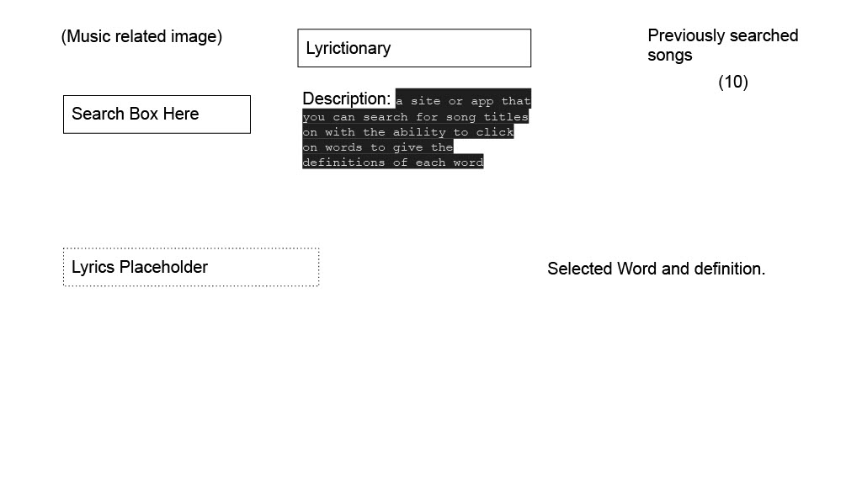
Wireframe

Slide 4
HTML, CSS, and Javascript
Simple page
User friendly interface
Has a search area with ability to search by Song Title, Artist, or specific lyrics
Has a navigation bar so the user can see Search History, Word Definition and Song Lyrics

Slide 5
API’s
MusiXMatch
Words API

Slide 6
MusiXMatch
About MusiXMatch

Slide 7
Words API
About Words API

Slide 8
GIT Hub
GIT Hub info
GIT HUB Deployed link

Slide 9
Screenshot of page

