Slide 1
Opinion entity extraction with Bi-LSTM-CRF model
NLP实验室 宋阳

Slide 2
数据集：
MPQA version 2.0 corpus
( Train 6280 sentences, Dev 2298 sentences, Test 892 sentences )
eg.
token probably RB -1 ROOT m-DSE
data
label
Entity: AGENT, TARGET, DSE
Label
Prefix: b, m, e, s

Slide 3
任务：
Opinion Entity Extraction
模型：
Bi-LSTM+CRF
评价指标：
(1) Exact Matching
(2) Binary Overlap
(3) Proportional Overlap

Slide 4
任务区分：
标注：看上去像是在序列上做分类。但是标注采用的特征里面有上下文分类的结果。
分类：根据当前特征确定当前类别，分类的时候不需要考虑上下文的分类结果，但可以引入上下文的特征。

Slide 5
Example：命名实体识别
分类任务可抽取特征：
{当前词，当前词性，当前词语义角色，上一个词，上一个词的词性}
序列标注任务可抽取特征：
{当前词，当前词性，当前词语义角色，上一个词，上一个词的标签，上一个词的词性}

Slide 6
序列标注任务有哪些 ？
词性标注
我 去 北京
PN VV NN
分词
我 去 北 京
S S B E
分词-词性标注
我 去 北 京
S-PN S-VV B-NN E-NN

Slide 7
模型对比：
基准模型：Bi-LSTM
本实验模型：Bi-LSTM+CRF
核心：
问：为什么要加上CRF？功能是什么？
答：具体内容请来现场聆听。

Slide 8
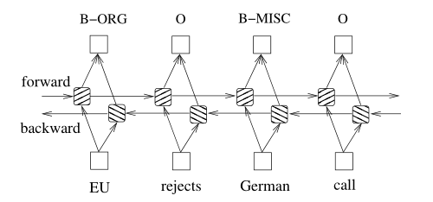
基准模型：Bi-LSTM

Slide 9
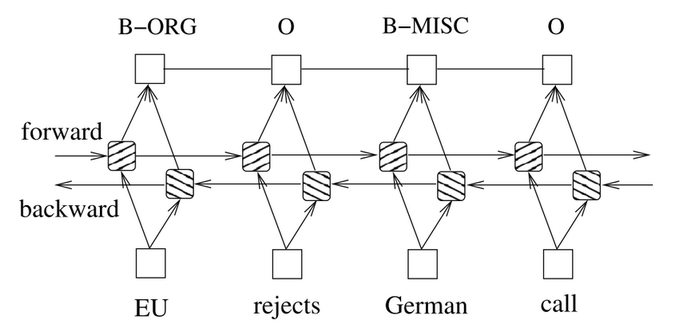
Bi-LSTM+CRF模型
CRF是计算序列全局的似然概率，而不是计算单点的似然概率。

Slide 10
设Bi-LSTM的输出矩阵为P，其中P_{i,j}代表词w_i映射到tag_j的非归一化概率，对于CRF来说，假定存在一个转移矩阵T，则T_{i,j}代表tag_i转移到tag_j的转移概率。
对于输入序列X对应的输出tag序列y，定义分数为
利用Softmax函数，为每一个正确的tag序列y定义一个概率值（代表所有的tag序列，包括不可能出现的）

Slide 11
在训练中，我们只需要最大化似然概率p(y|X)即可，这里利用对数似然
将损失函数定义为
，就可以利用梯度下降法了

Slide 12
Example:
Instance: 我去北京
word_alphabet: {0: '我', 1: '去', 2: '北', 3: '京', 4: '<unk>', 5: '<pad>'}
label_alphabet: {0: b, 1: m, 2: e, 3: s, 4: o, 5: '<start>', 6: '<pad>'}
word_nums = 6
label_nums = 7
initial:
word_index
0
1
2
3
word
我
去
北
京
label
START
o
o
b
e
<pad>
label_index
5
4
4
0
2
6
mask
1
1
1
1
note: use <start> and <pad> as the START tag and STOP tag

Slide 13
no-batch version:
1. calculate sentence scores (input: emit_scores, labels, masks)
emit_scores: size (seq_length, label_nums)
in this instance: size (6, 7)
word_index
0
1
2
3
labels: size (seq_length)
in this instance: size (6)
label_index
5
4
4
0
2
6
masks: size (seq_length)
in this instance: size (6)
mask
1
1
1
1
transition: inital size (label_nums, label_nums)
in this instance: size (7, 7)
the initial formula:
scores = T[5][4]+emit[0][4]+T[4][4]+emit[1][4]+T[4][0]+emit[2][0]+T[0][2]+emit[3][2]+T[2][6]
tirck:
when computing emit scores, I use pack_padded_sequence function and pad_packed_sequence function.
Because I don't want padding word to attect the outcome.

Slide 14
no-batch version:
1. calculate sentence scores (input: emit_scores, labels)
the initial formula:
scores = T[5][4]+emit[0][4]+T[4][4]+emit[1][4]+T[4][0]+emit[2][0]+T[0][2]+emit[3][2]+T[2][6]
we will find:
scores =
T[5][4] + emit[0][4]
scores =
T[5][4] + emit[0][4]
T[4][4] + emit[1][4]
and
T[4][4] + emit[1][4]
are the same
T[4][0] + emit[2][0]
T[4][0] + emit[2][0]
can parallel
computing
T[0][2] + emit[3][2]
T[0][2] + emit[3][2]
T[2][6]
T[2][6]

Slide 15
optimized no-batch version
parallel computing:
for example: calculate the first portion
T[5][4] + emit[0][4]
T (size: 7*7)
emit[0] (size: 1*7)
have the same number on the column
(size: 7*7)
broadcast
00
01
02
03
04
05
06
00
01
02
03
04
05
06
00
01
02
03
04
05
06
10
11
12
13
14
15
16
+
00
01
02
03
04
05
06
=
10
11
12
13
14
15
16
20
21
22
23
24
25
26
00
01
02
03
04
05
06
20
21
22
23
24
25
26
30
31
32
33
34
35
36
00
01
02
03
04
05
06
30
31
32
33
34
35
36
40
41
42
43
44
45
46
00
01
02
03
04
05
06
40
41
42
43
44
45
46
50
51
52
53
54
55
56
00
01
02
03
04
05
06
50
51
52
53
54
55
56
60
61
62
63
64
65
66
00
01
02
03
04
05
06
60
61
62
63
64
65
66
42
43
44
45
46
47
48

Slide 16
optimized no-batch version
parallel computing:
for example: calculate the first portion
T[5][4] + emit[0][4]
T (size: 7*7)
emit[0] (size: 1*7)
have the same number on the column
(size: 7*7)
broadcast
00
01
02
03
04
05
06
00
01
02
03
04
05
06
00
01
02
03
04
05
06
10
11
12
13
14
15
16
+
00
01
02
03
04
05
06
=
10
11
12
13
14
15
16
20
21
22
23
24
25
26
00
01
02
03
04
05
06
20
21
22
23
24
25
26
30
31
32
33
34
35
36
00
01
02
03
04
05
06
30
31
32
33
34
35
36
two-dimension
40
41
42
43
44
45
46
00
01
02
03
04
05
06
40
41
42
43
44
45
46
50
51
52
53
54
55
56
00
01
02
03
04
05
06
50
51
52
53
54
55
56
60
61
62
63
64
65
66
00
01
02
03
04
05
06
60
61
62
63
64
65
66
the same
trick:
00
01
02
03
04
05
06
word_index
0
1
2
3
5
5
用一维映射二维
使用torch.gather函数
07
08
09
10
11
12
13
label_index
5
4
4
0
2
6
6
14
15
16
17
18
19
20
one-dimension
21
22
23
24
25
26
27
label_group
39
32
28
2
20
48
28
29
30
31
32
33
34
mask
1
1
1
1
0
0
35
36
37
38
39
40
41
42
43
44
45
46
47
48

Slide 17
optimized no-batch version
can ignore
then we can compute several portions in parallel
parallel computing:
for example: calculate the first portion
T[5][4] + emit[0][4]
T (size: 7*7)
emit[0] (size: 1*7)
have the same number on the column
(size: 7*7)
broadcast
00
01
02
03
04
05
06
00
01
02
03
04
05
06
00
01
02
03
04
05
06
10
11
12
13
14
15
16
+
00
01
02
03
04
05
06
=
10
11
12
13
14
15
16
20
21
22
23
24
25
26
00
01
02
03
04
05
06
20
21
22
23
24
25
26
30
31
32
33
34
35
36
00
01
02
03
04
05
06
30
31
32
33
34
35
36
two-dimension
40
41
42
43
44
45
46
00
01
02
03
04
05
06
40
41
42
43
44
45
46
50
51
52
53
54
55
56
00
01
02
03
04
05
06
50
51
52
53
54
55
56
60
61
62
63
64
65
66
00
01
02
03
04
05
06
60
61
62
63
64
65
66
the same
trick:
00
01
02
03
04
05
06
word_index
0
1
2
3
5
5
用一维映射二维
使用torch.gather函数
07
08
09
10
11
12
13
label_index
5
4
4
0
2
6
6
14
15
16
17
18
19
20
one-dimension
21
22
23
24
25
26
27
label_group
39
32
28
2
20
48
28
29
30
31
32
33
34
mask
1
1
1
1
0
0
35
36
37
38
39
40
41
42
43
44
45
46
47
48

Slide 18
optimized no-batch version
So
Part 1:
T (size: words_num*7*7)
+
calculate sentence scores
emit_scores (size: words_num*7*7)
transform:
(size: words_num*7)
(size: words_num*7*7)
broadcast
Part 2:
compute the end transition scores
note: 如果加了batch，计算是一样的。

Slide 19
no-batch version:
2. calculate encode scores (input: emit_scores, masks)
label_alphabet: {0: b, 1: m, 2: e, 3: s, 4: o, 5: '<start>', 6: '<pad>'}
word_index
0
1
2
3
word
我
去
北
京
0
1
2
3
4
5
5
6

Slide 20
no-batch version:
2. calculate encode scores (input: emit_scores, masks)
label_alphabet: {0: b, 1: m, 2: e, 3: s, 4: o, 5: '<start>', 6: '<pad>'}
word_index
0
1
2
3
word
我
去
北
京
0
1
2
3
4
5
5
6

Slide 21
no-batch version:
2. calculate encode scores (input: emit_scores, masks)
we will find
can parallel computing
so
s[1][0] = log_sum_exp
( s[0] + e[1][0] + t[:][0] )
1*1
broadcast
size:
1*7
1*7
1*7

Slide 22
no-batch version:
2. calculate encode scores (input: emit_scores, masks)
we will find
=log_sum_exp
( s[0] + e[1][0] + t[:][0] )
1*1
broadcast
size:
1*7
1*7
1*7
same
the same number
=log_sum_exp
( s[0] + e[1][6] + t[:][6] )
1*1
broadcast
size:
1*7
1*7
1*7

Slide 23
no-batch version:
2. calculate encode scores (input: emit_scores, masks)
we will find
=log_sum_exp
( s[0] + e[1][0] + t[:][0] )
1*1
broadcast
size:
1*7
1*7
1*7
can parallel
computing
same
the same number
=log_sum_exp
( s[0] + e[1][6] + t[:][6] )
1*1
broadcast
size:
1*7
1*7
1*7

Slide 24
optimized no-batch version
parallel computing:
T (size: 7*7)
emit[1] (size: 1*7)
(size: 7*7)
s[0](size: 1*7)
(size: 7*7)
broadcast
broadcast
00
01
02
03
04
05
06
10
11
12
13
14
15
16
00
00
00
00
00
00
00
10
11
12
13
14
15
16
+
10
11
12
13
14
15
16
+
01
01
01
01
01
01
01
20
21
22
23
24
25
26
10
11
12
13
14
15
16
02
02
02
02
02
02
02
30
31
32
33
34
35
36
10
11
12
13
14
15
16
03
03
03
03
03
03
03
40
41
42
43
44
45
46
10
11
12
13
14
15
16
04
04
04
04
04
04
04
50
51
52
53
54
55
56
10
11
12
13
14
15
16
05
05
05
05
05
05
05
60
61
62
63
64
65
66
10
11
12
13
14
15
16
06
06
06
06
06
06
06
=
00
01
02
03
04
05
06
10
11
12
13
14
15
16
20
21
22
23
24
25
26
30
31
32
33
34
35
36
40
41
42
43
44
45
46
50
51
52
53
54
55
56
60
61
62
63
64
65
66

Slide 25
optimized no-batch version
parallel computing:
T (size: 7*7)
emit[1] (size: 1*7)
(size: 7*7)
s[0](size: 1*7)
(size: 7*7)
broadcast
broadcast
00
01
02
03
04
05
06
10
11
12
13
14
15
16
00
00
00
00
00
00
00
10
11
12
13
14
15
16
+
10
11
12
13
14
15
16
+
01
01
01
01
01
01
01
20
21
22
23
24
25
26
10
11
12
13
14
15
16
02
02
02
02
02
02
02
30
31
32
33
34
35
36
10
11
12
13
14
15
16
03
03
03
03
03
03
03
40
41
42
43
44
45
46
10
11
12
13
14
15
16
04
04
04
04
04
04
04
50
51
52
53
54
55
56
10
11
12
13
14
15
16
05
05
05
05
05
05
05
60
61
62
63
64
65
66
10
11
12
13
14
15
16
06
06
06
06
06
06
06
=
00
01
02
03
04
05
06
10
11
12
13
14
15
16
20
21
22
23
24
25
26
30
31
32
33
34
35
36
40
41
42
43
44
45
46
50
51
52
53
54
55
56
60
61
62
63
64
65
66
log_sum_exp function
s[1][0]
s[1][6]
s[1]

Slide 26
optimized version
Part 1:
So
compute the first word's score
s[0]
calculate encode scores
Part 2:
T (size: [batch_size]*7*7)
+
emit_scores (size: [batch_size]*7*7)
transform:
(size: [batch_size]*1*7)
(size: [batch_size]*7*7)
+
broadcast
forward_scores(size:[batch_size]*7*7)
transform:
(size: [batch_size]*7*1)
(size: [batch_size]*7*7)
broadcast
Part 3:
compute the end transition scores

Slide 27
no-batch version:
2. calculate decode scores (input: emit_scores, masks)
word_index
0
1
2
3
word
我
去
北
京
0
1
2
3
4
5
5
6

Slide 28
no-batch version:
2. calculate decode scores (input: emit_scores, masks)
word_index
0
1
2
3
word
我
去
北
京
0
last_max_label: 4
1
2
3
4
5
5
6

Slide 29
no-batch version:
2. calculate decode scores (input: emit_scores, masks)
word_index
0
1
2
3
word
我
去
北
京
0
last_max_label: 4
last_max_label: 4
last_max_label: 0
1
last_max_label: 0
last_max_label: 1
last_max_label: 3
2
last_max_label: 1
last_max_label: 4
last_max_label: 0
3
last_max_label: 0
last_max_label: 1
last_max_label: 0
4
last_max_label: 4
last_max_label: 1
last_max_label: 4
5
last_max_label: 0
last_max_label: 3
last_max_label: 4
6
last_max_label: 2
last_max_label: 0
last_max_label: 2

Slide 30
no-batch version:
2. calculate decode scores (input: emit_scores, masks)
word_index
0
1
2
3
word
我
去
北
京
0
last_max_label: 4
last_max_label: 4
last_max_label: 0
1
last_max_label: 0
last_max_label: 1
last_max_label: 3
2
last_max_label: 1
last_max_label: 4
last_max_label: 0
3
last_max_label: 0
last_max_label: 1
last_max_label: 0
4
last_max_label: 4
last_max_label: 1
last_max_label: 4
5
last_max_label: 0
last_max_label: 3
last_max_label: 4
6
last_max_label: 2
last_max_label: 0
last_max_label: 2
last_max_label: 2

Slide 31
no-batch version:
2. calculate decode scores (input: emit_scores, masks)
word_index
0
1
2
3
word
我
去
北
京
0
last_max_label: 4
last_max_label: 4
last_max_label: 0
1
last_max_label: 0
last_max_label: 1
last_max_label: 3
2
last_max_label: 1
last_max_label: 4
last_max_label: 0
3
last_max_label: 0
last_max_label: 1
last_max_label: 0
4
last_max_label: 4
last_max_label: 1
last_max_label: 4
5
last_max_label: 0
last_max_label: 3
last_max_label: 4
6
last_max_label: 2
last_max_label: 0
last_max_label: 2
last_max_label: 2

Slide 32
no-batch version:
2. calculate decode scores (input: emit_scores, masks)
word_index
0
1
2
3
word
我
去
北
京
0
last_max_label: 4
last_max_label: 4
last_max_label: 0
1
last_max_label: 0
last_max_label: 1
last_max_label: 3
2
last_max_label: 1
last_max_label: 4
last_max_label: 0
3
last_max_label: 0
last_max_label: 1
last_max_label: 0
4
last_max_label: 4
last_max_label: 1
last_max_label: 4
5
last_max_label: 0
last_max_label: 3
last_max_label: 4
6
last_max_label: 2
last_max_label: 0
last_max_label: 2
last_max_label: 2

Slide 33
no-batch version:
2. calculate decode scores (input: emit_scores, masks)
word_index
0
1
2
3
word
我
去
北
京
0
last_max_label: 4
last_max_label: 4
last_max_label: 0
1
last_max_label: 0
last_max_label: 1
last_max_label: 3
2
last_max_label: 1
last_max_label: 4
last_max_label: 0
3
last_max_label: 0
last_max_label: 1
last_max_label: 0
4
last_max_label: 4
last_max_label: 1
last_max_label: 4
5
last_max_label: 0
last_max_label: 3
last_max_label: 4
6
last_max_label: 2
last_max_label: 0
last_max_label: 2
last_max_label: 2

Slide 34
no-batch version:
2. calculate decode scores (input: emit_scores, masks)
word_index
0
1
2
3
word
我
去
北
京
0
last_max_label: 4
last_max_label: 4
last_max_label: 0
1
last_max_label: 0
last_max_label: 1
last_max_label: 3
2
last_max_label: 1
last_max_label: 4
last_max_label: 0
3
last_max_label: 0
last_max_label: 1
last_max_label: 0
4
last_max_label: 4
last_max_label: 1
last_max_label: 4
5
last_max_label: 0
last_max_label: 3
last_max_label: 4
6
last_max_label: 2
last_max_label: 0
last_max_label: 2
last_max_label: 2
The predict path is: 4 4 0 2

Slide 35
optimized version
Part 1:
So
compute the first word's score
s[0]
Part 2:
calculate decode scores
T (size: [batch_size]*7*7)
+
emit_scores (size: [batch_size]*7*7)
transform:
(size: [batch_size]*1*7)
(size: [batch_size]*7*7)
+
broadcast
forward_scores(size:[batch_size]*7*7)
transform:
(size: [batch_size]*7*1)
(size: [batch_size]*7*7)
broadcast
Part 3:
compute the end transition scores
Part 4:
compute the predict path

Slide 36
评价指标：
(1) Exact Matching
Sen: The Hospital said it would probably know by Tuesday whether its patients
Gold:b-AGENT e-AGENT o o b-DSE m-DSE e-DSE o o b-TARGET m-TARGET m-TARGET
Predict: o e-AGENT b-DSE o b-DSE m-DSE e-DSE o o b-AGENT b-DSE b-TARGET
Sen: had Congo Fever .
Gold:m-TARGET m-TARGET e-TARGET o
Predict:m-TARGET e-TARGET o o
predict_num=2
gold_num=3
P=
R=
F1=
correct_num=1

Slide 37
评价指标：
(2) Binary Overlap
Sen: The Hospital said it would probably know by Tuesday whether its patients
Gold:b-AGENT e-AGENT o o b-DSE m-DSE e-DSE o o b-TARGET m-TARGET m-TARGET
Predict: o e-AGENT b-DSE o b-DSE m-DSE e-DSE o o b-AGENT b-DSE b-TARGET
Sen: had Congo Fever .
Gold:m-TARGET m-TARGET e-TARGET o
Predict:m-TARGET e-TARGET o o
predict_num=2
gold_num=3
P=
R=
F1=
correct_num=2

Slide 38
评价指标：
(3) Proportional Overlap
Sen: The Hospital said it would probably know by Tuesday whether its patients
Gold:b-AGENT e-AGENT o o b-DSE m-DSE e-DSE o o b-TARGET m-TARGET m-TARGET
Predict: o e-AGENT b-DSE o b-DSE m-DSE e-DSE o o b-AGENT b-DSE b-TARGET
Sen: had Congo Fever .
Gold:m-TARGET m-TARGET e-TARGET o
Predict:m-TARGET e-TARGET o o
predict_num=2
gold_num=3
P=
R=
F1=
correct_num=1.5

Slide 40
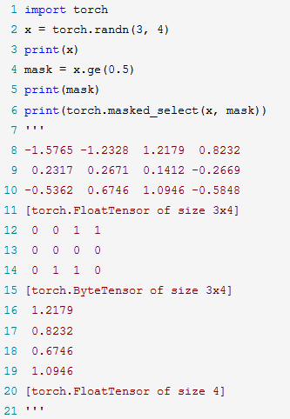
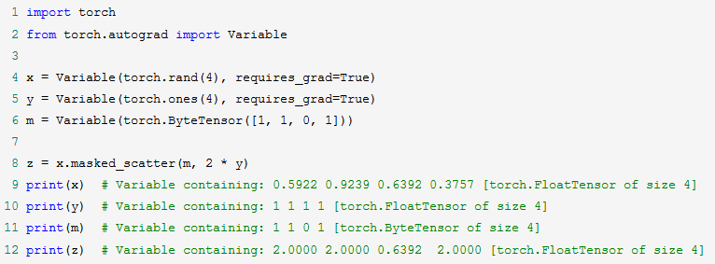
一些会用到的函数
1. masked_scatter_(mask, source)
Copies elements from source into self tensor at positions where the mask is one.
The shape of mask must be broadcastable with the shape of the underlying tensor. The source should have at least as many elements as the number of ones in mask
2. torch.masked_select(input, mask, out=None) → Tensor
Returns a new 1-D tensor which indexes the input tensor according to the binary mask mask which is a ByteTensor.

Slide 41
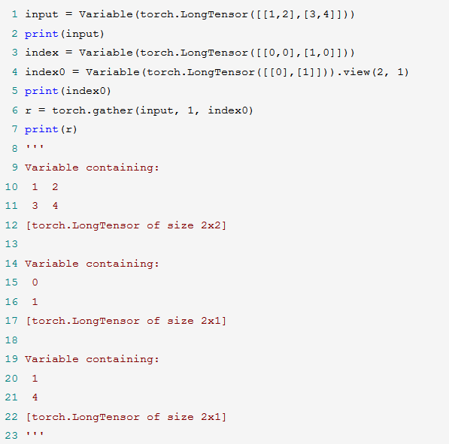
3. torch.gather(input, dim, index, out=None) → Tensor
out[i][j][k] = input[index[i][j][k]][j][k] # if dim == 0
out[i][j][k] = input[i][index[i][j][k]][k] # if dim == 1
out[i][j][k] = input[i][j][index[i][j][k]] # if dim == 2
out[i][j] = input[index[i][j]][j] # if dim == 0
out[i][j] = input[i][index[i][j]] # if dim == 1
input与index维度不相同，dim为他们不相同的维度值

Slide 42
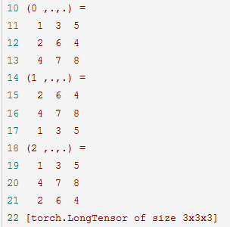
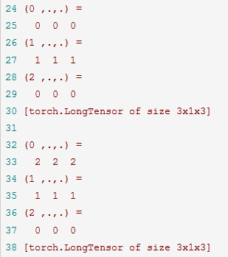
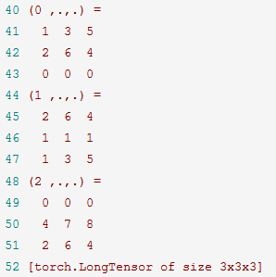
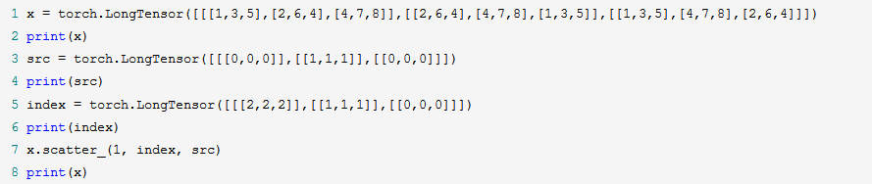
4. scatter_(dim, index, src) → Tensor
Writes all values from the tensor src into self at the indices specified in the index tensor.
For each value in src, its output index is specified by its index in src for dimension != dim and by the corresponding value in index for dimension = dim.
self[index[i][j][k]][j][k] = src[i][j][k] # if dim == 0
self[i][index[i][j][k]][k] = src[i][j][k] # if dim == 1
self[i][j][index[i][j][k]] = src[i][j][k] # if dim == 2

