Slide 1
CS224n 第六讲 依存分析-学习笔记
听课链接：http://www.mooc.ai/course/494

Slide 2
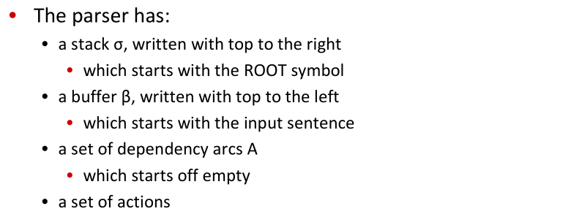
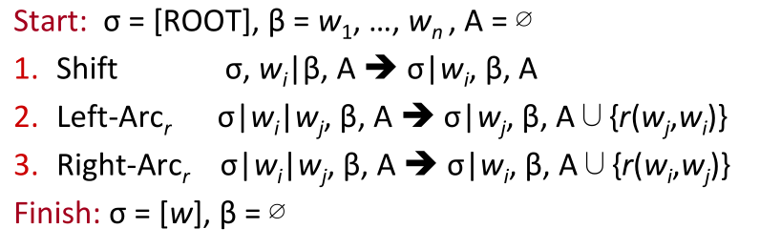
Basic transition-based dependency parser

Slide 3
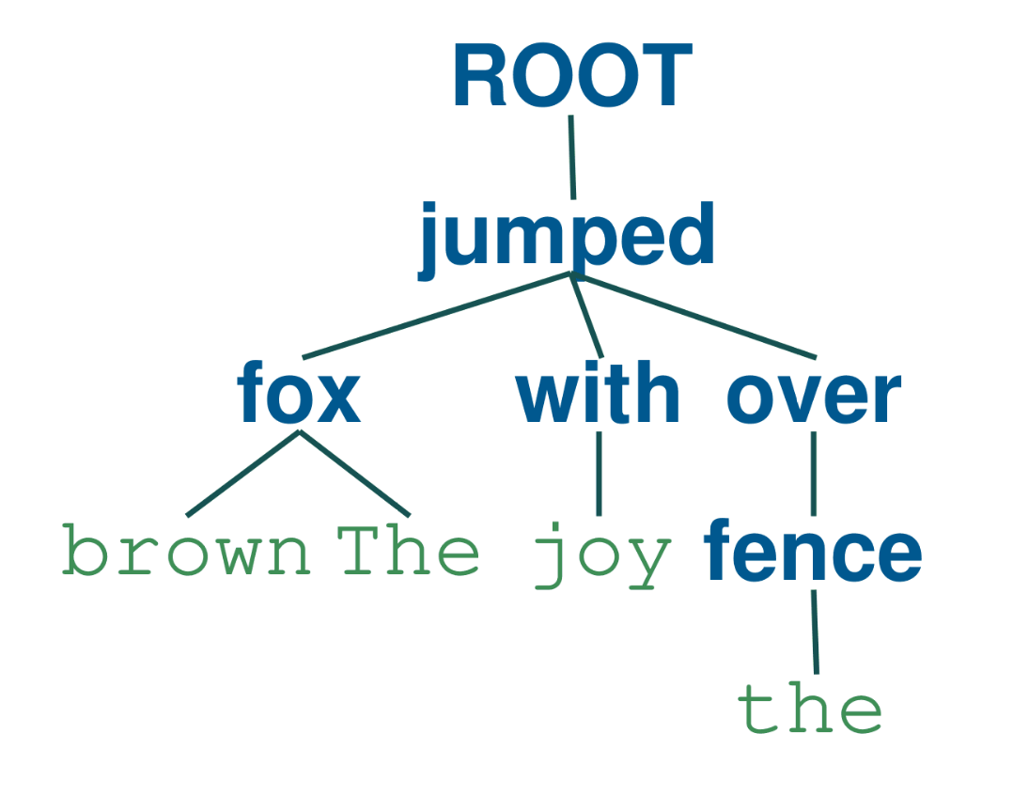
Basic transition-based dependency parser
For example:
The brown fox jumped with joy over the fence.
索引 | 词 | 词性 | 父亲节点索引 | 弧上关系
0 | The | DT | 2 | det
1 | brown | JJ | 2 | amod
2 | fox | NN | 3 | usubj
3 | jumped | VBD | -1 | root
4 | with | IN | 3 | prep
5 | joy | NN | 4 | probj
6 | over | IN | 3 | prep
7 | the | DT | 8 | det
8 | fence | NN | 6 | probj

Slide 4
Basic transition-based dependency parser
steps | stack | queue | next action | buffer
1 | null | 0,1,2,3,4,5,6,7,8 | shift | null
2 | 0 | 1,2,3,4,5,6,7,8 | shift | null
3 | 0,1 | 2,3,4,5,6,7,8 | shift | null
4 | 0,1,2 | 3,4,5,6,7,8 | left | null
5 | 0,2 | 3,4,5,6,7,8 | left | (2,1)
6 | 2 | 3,4,5,6,7,8 | shift | (2,1),(2,0)
7 | 2,3 | 4,5,6,7,8 | left | (2,1),(2,0)
8 | 3 | 4,5,6,7,8 | shift | (2,1),(2,0),(3,2)
9 | 3,4 | 5,6,7,8 | shift | (2,1),(2,0),(3,2)
10 | 3,4,5 | 6,7,8 | right | (2,1),(2,0),(3,2)
11 | 3,4 | 6,7,8 | right | (2,1),(2,0),(3,2),(4,5)

Slide 5
Basic transition-based dependency parser
steps | stack | queue | next action | buffer
12 | 3 | 6,7,8 | shift | (2,1),(2,0),(3,2),(4,5),(3,4)
13 | 3,6 | 7,8 | shift | (2,1),(2,0),(3,2),(4,5),(3,4)
14 | 3,6,7 | 8 | shift | (2,1),(2,0),(3,2),(4,5),(3,4)
15 | 3,6,7,8 | null | left | (2,1),(2,0),(3,2),(4,5),(3,4)
16 | 3,6,8 | null | right | (2,1),(2,0),(3,2),(4,5),(3,4),(8,7)
17 | 3,6 | null | right | (2,1),(2,0),(3,2),(4,5),(3,4),(8,7),(6,8)
18 | 3 | null | pop_root | (2,1),(2,0),(3,2),(4,5),(3,4),(8,7),(6,8),(3,6)
19 | null | null | no_action | (2,1),(2,0),(3,2),(4,5),(3,4),(8,7),(6,8),(3,6),(-1,3)

Slide 6
Evaluation method
方法1：UAS，仅看父亲节点预测结果，忽略关系
index | gold | predict | word | gold-rel | predict-rel
1 | 2 | 2 | she | nsubj | nsubj
2 | 0 | 0 | saw | root | root
3 | 5 | 4 | the | det | det
4 | 5 | 5 | video | nn | nsubj
5 | 2 | 2 | lecture | obj | ccomp
table: a example
方法2：LAS，父亲节点和关系都预测正确

