Slide 1

Database Design
for UMD Smith Master Programs
Ranking Website
Dragon Keepers
Team member: Huan Gao, Huidan Wu, Ning Xu, Yuntian Zhang
Date: 12/10/2023

Slide 2
Content
Background
Introduction
Conceptual Database Design
Logical Database Design
Physical Database Design
Four business transactions

Slide 3
Background
who users are and what data/sources it includes
This database is designed for the UMD Smith School program ranking website.The primary users of this database are prospective students who are interested in the programs offered at Robert H. Smith School of Business. The database provides comprehensive information about various aspects of these programs, including faculty, rankings, program details, and admission requirements. It aims to assist users in understanding the performance of different programs over time and making informed decisions about their educational paths.
Our project could help undergraduate students who are interested in programs in Robert H. Smith School of Business by providing information of Business Master’s programs. Students could make their decisions with more insights. Our goal is to offer guidance for the students’ further education achievements.
Our data source are as follows:
Robert H. Smith School of Business website (https://www.rhsmith.umd.edu/programs)
USNews (https://www.usnews.com/best-colleges/university-of-maryland-2103)
QS News (https://www.topuniversities.com/business-masters-rankings)

Slide 4
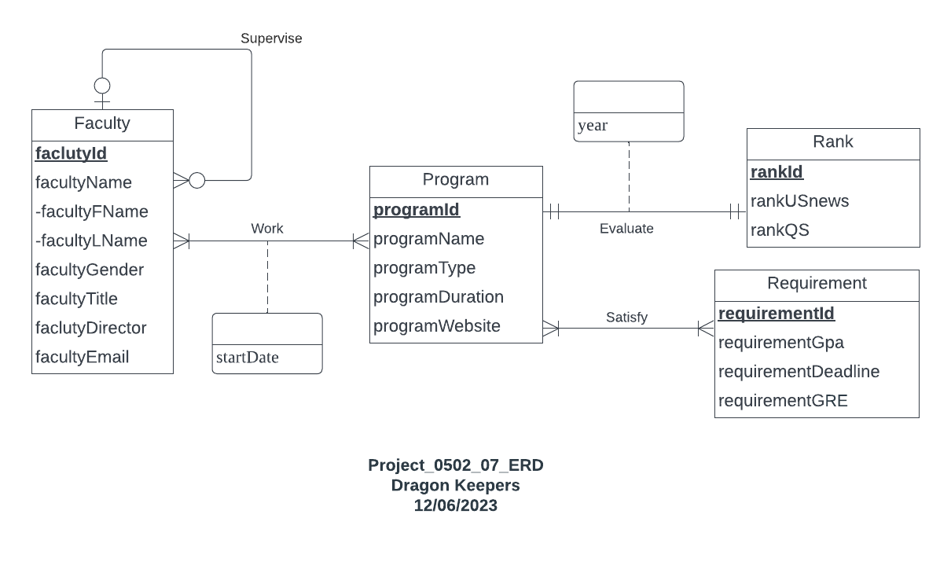
Conceptual Database Design

Slide 5
Introduction
Mission statement:
To design a database for the UMD Smith School program ranking website, providing comprehensive information on programs, faculty, rankings, and admission requirements for applicants. To analyze and track the historical rankings of the Smith School and build insights on their performance.
Mission objective:
To find the top programs at UMD Smith School based on their current ranking to provide students with insights into the best-performing programs.
To find the faculty members belonging to the highest-ranked programs and their supervisors.
To find all the UMD Smith School programs with an improved rank compared to previous year.
To recommend UMD Smith School programs to applicants based on their academic backgrounds.

Slide 6
Logical Database Design
Relational Schema
Program(programId, programName, programType, programDuration, programWebsite, requirementId)
Faculty(facultyId, facultyFName, facultyLName, facultyGender, facultyTitle, facultyPhone, facultyDirectorId)
Rank(rankId, rankUSNews, rankQS, year, programId)
Requirement(requirementId, requirementGpa, requirementDeadline, requirementGRE)
Work(programId, facultyId, startDate)

Slide 7
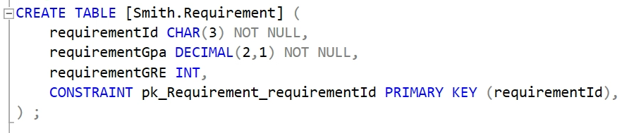
Physical Database Design—Requirement

Slide 8
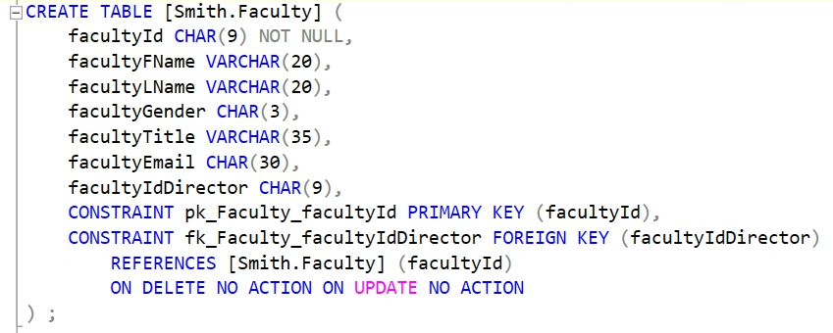
Physical Database Design—Program

Slide 9
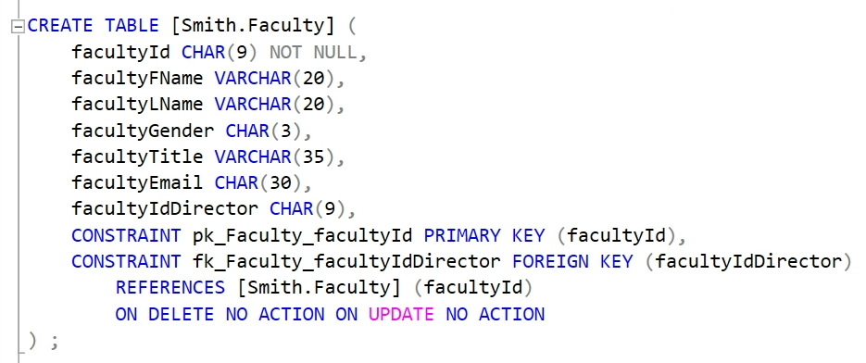
Physical Database Design—Faculty

Slide 10
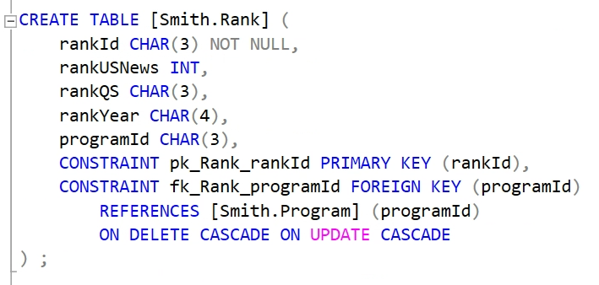
Physical Database Design—Rank

Slide 11
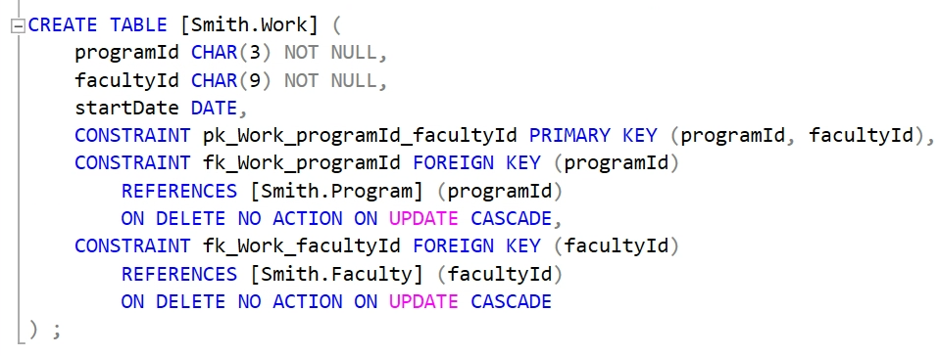
Physical Database Design—Work

Slide 12
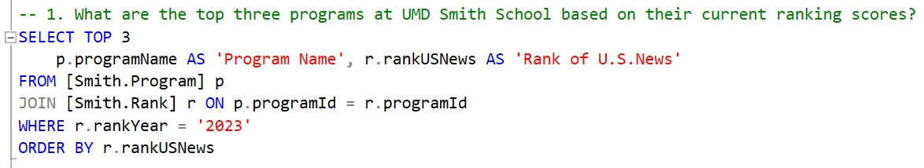
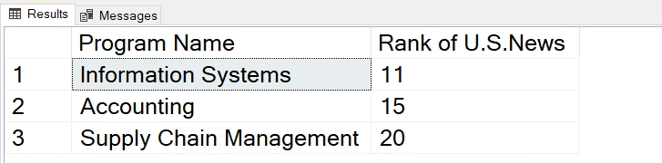
Business transactions 1
The result is shown in order by current rank of 2023.

Slide 13
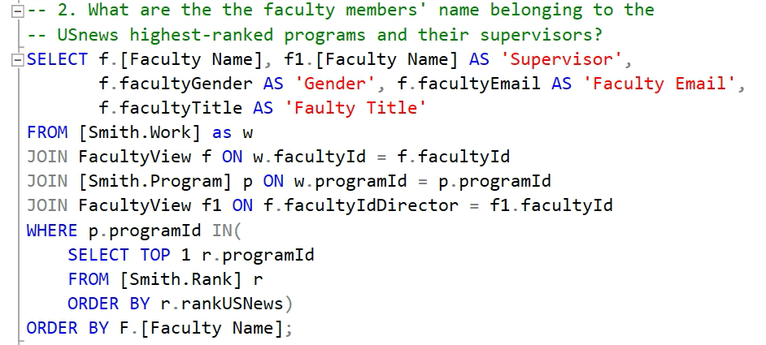
Business transactions 2

Slide 14
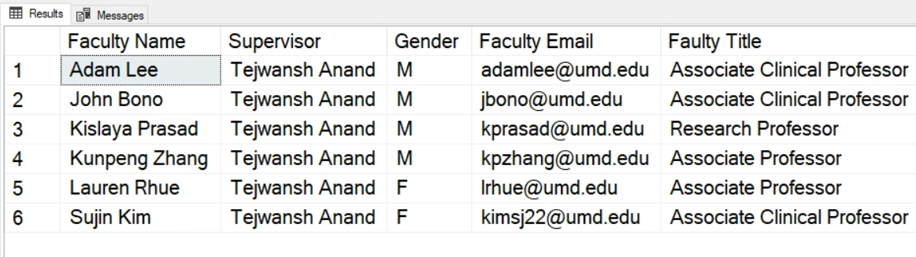
What are the the faculty members' name belonging to the USnews highest-ranked programs and their supervisor?
The result is shown in order by the faculty name.

Slide 15
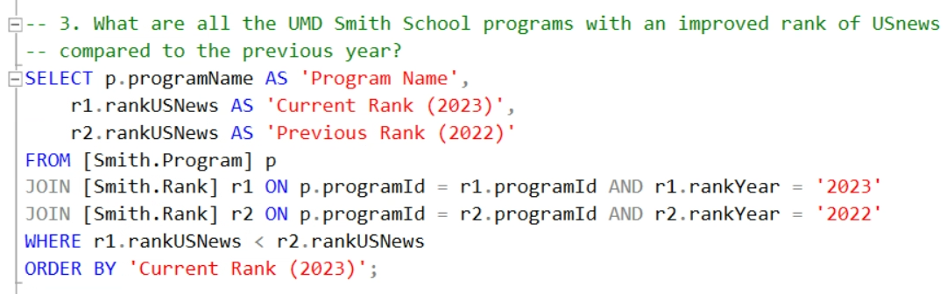
Business transactions 3

Slide 16
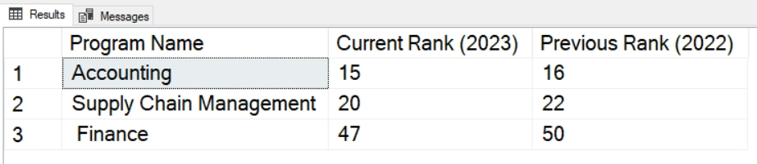
What are all the UMD Smith School programs with an improved rank of USnews compared to the previous year?
The result is shown in order by current rank of 2023.

Slide 17
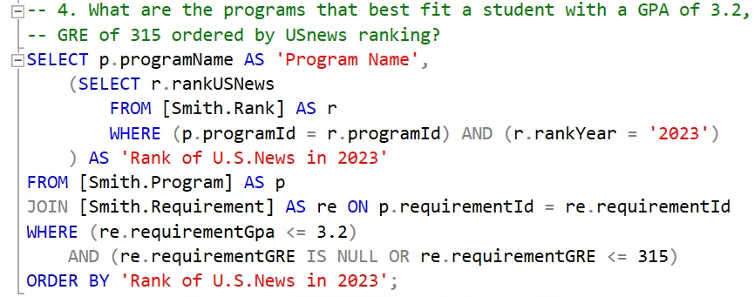
Business transactions 4

Slide 18
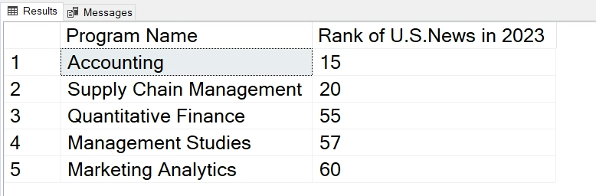
The result is shown in order by current rank of 2023.
What are the programs that best fit a student with a GPA of 3.2, GRE of 315 ordered by U.S.news ranking?

Slide 19

Thank You

