Slide 1
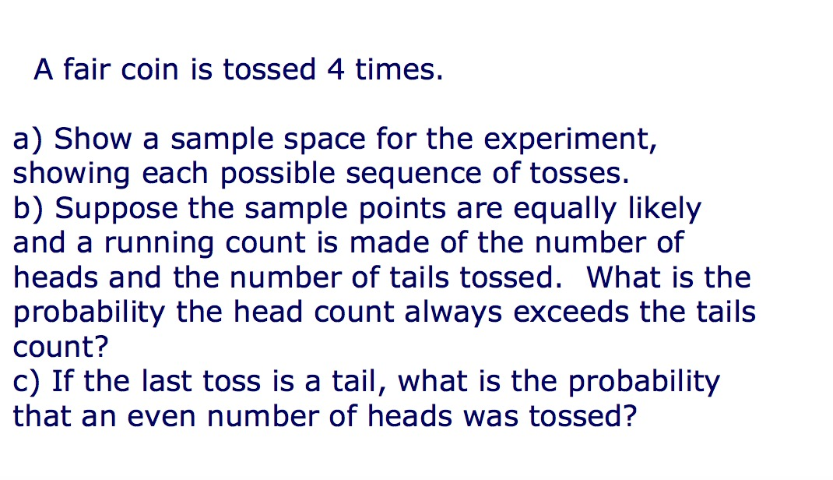

Slide 2
Pr(number of Heads is even | last toss is Tail)
=Pr(number of Heads is even & Last toss is Tail)/Pr(Last toss is Tail)
=4/8

Slide 3
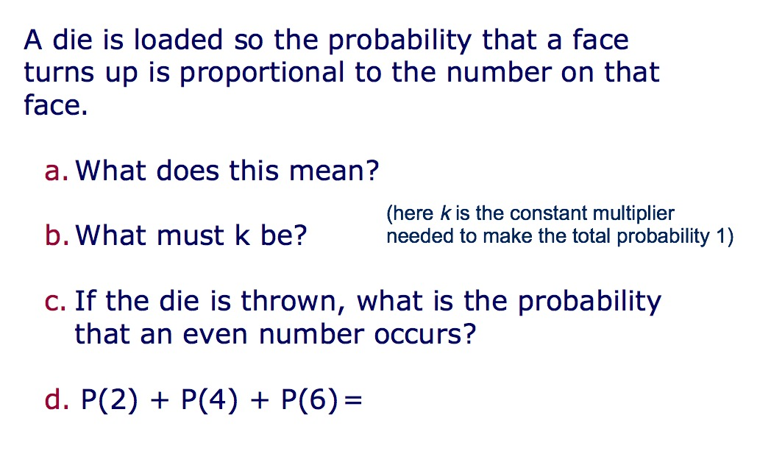

Slide 4
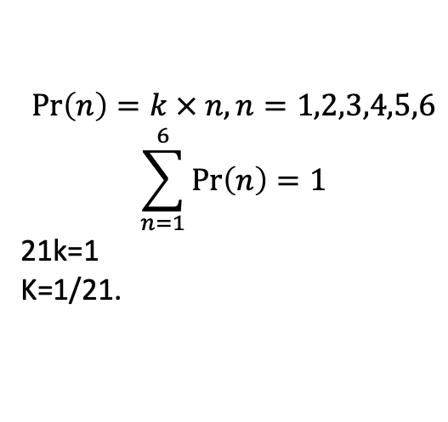
$$\operatorname{Pr}\left(n\right)=k × n, n=1,2,3,4,5,6$$
$$\sum_{n=1}^{6}{\operatorname{Pr}\left(n\right)=1}$$
21k=1
K=1/21.

Slide 5
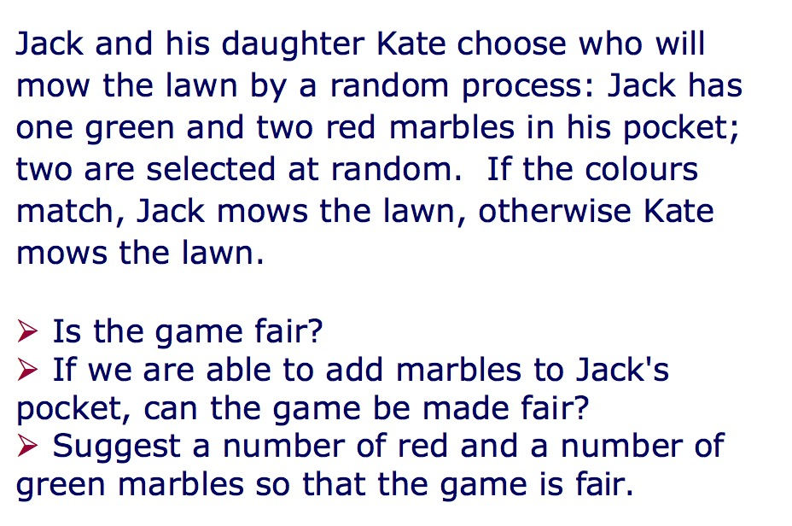

Slide 6
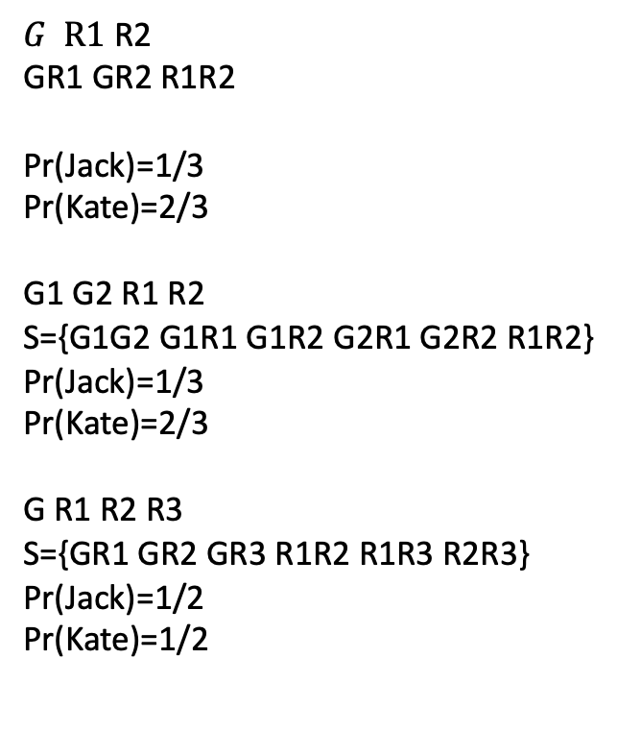
$G R1$ R2
GR1 GR2 R1R2
Pr(Jack)=1/3
Pr(Kate)=2/3
G1 G2 R1 R2
S={G1G2 G1R1 G1R2 G2R1 G2R2 R1R2}
Pr(Jack)=1/3
Pr(Kate)=2/3
G R1 R2 R3
S={GR1 GR2 GR3 R1R2 R1R3 R2R3}
Pr(Jack)=1/2
Pr(Kate)=1/2

