Slide 1
HCI暑假訓練
Andriod studio HW3
碩一 李怡靜
2019.07.26

Slide 2
CONTENTS
1
My Adapter
2
0000
3
0000
4
0000

Slide 3
01
My Adapter

Slide 4
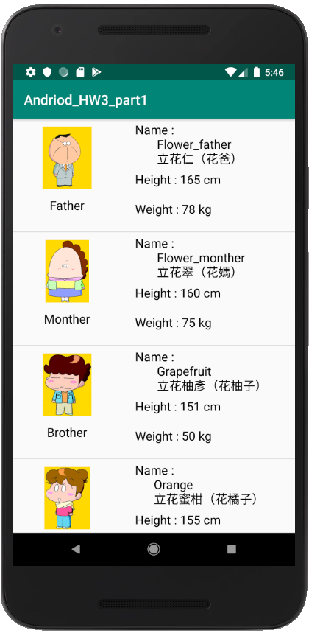
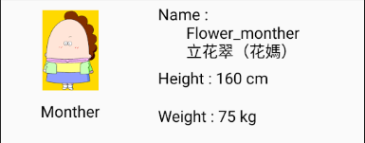
My Adapter

Slide 5

My Adapter
LinearLayout
(Horizontal)
ImageView
LinearLayout
(Vertical)
AB
TextView

Slide 6
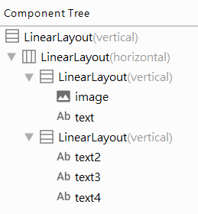
My Adapter

Slide 7
My Adapter

Slide 8
My Adapter

Slide 9
My Adapter

Slide 10
Thanks for listening
碩一 李怡靜
2019.07.26

