Slide 1



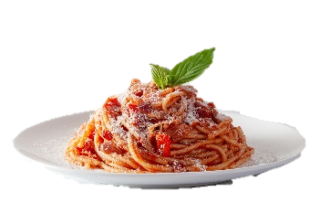
Nourishment Ninjas
栄養忍者

Slide 2
MEET THE TEAM

Slide 3
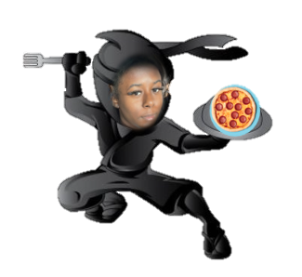
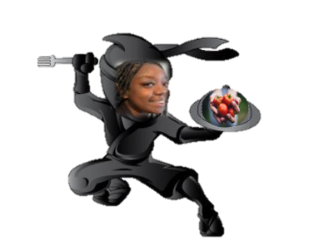
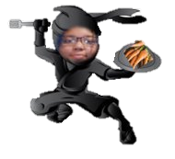

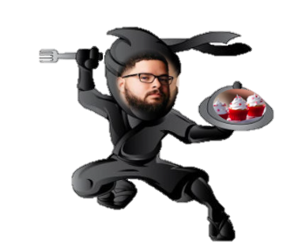
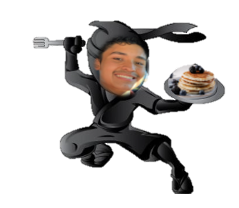
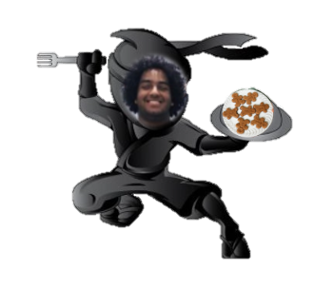
Lenasha williams
Jasmine trapier
Joycelyn Rouse
Rebecca caldwell
Hector santiago
Kevin rodriguez
Eyad kathir

Slide 4
Goal
To display the results of our investigations into the impact of food insecurity in North Carolina

Slide 5
Final demo

Slide 6

さようなら

