Slide 1
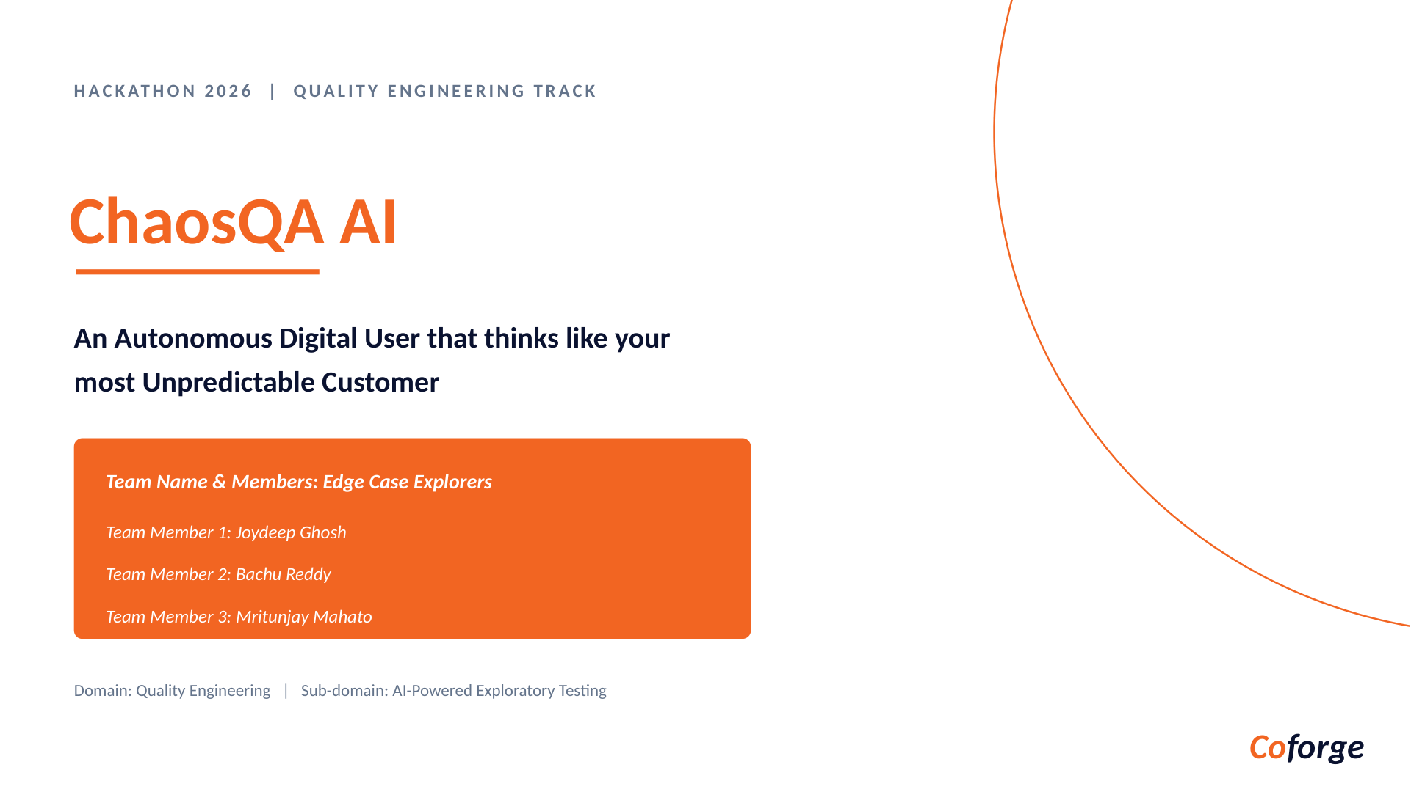

Slide 2
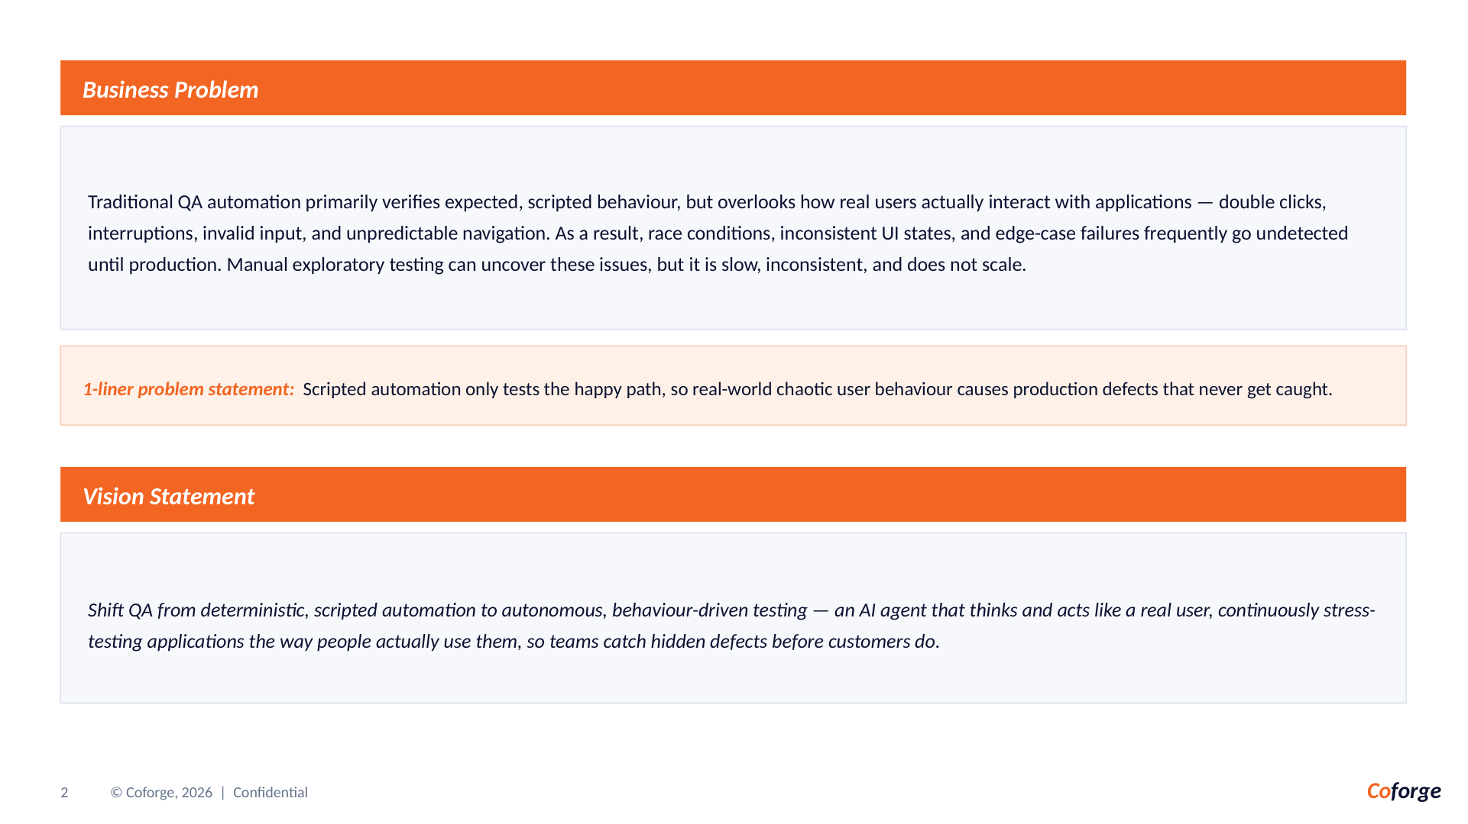

Slide 3
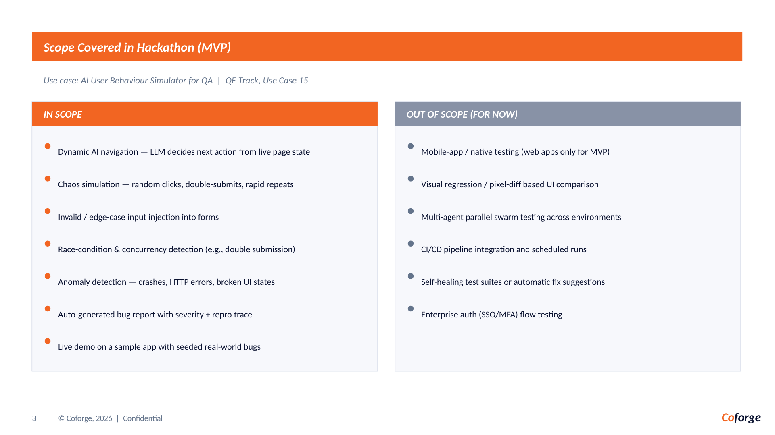

Slide 4
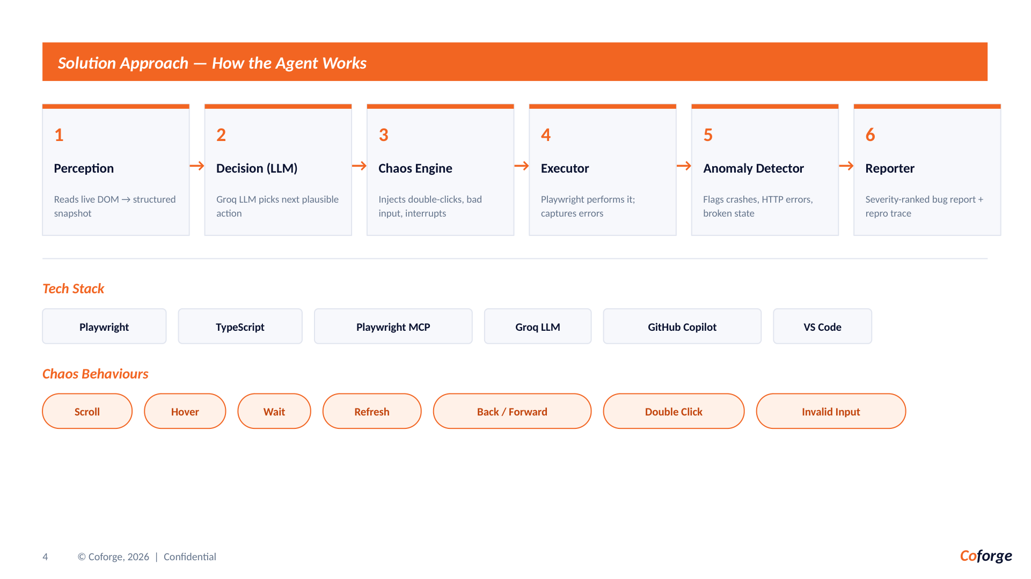

Slide 5
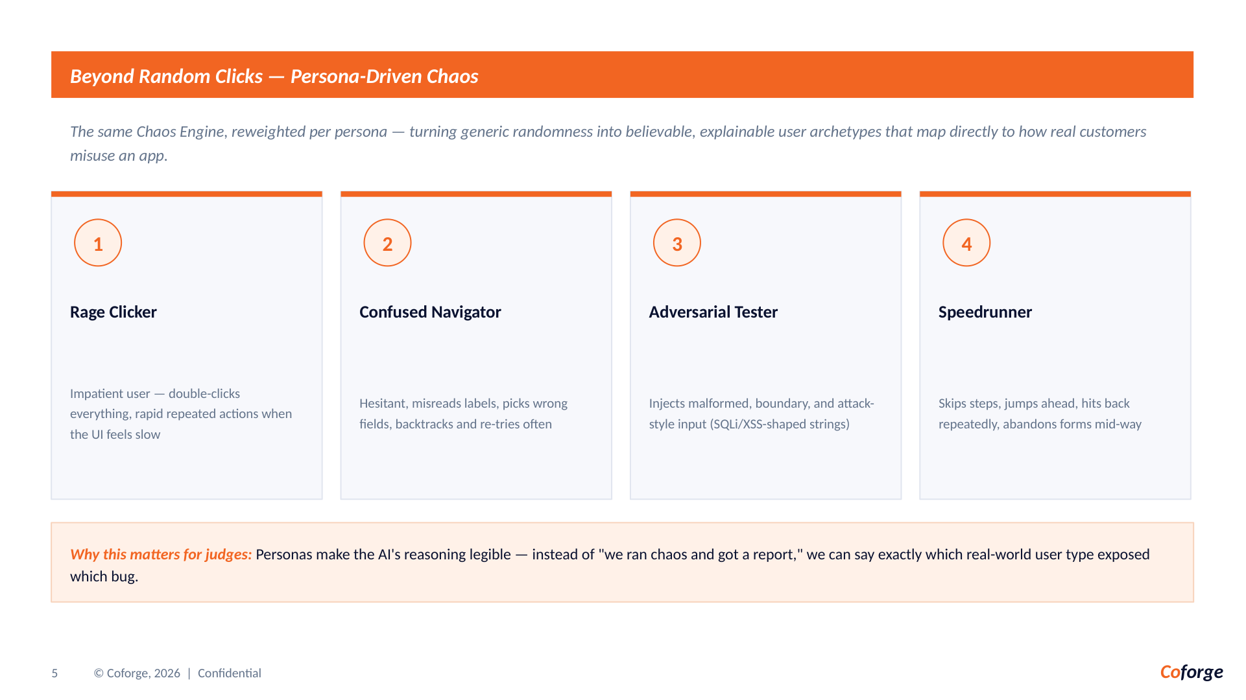

Slide 6
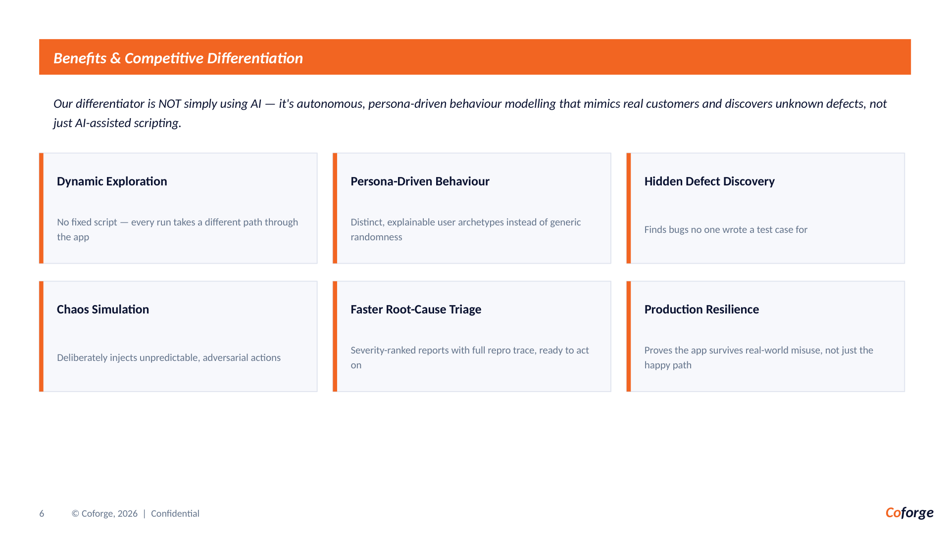

Slide 7
MVP Coverage: Every Submitted Use Case Is Demonstrable
STAGE 2 | MVP PROOF
The playground is not a random-click demo. Each required behavior has a visible trigger, an expected oracle, and a reportable outcome.
01 Dynamic AI navigation
02 Chaos simulation
03 Edge-case inputs
Live DOM snapshot → LLM chooses the next safe action; no fixed script.
Double-clicks, repeats, waits, back/forward, refresh, and interrupted journeys.
Empty, negative, fractional, unsafe-large quantities and malformed promo/email/card data.
04 Concurrency & race
05 Anomaly detection
06 Evidence-rich report
Idempotent pay lock, inventory re-check, and multi-tab cart synchronization.
Crash, navigation, validation, UI-state, data-handling, and unexpected-error signals.
Severity, confidence, repro action, URL, evidence, recommendation, and screenshot trail.
DEMO PATH | Search → product → quantity boundary → bag → promo → checkout → report
Scope discipline: web-first MVP; native mobile, visual pixel diff, and real payment processing remain intentionally out of scope.
COFORGE 2026 | CHAOSQA AI
8

Slide 8
The Edge-Case Lab: From Taxonomy to Test Oracle
STAGE 2 | DEPTH
Every category from the real-world brief becomes a controlled journey in Orchard—not a claim on a checklist.
CONCURRENCY
Agent stimulus
Expected oracle
Triple-click Place order
Button lock + one confirmation
BOUNDARY / TYPE
Agent stimulus
Expected oracle
−50, 1.5, 10¹⁸ quantity
Safe integer + min/max guard
STATE DESYNC
Agent stimulus
Expected oracle
Delete in Tab A, pay in Tab B
Storage event + inventory re-check
MALFORMED PAYLOAD
Agent stimulus
Expected oracle
Injection-shaped promo string
Length/character guard; no eval/SQL
SILENT FAILURE
Agent stimulus
Expected oracle
Simulated rejected payment
Visible alert + captured evidence
REPORT CONTRACT | handled boundary = EDGE_CASE • broken contract = EXCEPTION • every finding keeps repro context
COFORGE 2026 | CHAOSQA AI
9

Slide 9
The Category Gap: QA Tools Test Flows. ChaosQA Tests Reality.
STAGE 2 | DIFFERENTIATION
Most tools verify what teams already expect. ChaosQA discovers what customers do when intent, patience, and state collide.
Scripted automation
AI-assisted testing
ChaosQA AI
Fixed paths Known assertions Regression coverage
→
Human-authored scenarios AI helps write or heal tests Still script-led
→
Live DOM perception Persona-driven behavior Memory + evidence loop
Our moat is not “AI”. It is the closed loop between behavior, memory, and proof.
01 Simulate
02 Remember
03 Prove
Rage-clicker, confused navigator, adversarial tester — believable misuse, not random noise.
Persistent action signatures prevent repeat work and push every run toward unexplored state.
Repro trace + screenshots + severity + exception/edge-case split turns discovery into action.
POSITIONING | The autonomous exploratory layer between “tests pass” and “customers suffer.”
COFORGE 2026 | CHAOSQA AI
10

Slide 10
Why ChaosQA Wins the Edge-Case Moment
STAGE 2 | ADVANTAGE
A production incident is rarely a missing happy-path test. It is a believable sequence no one thought to script.
1
→
2
→
3
→
4
LIVE STATE
BEHAVIOR MODEL
CHAOS INJECTION
DECISION-READY PROOF
Reads the current DOM, controls, route, and visible state.
Chooses the next action as a customer persona with a goal.
Pushes boundaries: duplicate pay, stale cart, malformed input, race.
Classifies exception vs edge case and ships an evidence-rich report.
STANDOUT DEMO MOMENT
“The same app, after one run, is no longer the same search space.”
Value in one line
Less scripted coverage. More unknown defects found — with proof engineers can reproduce.
Run 1 discovers a stale-cart path. Run 2 remembers it, skips the duplicate, and targets a new failure boundary.
UNIQUE VALUE | Customer behavior is the test plan. Memory is the accelerator. Evidence is the output.
11
COFORGE 2026 | CHAOSQA AI
11
COFORGE 2026 | CHAOSQA AI

Slide 11
