Slide 1
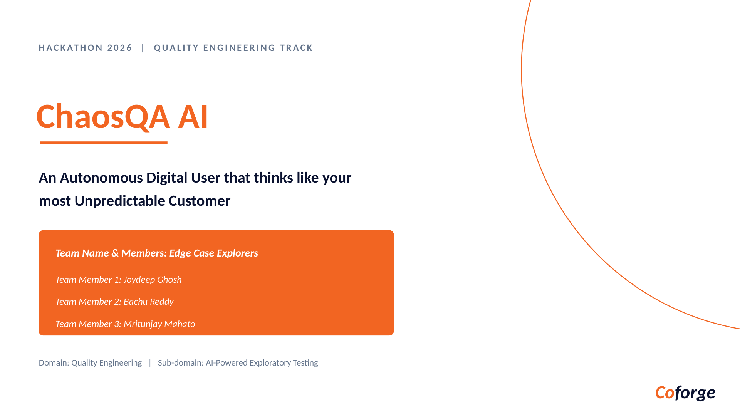

Slide 2
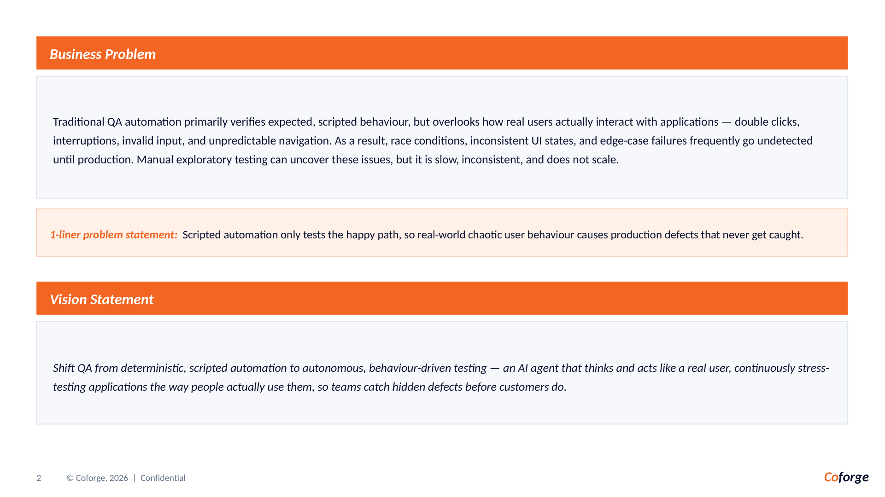

Slide 3
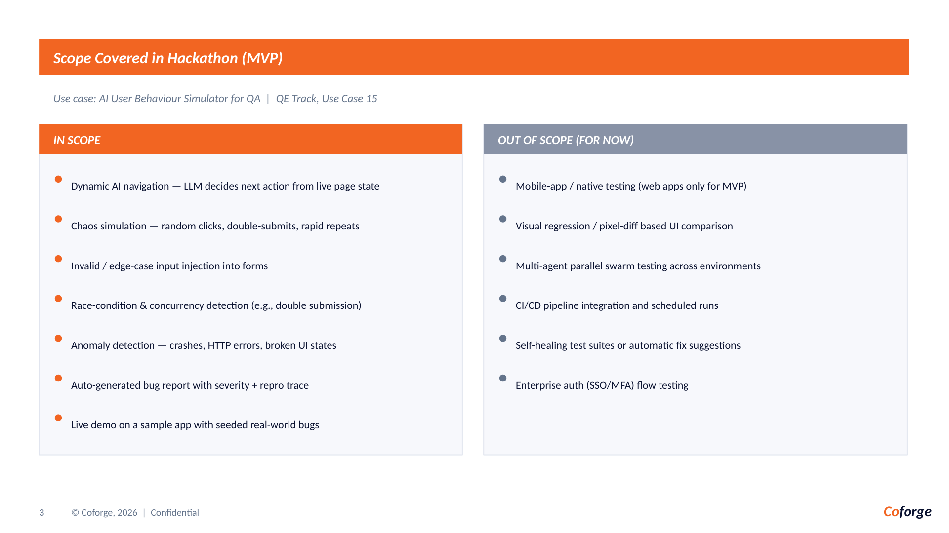

Slide 4
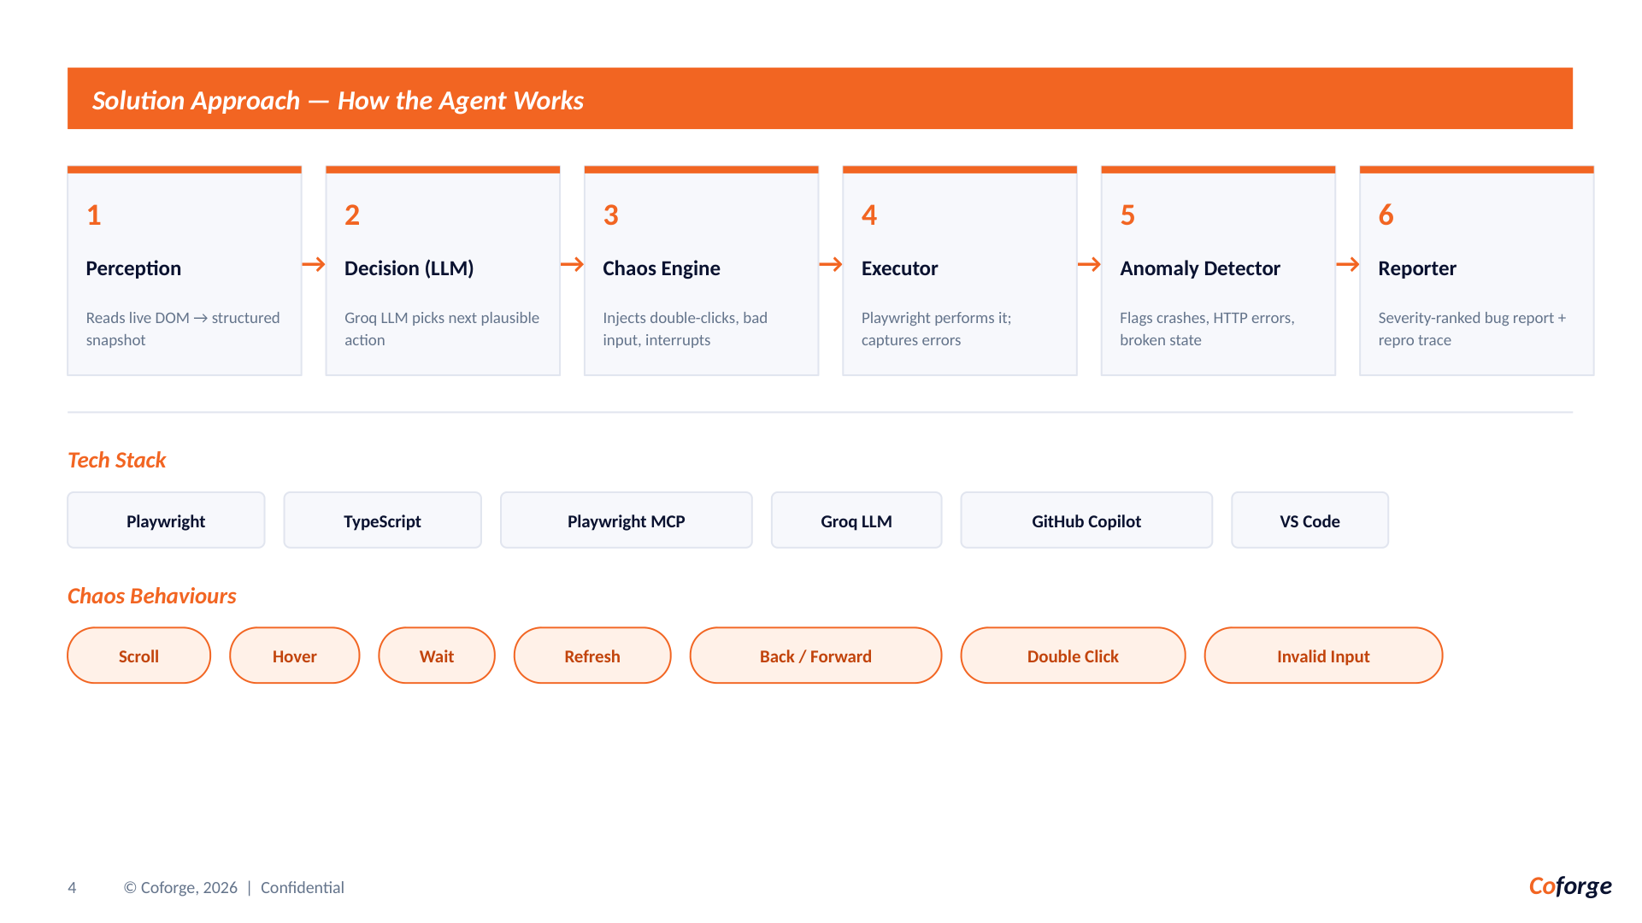

Slide 5
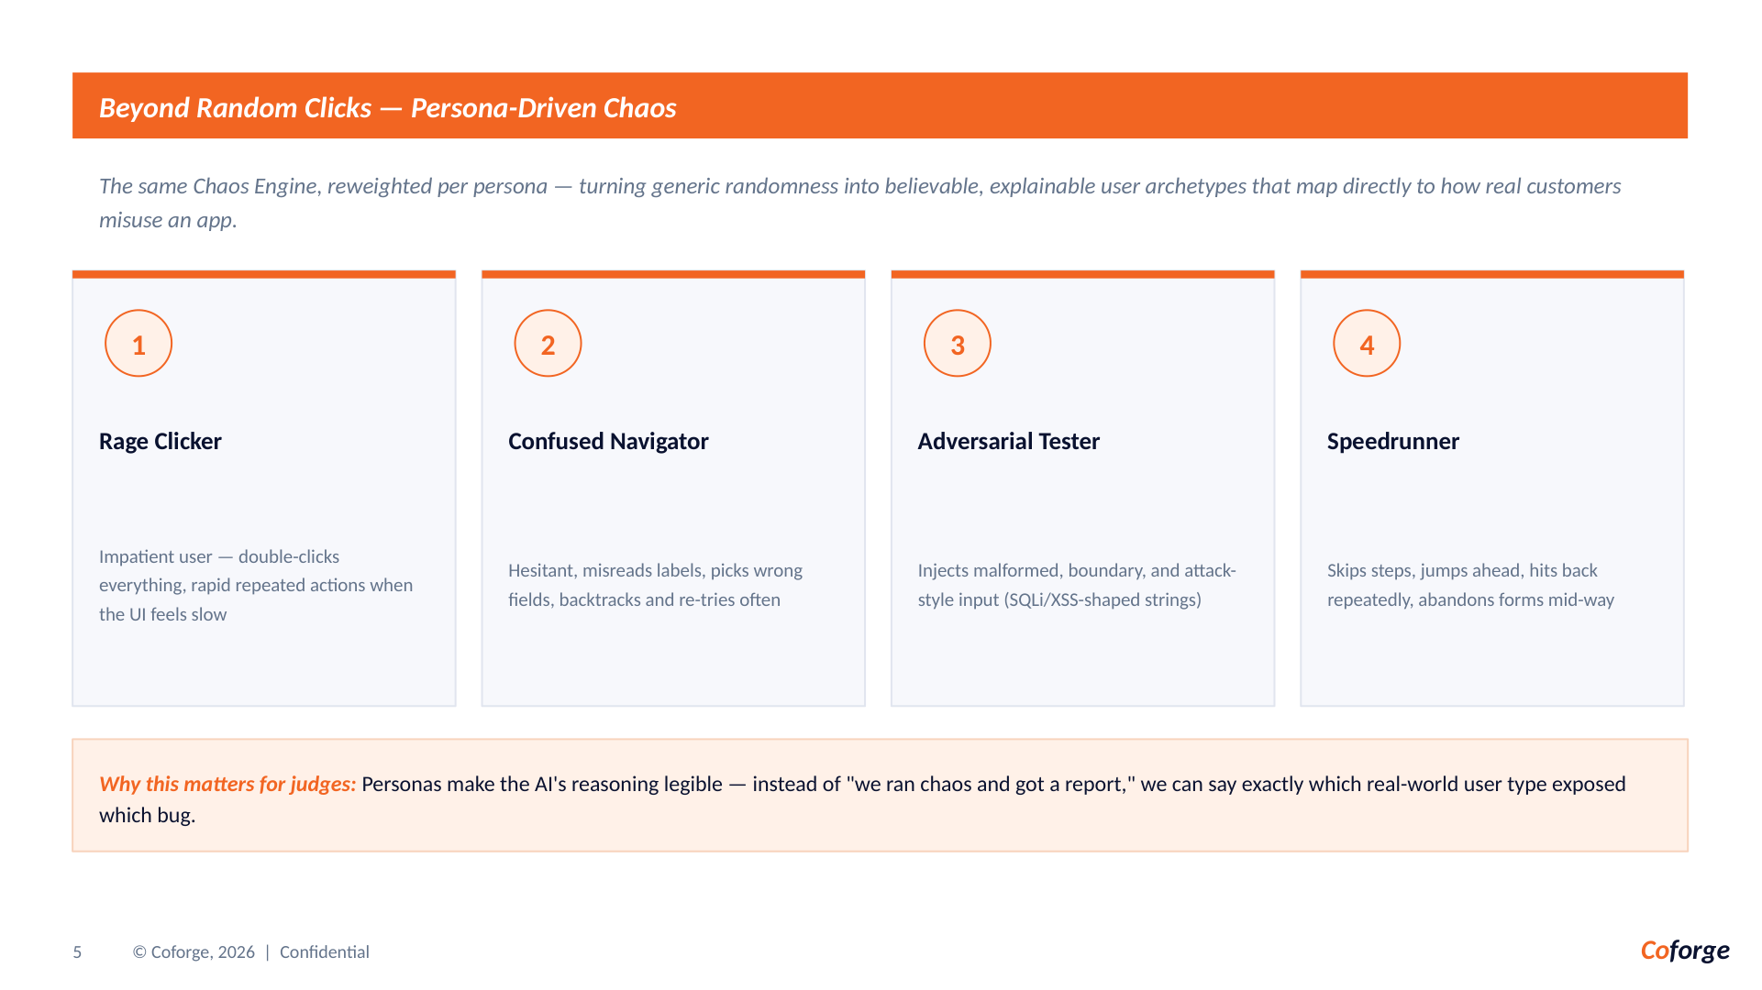

Slide 6
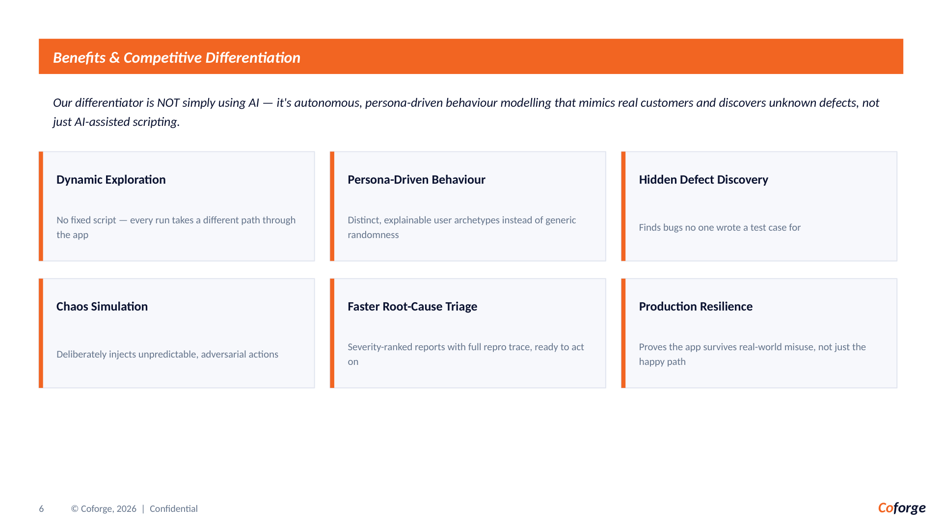

Slide 7
The Category Gap: QA Tools Test Flows. ChaosQA Tests Reality.
STAGE 2 | DIFFERENTIATION
Most tools verify what teams already expect. ChaosQA discovers what customers do when intent, patience, and state collide.
Scripted automation
AI-assisted testing
ChaosQA AI
Fixed paths Known assertions Regression coverage
→
Human-authored scenarios AI helps write or heal tests Still script-led
→
Live DOM perception Persona-driven behavior Memory + evidence loop
Our moat is not “AI”. It is the closed loop between behavior, memory, and proof.
01 Simulate
02 Remember
03 Prove
Rage-clicker, confused navigator, adversarial tester — believable misuse, not random noise.
Persistent action signatures prevent repeat work and push every run toward unexplored state.
Repro trace + screenshots + severity + exception/edge-case split turns discovery into action.
POSITIONING | The autonomous exploratory layer between “tests pass” and “customers suffer.”
COFORGE 2026 | CHAOSQA AI
8

Slide 8
Why ChaosQA Wins the Edge-Case Moment
STAGE 2 | ADVANTAGE
A production incident is rarely a missing happy-path test. It is a believable sequence no one thought to script.
1
→
2
→
3
→
4
LIVE STATE
BEHAVIOR MODEL
CHAOS INJECTION
DECISION-READY PROOF
Reads the current DOM, controls, route, and visible state.
Chooses the next action as a customer persona with a goal.
Pushes boundaries: duplicate pay, stale cart, malformed input, race.
Classifies exception vs edge case and ships an evidence-rich report.
STANDOUT DEMO MOMENT
“The same app, after one run, is no longer the same search space.”
Value in one line
Less scripted coverage. More unknown defects found — with proof engineers can reproduce.
Run 1 discovers a stale-cart path. Run 2 remembers it, skips the duplicate, and targets a new failure boundary.
UNIQUE VALUE | Customer behavior is the test plan. Memory is the accelerator. Evidence is the output.
8
COFORGE 2026 | CHAOSQA AI
9
COFORGE 2026 | CHAOSQA AI

Slide 9
