Slide 1
AIML Part A: Classification
Jayden Yap Jean Hng p2112790

Slide 2
Classification Task: Factory Machines
Target: Status (0 = working, 1 = broken)
Features:
Quality (Low,Medium,High)
Temperature (room and operating temps)
Rotation Speed of machine (rpm)
Torque (Force in Newton Metre)
Estimated Tool Wear Time (estimated time before breaking)
Potential Features (engineered):
Temperature Rise (Operating temperature – Room temperature)
Efficiency (Rotation Speed/Torque Force)

Slide 3
Data Visualisation
Understanding our data and features

Slide 4
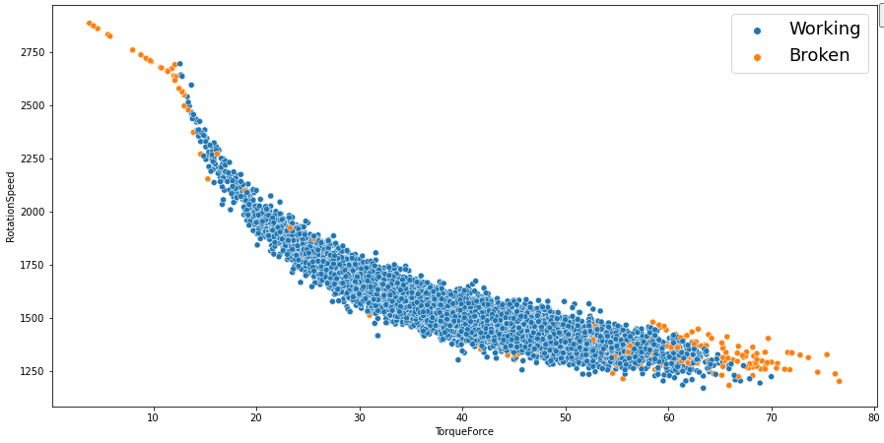
Data Visualisation 1
There is clearly a relationship between Rotation Speed and Torque Force. As Torque Force increases, Rotation Speed decreases non-linearly.
This is why having an Efficiency Column makes sense. (Useful Output divided by Total Input)
We can also see from the colours that machines with low Torque, but high Rotation speed are mostly broken machines. Same goes for high torque with low speed. This indicates some bad quality control. (Not enough force to accommodate speeds leading to malfunctions or vice versa)

Slide 5
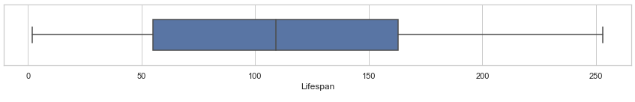
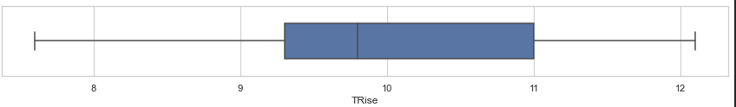
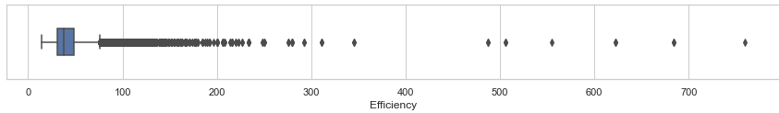
Data Visualisation 2
Lifespan (minutes) has a median of ~110 minutes, with a IQR of ~100 minutes. Quite a lot of variation
Temperature Rise (Celcius) has not much variability with IQR of ~1.6C
Would be even less without this engineered feature
Efficiency boxplot is very skewed to the right
This means there are some machines with much higher efficiency than the rest
NOTE: Efficiency here is not a %, just a scalar measure

Slide 6
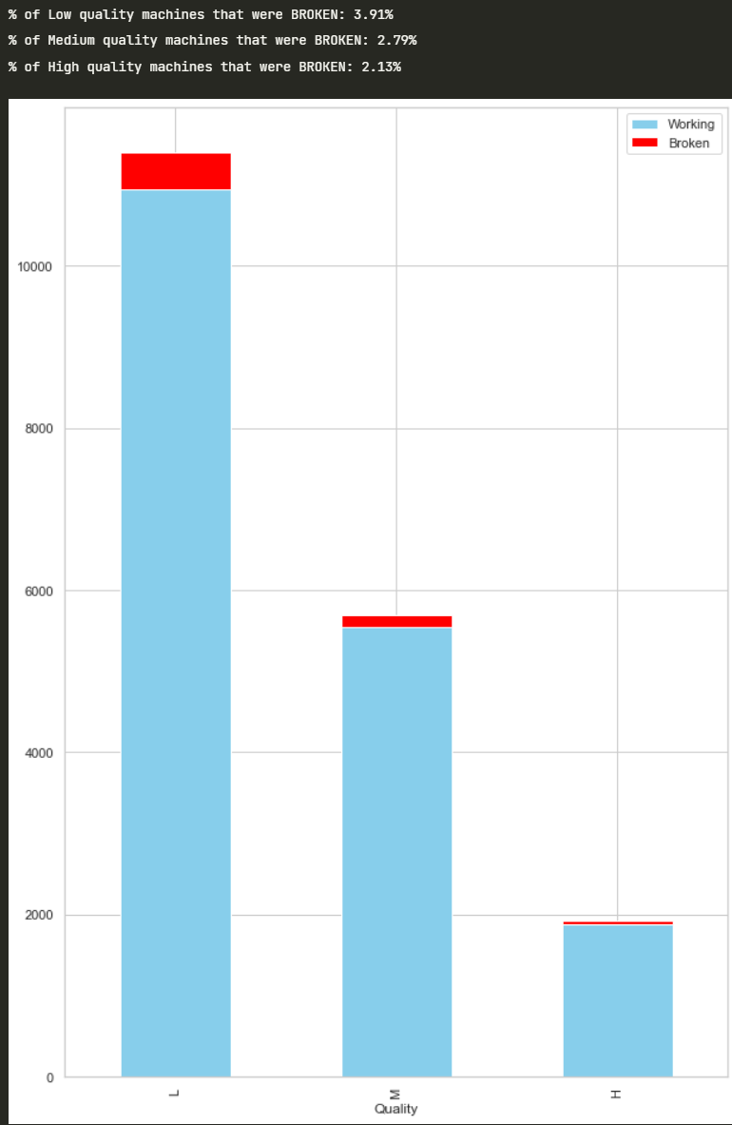
Data Visualisation 3
Count plot of Quality (low, medium high) with mapped colours for working/broken machines (red=broken)
High quality machines had the least proportion of broken machines, medium the 2nd least, then low quality had the most broken machines
This makes sense as High quality machines should be made to be longer lasting
Overall however, these proportion differences are very small (2%-3%)

Slide 7
Data Processing
Understanding our data and features

Slide 8
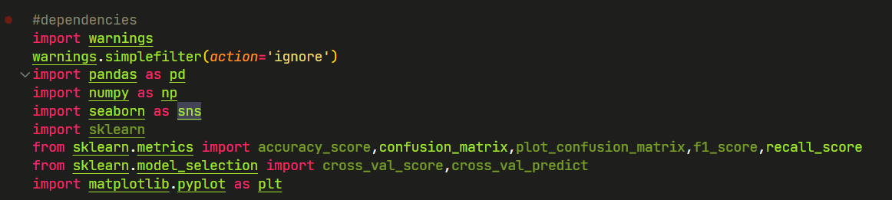
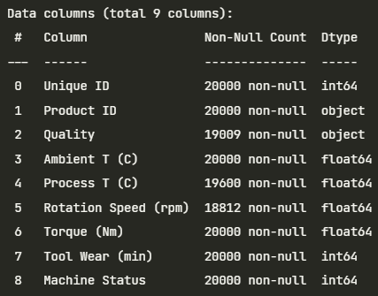
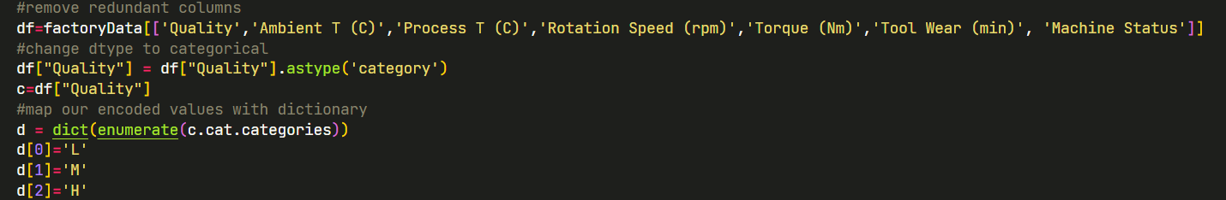
Importing neccesary packages
df.info()
Remove Unique ID and Product ID (no use for model)
Then for 'Quality' column change letter values ('L','M','H') to numbers with dictionary mapping

Slide 9
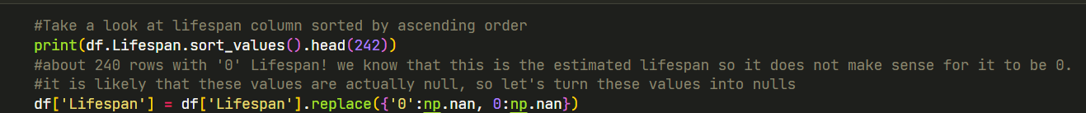
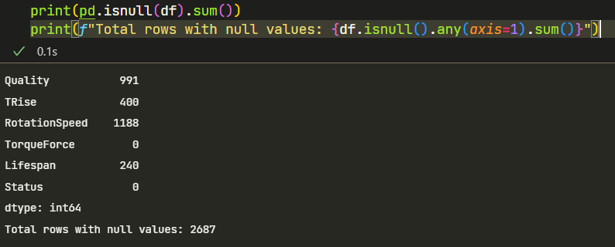
Create Temperature Rise column computed as Process Temperature (higher) - Ambient Temperature (lower)
2 paired variables ---> 1 variable
There are 240 rows with 0 Lifespan, this does not make sense because it's an estimated value, I will consider this as null values so I turn 0 into NULL to be imputed later
Let's check for null values (by columns)
We have 2687 total rows with null values
Let's impute these rows (dropping rows would lose too much data)

Slide 10
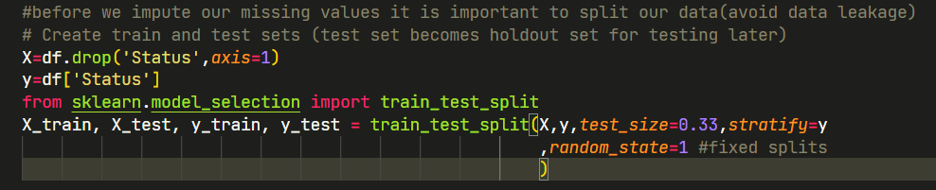
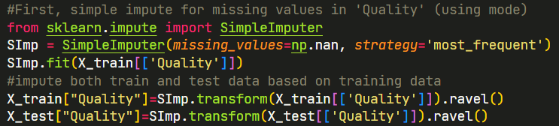
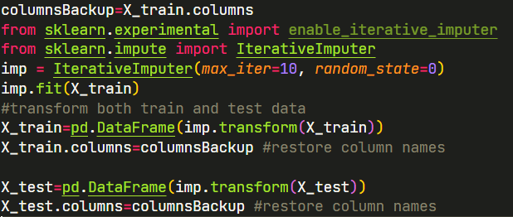
Imputing Values
Before imputing values, we must split our data into train and test to avoid data leakage
We use Simple Impute with Mode strategy (most frequent value) for Quality Column
First, backup the column names due to functions returning numpy arrays
We use IterativeImputer (takes into account multiple columns' relationship with each other)
Fit train data on imputer
Transform both train and test data
This will impute the remaining missing values (numbered/continuous columns)

Slide 11
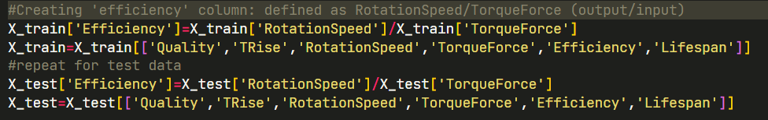
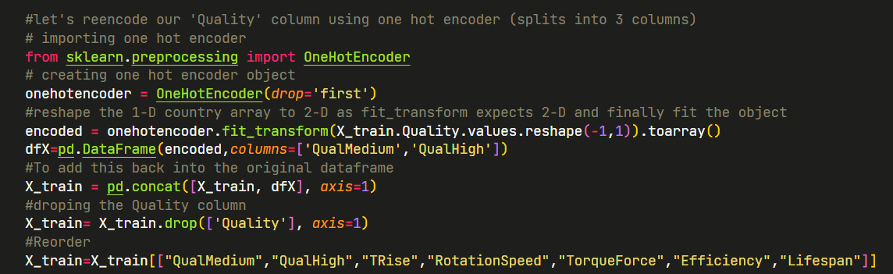
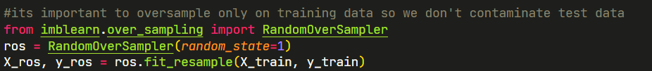
Now that we have no null values, we can engineer an 'Efficiency' feature for both train and test data
Use One Hot Encoder for Quality Column (separate every value into new column) However, we drop first column to avoid linear dependence. Therefore we have QualityMedium, and QualityHigh column.
Our dataset is very inbalanced (678 broken machines out of 20,000), let's oversample to make the distribution more even to reduce biasness later
This creates new rows of data of broken machines such that roughly half of our final dataset will be broken machines instead of less than 5%
(We only oversample training data)

Slide 12
Testing Models
Try many models with their default parameters (both with oversampled and normal training data) and find the best ones

Slide 13
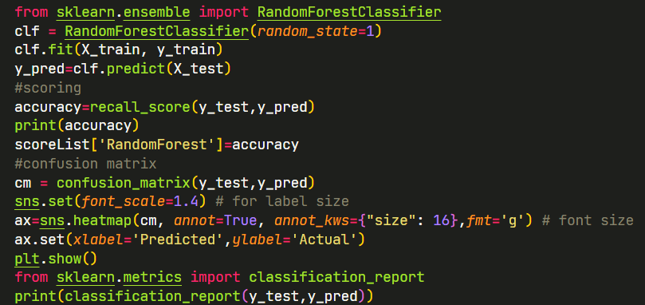
Example (Random Forest Classifier)
When creating model, be sure to use random_state=1 so any improvement we make will be accurate.
Then, we fit training data, test on test data. For every model we record Recall score
Recall score focuses on True Positive rate (True positives/All Positives) This refers to broken machines
Most appropriate because our dataset is imbalanced (very little broken machines)
If we used Accuracy, a model could simply classify all machines as Working and would obtain a high score
We want to prioritise broken machines being classified correctly, so we use Recall

Slide 14
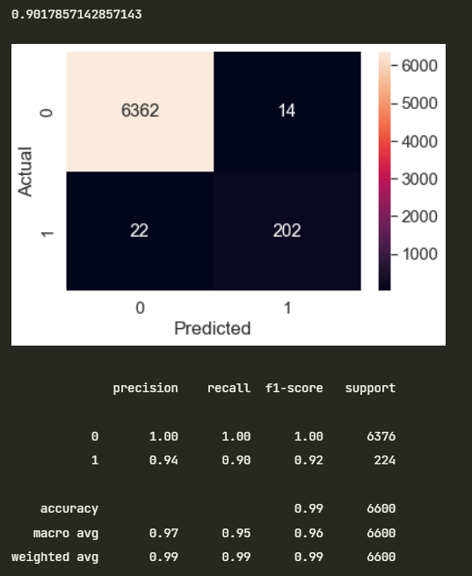
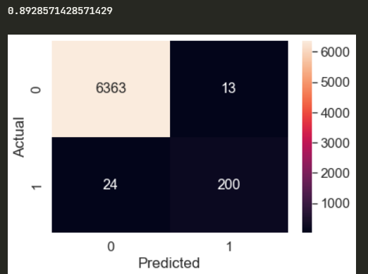
Example (Random Forest Classifier)
Examples of Recall Score and Confusion Matrix results
Fitted on Normal Data vs Oversampled Data
Oversampled data across most models had better results than normal data!
For example, Naïve Bayes model using oversampled data gave us a improvement from 0.16 to 0.60!

Slide 15
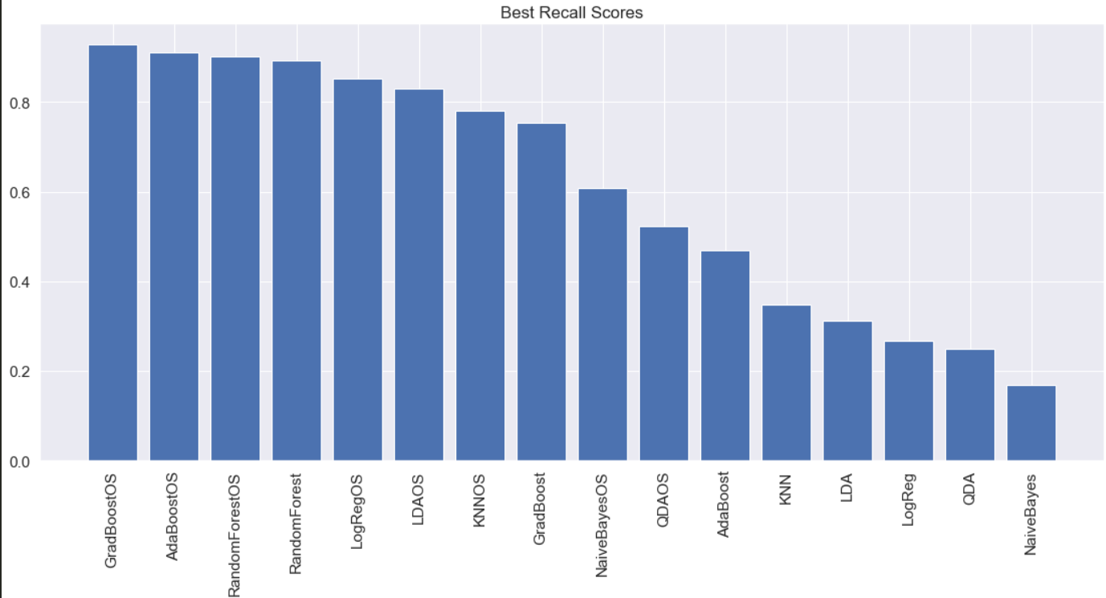
Comparing all models
The Top 3 models with the best Recall Scores (out of 16)
1. Gradient Boost (oversampled data)
2. Adaboost (oversampled data)
3. Random Forest (oversampled data)
I will choose to perform Hyperparameter Tuning on these 3 models

Slide 16
Hyperparameter Tuning
Try models with different sets of settings to find the most optimal settings

Slide 17
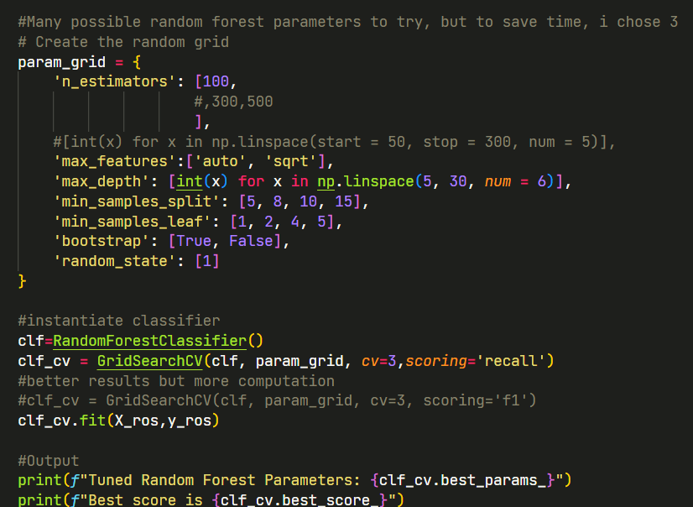
GridSearchCV
Create parameter grid
Fit data to GridSearch and change scoring to 'recall'
Run GridSearch for each model (can take 30 to 90 mins)
Get best parameters
How did we get a perfect score of 1.0? With GridSearchCV, due to cross validation, we are testing on our own oversampled data, hence scores will be overly optimistic, however we will be able to test these parameters properly later

Slide 18
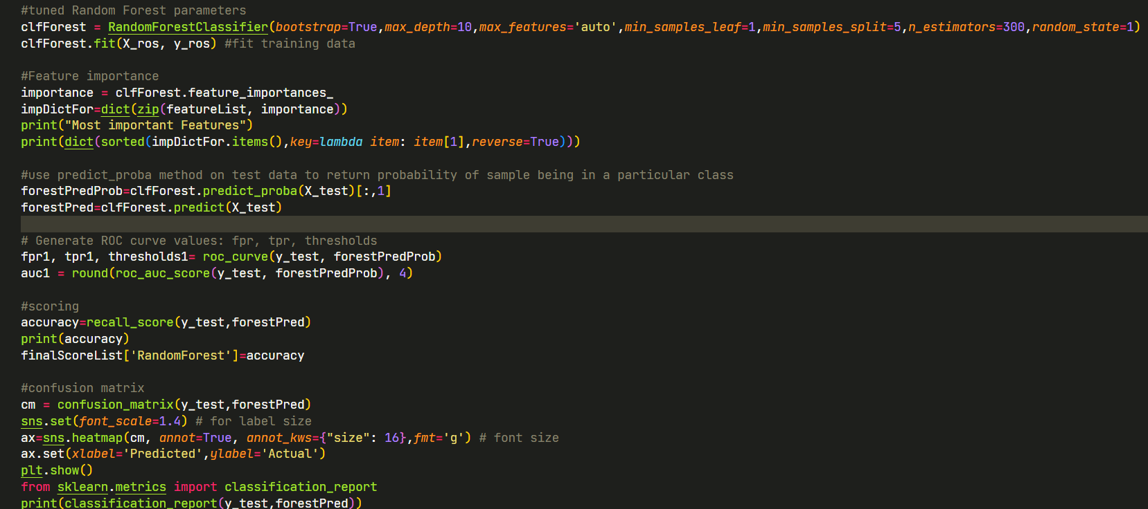
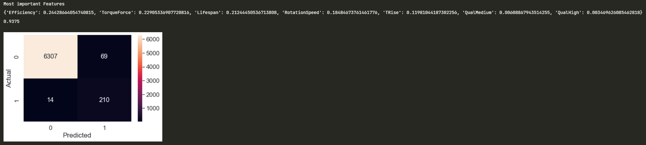
Final tests
Using tuned parameters, we do a final test on test data while collecting information like Recall score, ROC score and Feature Importance
Our Recall for RandomForest improved from ~0.89 to ~0.94!

Slide 19
Final Results
Compare scores and decide which model to use

Slide 20
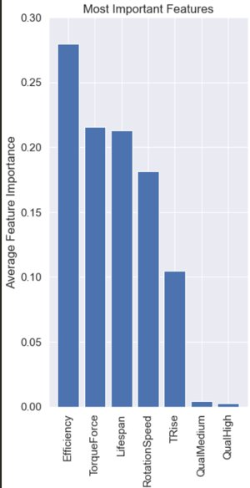
Feature Importance
We calculate the mean feature importance for each feature and then plot them. Efficiency, the feature we engineered, has the highest score! That's great
Curiously, the Quality columns (medium , high) were the least important by far. Perhaps this is because the quality of a product already determines the other attributes (Efficiency,Lifespan etc), hence being more redundant

Slide 21
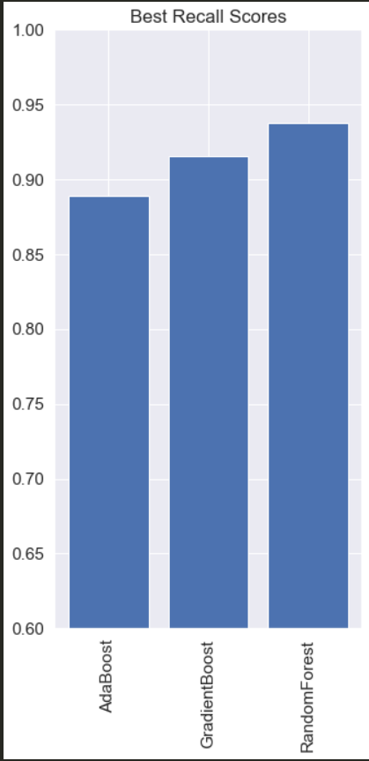
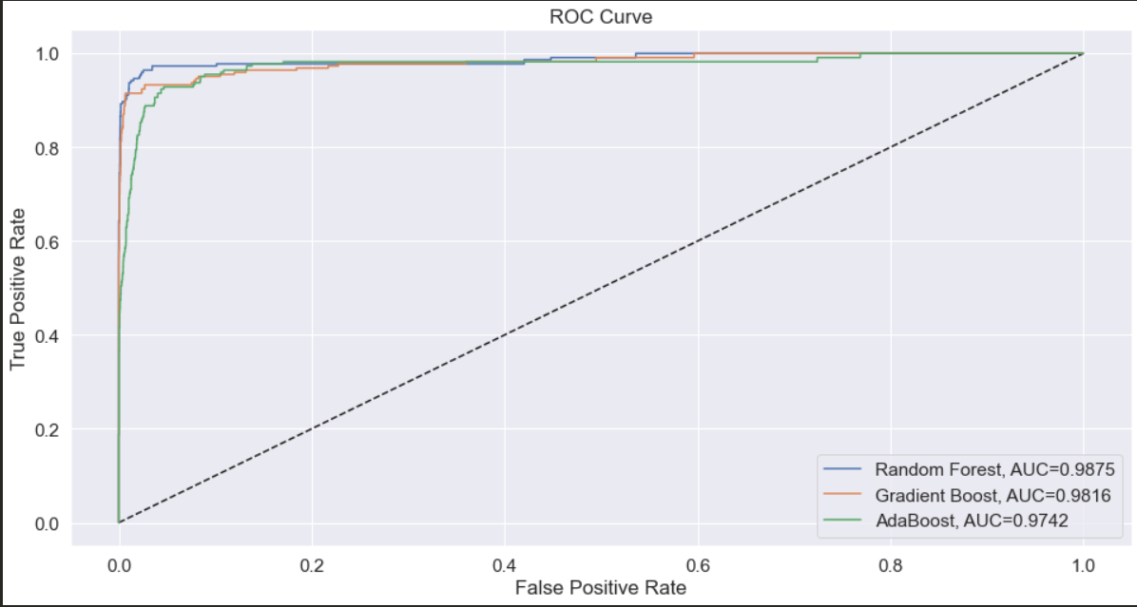
Final Scores
We repeat this process for all 3 models and then we compare the final results
1. RandomForest scored best in Recall
2. RandomForest had best AUC score (for ROC) with 0.9875
Therefore, we will choose RandomForest with tuned parameters as our final model

Slide 22
Thanks for listening :)

