Slide 1
AIML Part B: Regression
Jayden Yap Jean Hng p2112790

Slide 2
Regression Task: Laptop Data
Target: Price ($)
Potential Features:
Brand
Type
Screen Size
Screen Specs ------> IPS(binary) , Touchscreen (binary)
CPU
RAM
Hard Disk (Storage) ----> HDD , SSD, Hybrid, Flash_Storage
GPU ----> GPU Brand
Operating System (OS)
Weight (kg)
Pixel Density (PPI)

Slide 3
Data Visualisation
Understanding our data and features

Slide 4
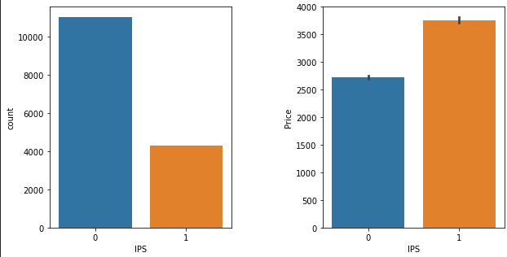
IPS Displays
IPS (in-plane switching) is widely regarded as superior panel technology (best colors and viewing angles)
Some of the laptops have this technology and are more expensive on average than those without

Slide 5
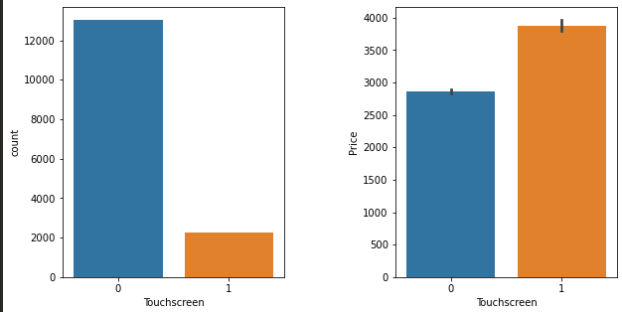
Touchscreen Displays
Touchscreens allow users to use the screen like their phone for convenience
This feature is rare in this dataset, but laptops with the feature are generally more expensive

Slide 6
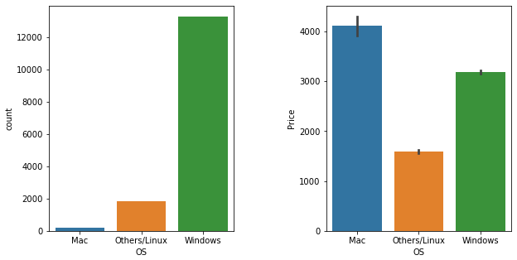
Operating System
Mac OS is the least common OS in the dataset by far, followed closely by Linux/other OS. It is largely dominated by Windows laptops.
Logical as Apple only makes a few Macbooks compared to the multitude of manufacturers creating Windows laptops
Mac laptops are the most expensive type on average, folowed by Windows then Linux
Logical because Apple makes premium products, Windows has a mix of premium and budget, and Linux are mostly budget laptops (Linux is free)

Slide 7
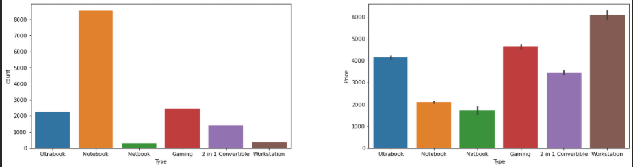
Type of Laptop
Notebooks are the most common, followed by gaming laptops
Workstations are the most expensive laptop, logical because they have the best specifications, followed by gaming laptops
Note: Ultrabooks are high-end thin notebooks, Netbooks are weak laptops meant for internet apps, 2in1 or 'Hybrid' laptops are laptops AND tablets

Slide 8
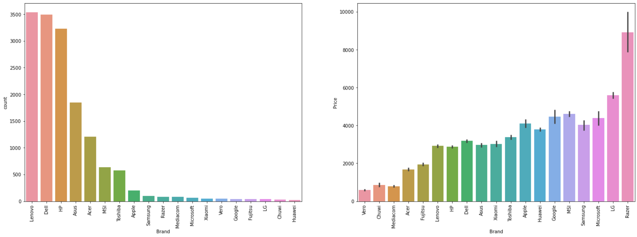
Brand of Laptop
Lenovo, Dell and HP dominate in terms of most common laptop
Razer have very expensive laptops on average
Other windows brands are quite similar in terms of average price, even Apple is comparable

Slide 9
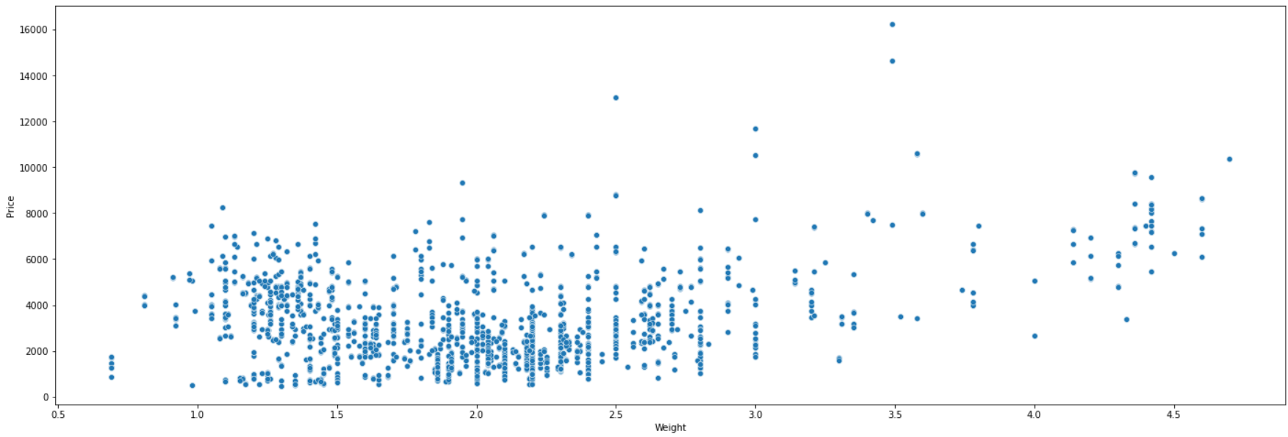
Weight vs Price
Scatterplot a bit messy because most laptops lie in the same weight categories
Not much of a clear relationship, there are some points on the right (heavy weight) that are generally of higher price but there are too few data points to consider it a clear relationship
This makes sense because being a light weight laptop is also something demanded for and can cause a laptop be expensive (eg. Ultrabooks)

Slide 10
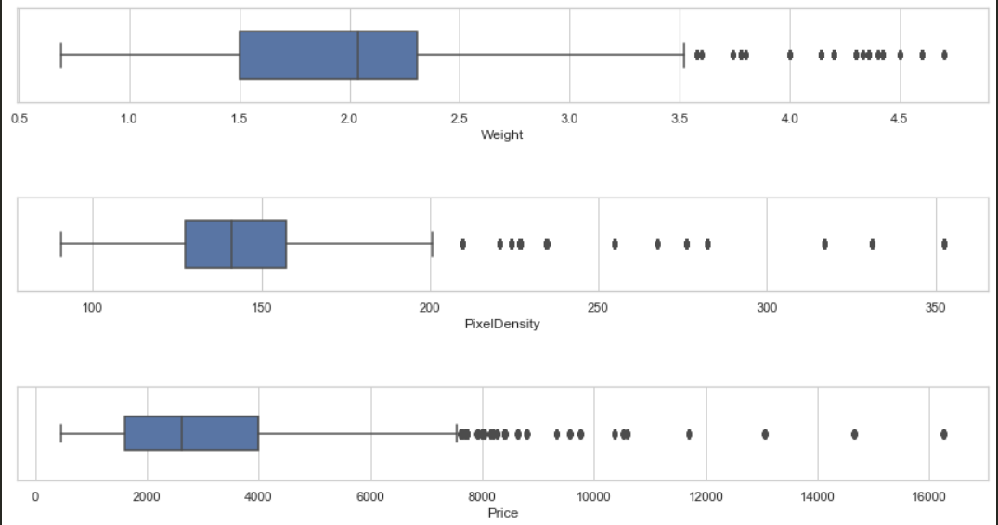
Numerical Columns
Median of Weight is ~2.1kg
Median Pixel Density is ~140PPI
Median price is $2800
Many outliers in all boxplots

Slide 11
Data Processing
Understanding our data and features

Slide 12
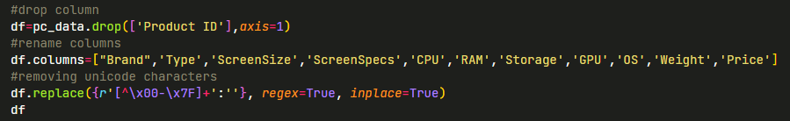
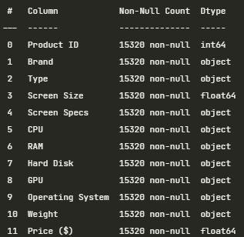

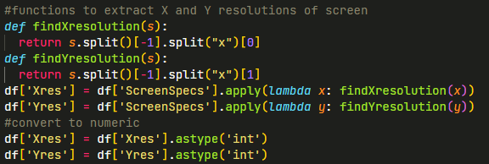
df.info()
Drop ProductID (redundant)
Remove Unicode characters (there are a few in dataset with no meaning)
Since no null values , we can work on each column
For Screen Specs column, we extract TouchScreen and IPS columns (binary)
Extract X and Y screen resolutions then create a column for pixel density

Slide 13


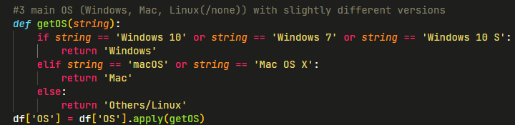

Remove the 'GB' format from RAM column to get integers
Extract GPU Brand (GPU AMD Intel)
There is only 1 laptop with ARM GPU so I will remove it (ARM is for mobile devices)
getOS function to extract OS of laptop
Remove 'kg' format from Weight and turn into floats

Slide 14
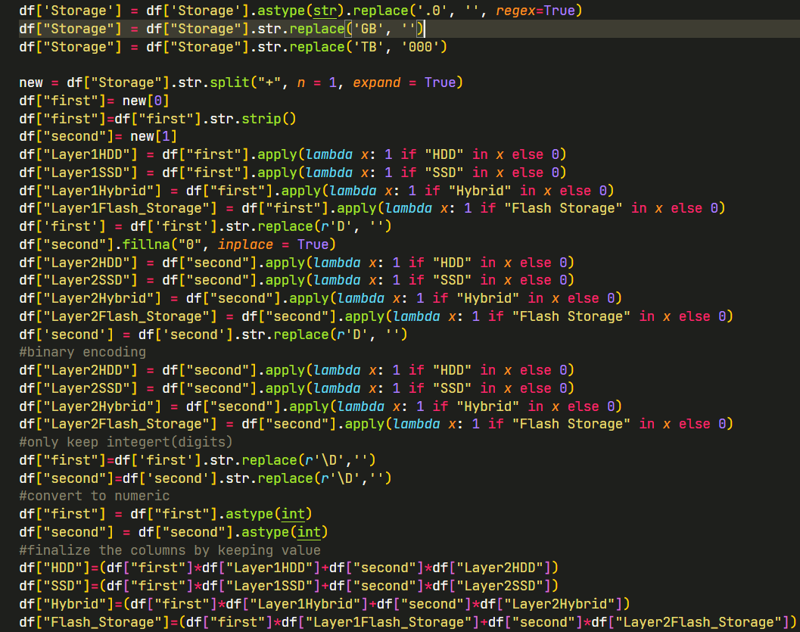
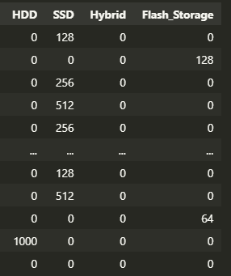
Storage Column
Separate into 4 columns (HDD,SSD,Hybrid and Flash Storage)
Essentially, we extract the numerical values and then categorise by whether its HDD, SSD , Hybrid or Flash type
Then we encode them with lambda functions
Finally we convert the columns into integer types and delete old columns
Final output: ---->

Slide 15
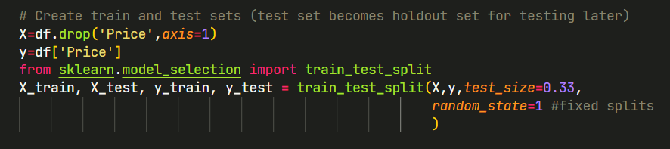
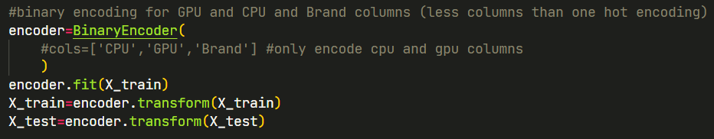
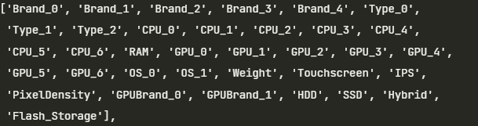
Encoding Categorical Columns
Split into train and test data before encoding
Avoids data leakage
Use random state so that the splits are consistent for testing
Using Binary Encoding
Like One Hot Encoding but creates much less columns, very important since we have columns like CPU and GPU with 100+ different values
Stores categories as binary bitstrings.
Tradeoff between some loss of information VS having too many columns which can lead to overfitting/extremely slow processing time
In the end we have 35 columns, up from 16
If we used One Hot: we would have had over 200 columns!

Slide 16
Testing Models
Try many models with their default parameters and find the best ones

Slide 17
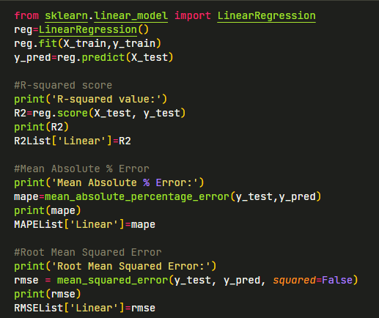
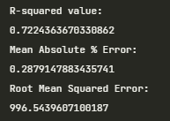
Example (Linear Regression)
Fit training data, test on test data. For every model we record R2 score, Mean Absolute Percentage Error (MAPE) and Root Mean Squared Error (RMSE) so we can compare the 13 different models

Slide 18
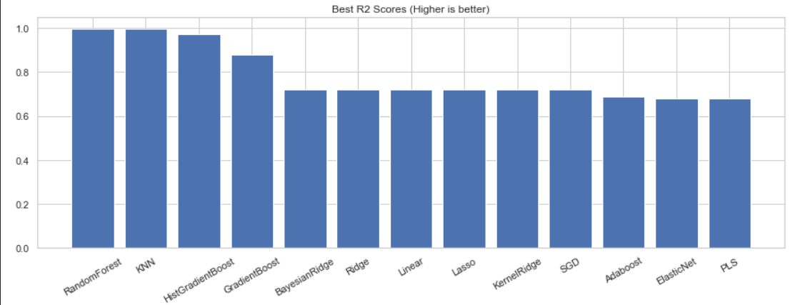
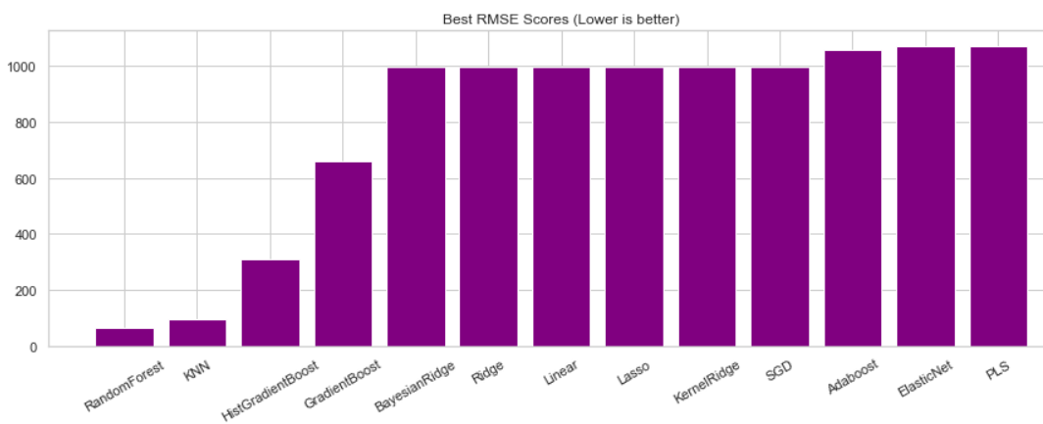
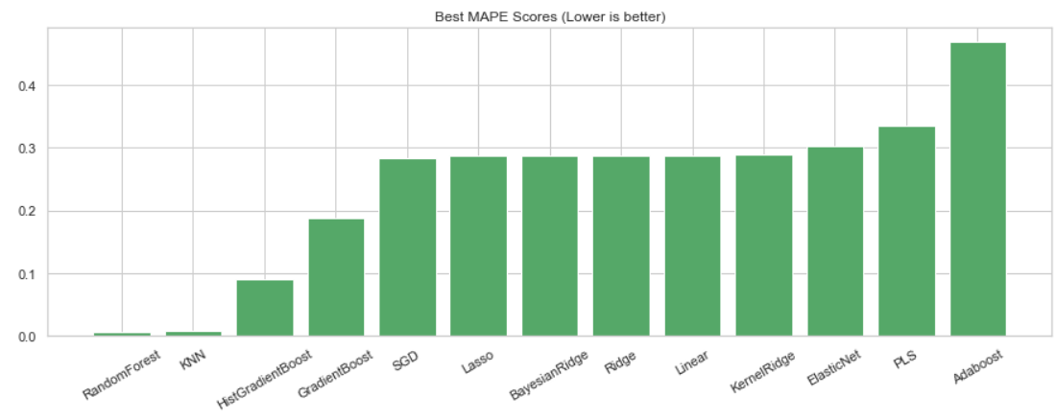
Comparing all models
The models with the best Recall Scores out of 16 were:
1. RandomForest
2. K Nearest Neighbors
3. Histogram-based Gradient Boosting
I will choose to perform Hyperparameter Tuning on these 3 models

Slide 19
Hyperparameter Tuning
Try models with different sets of settings to find the most optimal settings

Slide 20
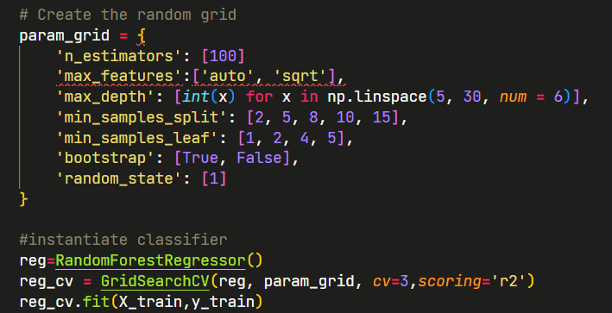
GridSearchCV (Random Forest Example)
Create parameter grid
Fit data to GridSearch with scoring set to 'R2'
This means the model will search for parameters with best R2 score
Run GridSearch for each of the 3 models.
Get best parameters
Let's save these tuned parameters and test them properly now

Slide 21
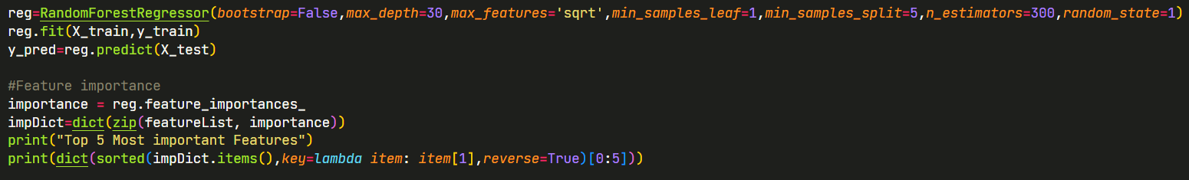
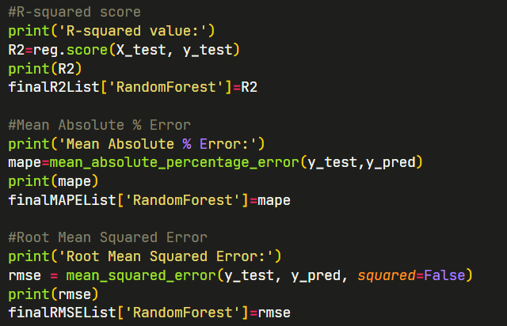
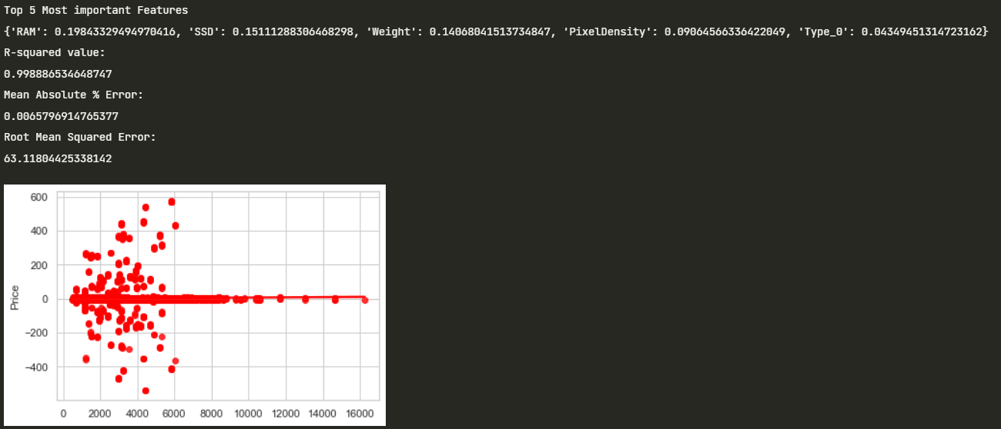
Final Test with Tuned Parameters
Test new tuned parameters on test data, then get feature importance (only random forest was applicable for this)
Measure scores like R2,MAPE and RMSE
Plot a Residual Plot

Slide 22
Final Results
Compare scores and decide which model to use

Slide 23
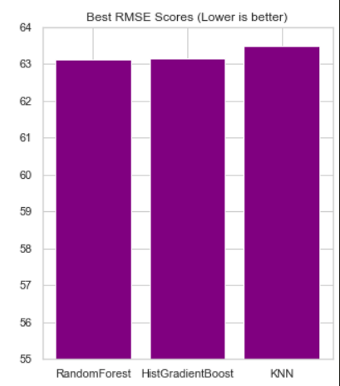
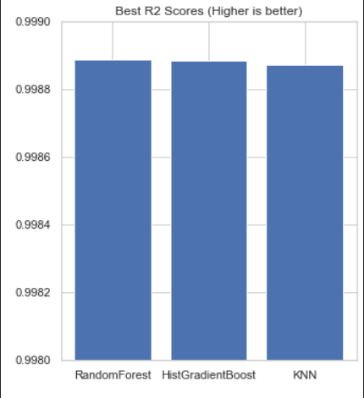
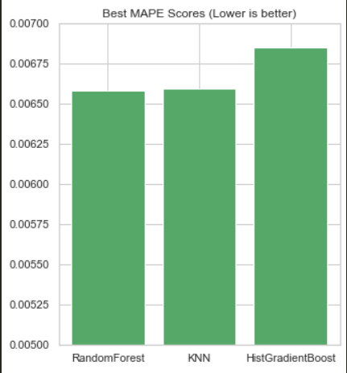
Final Scores
After testing all 3 models:
Random Forest scored the best in all 3 metrics (RMSE,R2 and MAPE)
However, the difference in scores are extremely small so any of the 3 models could work well
Still, we will choose RandomForest with tuned parameters as our final model

Slide 24
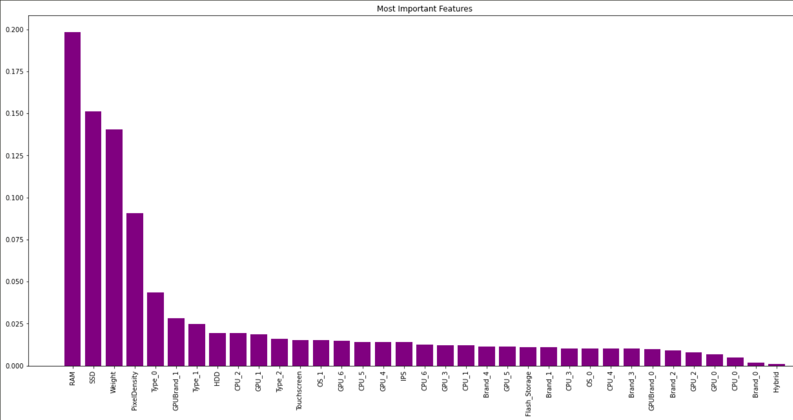
Feature Importance
When looking at Feature Importance of this Random Forest model, RAM was most important feature along with SSD, Weight and Pixel Density. The rest were more negligible

Slide 25
Thanks for listening :)

