Slide 1
BUDGET
BUDDY
Save Money , Build Rizz….

Slide 2
OUR TEAM MEMBERS:
Kamat Uttara Milan (22BCS126)
Kadam Sayali Ananda (22BCS122)
Geetika Khandelwal (22BCS090)
Anumolu Sri Sal Geethika (22BCS039)
Joyee Biswas (22BCS116)

Slide 3



Ṅ
FEATURES
L
Ṅ
Track expenditure and income
Get a complete record of savings and payment history.
Categorize expenses, savings and add notes at your ease.

Slide 4
ADVANTAGES OF OUR WEBSITE
01
Efficient Financial Management
02
Use for Financial Success
03
Secure and Modern Financial Solution

Slide 5
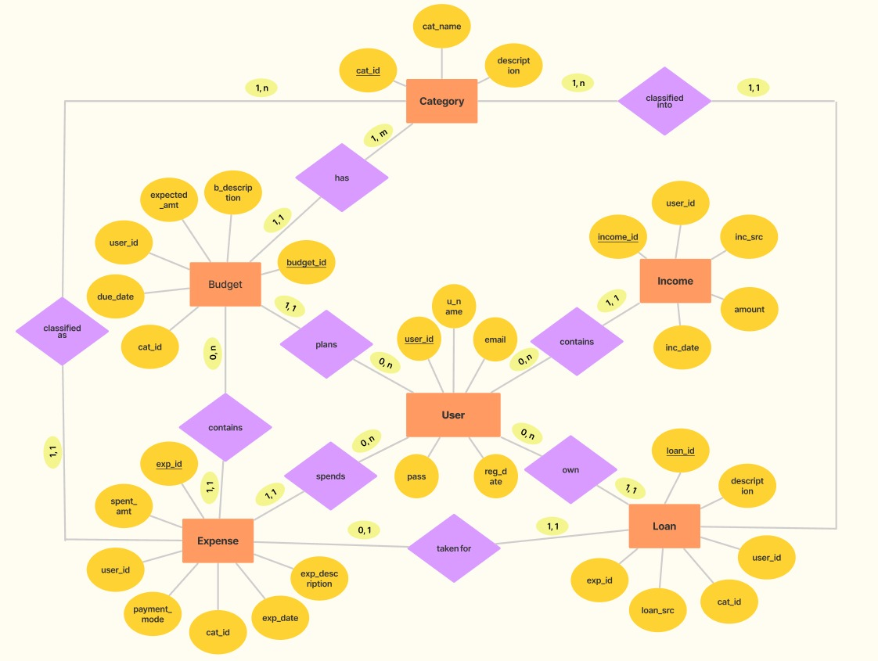
ER MODEL
LINK: ER Model

Slide 6






TECH STACK
REACT
NODE JS
FIGMA
MYSQL

Slide 7

Challenges faced
Designing a user-interactive UI design and implementing it.
Linking all the pages and making frontend more interactive.
Designing a database based on the plans and ideation.
Setting up backend and making it functional.

Slide 8

FUTURE SCOPE
01
Improving UI/UX
02
cCreating a more comprehensive database

Slide 9
THANK YOU

