Slide 1
Pelvis_static_LAC
[306,206]@0.95
[300,200]@1
[60,60]@1.8
[50,50]@0.95
[60,60]@1.8
[44,44]@1
[50,50]@1.5
[5,1]@3.6

Slide 2
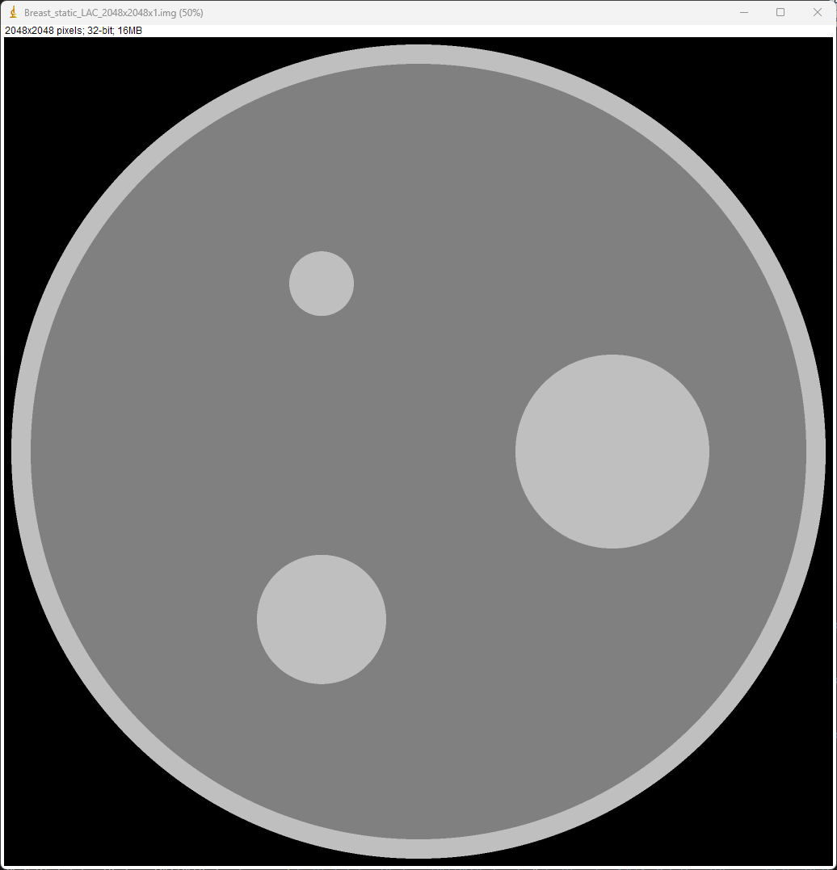
Breast_static_LAC
D126mm – 150 HU (Skin)
1.15
D120mm – 125 HU (Fat)
D20mm – 150 HU
1.125
D30mm – 150 HU (Gland)
1.15
D10mm – 150 HU

Slide 3
Y
6 cm
X

Slide 4
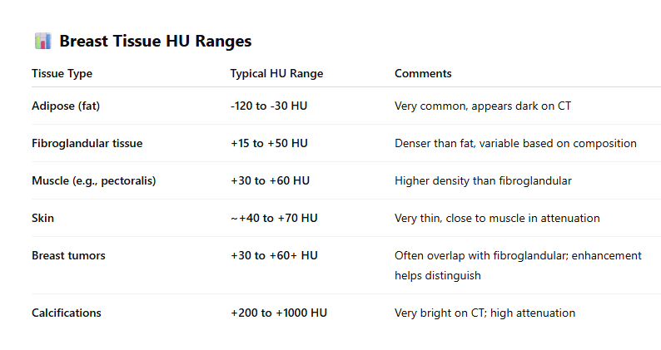
Y
Fibroglandular: 2- 5cm
Microcalcification: 0.1 – 0.5 cm
1 .0 cm
6 cm
Z

Slide 5





1. Breast tissue
2. Fibroglandular: 2- 5cm
4. Breast tumor: 15 HU contrast
3. Microcalcification: 0.1 – 0.5 cm
Y
R60mm
2
$R$10mm
1
$φ$(10,5,5)mm
$φ$4
mm
3
X
$φ30$
mm
$φ10$
mm
4
2
R35mm

Slide 6

Y
10 mm
3
R40mm
2
Z
$${30}^{∘}$$
4
2

