Slide 1

Ant_gen
- Team-12

Slide 2
Motivation (why we did what we did?)
There's a lot of automation that can happen that isn't a replacement of humans, but of mind-numbing behavior.
~ Stewart Butterfield
We tried designing a antenna that radiates at 30Ghz and tried improving parameters with slot based optimizations
We needed a program or a package or some kind of automation script that can design for us and we just wanted to be the decision makers

Slide 3


Workflow
.yaml
Py-patch
.py file
HFSS
The above is a basic workflow of the py-patch cli tool

Slide 4
Usage
> Py-patch is a cli python package that allows you to generate a patch in ansys HFSS EDA platform.
$ ant_gne -help (or) ant_gen --h
> Generates a summary of click commands provided by the package
$ ant_gen generate
> Generates a patch out of the input YAML file
$ ant_gen generate –src[source yaml] –build_dir[build_source]
> Providing an external source to the package

Slide 5
The description tree
> Antenna
- Substrate
>[Material, Dimension, offset]
- Patch
>[Optimizations]
>[Dimension, offset]
- Feed
>[feed width, Patch_name]

Slide 6
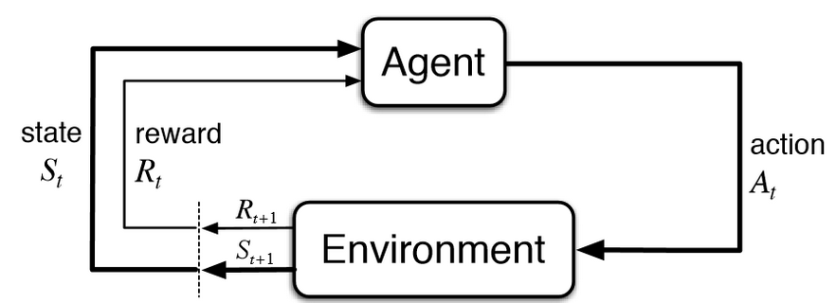
Use case
> Reinforcement Learning
> Enhancing Design using ML and DL algorithms
> Design Brut-forcing
> Automating your workflow
> Version Controlling
> Distributed workflow
Py-Patch
* These are just potential use cases, one can use Py-Patch for any purpose and as Py-Patch is under MIT License one can build upon the package as their own

Slide 7

Documentation
[https://joyenbenitto.com/posts/pypatch]

