Slide 1

Embedded System Design Concepts
A simple approach
Mahesh Awati
Department of Electronics and Communication Engg.

Slide 2
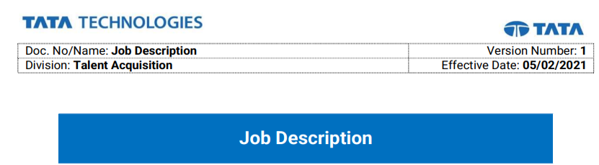





Embedded System Design Concepts - A simple approach
Objective:
To meet the Job description of various companies working in embedded domain
EMBEDDED SYSTEM DESIGN
A simple hands-on approach

Slide 3

Embedded System Design Concepts - A simple approach
How to get a JOB in EMBEDDED DOMAIN?
Electronics ( Electronic Principles, Digital Electronics)
Microprocessor/ Microcontroller
Protocols – UART,SPI,CAN and so on
Programming (Minimum C )
EMBEDDED SYSTEM DESIGN
A simple hands-on approach

Slide 4

Embedded System Design Concepts - A simple approach
Introduction to Embedded System
Mahesh Awati
Department of Electronics and Communication Engineering

Slide 5
Embedded System Design Concepts - A simple approach
What is an embedded system ?
An embedded system is an electronic/electro-mechanical system designed to perform a specific function involving a combination of both hardware and firmware (software).
Electronic/Electro-Mechanic
A Specific Function
Combination of Hardware & Firmware.
Respond, monitor, control external environment using sensors and actuators.
“A Combination of hardware (electro/electro-mechanical ) & Software performing a specific task without human intervention”

Slide 6
Embedded System Design Concepts - A simple approach
Elements of Embedded System
Communication Interface (UART,USB,DB9,Ethernet)
Memory
Embedded Firmware Embedded to perform a Particular Task
Digital Sensors
I/P PORT
System Core (ASIC/SoC/FPGA /DSP/MP/MCU)
O/P PORT
LED,BUZZER,RELAY,Display Devices like LCD
ADC
DAC
Analog Sensors
Other Supporting Integrated Circuits & Subsystems
(Human Interface, Diagnostic tools, Heat Management)
Diagnostic Unit
Fault Detection and correction
Self Test Tools

Slide 7
Embedded System Design Concepts - A simple approach
System Core of Embedded System
Embedded systems are domain and application specific and are built around a central core.
The core of the embedded system falls into any of the following categories:
General purpose and Domain specific processor.
General Purpose Processors: Microprocessors (GPP)
Domain Specific - Application Specific Instruction Processors(ASIP) : They have processor with architecture and instruction set optimized to specific-domain/application requirements
Microcontrollers(industrial)
Digital signal processors(DSP) ,Networking Processors.
Automotive and telecom
Application Specific Integrated Circuits (ASIC)
Programmable logic devices (PLD’s):CPLDs & FPGA
SoC (Multiprocessor cores (ARM +DSP + Peripherals))

Slide 8
Embedded System Design Concepts - A simple approach
General purpose System Core – Basic blocks
A Processing Unit - Microprocessor
Arithmetic and Logical (ALU) Unit
Register File
Register Files are set of registers which are used to store
Data
Address of Memory/IO Devices
Intermediate Results and so on
ALU – Arithmetic and Logical Unit
Arithmetic Operation like
Addition
Subtraction
Multiplication
Division
Logical Operation like
AND,OR,XOR ……so on
Control Unit – It is used generate the required control signals based on instructions decoded.
Control Unit

Slide 9
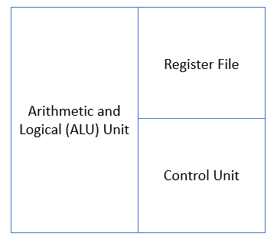
Embedded System Design Concepts - A simple approach
A Microprocessor based system
Memory
(ROM and RAM)
ROM
RAM
A General purpose Processor can be called as system iff we interface
Memory – ROM and RAM
Input Device through Input Port and
Output device through output port.
Other interfaces depending on system requirements like – Timer/Counter, PWM, ADC,DAC and Serial communication protocols and so on.
INPUT DEVICE
IO PORT
IO PORT
OUTPUT DEVICE

Slide 10
Embedded System Design Concepts - A simple approach
Domain Specific - Application Specific System Core – Basic blocks
A Microcontroller
CPU/ALU
ROM
RAM
I/O PORTs
DAC
ADC
PWM
Timer/ Counter
Clock Generator
Communication Protocols (UART,SPI and so on)

Slide 11
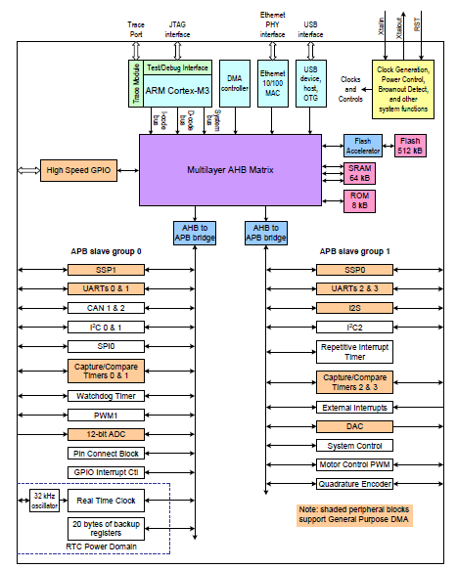
Embedded System Design Concepts - A simple approach
ARM Cortex M3 as System Core

Slide 12
Embedded System Design Concepts - A simple approach
ARM Cortex M3 as System Core
What is ARM Cortex M3?
Advanced RISC Machine.
Harvard Architecture.
M –Microcontroller Series/ version.
LPC – Low Power Controller.

Slide 13
Embedded System Design Concepts - A simple approach
Features of LPC1768
General purpose 32-bit microprocessor.
Operating frequencies of up to 100 to 120MHz CPU frequency.
Built-in Nested Vectored Interrupt Controller (NVIC).
Up to 512 kB on-chip flash program memory, up to 64 kB of data memory.
Eight channel General Purpose DMA controller (GPDMA).
Peripherals:
8 Channel 12 bit ADC
10 bit DAC.
Timer/ Counter -04.
PWM - 06.
GPIO -70 programmable pins
RTC.
Serial Protocols: UART – 04, Serial Peripheral Interface (SPI) – 02, Inter Integrated Circuit ( I2C ) – 03, Ethernet -01, Controller Area Network (CAN) – 02, USB - 01.

Slide 14
Embedded System Design Concepts - A simple approach
Header File
LPC17xx.h
The Name of Registers, Data structures that we use are defined in LPC17xx.h header file.
LPC17xx.h header is based on CMSIS(Cortex Microcontroller System Interface Standard) developed by ARM
As per the CMSIS convention, the different registers are grouped into different structures
LPC_GPIOx is defined as a pointer to this structure in LPC17xx.h header.
Example: all registers for Port 0 are grouped into structure defined as LPC_GPIO0.

Slide 15
Embedded System Design Concepts - A simple approach
Low Power, Pin function, mode, clock generation
Mahesh Awati
Department of Electronics and Communication Engineering

Slide 16
Embedded System Design Concepts - A simple approach
System Control Register – Power, Pin function, mode, clock
The Power , Pin function , Pin mode , peripheral clock are need to be done for any on-chip peripheral to be used
Power Control for Peripheral : PCONP
Pin Function Selection : PINSEL
Peripheral Clock Select : PCLKSEL
Pin Mode Selection : PINMODE
All these are member of LPC_SC (system control) structure

Slide 17
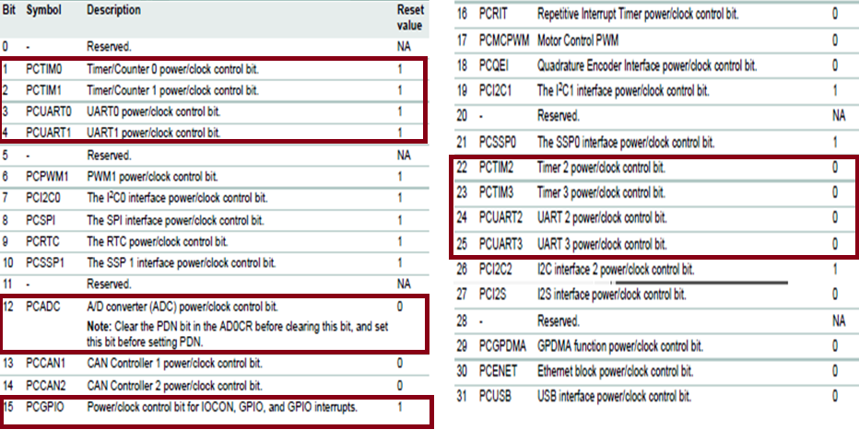
Power Control for peripherals (PCONP)
Embedded System Design Concepts - A simple approach
System Control Register – Power, Pin function, mode, clock
The PCONP register allows turning off selected peripheral functions for the purpose of saving power.
This is accomplished by gating off the clock source to the specified peripheral blocks.
Some peripherals, particularly those that include analog functions, may consume power that is not clock dependent. These peripherals may contain a separate disable control that turns off additional circuitry to reduce power.
On Reset PCONP= 0x042887DE = 0000 0010 1000 1000 0111 1101 1110 b

Slide 18

PINSEL Register – To choose Multifunctions of a PIN
Embedded System Design Concepts - A simple approach
System Control Register – Power, Pin function, mode, clock
Why PINs are configured to perform Multifunction ?
PINSEL Register bits for pin | Functions
00 | Primary (default) function, typically GPIO port
01 | First alternate function
10 | Second alternate function
11 | Third alternate function
Primary
1st Alternate
4:1 MUX
2nd Alternate
3rd Alternate
P0.0
Select 1 Select 0

Slide 19
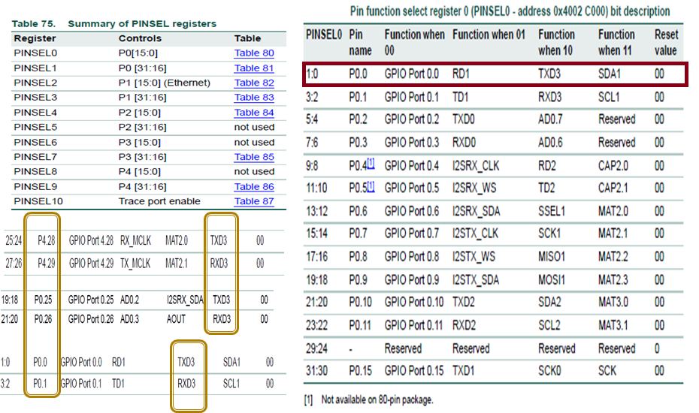
PINSEL Register – To choose Multifunctions of a PIN
Embedded System Design Concepts - A simple approach
System Control Register – Power, Pin function, mode, clock
Each PIN does 4 functions with 3 alternate and 1 primary function as GPIO.
Few alternate functions can be done by multiple pins.

Slide 20
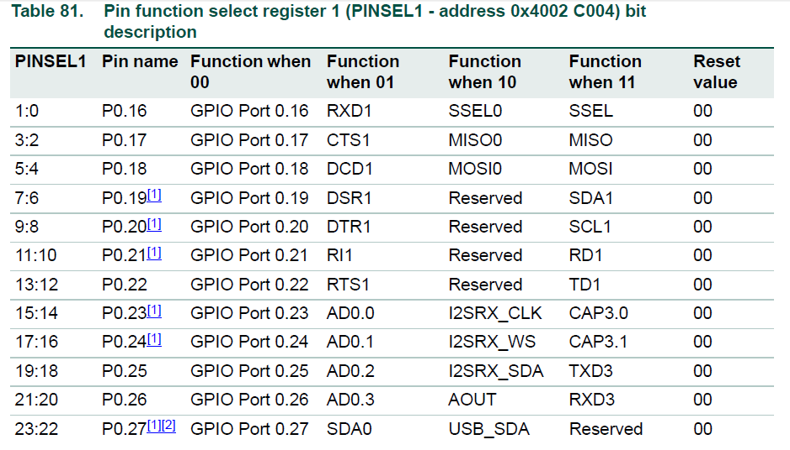
PINSEL Register – To choose Multifunctions of a PIN
Embedded System Design Concepts - A simple approach
System Control Register – Power, Pin function, mode, clock

Slide 21
PINSEL Register – To choose Multifunctions of a PIN
Embedded System Design Concepts - A simple approach
System Control Register – Power, Pin function, mode, clock
PORT P0 [31:16] | PORT P0 [15:0]
PINSEL1[31:0] | PINSEL0[31:0]
PORT P1 [31:16] | PORT P1 [15:0]
PINSEL3[31:0] | PINSEL2[31:0]
PORT P2 [31:16] | PORT P2 [15:0]
PINSEL5[31:0] | PINSEL4[31:0]
31 | 30 | 29 | 28 | 27 | 26 | 25 | 24 | 23 | 22 | 21 | 20 | 19 | 18 | 17 | 16 | 15 | 14 | 13 | 12 | 11 | 10 | 09 | 08 | 07 | 06 | 05 | 04 | 03 | 02 | 01 | 0
P0.15 |  | P0.14 |  | P0.13 |  | P0.12 |  | P0.11 |  | P0.10 |  | P0.9 |  | P0.8 |  | P0.7 |  | P0.6 |  | P0.5 |  | P0.4 |  | P0.3 |  | P0.2 |  | P0.1 |  | P0.0

Slide 22
PINSEL Register – To choose Multifunctions of a PIN
Embedded System Design Concepts - A simple approach
System Control Register – Power, Pin function, mode, clock
Initialize P2.11 –P2.13 as GPIO.
Initialize P0.2 & P0.3 as TXD0 & RXD0
Initialize P4.28 & p4.29 as TXD3 & RXD3
Initialize P1.31 as AD0.5
Initialize P0.21 to P0.22 as GPIOs , P0.23 as AD0.0

Slide 23
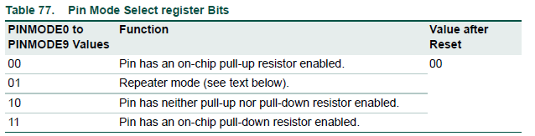
PINMODE- Pin mode select register values
Embedded System Design Concepts - A simple approach
System Control Register – Power, Pin function, mode, clock
PINMODE Register – To choose Multifunction of a PIN
The PINMODE registers control the input mode of all ports. This includes the use of the on-chip pull-up/pull-down resistor feature and a special open drain operating mode.
Repeater mode enables the pull-up resistor if the pin is at a logic high and enables the pull-down resistor if the pin is at a logic low. This causes the pin to retain its last known state.
state if it is configured as an input and is not driven externally.

Slide 24
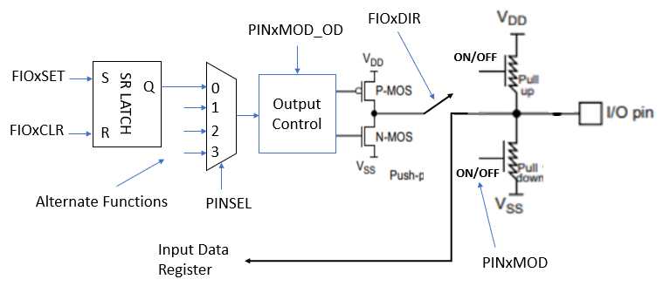
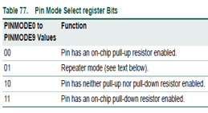

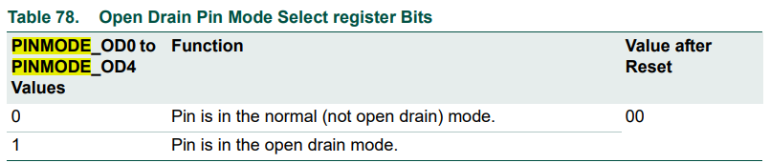
Embedded System Design Concepts - A simple approach
System Control Register – Power, Pin function, mode, clock
Let us understands how to use GPIOs are configured to operate in different modes
Push-Pull configuration
Open drain configuration

Slide 25
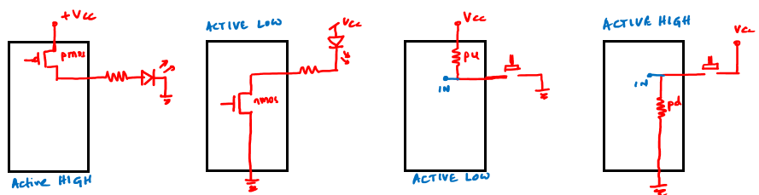
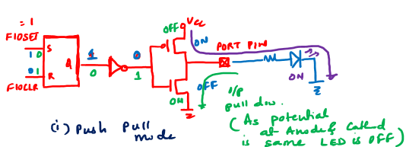
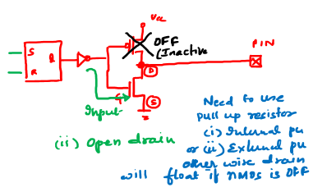
Embedded System Design Concepts - A simple approach
System Control Register – Power, Pin function, mode, clock
How Input and Output devices are connected ?

Slide 26

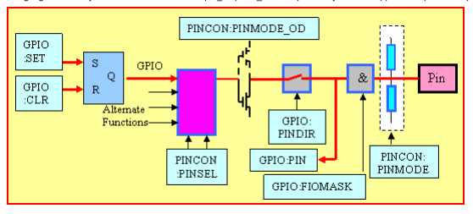
Embedded System Design Concepts - A simple approach
Learning – General Purpose Input and Outputs
Let us understands how to use GPIOs
GPIOs used as Output
PINs as Open Drain
PINs Pull Up or Pull down Internal Resistor
4:1
MUX

Slide 27
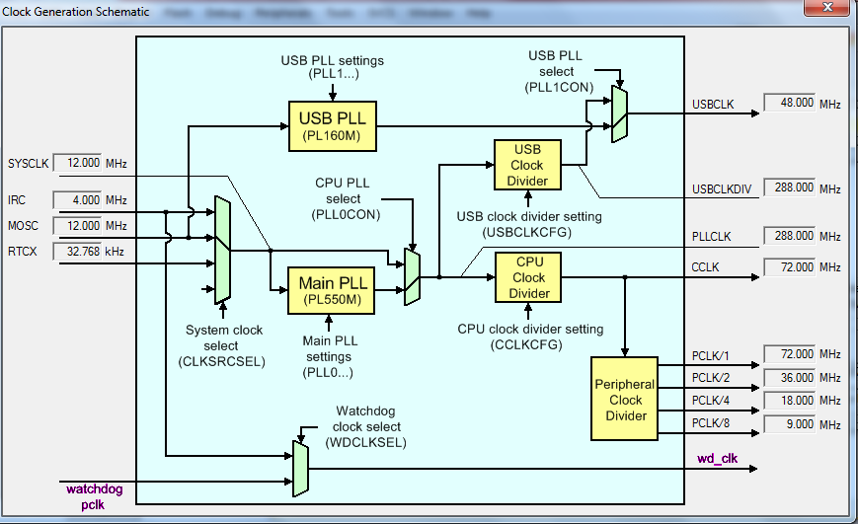
Embedded System Design Concepts - A simple approach
System Control Register – Power, Pin function, mode, clock
PCLKSEL Register – To choose Multifunction of a PIN

Slide 28
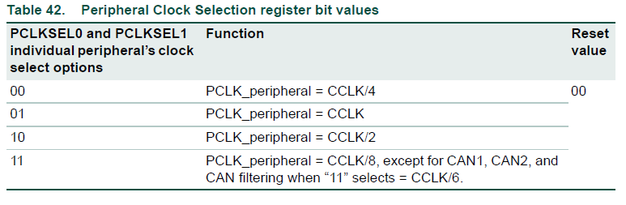
Embedded System Design Concepts - A simple approach
System Control Register – Power, Pin function, mode, clock
PCLKSEL Register – To choose Multifunction of a PIN
CPU_CLOCK (CCLK) = 72MHz
Peripheral CLK Divider
18M
04
PCLKSEL0

Slide 29
THANK YOU
Mahesh Awati
Department of Electronics and Communication
mahesha@pes.edu
+91 9741172822

