Slide 1

Embedded System Design Concepts
A simple approach
Mahesh Awati
Department of Electronics and Communication Engg.

Slide 2

Embedded System Design Concepts - A simple approach
General Purpose Input and Output ( GPIOs)
Mahesh Awati
Department of Electronics and Communication Engineering

Slide 3
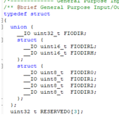
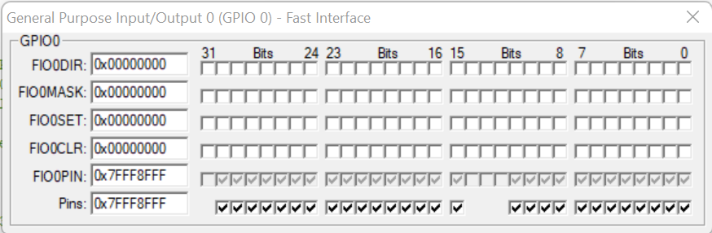
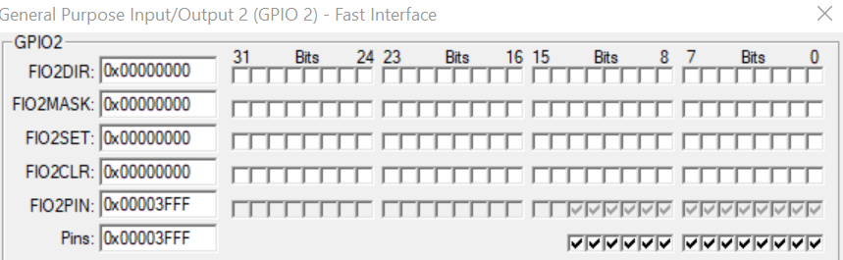
Embedded System Design Concepts - A simple approach
Programmable GPIOs
LPC1768 is an ARM Cortex-M3 based MCU by Phillips/NXP and has around 70 General Purpose Input Output pins.
GPIOS on LPC1768 are grouped into 5 Ports as Port 0 to 4.
The associated registers for each port are grouped into a structure with the following naming convention :LPC_GPIOx, where x is the port number.
Ports are 32-bit wide i.e. a maximum 32pin scan be mapped, but each port may have a few or many pins which cannot be used i.e. they are ‘reserved’
PORT | Pins Details ( Used/ Reserved)
PORT0 | Pins 12, 13, 14 & 31 are not available
PORT1 | Pins 2, 3, 7, 6, 5, 11, 12, & 13 are not available
PORT2 | only pins 0 to 13 are available and rest are reserved
PORT3 | only pins 25, 26 are available and rest are reserved
PORT4 | only 28, 29 are available and rest are reserved

Slide 4

Embedded System Design Concepts - A simple approach
Programmable Registers for GPIOs
Initialization of PCONP,PINSEL,PINMODE need to be done based on requirement.
Once PINSEL indicates function of GPIO, The following registers of GPIO need to be initialized
FIOMASK : Fast Mask Register for PORTs: Enable the required pins and disable other pins. ( 0-enable & 1-disabled)
FIODIR : Fast IO Direction Register : Set the direction of GPIO as Input or Output pin.(0-input & 1-output )
FIOSET & FIOCLR : Make OUTPUT pin as High / Low : Make the PIN High using FIOSET. (1- pin defined as output become HIGH , 0- No effect i.e remains in previous state). Make the PIN Low using FIOCLR. (1- pin defined as output become LOW , 0- No effect i.e remains in previous state)
FIOPIN – It directly effect the PIN status by bypassing SET and CLR registers. It can also be used for reading PIN status.

Slide 5
Byte, Half Word and Word Accessible Mask Register
Embedded System Design Concepts - A simple approach
Byte Accessible Mask Registers
PORT0 | 31 24 | 23 16 | 15 8 | 0
 | FIOxMASK3 | FIOxMASK2 | FIOxMASK1 | FIOxMASK0
Half Word Accessible Mask Registers
PORT0 | 31 16 | 15 0
 | FIOxMASKH | FIOxMASKL
Word Accessible Mask Registers
PORT0 | 31 0
 | FIOxMASK

Slide 6
Byte, Half Word and Word Accessible Mask Register
Embedded System Design Concepts - A simple approach
Byte Accessible Direction Registers
PORT0 | 31 24 | 23 16 | 15 8 | 0
 | FIOxDIR3 | FIOxDIR2 | FIOxDIR1 | FIOxDIR0
Half Word Accessible Direction Registers
PORT0 | 31 16 | 15 0
 | FIOxDIRH | FIOxDIRL
Word Accessible Direction Registers
PORT0 | 31 0
 | FIOxDIR
X→ 0,1,2,3,4 indicating PORT no.

Slide 7
Embedded System Design Concepts - A simple approach
Byte, Half Word and Word Accessible Mask Register
Similarly we have byte, Half Word, Word accessible
Byte:
Half Word:
Full Word:
31 24 | 23 16 | 15 8 | 7 0
FIOxSET3 | FIOxSET2 | FIOxSET1 | FIOxSET0
FIOxCLR3 | FIOxCLR2 | FIOxCLR1 | FIOxCLR0
FIOxPIN3 | FIOxPIN2 | FIOxPIN1 | FIOxPIN0
31 16 | 15 0
FIOxSETU | FIOxSETL
FIOxCLRU | FIOxCLRL
FIOxPINU | FIOxPINL
31 0
FIOxSET
FIOxCLR
FIOxPIN

Slide 8
GPIO Initialization Function: Registers of Full word & Byte Size
Embedded System Design Concepts - A simple approach
PORT ACCESSING - FULLWORD
LPC_GPIO2->FIOMASK|=0XFFFFC7FF;
LPC_GPIO2->FIODIR|=0X00003800;
PORT ACCESSING – BYTE SIZE
LPC_GPIO2->FIOMASK1|=0XC7;
LPC_GPIO2->FIODIR1|=0X38;

Slide 9
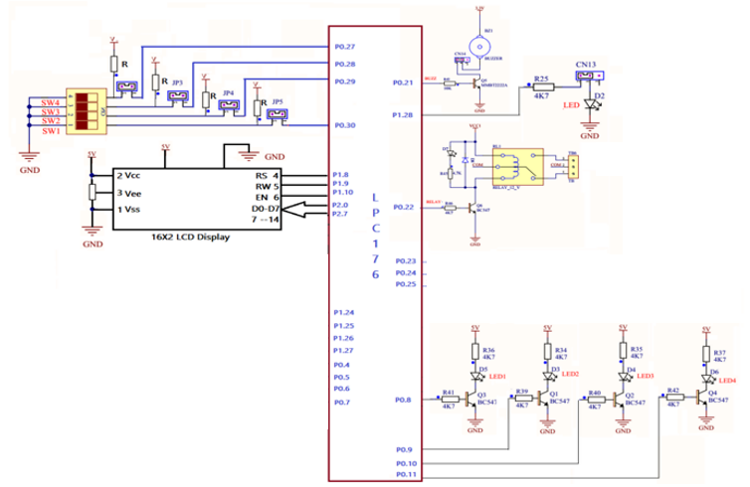
Embedded System Design Concepts - A simple approach
Basic details of ARM Cortex M3 board

Slide 10
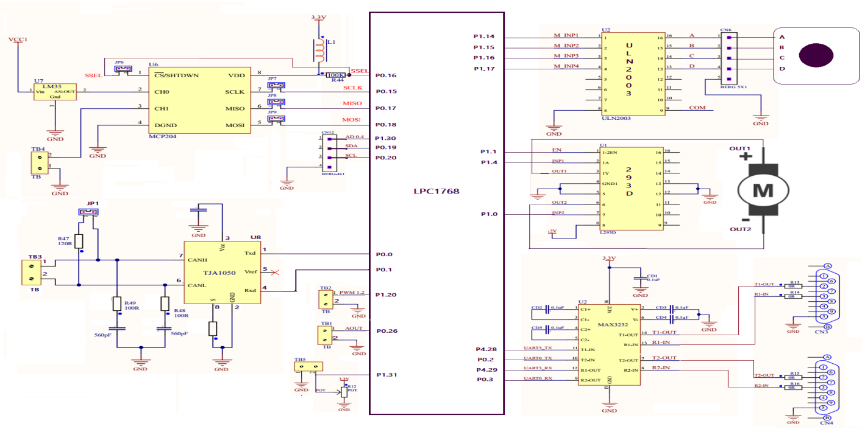
Embedded System Design Concepts - A simple approach
Basic details of ARM Cortex M3 board

Slide 11
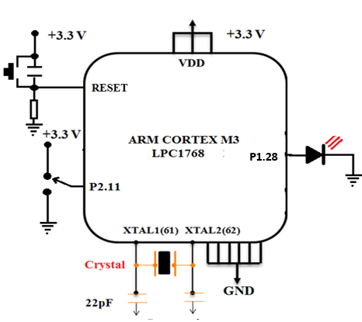
Embedded System Design Concepts - A simple approach
Programming 1
Write a program to blink LED connected at P1.28 continuously with a delay

Slide 12
Embedded System Design Concepts - A simple approach
Programming 1
#include <LPC17xx.H>
void delay(unsigned long int x);
int main()
{ SystemInit ();
LPC_GPIO1->FIOMASK3=0XEF; // 1110 1111
LPC_GPIO1->FIODIR3=0X10; // 0001 0000
while(1)
{
LPC_GPIO1->FIOSET3=0X10;
delay(0x500000);
LPC_GPIO1->FIOCLR3=0X10;
delay(0x500000);
}
}
void delay(unsigned long int x)
{
unsigned long int i=0;
for(i=0;i<x;i++);
}

Slide 13
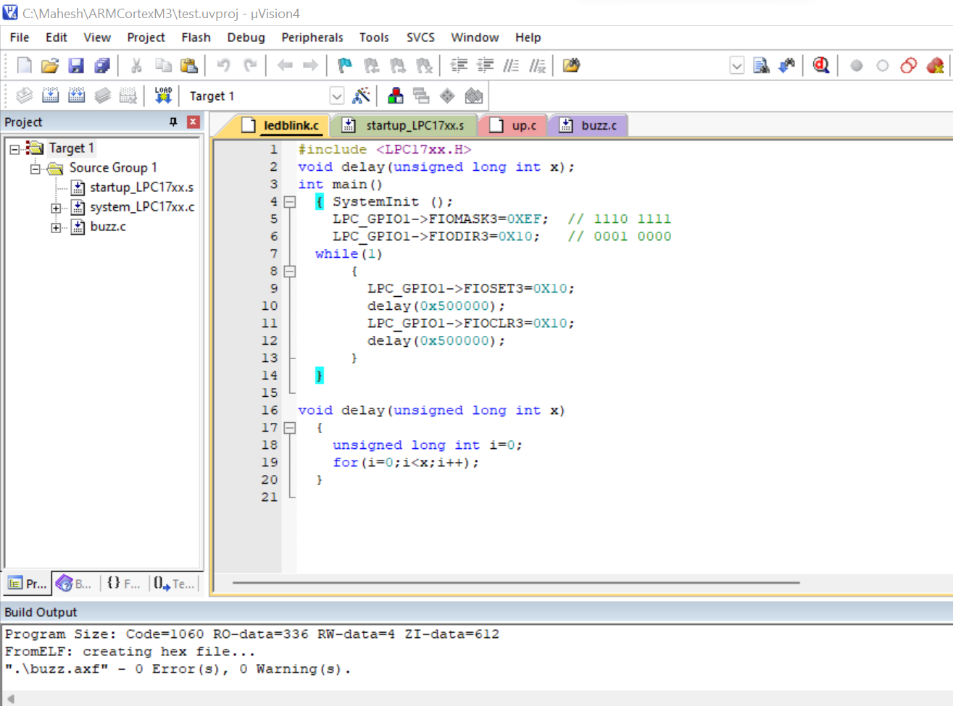
Embedded System Design Concepts - A simple approach
Programming 1

Slide 14
FIOxPIN Register:
Embedded System Design Concepts - A simple approach
This register will give the logic levels of the pin regardless of whether the pin is configured for input or output, or as GPIO or an alternate digital function.
This register provides the value of port pins that are configured to perform only digital functions.
Writing to the FIOxPIN register stores the value in the port output register, bypassing the need to use both the FIOxSET and FIOxCLR registers to obtain the entire written value

Slide 15
Register Configuration
Embedded System Design Concepts - A simple approach
31 0
All the LPC1768 SFRs(Special Function Registers) are defined in lpc17xx.h, this has to be included at the beginning of our project/code.
LPC1768 has its GPIOs divided into five ports PORT0 - PORT4, although many of them are not physically 32bit wide.
A structure LPC_GPIOn(n= 0,1,2,3) contains all the registers required for GPIO operation. Refer lpc17xx.h file for more info on the registers.
LPC_GPIO0→
FIO0MASK (3,2,1,0)
FIO0SET (3,2,1,0)
FIO0CLR (3,2,1,0)
FIO0PIN (3,2,1,0)
LPC_GPIO1→
FIO1MASK (3,2,1,0)
FIO1SET (3,2,1,0)
FIO1CLR (3,2,1,0)
FIO1PIN (3,2,1,0)
LPC_GPIO2→
FIO2MASK (3,2,1,0)
FIO2SET (3,2,1,0)
FIO2CLR (3,2,1,0)
FIO2PIN (3,2,1,0)
LPC_GPIO0→ FIOMASK=0XFFFFC7FF

Slide 16
Tasks to be done….
Embedded System Design Concepts - A simple approach
Initialize a GPIO P2.11 as output pin and blink the LED.
Initialize P2.11 to P2.13 as output pins and
Blink the LEDs one by one with a delay.
Turn ON LEDs one by one in order and then turn them OFF in order.
Assume P2.11 ,P2.12 and P2.13 connected to RS,R/W and EN of LCD. The condition for command write are RS=0,R/W=0,EN=1 after a delay EN=0.
Initialize P0.21 to P0.28 as output pins and send the array elements one by one.
Interfacing 2x16 LCD display with Cortex M3

Slide 17
THANK YOU
Mahesh Awati
Department of Electronics and Communication
mahesha@pes.edu
+91 9741172822

