Slide 1

Embedded System Design Concepts
A simple approach
Mahesh Awati
Department of Electronics and Communication Engg.

Slide 2
Embedded System Design Concepts - A simple approach
LCD
THEORY: An LCD (Liquid Crystal Display) screen is an electronic display module and has a wide range of applications. A 16x2, 5x7 LCD display is very basic module and is very commonly used in various devices and circuits.
A 16x2 LCD means it can display 16 characters per line and there are 2 such lines.
In this LCD each character is displayed in 5x7 pixel matrix.
The 16 x 2 intelligent alphanumeric dot matrix display is capable of displaying 224 different characters and symbols. This LCD has two registers, namely, Command and Data.
Command Register stores various commands given to the display.
Data register stores data to be displayed. The process of controlling the display involves putting the data that form the image of what you want to display into the data registers, then putting instructions in the instruction register.

Slide 3
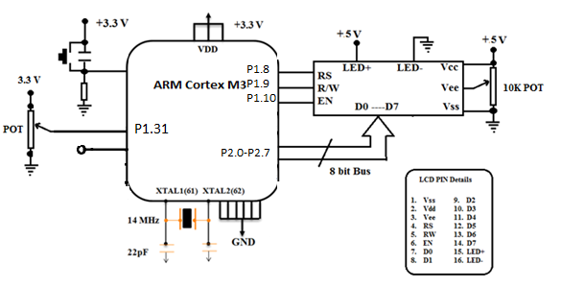
Embedded System Design Concepts - A simple approach
LCD
Interfacing Diagram
Command | Description
0x38 | It initialises the 2x16 display as 2X16 Display with both the lines active for display
0x30 | It initialises the 2x16 display as 1X16 Display with only line 1 active for display
0x0E | Display ON & Curser ON
0X06 | Increment Curser ( Shift Curser Right)
0X01 | Clear Display & Initialise curser to address 0 (Line 1 position 1)
0X80 | Set DDRAM address or courser position to Line1 position1on display
0XC0 | Set DDRAM address or courser position to Line2 position1on display

Slide 4
Embedded System Design Concepts - A simple approach
LCD
LCD PIN functions
Pin No | Function | Description
1 | Vss | LCD Ground
2 | Vdd | LCD Supply +5 V
3 | Vee | Contrast Control for Pixels
4 | RS | Register Select
 | RS=0 | Register Selected is Command Register. The write operation stores the 8 bit value into command register for initialisation. Note: RS should be LOW when writing commands of LCD.
 | RS=1 | Register Selected is Data Register. The write operation stores the 8 bit value into Data register for initialisation. Note: RS should be HIGH when writing data (ASCII value of alphanumeric character to be displayed) to be displayed on LCD.
5 | R/Wbar | Read/ Write signal
 | R/Wbar =0 | Write Operation – Writing command or data.
 | R/Wbar=1 | Read Operation – Reading Busy status from LCD using D7 pin
6 | EN | Enable pin should have High to Low transition to order to latch the command/data available at D0-D7
7-14 | D0-D7 | 8 bit Data Lines through which command of data can be sent.
15 | LED+ | +5V to Anode of back LCD
16 | LED- | Ground to back LED

Slide 5
Embedded System Design Concepts - A simple approach
LCD
#include <LPC17xx.H>
#define RS 0x01 //(01000000000000000000000000000000)
#define RW 0x02 //(00100000000000000000000000000000)
#define EN 0x04 //(00010000000000000000000000000000)
void delay(unsigned long int x);
Void lcdwrt(unsigned char y);
void lcdgpioinit();
int main(void)
{ unsigned char cmd[]={0X38,0X0E,0X06,0X01,0X80};
unsigned char msg[]=“PES UNIVERSITY“,i;
SystemInit ();
LPC_GPIO1->FIOCLR1=RW;
LPC_GPIO1->FIOCLR1=RS;
for(i=0;i<5;i++)
{ lcdwrt(cmd[i]);
}
LPC_GPIO1->FIOSET1=RS; // RS=1 – Data Register
for(i=0;msg[i]!='\0';i++)
{
lcdwrt(msg[i]);
}
}
Embedded C Program to Display a STRING in LCD using LPC1768
voidlcdwrt(unsigned char y)
{ LPC_GPIO2->FIOPIN0=y;
LPC_GPIO1->FIOSET1=EN;
delay(10);
LPC_GPIO1->FIOCLR1=EN;
delay(1000);
}
void lcdgpioinit()
{ LPC_GPIO2->FIOMASK0|=0X00;
LPC_GPIO2->FIODIR0|=0XFF;
LPC_GPIO1->FIOMASK1|=0X00;
LPC_GPIO1->FIODIR1|=0XFF;
}
void delay (unsigned long int x)
{ unsigned long int j;
for(j=0;j<x;j++);
}

Slide 6
THANK YOU
Mahesh Awati
Department of Electronics and Communication
mahesha@pes.edu
+91 9741172822

