Slide 1

Embedded System Design Concepts
A simple approach
Mahesh Awati
Department of Electronics and Communication Engg.

Slide 2

Embedded System Design Concepts - A simple approach
Analog to Digital Converter
Mahesh Awati
Department of Electronics and Communication Engineering

Slide 3
Embedded System Design Concepts - A simple approach
Analog to Digital Converter (ADC)
THEORY: The ADC is configured using the following registers:
1. Power: In the PCONP register (Table 46), set the PCADC bit.
Remark: On reset, the ADC is disabled. To enable the ADC, first set the PCAD bit, and then enable the ADC in the AD0CR register (bit PDN). To disable the ADC, first clear the PDN bit, and then clear the PCADC bit.
2. Clock: In the PCLKSEL0 register (Table 40), select PCLK_ADC. To scale the clock for the ADC.
3. Pins: Enable ADC0 pins through PINSEL registers. Select the pin modes for the port pins with ADC0 functions through the PINMODE registers.
4. Interrupts: To enable interrupts in the ADC, see Table 536. Interrupts are enabled in the NVIC using the appropriate Interrupt Set Enable register. Disable the ADC interrupt in the NVIC using the appropriate Interrupt Set Enable register.

Slide 4
Embedded System Design Concepts - A simple approach
Analog to Digital Converter (ADC)
What to know before using ADC
What is step Size?
How step Size is Calculated ?
What is the resolution of ADC?
What is Single Ended and Differential Input ?
What is Successive Approximation type of ADC ?
Why most of MCU does on have on-chip ADC of more than 12 bit size?

Slide 5

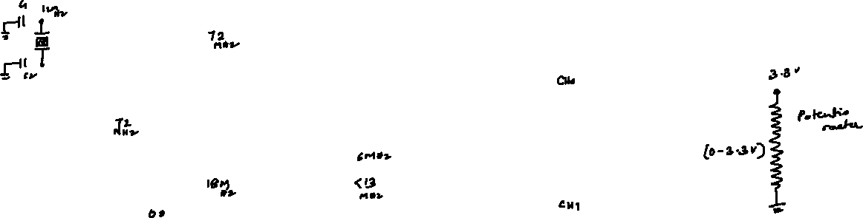
Embedded System Design Concepts - A simple approach
Analog to Digital Converter (ADC)
Analog to Digital Converter (ADC)
LPC1768
CLOCK Generator
CPU
12 bit ADC
4:1 MUX
Peripheral CLK DIVIDER
ADC CLK DIVIDER
PCLKSEL0
ADCCR[15:8]

Slide 6
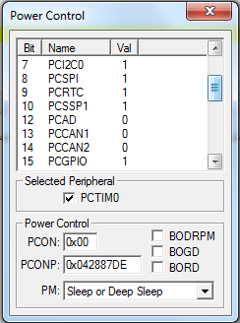
Embedded System Design Concepts - A simple approach
Analog to Digital Converter (ADC)
Programming ADC involves the following Initialization to be done
Power CONtrol for Peripherals (PCONP) initialization
On Reset PCAD bit in PCONP is 0, It means Power for ADC is disabled. Therefor PCAD bit should be made as 1 in order enable the Power to ADC peripheral
Statement to be used
LPC_SC->PCONP |=0X00001000; ORing the content of PCONP with 0x00001000 which sets the 12 bit (PCAD) bit of PCPNP and retains the Initial status.

Slide 7

Embedded System Design Concepts - A simple approach
Analog to Digital Converter (ADC)
Configuring ADC PIN – P1.31 as AD0.5
4:1MUX
ADC

Slide 8
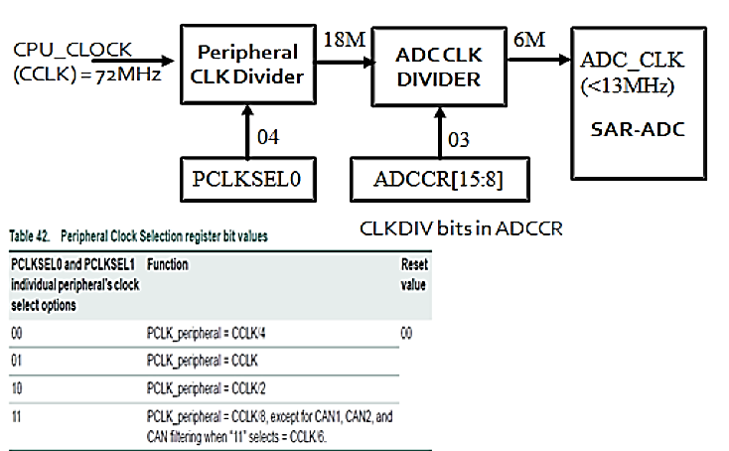
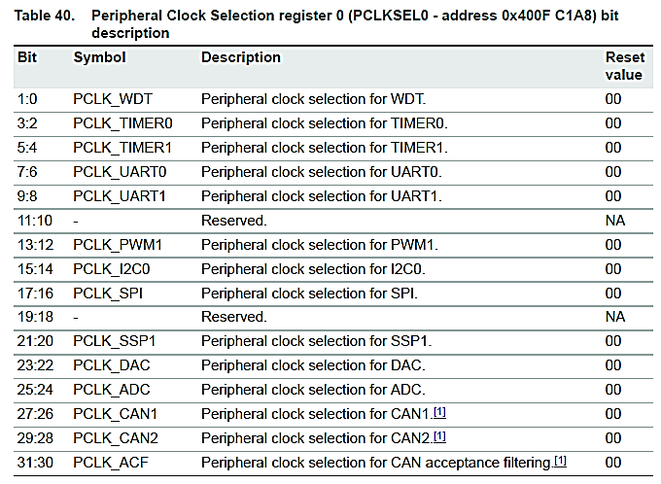
Embedded System Design Concepts - A simple approach
Analog to Digital Converter (ADC)
Configuring ADC CLOCK –ADCLK as 6MHz (Max 13MHz)

Slide 9
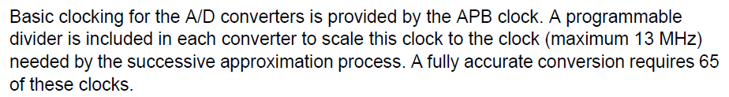
Embedded System Design Concepts - A simple approach
Analog to Digital Converter (ADC)
Configuring ADC Control Register - ADCR)
15 | 14 | 13 | 12 | 11 | 10 | 9 | 8 | 7 | 6 | 5 | 4 | 3 | 2 | 1 | 0
CLKDIV bits to divide PCLK_ADC |  |  |  |  |  |  |  | SELECT BITS [AD0.7:0]
0X0021 0320
If CLKDIV =00000000 then PCLK_ADC /1
If CLKDIV =00000000 then PCLK_ADC /2
If CLKDIV =00000000 then PCLK_ADC /3
If CLKDIV =00000000 then PCLK_ADC /4
…..

Slide 10
Embedded System Design Concepts - A simple approach
Analog to Digital Converter (ADC)
Configuring ADC Control Register - ADCR)
31 | 30 | 29 | 28 | 27 | 26 | 25 | 24 | 23 | 22 | 21 | 20 | 19 | 18 | 17 | 16
Reserved |  |  |  | Edge | START |  |  |  |  | PDN | Reserved |  |  |  | Burst
Burst | If Burst=1 :The AD converter does repeated conversions at up to 200 kHz, scanning (if necessary)through the pins selected by bits set to ones in the SEL field.
PDN | PDN=1; ADC Conversion is operational; PDN=0; Conversion Power down
START | 000 :No start (this value should be used when clearing PDN to 0). 001 :Start conversion now.
Edge | This bit is significant only when the START field contains 010-111. In these cases: 0 1 Start conversion on a falling edge on the selected CAP/MAT signal. 0 Start conversion on a rising edge on the selected CAP/MAT signal.

Slide 11
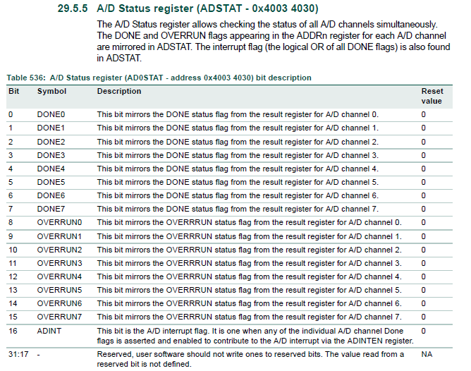
Embedded System Design Concepts - A simple approach
Analog to Digital Converter (ADC)
ADC STATUS Register – ADSTAT)

Slide 12
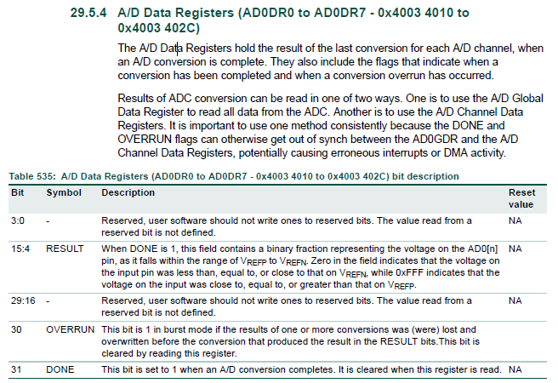
Embedded System Design Concepts - A simple approach
Analog to Digital Converter (ADC)
ADC DATA Register – ADDR0-7)

Slide 13
Embedded System Design Concepts - A simple approach
Analog to Digital Converter (ADC)
Example
#include <LPC17xx.H>
void delay(unsigned long int dk);
unsigned long int di=0;
unsigned short int adc=0;
int main()
{
SystemInit();
LPC_SC->PCONP|=0X00001000;
LPC_GPIO0->FIOMASK2|=0XBF;
LPC_GPIO0->FIODIR2|=0X40;
LPC_PINCON->PINSEL3|=0XC0000000;
LPC_ADC->ADCR=0X00210320;
while(1)
{
while((LPC_ADC->ADSTAT&0X00000020)!=0X00000020)
{
}
adc=((LPC_ADC->ADDR5>>4)& 0x00000fff);
if (adc > 0x9B2) // Comparing MV with RV
{
LPC_GPIO0->FIOSET2=0X40;
}
else
{
LPC_GPIO0->FIOCLR2=0X40;
}
}
}

Slide 14
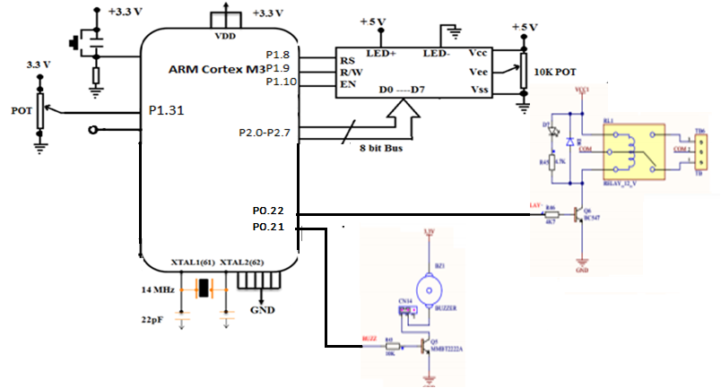
Embedded System Design Concepts - A simple approach
Analog to Digital Converter (ADC)
ADC+RELAY+BUZZER+LCD
A POT is connected at P0.31 which need to configured as Analog PIN AD0.5
Relay is connected to P0.22 through NPN transistor as Driver and to be configured as GPIO acting as output.

Slide 15
THANK YOU
Mahesh Awati
Department of Electronics and Communication
mahesha@pes.edu
+91 9741172822

