Slide 1

Embedded System Design Concepts
A simple approach
Mahesh Awati
Department of Electronics and Communication Engg.

Slide 2

Embedded System Design Concepts - A simple approach
Timer/Counter
Mahesh Awati
Department of Electronics and Communication Engineering

Slide 3
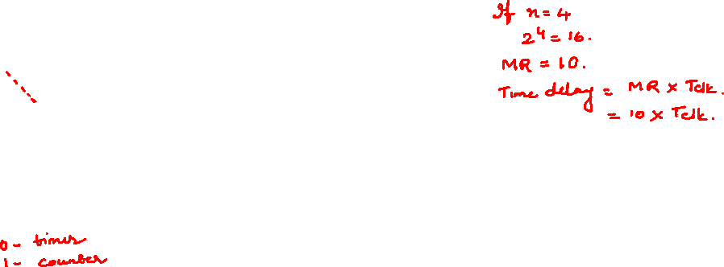
Embedded System Design Concepts - A simple approach
Timer/ Counter ( Timer0,1,2,3)
Match Register
Source of Clock
Clock Generator
Timer/Counter (n bit )
mux
External Input
Counter/Time

Slide 4
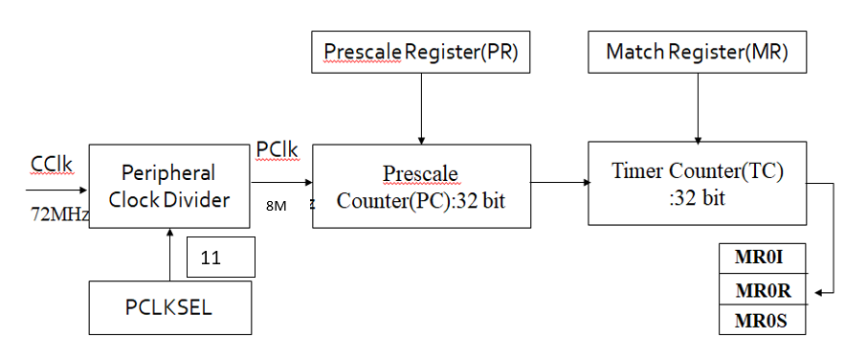
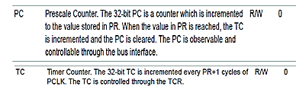
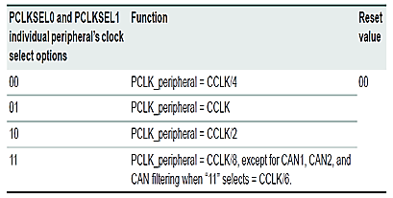
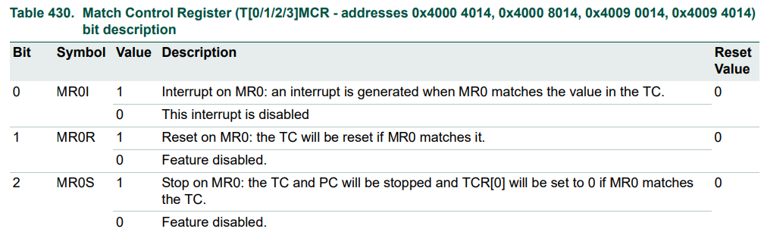
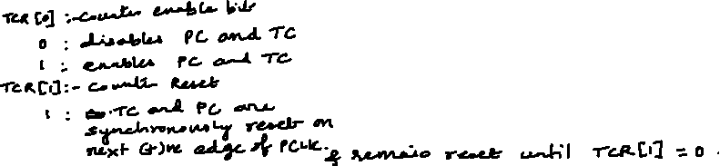
Embedded System Design Concepts - A simple approach
Timer/ Counter ( Timer0,1,2,3)
LPC1768 Timer/ Counter basic block diagram
TCR[31:0]
CTCR[31:0]

Slide 5
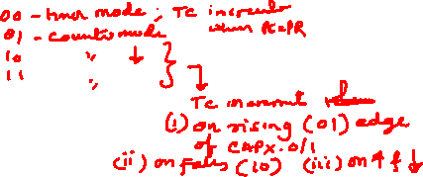
Embedded System Design Concepts - A simple approach
Timer/ Counter ( Timer0,1,2,3)
LPC1768 Timer/ Counter basic block diagram
TCR[31:0]
CTCR[31:0]

Slide 6
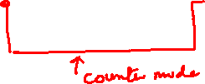
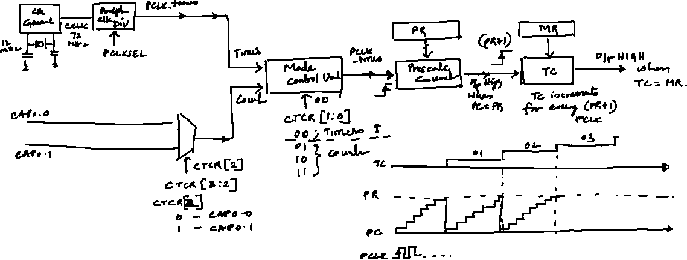
Embedded System Design Concepts - A simple approach
Timer/ Counter ( Timer0,1,2,3)
LPC1768 Timer/ Counter basic block diagram

Slide 7
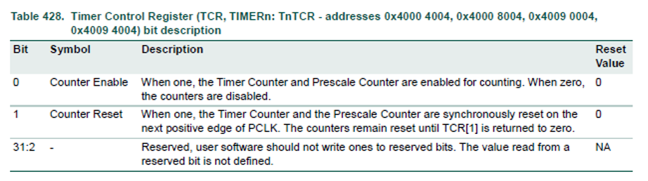
Embedded System Design Concepts - A simple approach
Timer/ Counter ( Timer0,1,2,3)
LPC1768 Timer/ Counter basic block diagram
Timer Control Register (TCR)

Slide 8
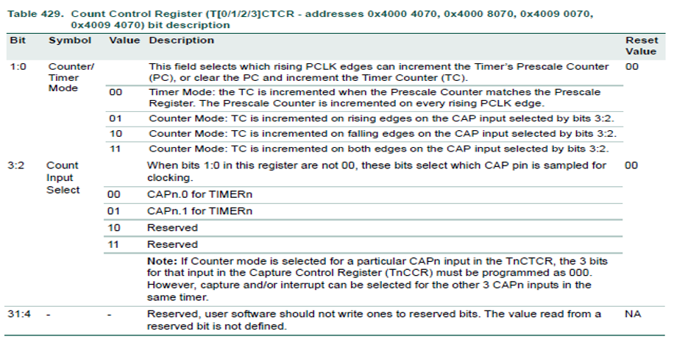
Embedded System Design Concepts - A simple approach
Timer/ Counter ( Timer0,1,2,3)
LPC1768 Timer/ Counter basic block diagram
Counter Control Register ( CTCR)

Slide 9
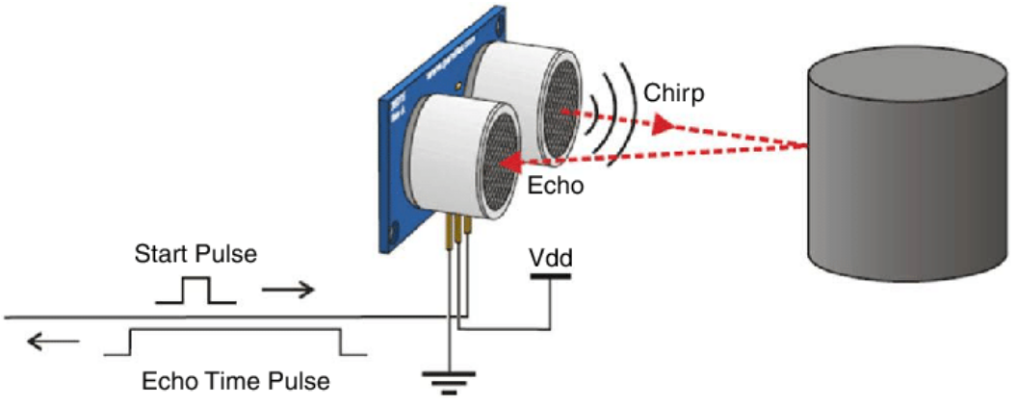
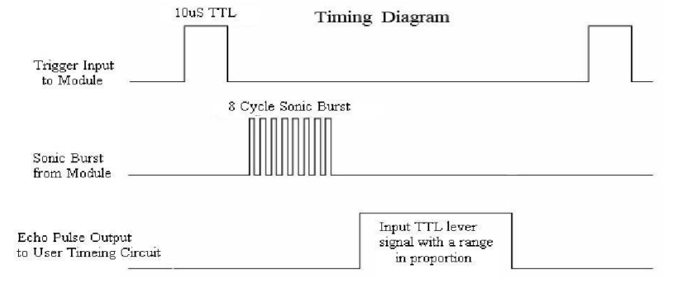

Embedded System Design Concepts - A simple approach
Ultrasonic Sensor

Slide 10
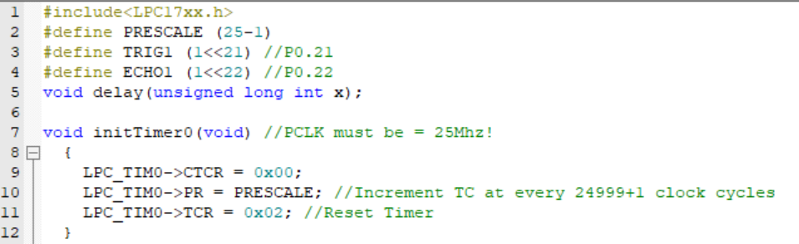
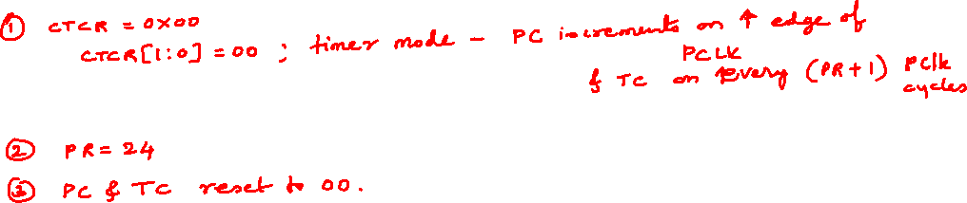
Embedded System Design Concepts - A simple approach
Ultrasonic Sesnor

Slide 11
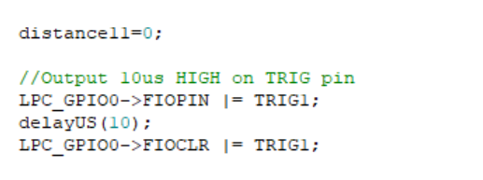
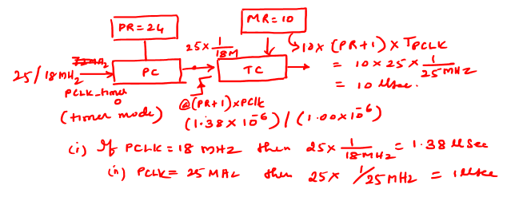
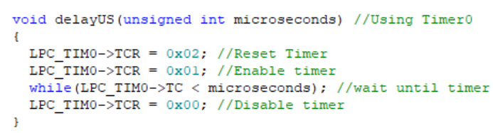
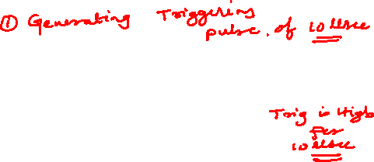
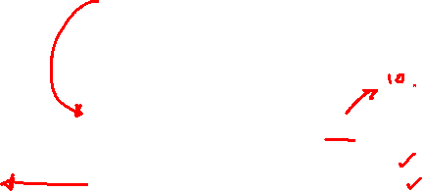
Embedded System Design Concepts - A simple approach
Ultrasonic Sesnor

Slide 12
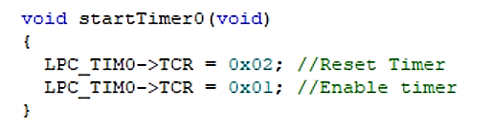
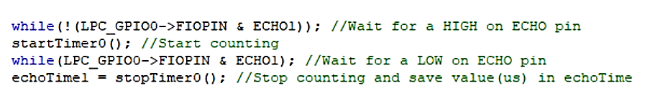
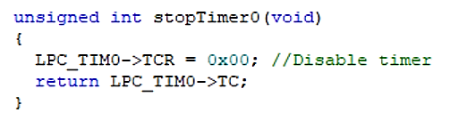
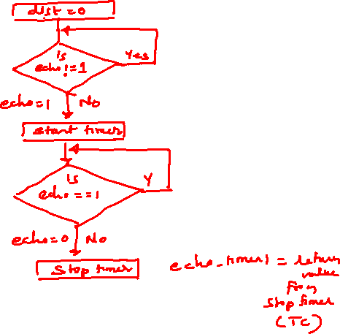
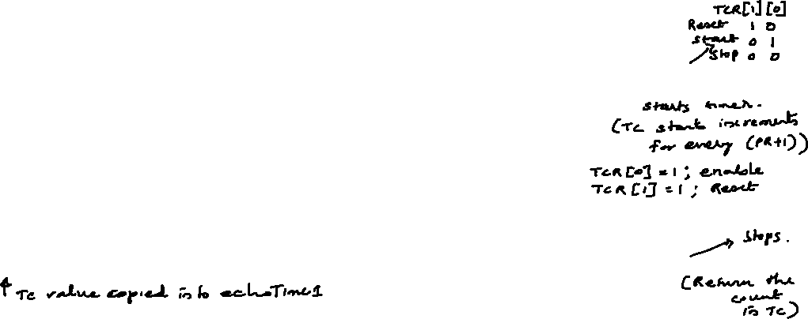
Embedded System Design Concepts - A simple approach
Ultrasonic Sesnor

Slide 13
THANK YOU
Mahesh Awati
Department of Electronics and Communication
mahesha@pes.edu
+91 9741172822

