Slide 1

Embedded System Design Concepts
A simple approach
Mahesh Awati
Department of Electronics and Communication Engg.

Slide 2

Embedded System Design Concepts - A simple approach
Serial communication Protocols : UART
Mahesh Awati
Department of Electronics and Communication Engineering

Slide 3
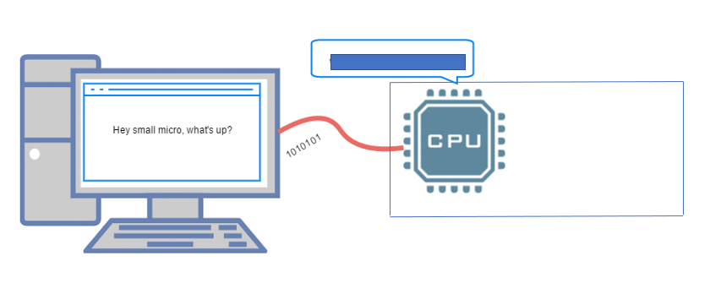
Embedded System Design Concepts - A simple approach
Serial communication Protocols
Introduction

Slide 4
Embedded System Design Concepts - A simple approach
Serial communication Protocols
What is Serial Communication
In embedded systems, the communication means the exchange of data between two devices like Microcontrollers in the form of bits. This exchange of data bits in between devices is done by some set of defined rules known as communication protocols.
The data can be communicated
As Set of bits – In Parallel between two devices.
Example: Sending a 8 bit value using a PORT to 8 LEDs connected using 8 parallel conducting paths
As bit by bit - In Serial as one bit after the other then the communication protocol is known as Serial Communication Protocol. More specifically, the data bits are transmitted one at a time in sequential manner over the data bus or communication channel in Serial Communication.
Example: Sending a 8 bit value using a Single PORT pin and displaying on a Single LED sequentially
Transmitter
Receiver
D0
D1
D2
D3
D4
D5
D6
D7
1 (MSB)
0
1
1
0
0
1
0 (LSB)
D0
D1
D2
D3
D4
D5
D6
D7
Transmitter
Receiver
MSB LSB
1 0 1 1 0 0 1 0
D0
DI

Slide 5
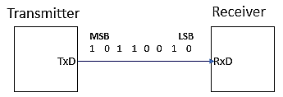
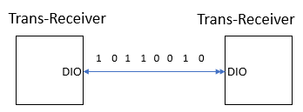
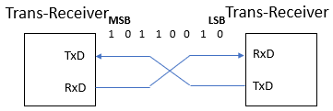
Embedded System Design Concepts - A simple approach
Serial communication Protocols
Basic Terminologies
A Serial communication protocols used in Embedded System may have the following Mode of Transmission
Simplex Method:
In simplex method either of the medium i.e sender or receiver can be act as a Transmitter. So if the sender is transmitting the data then receiver can only accept. So simplex method is one-way communication technique.
Examples: Television and Radio.
Duplex Method:
In Duplex , Either of the medium can act as a Transmitter or Receiver. In this gain based to connection they are classified as
Half Duplex: The Tran-receivers are connected through a Single conducting path, As a result at a given point of time one of them acts as Transmitter and other as Receiver . So if the sender is transmitting then receiver can accept but cannot send and similarly vice versa.
Full Duplex: The Tran-receivers are cross connected i.e., T_{X}D to R_{X}D on both ends. It means they can simultaneously Transmit and Receive the data using separate set of conducting paths.

Slide 6
Embedded System Design Concepts - A simple approach
Serial communication Protocols
Basic Terminologies
Clock Synchronization
Asynchronous Serial Communication
Asynchronous transmission is the type of transmission in which the sender and receiver have their own internal clocks thus do not need an external common clock pulse.
Mutually agreed speed of communication.
Synchronous Serial Communication
Synchronous transmission is the type of transmission in which a common clock pulse is shared between transmitter and receiver in order to permit synchronized communication.
Transmitter and Receiver use common clock
Transmitter
Receiver
Clock
Clock
Transmitter
Receiver
Clock

Slide 7
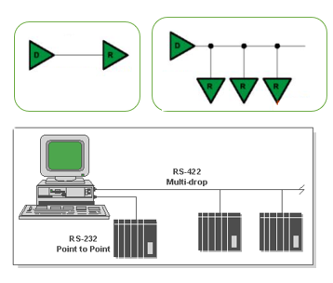
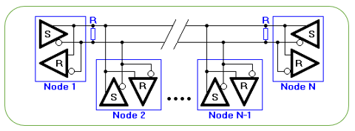
Embedded System Design Concepts - A simple approach
Serial communication Protocols
Basic Terminologies
Point to Point, Multi Drop and Multi Point
Point to Point: Interface between devices having peer relationship i.e., When there is a single dedicated link only between two devices, it is a point-to-point connection.
Example: RS-232
Multi Drop : One Transmitter communicating with Multiple Receivers.
Example: RS-422
Multi Point: Several Devices communicating with several receivers. It is the interfaces capable of internetworking multiple transmitters and receivers in the same network.

Slide 8
Embedded System Design Concepts - A simple approach
Serial communication Protocols
Serial Communication Standards
Onboard Communication Interfaces
These are used for internal communication of data in a embedded system.
Used for communication between different components present on the system.
Universal Asynchronous Receiver Transmitter (UART)
Serial Peripheral Interface (SPI)
Inter Integrated Circuit (I2C)
Controller Area Network (CAN)
1-Wire Interface, Parallel Interface
Peripheral Communication Interfaces
These are used for external communication of the embedded system i.e: communication of different components present on the system with external or peripheral components/devices.
Common examples of external interfaces are:
RS-232 & RS-485
Universal Serial Bus (USB)
Bluetooth
Wi-Fi
Zig Bee

Slide 9
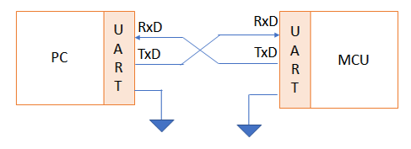
Embedded System Design Concepts - A simple approach
Serial communication Protocols
UART – Universal Asynchronous Receiver and Transmitter
Universal – As the Frame (data size ) and the speed with the data communicated are configurable to meet the need of given communication requirements, Therefore it is referred as Universal
UART is a Simple Half duplex , Asynchronous Serial communication protocol used fro point to point communication. It communicates the data using a defined baud rate.
In UART, the data is Transmitted from TxD pin of Transmitter to RxD pin of Receiver and It is Duplex in nature on both side TxD and RxD available. These pins are operating with TTL logic

Slide 10
Embedded System Design Concepts - A simple approach
Serial communication Protocols
UART – Universal Asynchronous Receiver and Transmitter
How data Synchronization is achieved in UART even though both Tx and Rx are separately clocked?
UART achieves data synchronisation by
Making both the devices to agree on common speed of data transfer which is managed with a separate module called baud rate generator.
Baud-rate generators on both side are configured to generate same standard baurates like 1200,2400,4800,9600 and 19200 so on.
Synchronisation Bits – Along with the data bits , other bits are sent to enable synchronization of data. These include start bit, stop bit(s) and parity bit.

Slide 11
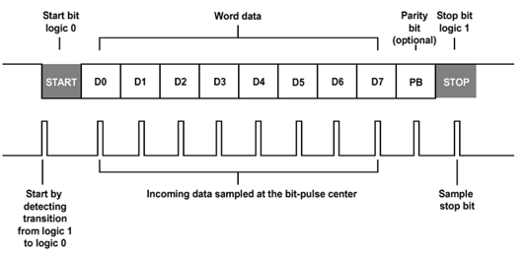
Embedded System Design Concepts - A simple approach
Serial communication Protocols
UART – Universal Asynchronous Receiver and Transmitter
FRAME
Start Bit
The UART data transmission line is normally held at a high voltage level when it’s not transmitting data.
To start the transfer of data, the transmitting UART pulls the transmission line from high to low for one clock cycle.
When the receiving UART detects the high to low voltage transition, it begins reading the bits in the data frame at the frequency of the baud rate.
Data Frame
The data frame contains the actual data being transferred.
It can be 5 bits up to 8 bits long if a parity bit is used. If no parity bit is used, the data frame can be 9 bits long. In most cases, the data is sent with the least significant bit first.

Slide 12
Embedded System Design Concepts - A simple approach
Serial communication Protocols
UART – Universal Asynchronous Receiver and Transmitter
FRAME
Parity
Parity describes the evenness or oddness of a number. If even Parity is Set as 0 else 1 by the Transmitting UART.
The parity bit is a way for the receiving UART to tell if any data has changed during transmission.
Bits can be changed by electromagnetic radiation, mismatched baud rates, or long distance data transfers.
After the receiving UART reads the data frame, it counts the number of 1’s in frame is Even or Odd.
If the parity bit is a 0 (even parity), the 1 bits in the data frame should total to an even number.
If the parity bit is a 1 (odd parity), the 1 bits in the data frame should total to an odd number.
When the parity bit matches the data, the UART knows that the transmission was free of errors else the UART knows that bits in the data frame have changed.
Stop Bits
To signal the end of the data packet, the sending UART drives the data transmission line from a low voltage to a high voltage for at least two bit durations.

Slide 13
Embedded System Design Concepts - A simple approach
Serial communication Protocols
UART – Universal Asynchronous Receiver and Transmitter
UART
Transmit Register: Buffer Register used to hold the data to be Transmitted
Control Register
Transmit Register
START
STOP
Shift Register
UART
TxD
TxD
Status Register
 | P | 7 | 6 | 5 | 4 | 3 | 2 | 1 | 0
BRG Registers
STOP
Baudrate Generator (BRG)
 | 0 | 1 | 2 | 3 | 4 | 5 | 6 | 7 | P
RxD
RxD
Shift Register
START
Receive Register
Receive Register: Buffer Register used to hold the data to be Received after discarding the Start, stop and Parity bit
Clock

Slide 14
Embedded System Design Concepts - A simple approach
Serial communication Protocols
UART – Universal Asynchronous Receiver and Transmitter
Control Register: As frame is configurable, the Control Registers will have bits to define
Number of data bits (5/6/7/8)
Number of Stop bits
Parity Control – Parity checking enabled/disabled, type of parity checking.
Transmit and Receive Interrupt enabled.
Baud-rate Register Enable and disable
Status Register : It holds UART condition or state in Run time.
Transmit Flag – Which is set when the Stop bit is Transmitted in a FRAME indicating the FRAME is successfully transmitted and UART is ready for Transmitting the next data.
Receive Flag - Which is set when the Receiver receives the Stop bit of FRAME indicating the FRAME is successfully received and UART is ready for Receiving the next data. i.e., Receiver has to wait for Rx flag to be SET and then the data from Receive Register can be read.
Baud-rate Generator Registers: These registers need to be initialised to generate the required baud-rate using the Source of clock.

Slide 15
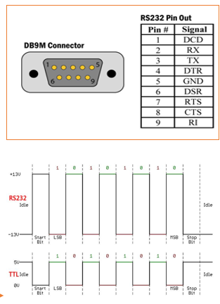

Embedded System Design Concepts - A simple approach
Serial communication Protocols
UART – Universal Asynchronous Receiver and Transmitter
Transistor –Transistor Logic (TTL) & Recommended Standard 232 (RS-232)
Most microcontrollers these days have built in UARTs (universally asynchronous receiver/transmitter) that can be used to receive and transmit data serially.
The data transmitted or received through TxD and RxD pin are with TTL logic. Serial communication at a TTL level will always remain between the limits of 0V and Vcc, which is often 5V or 3.3V.
A logic high ('1') is represented by Vcc, while a logic low ('0') is 0V.
In RS-232 standard, the Logic levels are anything from +/- 3V to +/- 25V.
Logic 1 : [-3 to -25]V and Logic 0: [+3 to +25] V
These Logic level makes the serial communication more Susceptibility to external conditions
RS232 more extreme voltages help make it less susceptible to noise, interference, and degradation.

Slide 16
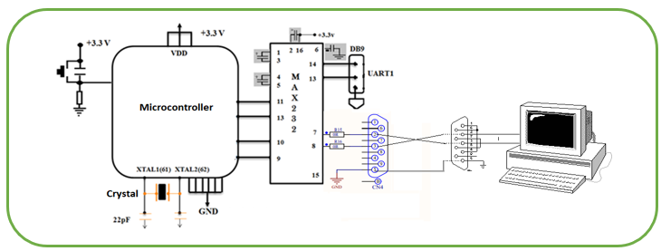
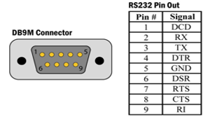
Embedded System Design Concepts - A simple approach
Serial communication Protocols
UART – Universal Asynchronous Receiver and Transmitter
Interfacing a Modem with Microcontroller : Null Modem Connection
A Microcontroller can be interfaced with PC using UART but the inbuilt UART supports TTL logic and where in PC/ Modem might be supporting RS232 logic. Therefore a Level shifter is needed which can shift the TTL logic to RS232 logic on Microcontroller side so that the communication is done using RS232 logic.
The connection between the MCU and PC is done through RS232 cable.
A MAX232 is a IC which converts TTL logic to RS232 logic. A single IC has two Level shifters which can be used for Two UARTs in a MCU

Slide 17
Embedded System Design Concepts - A simple approach
Serial communication Protocols
UART – Universal Asynchronous Receiver and Transmitter
What's Wrong with Serial Ports?
It is Asynchronous , there is No guarantee that both sides are running at precisely with the same baud rate as the Clock sources are different.
Since computers normally rely on everything being synchronized to a single “clock” (the main crystal attached to a computer that drives everything), this can be a problem when two systems with slightly different clocks try to communicate with each other.
In order to work around this problem, asynchronous serial connections add extra start and stop bits to each byte help the receiver sync up to data as it arrives. Slight differences in the transmission rate aren't a problem because the receiver re-syncs at the start of each byte.
The additional Start and stop bits for every byte lead to lot of overhead required to send and receive data and a complex hardware is required.
If both sides aren't set to the same speed, the received data will be garbage. This is because the receiver is sampling the bits at very specific times. If the receiver is looking at the wrong times, it will see the wrong bits.

Slide 18
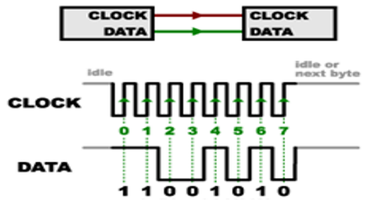
Embedded System Design Concepts - A simple approach
Serial communication Protocols
UART – Universal Asynchronous Receiver and Transmitter
Synchronous Serial Communication
Synchronous - The clock is an oscillating signal that tells the receiver exactly when to sample the bits on the data line. This could be the rising (low to high) or falling (high to low) edge of the clock signal; the datasheet will specify which one to use.
When the receiver detects that edge, it will immediately look at the data line to read the next bit (see the arrows in the below diagram).

Slide 19
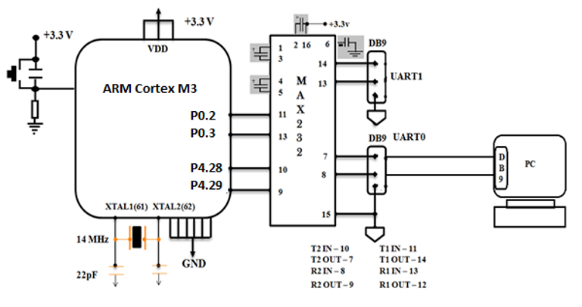
Embedded System Design Concepts - A simple approach
Serial communication Protocols
UART Programming
Interfacing Diagram

Slide 20
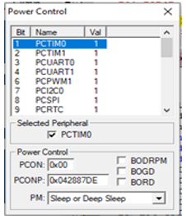
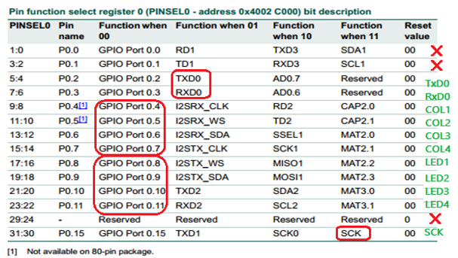
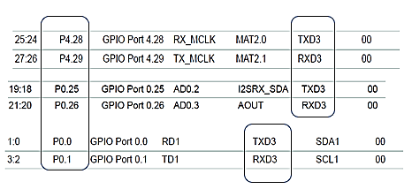
Embedded System Design Concepts - A simple approach
Serial communication Protocols
UART Programming
Power Control Peripherals: PCONP|=0X000000FF;
Pin Select :PINSEL0|=0X00000050;

Slide 21
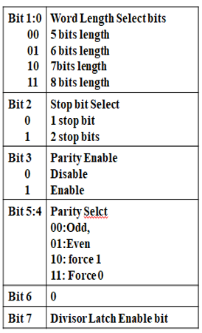

Embedded System Design Concepts - A simple approach
Serial communication Protocols
UART Programming : Mode configuration using Control Register
Line Control Register: LCR = 0x83;
Peripheral Clock Select:PCLKSEL0
For each UART 2 bits are used to select PCLK as
00 --------- CCLK/4
01 --------- CCLK Bit 10 & 9 –UART1
10 --------- CCLK/2 Bit 8 & 7 –UART0
11 --------- CCLK/8 or 6

Slide 22
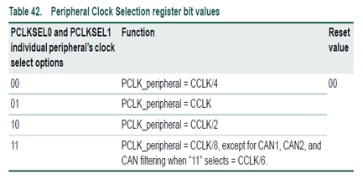
Embedded System Design Concepts - A simple approach
Serial communication Protocols
UART Programming – Baud rate Generation
CPU_CLOCK (CCLK) = 72MHz
Peripheral CLK Divider
18M
void uart0_init(void)
{
LPC_UART0->LCR = 0x83;
LPC_UART0->DLM=0X00;
LPC_UART0->DLL=0X75;
LPC_UART0->FDR=0X00000010;
LPC_UART0->LCR=0X03;
}
04
PCLKSEL0
DLM
DLL
FDR
CLKDIV bits in ADCCR

Slide 23
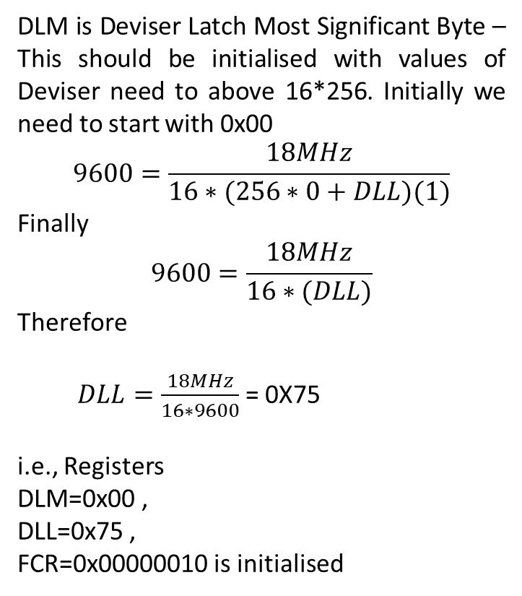
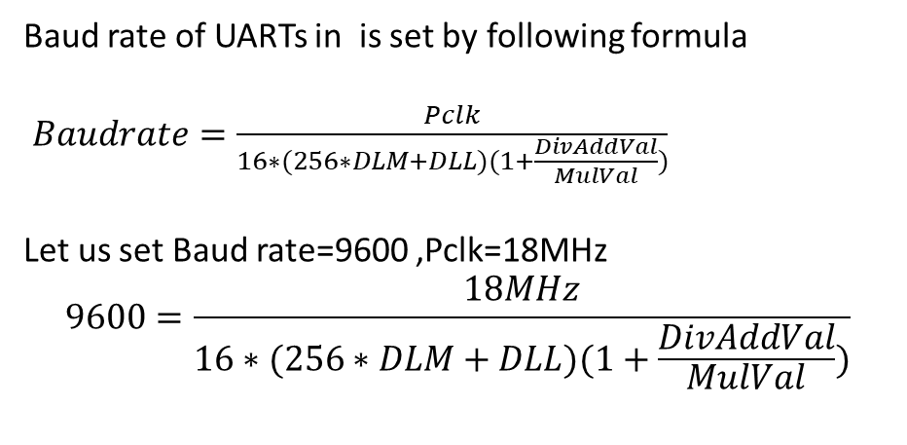
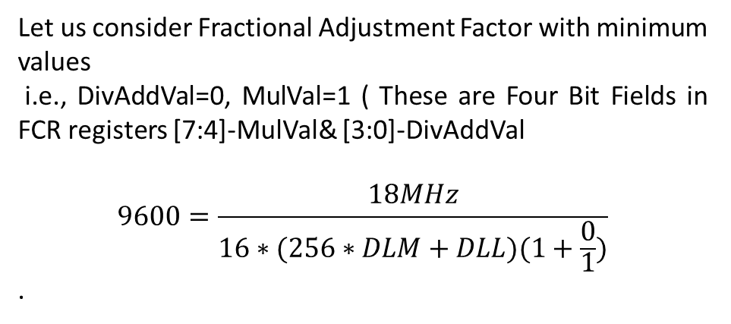
Embedded System Design Concepts - A simple approach
Serial communication Protocols
UART Programming – Baud rate Generation

Slide 24
Embedded System Design Concepts - A simple approach
Serial communication Protocols
UART Programming – Baud rate Generation
UART Power, PIN and CLK initialization
LPC_SC->PCONP|=0X00000000;
LPC_PINCON->PINSEL0|=0X00000050;
LPC_SC->PCLKSEL0|=0X00000000;
UART Mode and baud-rate Initialization
void uart0_init(void)
{
LPC_UART0->LCR = 0x83;
LPC_UART0->DLM=0X00;
LPC_UART0->DLL=0X75;
LPC_UART0->FDR=0X00000010;
LPC_UART0->LCR=0X03;
}

Slide 25
Embedded System Design Concepts - A simple approach
Serial communication Protocols
UART Programming – Baud rate Generation
UARTn Receiver Buffer Register (RBR )
The UnRBR is the top byte of the UARTn Rx FIFO.
The top byte of the Rx FIFO contains the oldest character received and can be read via the bus interface.
The LSB (bit 0)represents the “oldest” received data bit.
If the character received is less than 8 bits, the unused MSBs are padded with zeroes.
The Divisor Latch Access Bit (DLAB) in LCR must be zero in order to access the UnRBR.
The UnRBR is always read-only.
UARTn Transmit Holding Register (THR -)
The UnTHR is the top byte of the UARTn TX FIFO.
The top byte is the newest character in the TX FIFO and can be written via the bus interface. The LSB represents the first bit to transmit.
The Divisor Latch Access Bit (DLAB) in UnLCR must be zero in order to access the UnTHR.
The UnTHR is always write-only.

Slide 26
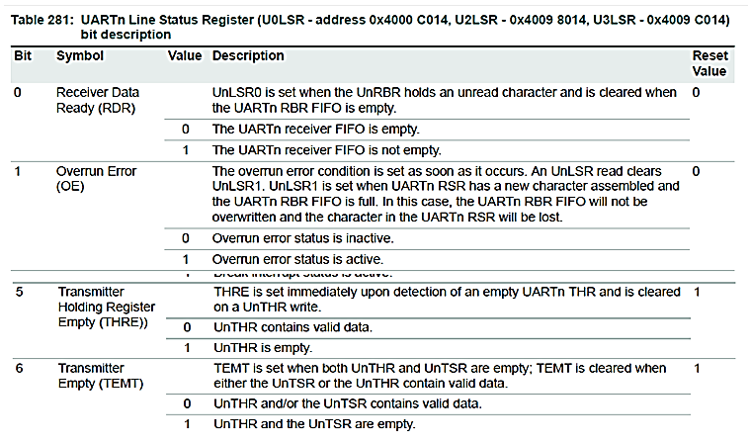
Embedded System Design Concepts - A simple approach
Serial communication Protocols
UART Programming – Baud rate Generation
Line Status Register (LSR)

Slide 27
Embedded System Design Concepts - A simple approach
Serial communication Protocols
UART Programming
Example : Transmitting a string
#include<LPC17XX.H>
void uart0_init(void);
void delay(unsigned long int x);
int main()
{
unsigned char str1[]=“ ARM Cortex M3",i;
SystemInit();
LPC_PINCON->PINSEL0|=0X00000050;
uart0_init();
for(i=0;str1[i]!='\0';i++)
{
LPC_UART0->THR=str1[i];
while (LPC_UART0->LSR&0xFF==0X20);
delay(100000);
}
}
void uart0_init(void)
{
LPC_UART0->LCR = 0x83;
LPC_UART0->DLM=0X00;
LPC_UART0->DLL=0X75;
LPC_UART0->FDR=0X00000010;
LPC_UART0->LCR=0X03;
}
void delay(unsigned long int x)
{
unsigned long int j;
for(j=0;j<x;j++)
{}
}

Slide 28
Embedded System Design Concepts - A simple approach
Serial communication Protocols
UART is used for
Interfacing Microcontroller with Modules like
RFID Card reader,
GSM,
GPS ,
XBee-S2
Finger Print Scanner and so on based the requirements of the application..

Slide 29
THANK YOU
Mahesh Awati
Department of Electronics and Communication
mahesha@pes.edu
+91 9741172822

