Slide 1

Embedded System Design Concepts
A simple approach
Mahesh Awati
Department of Electronics and Communication Engg.

Slide 2

Embedded System Design Concepts - A simple approach
Interrupts : Understanding Hardware Interrupts
Mahesh Awati
Department of Electronics and Communication Engineering

Slide 3
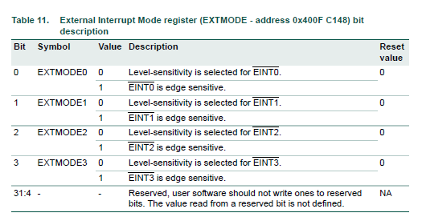
Embedded System Design Concepts - A simple approach
Hardware Interrupt Programming
Hardware Interrupt Programming
External Interrupt Mode register (EXTMODE - 0x400F C148)
The bits in this Register select whether each EINT pin is level- or edge-sensitive. Only pins that are selected for the EINT function (see Section 8.5) and enabled in the appropriate NVIC register) can cause interrupts from the External Interrupt function
Note: Software should only change a bit in this register when its interrupt is disabled in the NVIC (state readable in the ISERn/ICERn registers)

Slide 4
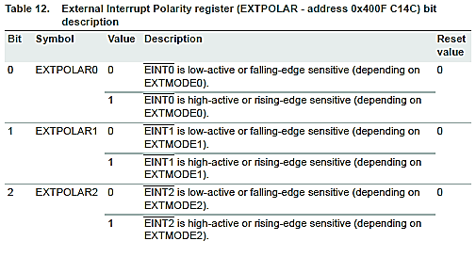
Embedded System Design Concepts - A simple approach
Hardware Interrupt Programming
Hardware Interrupt Programming
External Interrupt POLARITY Register (EXTPOLAR - 0x400F C148)
In level-sensitive mode, the bits in this register select whether the corresponding pin is high- or low-active.
In edge-sensitive mode, they select whether the pin is rising- or falling-edge sensitive. Only pins that are selected for the EINT function and enabled in the appropriate NVIC register) can cause interrupts from the External Interrupt function
Note: Software should only change a bit in this register when its interrupt is disabled in the NVIC (state readable in the ISERn/ICERn registers)

Slide 5
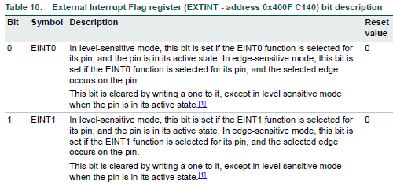
Embedded System Design Concepts - A simple approach
Hardware Interrupt Programming
Hardware Interrupt Programming
External Interrupt flag register (EXTINT - 0x400F C140)

Slide 6
Embedded System Design Concepts - A simple approach
Hardware Interrupt Programming
Hardware Interrupt Programming
External interrupt Initialization
void external_interruptinit(void)
{
LPC_SC->PCONP|=0X00000000;
LPC_PINCON->PINSEL4|=0X00400000;
LPC_SC->EXTMODE=0X00000002;
LPC_SC->EXTPOLAR=0X00000000;
}
LPC_SC->EXTMODE=0X00000002; // 0000 0000 0000 0000 0000 0000 0000 0010 -EDGE Sensistive
LPC_SC->EXTPOLAR=0X00000000; // 0000 0000 0000 0000 0000 0000 0000 0000 – Falling EDGE

Slide 7
THANK YOU
Mahesh Awati
Department of Electronics and Communication
mahesha@pes.edu
+91 9741172822

