Slide 1

Embedded System Design Concepts
A simple approach
Mahesh Awati
Department of Electronics and Communication Engg.

Slide 2

Embedded System Design Concepts - A simple approach
Serial communication Protocols : SPI
Mahesh Awati
Department of Electronics and Communication Engineering

Slide 3
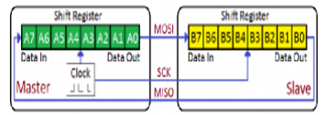
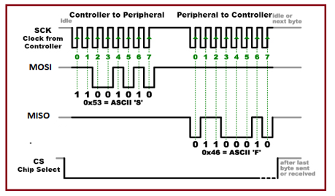
Embedded System Design Concepts - A simple approach
Serial communication Protocols
Serial Peripheral Interface (SPI) – Introduced by Motorola
Synchronous – Only one side generates the clock i.e., Master which is generally a Microcontroller and the Slave is a peripheral.
It is bidirectional full duplex – Which can Transmit as well as Receive the data simultaneously
It is a four wire bus as MISO, MOSI, SCL and CS.
It is Single Master – Multiple slave system./ if multiple master, then only one master should be active at a given time.
If the Slave devices not selected, their MISO will be disabled.
The SPI operation is based upon shift registers. Every device whether Master or Slave has an n-bit shift register inside it. The size of the shift register could be more than 8/10/12 bit, but it should be the same for both Master and Slave, and the protocol should support it.
The Master and Slave are connected in such a way that the two shift registers form an inter-device circular buffer. The following diagram should explains the hardware setup.

Slide 4
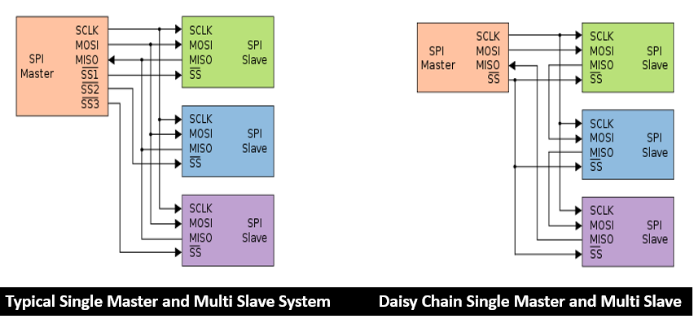
Embedded System Design Concepts - A simple approach
Serial communication Protocols
Serial Peripheral Interface (SPI) – Introduced by Motorola
Single Master – Multiple Slave System

Slide 5
SPI Modes: Clock Polarity and Phase
Embedded System Design Concepts - A simple approach
Serial communication Protocols
Serial Peripheral Interface (SPI) – Introduced by Motorola
Keeping synchronization in mind, Master’s role doesn’t end with simply generating clock pulses at a particular frequency (usually within the range of 10 kHz to 100 MHz). In fact, Master and Slave should agree on a particular synchronization protocol as well, or else everything will go wrong and data will get lost. This is where the concept of clock polarity (CPOL) and clock phase (CPHA) comes in.
CPOL – Clock Polarity: This determines the base value of the clock i.e. the value of the clock when SPI bus is idle.
When CPOL = 0, base value of clock is zero i.e. SCK is LOW when idle.
When CPOL = 1, base value of clock is one i.e. SCK is HIGH when idle.
CPHA – Clock Phase: This determines the clock transition at which data will be sampled/captured.
The CPHA=0: Data is captured on the first clock edge transition.
The CPHA =1,Data is captured on the second clock edge transition.

Slide 6
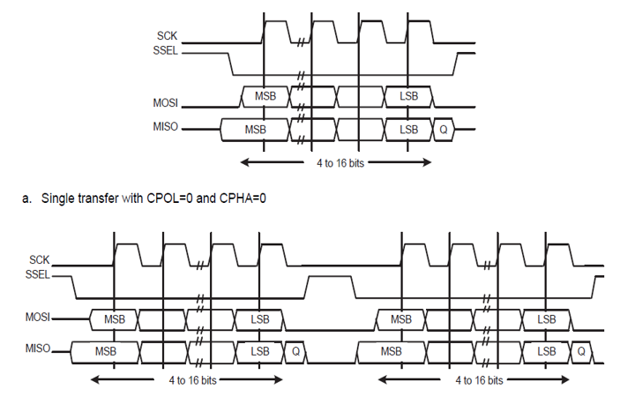
Case 1: SPI format with CPOL=0,CPHA=0
Embedded System Design Concepts - A simple approach
Serial communication Protocols
Serial Peripheral Interface (SPI) – Introduced by Motorola
CPOL =0 and CPHA =0
Ideally Clock is Low when Slave Select is HIGH and CPHA=0 makes the Master and Slave to Sample data on First Clock Edge

Slide 7
Case 1: SPI format with CPOL=0,CPHA=0
Embedded System Design Concepts - A simple approach
Serial communication Protocols
Serial Peripheral Interface (SPI) – Introduced by Motorola
The CLK signal is forced LOW , SSEL is forced HIGH , The transmit MOSI/MISO pad is in high impedance.
The Synchronous Serial Port (SPI) is enabled and there is valid data within the transmit FIFO.
The Start of Transmission is signified by the SSEL master signal being driven LOW. This causes slave data to be enabled onto the MISO input line of the master. Master’s MOSI is enabled.
The data is captured on the Rising and propagated on the falling edges of the SCK signal.
Continuous back-to-back transmissions, the SSEL signal must be pulsed HIGH between each data word transfer.

Slide 8
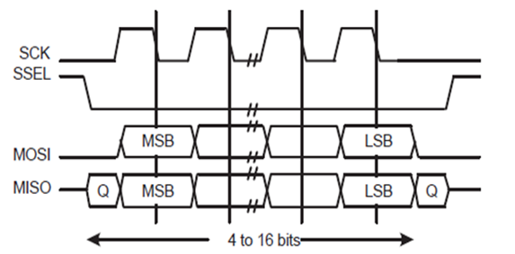
Case 2: SPI format with CPOL=0,CPHA=1
Embedded System Design Concepts - A simple approach
Serial communication Protocols
Serial Peripheral Interface (SPI) – Introduced by Motorola
CPOL =0 and CPHA =1
Ideally Clock is Low when Slave Select is HIGH and CPHA=1 makes the Master and Slave to Sample data on Second Clock Edge

Slide 9
Case 2: SPI format with CPOL=0,CPHA=1
Embedded System Design Concepts - A simple approach
Serial communication Protocols
Serial Peripheral Interface (SPI) – Introduced by Motorola
The CLK signal is forced LOW, SEL is forced HIGH, The transmit MOSI/MISO pad is in high impedance.
The SSP is enabled and there is valid data within the transmit FIFO.
The Start of Transmission is signified by the SSEL master signal being driven LOW. Master’s MOSI pin is enabled. After a further one half SCK period, both master and slave valid data is enabled onto their respective transmission lines. At the same time, the SCK is enabled with a rising edge transition.
Data is then captured on the Second Clock Edge (falling edge) and propagated on the rising edges of the SCK signal.
Single word transfer, after all bits have been transferred, the SSEL line is returned to its idle HIGH state one SCK period after the last bit has been captured.
Continuous back-to-back transfers, the SSEL pin is held LOW between successive data words and termination is the same as that of the single word transfer.

Slide 10
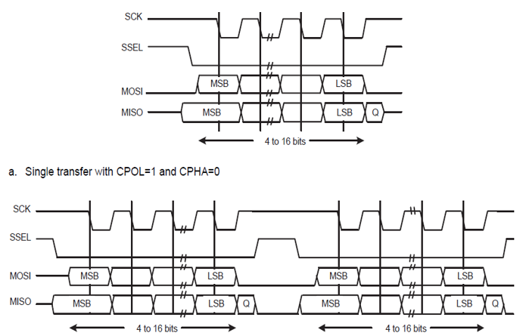
Case 3: SPI format with CPOL=1,CPHA=0
Embedded System Design Concepts - A simple approach
Serial communication Protocols
Serial Peripheral Interface (SPI) – Introduced by Motorola
CPOL =1 and CPHA =0
Ideally Clock is HIGH when Slave Select is HIGH and CPHA=0 makes the Master and Slave to Sample data on First Clock Edge ( Falling Edge)

Slide 11
Embedded System Design Concepts - A simple approach
Serial communication Protocols
Serial Peripheral Interface (SPI) – Introduced by Motorola
Case 3: SPI format with CPOL=1,CPHA=0
During idle periods
The CLK signal is forced HIGH, SSEL is forced HIGH, The transmit MOSI/MISO pad is in high impedance.
The SSP is enabled and there is valid data within the transmit FIFO, the start of transmission is signified by the SSEL master signal being driven LOW, which causes slave data to be immediately transferred onto the MISO line of the master. Master’s MOSI pin is enabled.
Data is captured on the first clock edge (falling edge) and be propagated on the rising edges of the SCK signal.
Single word transmission, after all bits of the data word are transferred, the SSEL line is returned to its idle HIGH state one SCK period after the last bit has been captured.
Continuous back-to-back transmissions, the SSEL signal must be pulsed HIGH between each data word transfer.

Slide 12
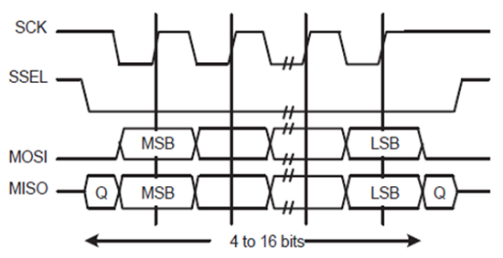
Case 4: SPI format with CPOL=1,CPHA=1
Embedded System Design Concepts - A simple approach
Serial communication Protocols
Serial Peripheral Interface (SPI) – Introduced by Motorola
CPOL =1 and CPHA =1
Ideally Clock is HIGH when Slave Select is HIGH and CPHA=1 makes the Master and Slave to Sample data on Second Clock Edge ( Rising Edge)

Slide 13
Embedded System Design Concepts - A simple approach
Serial communication Protocols
Serial Peripheral Interface (SPI) – Introduced by Motorola
Case 4: SPI format with CPOL=1,CPHA=1
During idle periods
The CLK signal is forced HIGH, SSEL is forced HIGH, The transmit MOSI/MISO pad is in high impedance.
The SSP is enabled and there is valid data within the transmit FIFO, the start of transmission is signified by the SSEL master signal being driven LOW, which causes slave data to be immediately transferred onto the MISO line of the master. Master’s MOSI pin is enabled.
Data is captured on the Second Clock Edge (RISING) and be propagated on the FALLING edges of the SCK signal.
Single word transmission, after all bits of the data word are transferred, the SSEL line is returned to its idle HIGH state one SCK period after the last bit has been captured.
Continuous back-to-back transmissions, the SSEL signal must be pulsed HIGH between each data word transfer.

Slide 14
THANK YOU
Mahesh Awati
Department of Electronics and Communication
mahesha@pes.edu
+91 9741172822

