Slide 1

Embedded System Design Concepts
A simple approach
Mahesh Awati
Department of Electronics and Communication Engg.

Slide 2

Embedded System Design Concepts - A simple approach
Serial communication Protocols : CAN
Mahesh Awati
Department of Electronics and Communication Engineering

Slide 3
Embedded System Design Concepts - A simple approach
History
First introduced in February of 1986 by Robert Bosch GmbH
Developed because existing serial buses in the early 1980s were not able to fulfill all the requirements to be used in passenger cars
Intel released the first CAN controller chip in 1987
In November 1993 the CAN ISO standard was published
First applications included use by an elevator manufacturer and some textile machine manufacturers
Multiple higher level protocols for CAN have been developed since 1994

Slide 4
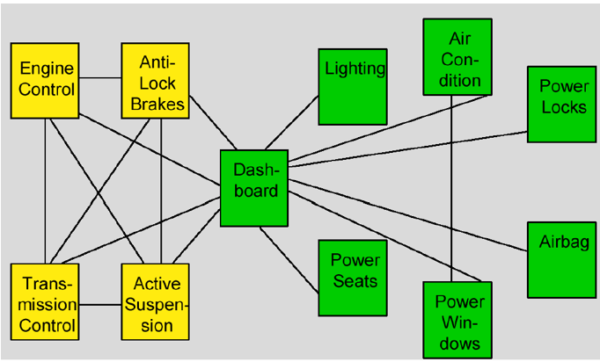
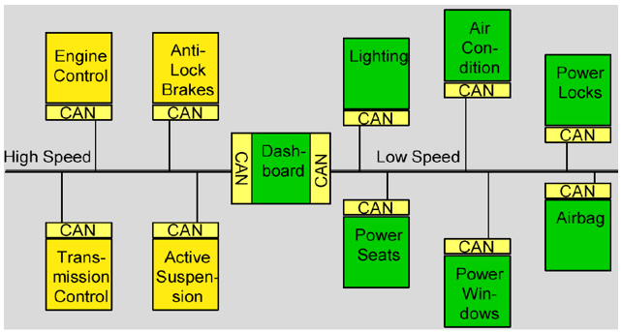
Embedded System Design Concepts - A simple approach
Without CAN and with CAN Bus
Without CAN
with CAN

Slide 5
Embedded System Design Concepts - A simple approach
Why Use CAN ?
Electrically robust with built-in error and arbitration features. These are automatic !
Differential pair reduces EMI in/out.
Cheap wiring: twisted pair
Many controllers, parts & software available.
Really, really easy to add and remove nodes.
Hard work is done by the CAN controller.

Slide 6
Embedded System Design Concepts - A simple approach
CAN Speeds
Speed may be from ~10 Kbps to 1Mbps. Most commonly used speed are 125, 250 & 500 Kbps.
Can’t change speed dynamically…ever !
Longer cable runs means slower frequency.
1 Mbps a bit hard to manage in a real system.
Better controllers and transceivers make higher speeds easier.

Slide 7
Embedded System Design Concepts - A simple approach
High Points of the CAN Bus
Uses a Differential twisted pair of wires.
It is message based communication.
The messages are communicated based on priority. The priority of message is its identifier.
The message with Lowest identifier has the HIGEST priority.
Uses non-destructive arbitration.
No Master or Slave – Peer to Peer.
All nodes see all messages on network.…except their own…..

Slide 8
Embedded System Design Concepts - A simple approach
Applications
Most common use is in the automobile industry
Used to connect subsystems within an electronic control unit as well as connect electronic control units together
Typically the largest control unit in a vehicle is the engine control unit
Modern automobiles may have up to 70 electronic control units
Many devices in cars use CAN including the radio, transmission, airbags, ABS, cruise control, and power steering
CAN is also used in both railway and aerospace applications
Other applications include use in hospital equipment, elevators, and even coffee machines

Slide 9
Embedded System Design Concepts - A simple approach
CAN protocol specification
CAN Specification 2.0 describes the base frame format (using 11-bit CAN-identifier) and the extended frame format (using 29-bit CAN-identifier).
A CAN device that uses 11-bit identifiers is commonly called CAN 2.0A
A CAN device that uses 11 bit/ 29-bit identifiers is commonly called CAN 2.0B.

Slide 10
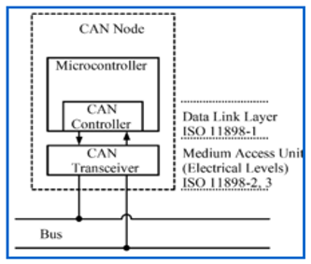
Embedded System Design Concepts - A simple approach
CAN Bus Node
CAN controller: It is often an integral part of the microcontroller
Receiving: the CAN controller stores the received serial bits from the bus until an entire message is available, which can then be fetched by the host processor (usually by the CAN controller triggering an interrupt).
Sending: the host processor sends the transmit message(s) to a CAN controller, which transmits the bits serially onto the bus when the bus is free.
Transceiver: Defined by ISO 11898-2/3 Medium Access Unit [MAU] standards
Receiving: it converts the data stream from CAN bus levels to levels that the CAN controller uses. It usually has protective circuitry to protect the CAN controller.
Transmitting: it converts the data stream from the CAN controller to CAN bus levels.
Central processing unit: Microprocessor, or host processor .
The host processor decides what the received messages mean and what messages it wants to transmit.
Sensors, actuators and control devices can be connected to the host processor.

Slide 11
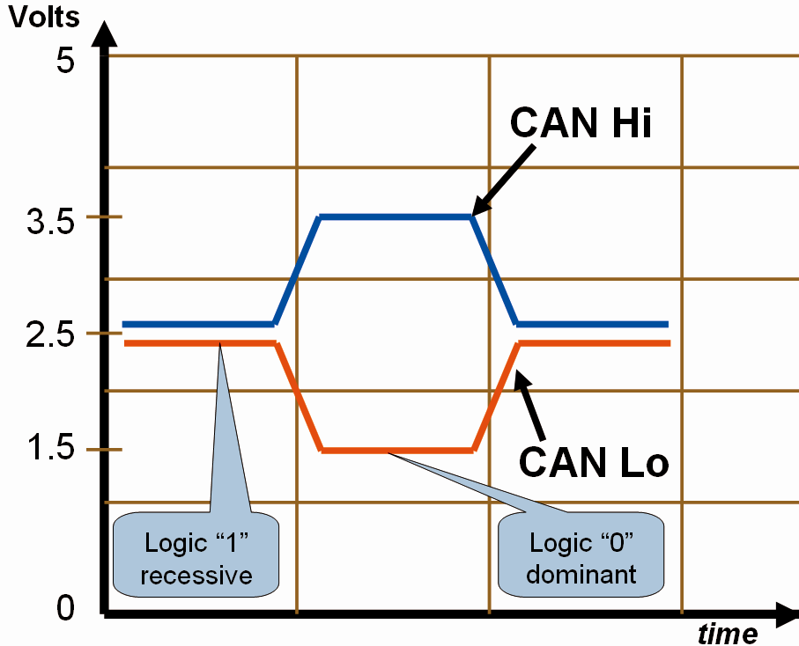
Embedded System Design Concepts - A simple approach
Differential Signaling
Recessive:
In this, CAN_Hi and CAN_Lo are at 2.5 volts
Difference is 2.5 – 2.5 = 0 volts.
Call this a “1”
Dominant
In this, CAN_Hi is at 3.5v CAN_Lo is at 1.5v.
Difference is 3.5 – 1.5 = 2.0 volts.
Call this a “0”
The important voltage is the difference
between CAN Hi and Lo and not to ground.

Slide 12
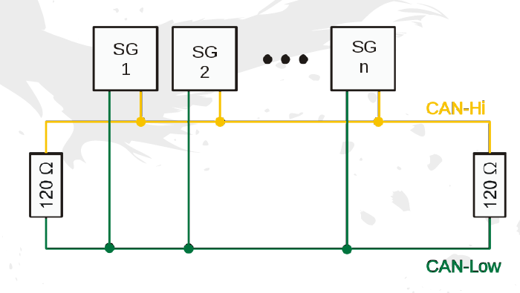
Embedded System Design Concepts - A simple approach
Topology
The main CAN backbone and drops are comprised of a twisted pair of wires.
a,b = 120 Ω ½ watt termination resistors. Drops use the same twisted pair of wires as the backbone

Slide 13
Embedded System Design Concepts - A simple approach
Frame Types
1. Data
2. Remote
3. Error
4. Overload

Slide 14
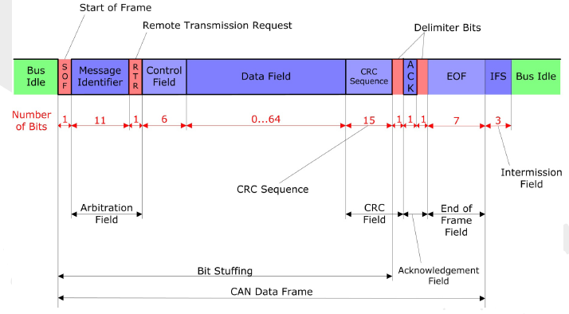
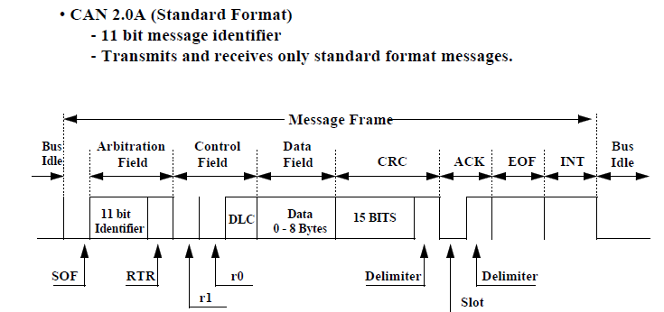
Embedded System Design Concepts - A simple approach
Data Frame / Remote Frame : 11bit identifier

Slide 15
Embedded System Design Concepts - A simple approach
Why Use CAN ?
Field name | Length (bits) | Purpose
Start-of-frame | 1 | Denotes the start of frame transmission
Identifier (green) | 11 | A (unique) identifier for the data which also represents the message priority
Remote transmission request (RTR] | 1 | RTR = 0 - DOMINANT in data frame (Sending) RTR = 1 - RECESSIVE in remote frame(Receiving)
Identifier extension bit (IDE) | 1 | Declaring if 11 bit message ID or 29 bit message ID is used. Dominant (0) indicate 11 bit message ID Recessive (1) indicate 29 bit message ID
Reserved bit (r0) | 1 | Reserved bit (it must be set to dominant (0), but accepted as either dominant or recessive)
Data length code (DLC) (yellow) | 4 | Number of bytes of data (0–8 bytes) DataByteCount = 8 × DLC.3 + 4 × DLC.2 + 2 × DLC.1 + DLC.0
Data field (red) | 0–64 (0-8 Bytes) | Data to be transmitted (length in bytes dictated by DLC field)
CRC | 15 | CRC
CRC delimiter | 1 | Must be recessive (1) ---Separation Bits
ACK slot | 1 | Transmitter sends recessive (1) and any receiver can assert a dominant (0)
ACK delimiter | 1 | Must be recessive (1)
End-of-frame (EOF) | 7 | Must be recessive (1)

Slide 16
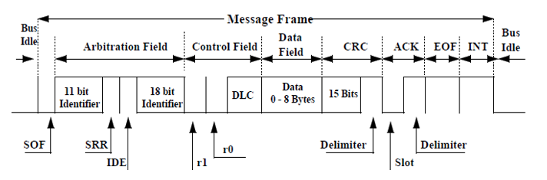
Embedded System Design Concepts - A simple approach
Extended frame format (CAN 2.0B )
Capable of receiving CAN 2.0 A messages
29 bit message identifier – 11 bits for CAN 2.0A message + 18 bits for a CAN 2.0B message

Slide 17
Embedded System Design Concepts - A simple approach
Extended frame format (CAN 2.0B )
Field name | Length (bits) | Purpose
Start-of-frame | 1 | Denotes the start of frame transmission
Identifier A | 11 | A (unique) identifier for the data which also represents the message priority
Substitute remote request (SRR) | 1 | Must be recessive (1). Optional The SRR bit is a recessive bit. It is transmitted in extended frames at the position of the RTR bit of standard frames.
Identifier extension bit (IDE) | 1 | Declaring if 11 bit message ID or 29 bit message ID is used. Dominant (0) indicate 11 bit message ID Recessive (1) indicate 29 bit message ID
Identifier B | 18 | Second part of the (unique) identifier for the data which also represents the message priority
Remote transmission request (RTR] | 1 | RTR = 0 - DOMINANT in data frame RTR = 1 - RECESSIVE in remote frame

Slide 18
Embedded System Design Concepts - A simple approach
Extended frame format (CAN 2.0B )
Field name | Length (bits) | Purpose
Reserved bit (r0,r1) | 2 | Reserved bit (it must be set to dominant (0), but accepted as either dominant or recessive)
Data length code (DLC) (yellow) | 4 | Number of bytes of data (0–8 bytes)
Data field (red) | 0–64 (0-8 Bytes) | Data to be transmitted (length in bytes dictated by DLC field) Data Byte Count = 8 × DLC.3 + 4 × DLC.2 + 2 × DLC.1 + DLC.0
CRC | 15 | CRC
CRC delimiter | 1 | Must be recessive (1)
ACK slot | 1 | Transmitter sends recessive (1) and any receiver can assert a dominant (0)
ACK delimiter | 1 | Must be recessive (1)
End-of-frame (EOF) | 7 | Must be recessive (1)

Slide 19
Embedded System Design Concepts - A simple approach
Arbitration
The arbitration field of the CAN message consists of an 11- or 29-bit identifier and a remote transmission (RTR) bit.
The CAN arbitration scheme is called “carrier sense multiple access with collision detection” or CSMA/CD, and assures that the highest priority message is broadcast.
Message priority is determined by the numerical value of the identifier in the arbitration field, with the lowest numerical value having the highest priority.
Non-destructive, bit-wise arbitration resolves conflicts among competing transmitters. This means that the bus can be thought of as acting like an AND gate.
If any node writes a dominant (0) bit on the bus, every node will read a dominant bit regardless of the value written by that node. Every transmitting node always reads back the bus value for each bit transmitted. If a node transmits a recessive bit and reads back a dominant bit, it immediately stops transmitting.
The RTR bit simply distinguishes between data frames and remote frames.
In data frames, the RTR bit must be dominant.
In Remote frames it must be recessive.

Slide 20
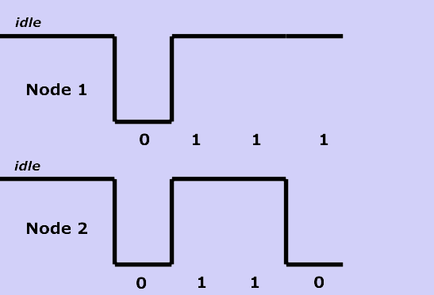
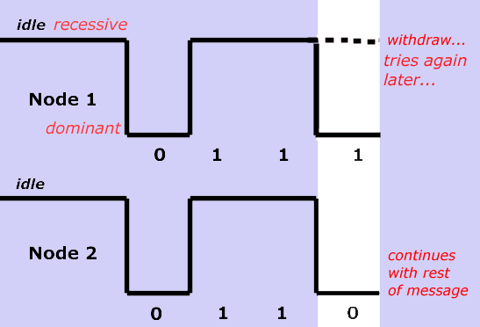
Embedded System Design Concepts - A simple approach
Priority Levels
Message with highest priority gets thru.
Lowest Identifier has priority. Ex: 000 beats 001, 123 beats 256. Always.
Arbitration evaluated in real-time.
Uses Recessive and Dominant bits.
A node can (and must!) see itself and others on the bus in real time.
Note: a node can’t see its own ID and data.
All this happens without your intervention !
if 11 and 29 bit same identifier at the same time – 11 bit wins arbitration. i.e.11010101010 & 11010101010101100101001101000

Slide 21
Embedded System Design Concepts - A simple approach
Acknowledge Field
During the ACK Slot bit the transmitting node sends out a recessive bit.
Any node that has received an error free frame acknowledges the correct reception of the frame by sending back a dominant bit

Slide 22
Embedded System Design Concepts - A simple approach
Programming CAN protocol
LPC 1768 REGISTERS
Initialization of PCONP, PCLKSEL0, PINSEL0
LPC_SC->PCONP|=0X00002000;
LPC_SC->PCLKSEL0|=0X00000000;
LPC_PINCON->PINSEL0|=0X00000005;

Slide 23
Embedded System Design Concepts - A simple approach
Programming CAN protocol
CAN1MOD:Read and write Register
BIT | SYMBOL | VALUE | FUNCTION
0 | RM (RESET MODE) | 0 | The CAN Controller is in the Operating Mode, and certain registers can not be written.
 |  | 1 | CAN operation is disabled, writable registers can be written and the current transmission/reception of a message is aborted.
1 | LOM Listen Only Mode. | 0 | The CAN controller acknowledges a successfully received message on the CAN bus. The error counters are stopped at the current value.
 |  | 1 | The controller gives no acknowledgment, even if a message is successfully received. Messages cannot be sent, and the controller operates in “error passive” mode. This mode is intended for software bit rate detection and “hot plugging”.
2 | STM (Self Test Mode.) | 0 | A transmitted message must be acknowledged to be considered successful.
 |  | 1 | The controller will consider a Tx message successful even if there is no acknowledgment received.
3 | TPM Transmit Priority Mode. | 0 | The transmit priority for 3 Transmit Buffers depends on the CAN Identifier.
 |  | 1 | The transmit priority for 3 Transmit Buffers depends on the contents of the Tx Priority register within the Transmit Buffer.

Slide 24
Embedded System Design Concepts - A simple approach
Programming CAN protocol
CAN1MOD:Read and write Register
BIT | SYMBOL | VALUE | FUNCTION
4 | SM SLEEP MODE | 0 | Normal operation.
 |  | 1 | The CAN controller enters Sleep Mode if no CAN interrupt is pending and there is no bus activity. See the Sleep Mode description
5 | RPM Receive Polarity Mode. | 0 | RD input is active Low (dominant bit = 0).
 |  | 1 | RD input is active High (dominant bit = 1) -- reverse polarity.
6 | - | - | Reserved, user software should not write ones to reserved bits.
7 | TM Test Mode. | 0 | Normal operation.
 |  | 1 | The TD pin will reflect the bit, detected on RD pin, with the next positive edge of the system clock.
31:8 | Reserved, user software should not write ones to reserved bits. The value read from a reserved bit is not defined. | Reserved, user software should not write ones to reserved bits. The value read from a reserved bit is not defined.
LPC_CAN1->MOD=0X00000001;

Slide 25
Embedded System Design Concepts - A simple approach
Programming CAN protocol
CAN1MOD
3 | 2 | 1 | 0
TPM | STM | LOM | RM
0 | 0 | 0 | 1
1 0
1 0
1 0
A Txted message is considered even if NO ACK received.
A Txted message must be ACKGD to be considered successful.
No ACK even after receiving msg and can not send msg
Sends a ACK on successful reception of msg and Error counter are stopped
Operation Disabled: Writable registers can be written
Operating Mode: Certain registers can be written

Slide 26
CAN Command Register:CAN1CMR
Embedded System Design Concepts - A simple approach
Programming CAN protocol
BIT | SYMBOL | VALUE | FUNCTION
0 | TR Transmission Request. | 0 | No transmission request.
 |  | 1 | The message, previously written to the CANxTFI, CANxTID, and optionally the CANxTDA and CANxTDB registers, is queued for transmission from the selected Transmit Buffer. If at two or all three of STB1, STB2 and STB3 bits are selected when TR=1 is written, Transmit Buffer will be selected based on the chosen priority scheme
1 | AT(Abort Transmission.) | 0 | Do not abort the transmission.
 |  | 1 | if not already in progress, a pending Transmission Request for the selected Transmit Buffer is cancelled.
2 | RRB Release Receive Buffer. | 0 | Do not release the receive buffer.
 |  | 1 | The information in the Receive Buffer (consisting of CANxRFS, CANxRID, and if applicable the CANxRDA and CANxRDB registers) is released, and becomes eligible for replacement by the next received frame. If the next received frame is not available, writing this command clears the RBS bit in the Status Register(s).

Slide 27
CAN Command Register:CAN1CMR
Embedded System Design Concepts - A simple approach
Programming CAN protocol
BIT | SYMBOL | VALUE | FUNCTION
3 | CDO Clear Data Overrun. | 0 | Do not clear the data overrun bit.
 |  | 1 | The Data Overrun bit in Status Register(s) is cleared.
4 | SRR Self Reception Request. | 0 | No self reception request.
 |  | 1 | The message, previously written to the CANxTFS, CANxTID, and optionally the CANxTDA and CANxTDB registers, is queued for transmission from the selected Transmit Buffer and received simultaneously. This differs from the TR bit above in that the receiver is not disabled during the transmission, so that it receives the message if its Identifier is recognized by the Acceptance Filter.
5 | STB1 Select Tx Buffer 1. | 0 | Tx Buffer 1 is not selected for transmission.
 |  | 1 | Tx Buffer 1 is selected for transmission.
6 | STB2 Select Tx Buffer 2 | 0 | Tx Buffer 2 is not selected for transmission.
 |  | 1 | Tx Buffer 2 is selected for transmission.
7 | STB3 Select Tx Buffer 3. | 0 | Tx Buffer 3 is not selected for transmission.
 |  | 1 | Tx Buffer 3 is selected for transmission.
31:8 | Reserved

Slide 28
Embedded System Design Concepts - A simple approach
Programming CAN protocol
CAN Global Status Register (CAN1GSR)
The content of the Global Status Register reflects the status of the CAN Controller.
This register is read-only, except that the Error Counters can be written when the RM bit in the CANMOD register is 1.
Bits not listed read as 0 and should be written as 0.

Slide 29
Embedded System Design Concepts - A simple approach
Programming CAN protocol
CAN Global Status Register (CAN1GSR)
BIT | SYMBOL | VALUE | FUNCTION
0 | RBS Receive Buffer Status. | 0 | No message is available.
 |  | 1 | At least one complete message is received by the Double Receive Buffer and available in the CANxRFS, CANxRID, and if applicable the CANxRDA and CANxRDB registers. This bit is cleared by the Release Receive Buffer command in CANxCMR, if no subsequent received message is available.
1 | DOS Data Overrun Status. | 0 | No data overrun has occurred since the last Clear Data Overrun command was given/written to CANxCMR (or since Reset).
 |  | 1 | A message was lost because the preceding message to this CAN controller was not read and released quickly enough (there was not enough space for a new message in the Double Receive Buffer).
2 | TBS Transmit Buffer Status. | 0 | At least one of the Transmit Buffers is not available for the CPU, i.e. at least one previously queued message for this CAN controller has not yet been sent, and therefore software should not write to the CANxTFI, CANxTID, CANxTDA, nor CANxTDB registers of that (those) Tx buffer(s).
 |  | 1 | All three Transmit Buffers are available for the CPU. No transmit message is pending for this CAN controller (in any of the 3 Tx buffers), and software may write to any of the CANxTFI, CANxTID, CANxTDA, and CANxTDB registers.

Slide 30
Embedded System Design Concepts - A simple approach
Programming CAN protocol
CAN Global Status Register (CAN1GSR)
BIT | SYMBOL | VALUE | FUNCTION
3 | TCS Transmit Complete Status. | 0 | At least one requested transmission has not been successfully completed yet.
 |  | 1 | All requested transmission(s) has (have) been successfully completed.
4 | RS Receive Status. | 0 | The CAN controller is idle.
 |  | 1 | The CAN controller is receiving a message.
5 | TS Transmit Status. | 0 | The CAN controller is idle.
 |  | 1 | The CAN controller is sending a message.
6 | ES Error Status. | 0 | Both error counters are below the Error Warning Limit.
 |  | 1 | One or both of the Transmit and Receive Error Counters has reached the limit set in the Error Warning Limit register.
7 | BS Bus Status. | 0 | The CAN Controller is involved in bus activities
 |  | 1 | The CAN controller is currently not involved/prohibited from bus activity because the Transmit Error Counter reached its limiting value of 255.
15:8 |  |  | Reserved
23:16 | RXERR |  | The current value of the Rx Error Counter (an 8-bit value).
31:23 | TXERR |  | The current value of the Tx Error Counter (an 8-bit value).

Slide 31
CAN Status Register (CAN1SR)
Embedded System Design Concepts - A simple approach
Programming CAN protocol
This read-only register contains three status
While those relating to transmission reflect the status of each of the 3 Tx Buffers.

Slide 32
CAN Status Register (CAN1SR)
Embedded System Design Concepts - A simple approach
Programming CAN protocol
BIT | SYMBOL | VALUE | FUNCTION
0 | RBS Receive Buffer Status. | 0 | No message is available.
 |  | 1 | At least one complete message is received by the Double Receive Buffer and available in the CANxRFS, CANxRID, and if applicable the CANxRDA and CANxRDB registers. This bit is cleared by the Release Receive Buffer command in CANxCMR, if no subsequent received message is available.
1 | DOS Data Overrun Status. | 0 | No data overrun has occurred since the last Clear Data Overrun command was given/written to CANxCMR (or since Reset).
 |  | 1 | A message was lost because the preceding message to this CAN controller was not read and released quickly enough (there was not enough space for a new message in the Double Receive Buffer).
2 | TBS1 Transmit Buffer Status 1. | 0 | Software cannot access the Tx Buffer 1 nor write to the corresponding CANxTFI, CANxTID, CANxTDA, and CANxTDB registers because a message is either waiting for transmission or is in transmitting process.
 |  | 1 | Software may write a message into the Transmit Buffer 1 and its CANxTFI,CANxTID, CANxTDA, and CANxTDB registers.

Slide 33
CAN Status Register (CAN1SR)
Embedded System Design Concepts - A simple approach
Programming CAN protocol
BIT | SYMBOL | VALUE | FUNCTION
3 | TCS1 Transmission Complete Status. | 0 | The previously requested transmission for Tx Buffer 1 is not complete.
 |  | 1 | The previously requested transmission for Tx Buffer 1 has been successfully completed.
4 | RS Receive Status. | 0 | The CAN controller is idle.
 |  | 1 | The CAN controller is receiving a message.
5 | TS1 Transmit Status 1. | 0 | There is no transmission from Tx Buffer 1.
 |  | 1 | The CAN Controller is transmitting a message from Tx Buffer 1.
6 | ES Error Status. | 0 | Both error counters are below the Error Warning Limit.
 |  | 1 | One or both of the Transmit and Receive Error Counters has reached the limit set in the Error Warning Limit register.

Slide 34
CAN Status Register (CAN1SR)
Embedded System Design Concepts - A simple approach
Programming CAN protocol
BIT | SYMBOL | VALUE | FUNCTION
7 | BS Bus Status. | 0 | The CAN Controller is involved in bus activities
 |  | 1 | The CAN controller is currently not involved/prohibited from bus activity because the Transmit Error Counter reached its limiting value of 255.
8 | RBS Receive Buffer Status. | 0 | No message is available.
 |  | 1 | At least one complete message is received by the Double Receive Buffer and available in the CANxRFS, CANxRID, and if applicable the CANxRDA and CANxRDB registers. This bit is cleared by the Release Receive Buffer command in CANxCMR, if no subsequent received message is available.
9 | DOS Data Overrun Status. | 0 | No data overrun has occurred since the last Clear Data Overrun command was given/written to CANxCMR (or since Reset).
 |  | 1 | A message was lost because the preceding message to this CAN controller was not read and released quickly enough (there was not enough space for a new message in the Double Receive Buffer).

Slide 35
CAN Status Register (CAN1SR)
Embedded System Design Concepts - A simple approach
Programming CAN protocol
BIT | SYMBOL | VALUE | FUNCTION
10 | TBS2 Transmit Buffer Status 2. | 0 | Software cannot access the Tx Buffer 2 nor write to the corresponding CANxTFI, CANxTID, CANxTDA, and CANxTDB registers because a message is either waiting for transmission or is in transmitting process.
 |  | 1 | Software may write a message into the Transmit Buffer 2 and its CANxTFI,CANxTID, CANxTDA, and CANxTDB registers.
11 | TCS2 Transmis Complete Status. | 0 | The previously requested transmission for Tx Buffer 2 is not complete.
 |  | 1 | The previously requested transmission for Tx Buffer 2 has been successfully completed.
12 | RS Receive Status. | 0 | The CAN controller is idle.
 |  | 1 | The CAN controller is receiving a message.

Slide 36
CAN Status Register (CAN1SR)
Embedded System Design Concepts - A simple approach
Programming CAN protocol
BIT | SYMBOL | VALUE | FUNCTION
13 | TS2 Transmit Status 2. | 0 | There is no transmission from Tx Buffer 2.
 |  | 1 | The CAN Controller is transmitting a message from Tx Buffer 2.
14 | ES Error Status. | 0 | Both error counters are below the Error Warning Limit.
 |  | 1 | One or both of the Transmit and Receive Error Counters has reached the limit set in the Error Warning Limit register.
15 | BS Bus Status. | 0 | The CAN Controller is involved in bus activities
 |  | 1 | The CAN controller is currently not involved/prohibited from bus activity because the Transmit Error Counter reached its limiting value of 255.
16 | RBS Receive Buffer Status. | 0 | No message is available.
 |  | 1 | At least one complete message is received by the Double Receive Buffer and available in the CANxRFS, CANxRID, and if applicable the CANxRDA and CANxRDB registers. This bit is cleared by the Release Receive Buffer command in CANxCMR, if no subsequent received message is available.

Slide 37
CAN Status Register (CAN1SR)
Embedded System Design Concepts - A simple approach
Programming CAN protocol
BIT | SYMBOL | VALUE | FUNCTION
17 | DOS Data Overrun Status. | 0 | No data overrun has occurred since the last Clear Data Overrun command was given/written to CANxCMR (or since Reset).
 |  | 1 | A message was lost because the preceding message to this CAN controller was not read and released quickly enough (there was not enough space for a new message in the Double Receive Buffer).
18 | TBS3 Transmit Buffer Status 3. | 0 | Software cannot access the Tx Buffer 3 nor write to the corresponding CANxTFI, CANxTID, CANxTDA, and CANxTDB registers because a message is either waiting for transmission or is in transmitting process.
 |  | 1 | Software may write a message into the Transmit Buffer 3 and its CANxTFI,CANxTID, CANxTDA, and CANxTDB registers.
19 | TCS3 Transmission Complete Status. | 0 | The previously requested transmission for Tx Buffer 3 is not complete.
 |  | 1 | The previously requested transmission for Tx Buffer 3 has been successfully completed.

Slide 38
CAN Status Register (CAN1SR)
Embedded System Design Concepts - A simple approach
Programming CAN protocol
BIT | SYMBOL | VALUE | FUNCTION
20 | RS Receive Status. | 0 | The CAN controller is idle.
 |  | 1 | The CAN controller is receiving a message.
21 | TS3 Transmit Status 3 | 0 | There is no transmission from Tx Buffer 3.
 |  | 1 | The CAN Controller is transmitting a message from Tx Buffer 3.
22 | ES | 1 | One or both of the Transmit and Receive Error Counters has reached the limit set in the Error Warning Limit register.
23 | BS Bus Status. | 0 | The CAN Controller is involved in bus activities
 |  | 1 | The CAN controller is currently not involved/prohibited from bus activity because the Transmit Error Counter reached its limiting value of 255.
31: 24 |  |  | Reserved, the value read from a reserved bit is not defined.

Slide 39
CAN Interrupt Enable Register (CAN1IER)
Embedded System Design Concepts - A simple approach
Programming CAN protocol
BIT | SYMBOL | FUNCTION
0 | RIE | Receiver Interrupt Enable. When the Receive Buffer Status is 'full', the CAN Controller requests the respective interrupt.
1 | TIE1 | Transmit Interrupt Enable for Buffer1. When a message has been successfully transmitted out of TXB1 or Transmit Buffer 1 is accessible again (e.g. after an Abort Transmission command), the CAN Controller requests the respective interrupt.
2 | EIE | Error Warning Interrupt Enable. If the Error or Bus Status change (see Status Register), theCAN Controller requests the respective interrupt.
3 | DOIE | Data Overrun Interrupt Enable. If the Data Overrun Status bit is set (see Status Register), the CAN Controller requests the respective interrupt.
4 | WUIE | Wake-Up Interrupt Enable. If the sleeping CAN controller wakes up, the respective interrupt is requested.
5 | EPIE | Error Passive Interrupt Enable. If the error status of the CAN Controller changes from error active to error passive or vice versa, the respective interrupt is requested.

Slide 40
CAN Interrupt Enable Register (CAN1IER)
Embedded System Design Concepts - A simple approach
Programming CAN protocol
BIT | SYMBOL | FUNCTION
6 | ALIE | Arbitration Lost Interrupt Enable. If the CAN Controller has lost arbitration, the respective interrupt is requested.
7 | BEIE | Bus Error Interrupt Enable. If a bus error has been detected, the CAN Controller requests the respective interrupt.
8 | IDIE | ID Ready Interrupt Enable. When a CAN identifier has been received, the CAN Controller requests the respective interrupt.
9 | TIE2 | Transmit Interrupt Enable for Buffer2. When a message has been successfully transmitted out of TXB2 or Transmit Buffer 2 is accessible again (e.g. after an Abort Transmission command), the CAN Controller requests the respective interrupt.
10 | TIE3 | Transmit Interrupt Enable for Buffer3. When a message has been successfully transmitted out of TXB3 or Transmit Buffer 3 is accessible again (e.g. after an Abort Transmission command), the CAN Controller requests the respective interrupt.
31:11 | - | Reserved, user software should not write ones to reserved bits. The value read from a reserved bit is not defined.

Slide 41
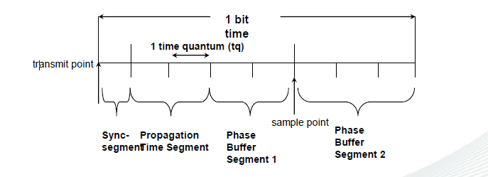
CAN Bit Timing
Embedded System Design Concepts - A simple approach
Programming CAN protocol
Each bit consists of a # of time quantum (tq).
Each tq is a fixed length.
TQs added and subtracted as clock syncs.
Tqs are set by designer in CAN controller chip.

Slide 42
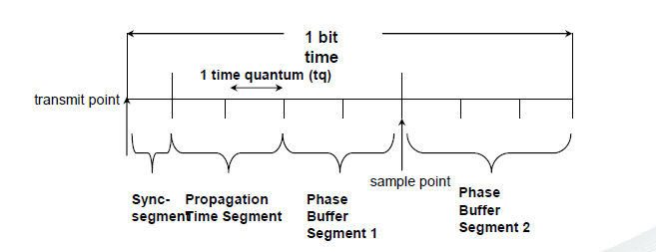
Example
Embedded System Design Concepts - A simple approach
Programming CAN protocol
CAN Bit Timing
Assume 500 Kbps CAN network.
Bit time = 1/(500 x 10³) = 2 usec.
With 8 tqs, tq time is 2 usec/8 = 250 nsec.
Sample point is 250 nsec(5) = 1,250 nsec.

Slide 43
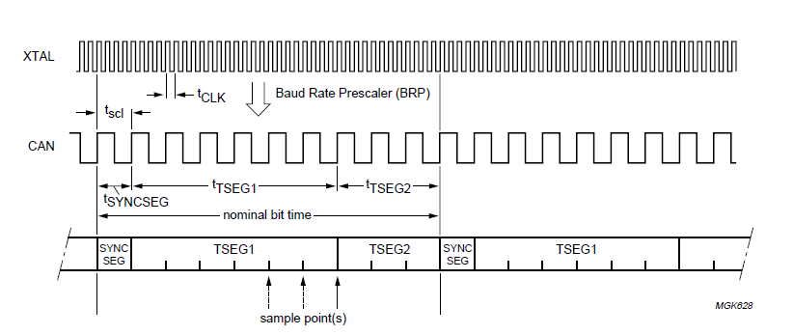
Embedded System Design Concepts - A simple approach
Programming CAN protocol
CAN Bit Timing

Slide 44
Embedded System Design Concepts - A simple approach
Programming CAN protocol
CAN Bus Timing Register (CAN1BTR)
This register controls how various CAN timings are derived from the APB clock.
It can be read at any time but can only be written if the RM bit in CAN mod is 1.
It defines the values of the Baud Rate Prescaler (BRP)
The Synchronization Jump Width (SJW).
It defines the length of the bit period, the location of the sample point The number of samples to be taken at each sample point.

Slide 45
Embedded System Design Concepts - A simple approach
Programming CAN protocol
CAN Bus Timing Register (CAN1BTR)
BIT | SYMBOL | FUNCTIONS
9:0 | BRP | Baud Rate Prescaler. The APB clock is divided by (this value plus one) to produce the CAN clock.
13:10 | ------ | Reserved, user software should not write ones to reserved bits. The value read from a reserved bit is not defined.
15:14 | SJW | The Synchronization Jump Width is (this value plus one) CAN clocks.
19:16 | TESG1 | The delay from the nominal Sync point to the sample point is (this value plus one) CAN clocks.
22:20 | TESG2 | The delay from the sample point to the next nominal sync point is (this value plus one) CAN clocks. The nominal CAN bit time is (this value plus the value in TSEG1 plus 3) CAN clocks.
23 | SAM | 0 :The bus is sampled once (recommended for high speed buses)
 |  | 1:The bus is sampled 3 times (recommended for low to medium speed buses to filter spikes on the bus-line)
31:24 |  | Reserved, user software should not write ones to reserved bits. The value read from a reserved bit is not defined.
CAN1BTR = 0X001C0007::0000 0000 0001 1100 0000 0000 0000 0111

Slide 46
Embedded System Design Concepts - A simple approach
Programming CAN protocol
Baud Rate Prescaler (BRP)
The period of the CAN system clock tSCL is programmable and determines the individual bit timing. The CAN system clock tSCL is calculated using the following equation:
tSCL = tCANsuppliedCLK *(BRP + 1)
tscl = tCLK × (512 × BRP.9 + 256 × BRP.8 + 128 × BRP.7 + 64 × BRP.6 + 32 × BRP.5 + 16 × BRP.4 + 8 × BRP.3 + 4 × BRP.2 + 2 × BRP.1 + BRP.0 + 1)

Slide 47
Embedded System Design Concepts - A simple approach
Programming CAN protocol
Baud Rate Prescaler (BRP)
BRP [9:0]=(00000000111)
CAN System Clock (tsck)
140.6 KHz
Divide by 16
Divide by 8
PCLK= 18MHz
tscl = tCLK × (512 × BRP.9 + 256 × BRP.8 + 128 × BRP.7 + 64 × BRP.6 + 32 × BRP.5 + 16 × BRP.4 + 8 × BRP.3 + 4 × BRP.2 + 2 × BRP.1 + BRP.0 + 1)
tscl= tclk x( 512x0+256x0+128x0+64x0+32x0+16x0+8x0+4x1+2x1+1+1)
Tscl=tclk X 8

Slide 48
Synchronization Jump Width(SJW)
Embedded System Design Concepts - A simple approach
Programming CAN protocol
To compensate for phase shifts between clock oscillators of different bus controllers, any bus controller must re-synchronize on any relevant signal edge of the current transmission.
The synchronization jump width tSJW defines the maximum number of clock cycles a certain bit period may be shortened or lengthened by one re-synchronization:
tSJW = tSCL *(SJW + 1)
tSJW = tscl ´ (2 ´ SJW.1 + SJW.0 + 1)

Slide 49
Time segment 1 and time segment 2
Embedded System Design Concepts - A simple approach
Programming CAN protocol
tSYNCSEG = tSCL
tTSEG1 = tSCL *(TSEG1 + 1)
tTSEG2 = tSCL *(TSEG2 + 1)
tSYNCSEG = 1 x tscl;
tTSEG1 = tscl x (8 xTSEG1.3 + 4 x TSEG1.2 + 2 xTSEG1.1 + TSEG1.0 + 1)
TSEG1[19:16] =1100 → tscl(8x1+4x1+2x0+1x0+1)=tscl*13
tTSEG2 = tscl (4 xTSEG2.2 + 2 xTSEG2.1 + TSEG2.0 + 1)
TSEG2[22:20] =tscl (4x0 +2x0 +1+1) = tscl*2

Slide 50
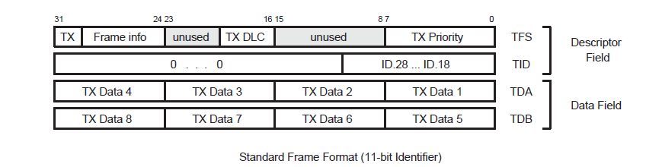
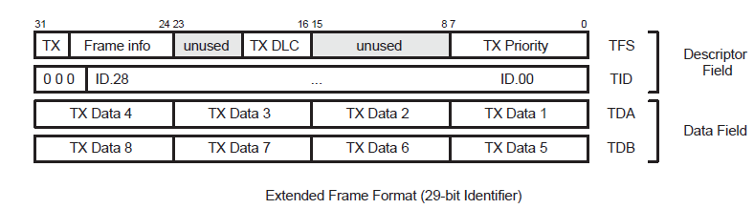
Transmit Buffers (TXB)
Embedded System Design Concepts - A simple approach
Programming CAN protocol
The TXB represents a Triple Transmit Buffer.
Each Transmit Buffer is able to store a complete message which can be transmitted over the CAN network.
The CAN Controller consist of three Transmit Buffers. Each of them has a length of 4 words and is able to store one complete CAN message

Slide 51
CAN Transmit Frame Information register (CAN1TFI1/CAN1TFI2/CAN1TFI13]
Embedded System Design Concepts - A simple approach
Programming CAN protocol
When the corresponding TBS bit in CANSR is 1, software can write to one of these registers.
First word of the Descriptor Field includes the TX Frame Info that describes the
Frame Format.11bit identifier or 29 bit identifier
Remote or Data Frame.
Data Length .
TX Priority register .

Slide 52
Embedded System Design Concepts - A simple approach
Programming CAN protocol
CAN Transmit Frame Information register (CAN1TFI1/CAN1TFI2/CAN1TFI13]
BIT | SYMBOL | FUNCTION
7:0 | PRIO | If the TPM (Transmit Priority Mode) bit in the CANxMOD register is set to 1, enabled Tx Buffers contend for the right to send their messages based on this field. The buffer with the lowest TX Priority value wins the prioritization and is sent first.
15:8 | ---------- | Reserved.
19:16 | DLC 0000-0111 = 0-7 bytes 1xxx = 8 bytes | Data Length Code. This value is sent in the DLC field of the next transmit message. In addition, if RTR = 0, this value controls the number of Data bytes sent in the next transmit message, from the CANxTDA and CANxTDB registers:
29:20 | --------- | Reserved.
30 | RTR | This value is sent in the RTR bit of the next transmit message. If this bit is 0, the number of data bytes called out by the DLC field are sent from the CANxTDA and CANxTDB registers. If this bit is 1, a Remote Frame is sent, containing a request for that number of bytes.
31 | FF | FF=0 : the next transmit message will be sent with an 11-bit Identifier (standard frame) FF=1: the message will be sent with a 29-bit Identifier (extended frame format).

Slide 53
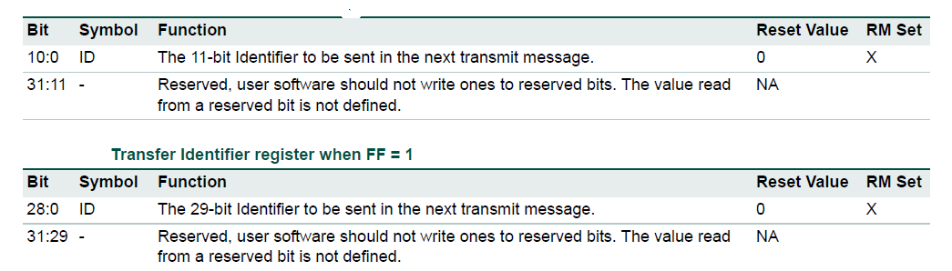
CAN Transmit Identifier register (CAN1TID[1/2/3]
Embedded System Design Concepts - A simple approach
Programming CAN protocol
When the corresponding TBS bit in CANxSR is 1, software can write to one of these registers to define the Identifier field of the next transmit message. Bits not listed read as 0and should be written as 0.
The most significant bit, and it is transmitted first on the bus during
the arbitration process. The Identifier acts as the message's name, used in a receiver for acceptance filtering, and also determines the bus access priority during the arbitration process.

Slide 54
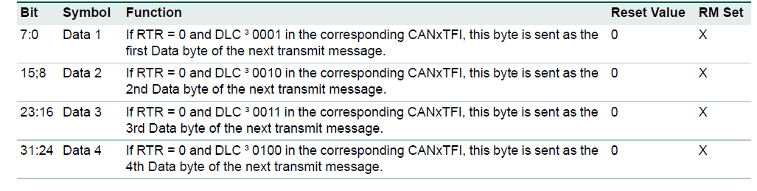
CAN Transmit Data register A (CAN1TDA[1/2/3]
Embedded System Design Concepts - A simple approach
Programming CAN protocol
When the corresponding TBS bit in CANSR is 1, software can write to one of these registers to define the first 1 - 4 data bytes of the next transmit message.
The Data Length Code defines the number of transferred data bytes. The first bit transmitted is the most significant bit of TX Data Byte 1.

Slide 55
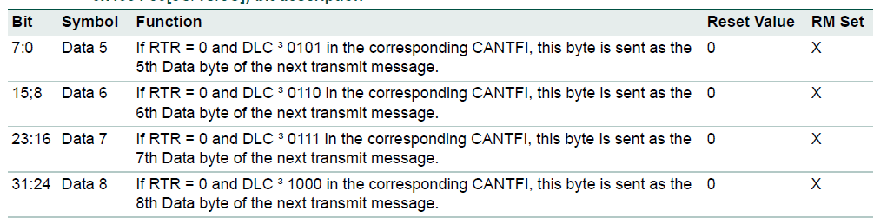
CAN Transmit Data register B (CAN1TDB[1/2/3])
Embedded System Design Concepts - A simple approach
Programming CAN protocol
When the corresponding TBS bit in CANSR is 1, software can write to one of these registers to define the 5th through 8th data bytes of the next transmit message.
The Data Length Code defines the number of transferred data bytes. The first bit transmitted is the most significant bit of TX Data Byte 1.

Slide 56
RECEIVING REGISTERS

Slide 57
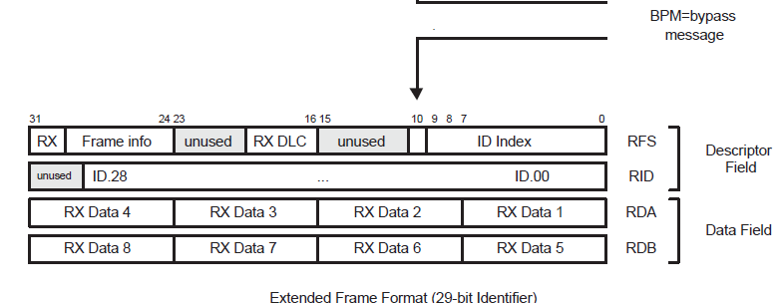
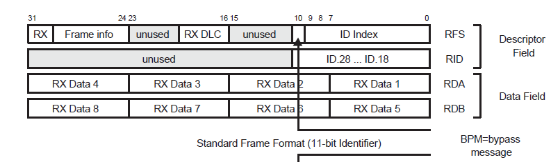
Receive Buffer (RXB)
Embedded System Design Concepts - A simple approach
Programming CAN protocol
The Receive Buffer (RXB) represents a CPU accessible Double Receive Buffer.
With the help of this Double Receive Buffer concept the CPU is able to process one message while another message is being received.

Slide 58
CAN Receive Frame Status register (CAN1RFS)
Embedded System Design Concepts - A simple approach
Programming CAN protocol
This register defines the characteristics of the current received message.
It is read-only in normal operation but can be written for testing purposes if the RM bit in CANxMOD is 1.

Slide 59
CAN Receive Frame Status register (CAN1RFS)
Embedded System Design Concepts - A simple approach
Programming CAN protocol
BIT | SYMBOL | FUNCTION
9:0 | ID Index | BP = 0, this value is the zero-based number of the Lookup Table RAM entry at which the Acceptance Filter matched the received Identifier. BP=1, the current message was received in AF Bypass mode, the ID Index field a is meaningless.
10 | BP | If this bit is 1, the current message was received in AF Bypass mode, the ID Index field a is meaningless.
15:11 | ---- | Reserved, user software should not write ones to reserved bits. The value read from a reserved bit is not defined.
19:16 | DLC | The field contains the Data Length Code (DLC) field of the current received message. RTR = 0, this is related to the number of data bytes available in the CANRDA and CANRDB registers as follows: 0000-0111 = 0 to 7 bytes1000-1111 = 8 bytes RTR = 1, this value indicates the number of data bytes requested to be sent back, with the same encoding.

Slide 60
CAN Receive Frame Status register (CAN1RFS)
Embedded System Design Concepts - A simple approach
Programming CAN protocol
BIT | SYMBOL | FUNCTION
29:20 | -------- | Reserved, user software should not write ones to reserved bits. The value read from a reserved bit is not defined.
30 | RTR | RTR = 0, this is related to the number of data bytes available in the CANRDA and CANRDB registers as follows: 0000-0111 = 0 to 7 bytes1000-1111 = 8 bytes With RTR = 1, this value indicates the number of data bytes requested to be sent back, with the same encoding.
31 | FF | 0 in this bit indicates that the current received message included an 11-bit Identifier, 1= indicates a 29-bit Identifier.

Slide 61
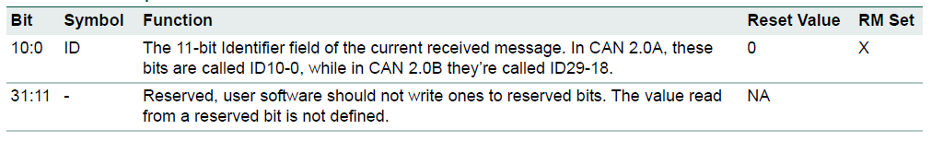
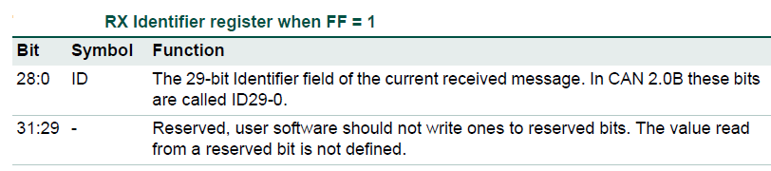
CAN Receive Identifier register (CAN1RID)
Embedded System Design Concepts - A simple approach
Programming CAN protocol
This register contains the Identifier field of the current received message.
It is read-only in normal operation but can be written for testing purposes if the RM bit in CANmod is 1.
It has two different formats depending on the FF bit in CANRFS.

Slide 62
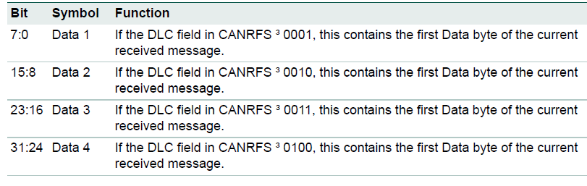
CAN Receive Data register A (CAN1RDA)
Embedded System Design Concepts - A simple approach
Programming CAN protocol

Slide 63
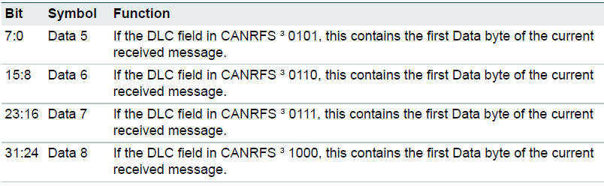
CAN Receive Data register B (CAN1RDB)
Embedded System Design Concepts - A simple approach
Programming CAN protocol

Slide 64
Global acceptance filter
Embedded System Design Concepts - A simple approach
Programming CAN protocol
This block provides lookup for received Identifiers (called Acceptance Filtering in CAN terminology) for all the CAN Controllers.
It includes a 512 X 32 (2 kB) RAM in which
Software maintains one to five tables of Identifiers. This RAM can contain up to 1024 standard Identifiers or 512 Extended Identifiers, or a mixture of both types.
The Acceptance Filter can be put into different modes by setting the according AccOff, AccBP, and eFCAN bits in the Acceptance Filter Mode Register.
A write access to all section configuration registers is only possible during the Acceptance Filter Off and Bypass Mode. Read access is allowed in all Acceptance Filter Modes

Slide 65
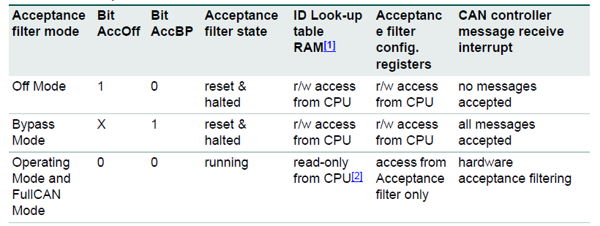
Acceptance filter modes
Embedded System Design Concepts - A simple approach
Programming CAN protocol
Off Mode: The Acceptance Filter Off Mode is typically used during initialization. During this mode an unconditional access to all registers and to the Look-up Table RAM is possible.
The Acceptance Filter Off Mode, CAN messages are not accepted and therefore not stored in the Receive Buffers of active CAN Controllers.
The Acceptance Filter Bypass Mode can be used for example to change the acceptance filter configuration during a running system, e.g. change of identifiers in the ID-Look-up Table memory.
During this re-configuration, software acceptance filtering has to be used.It is recommended to use the ID ready Interrupt (ID Index) and the Receive Interrupt (RI). In this mode all CAN message are accepted and stored in the Receive Buffers of active CAN Controllers.
The Acceptance Filter is in Operating Mode when neither the AccOff nor the AccBP in the Configuration Register is set and the eFCAN = 0.

Slide 66
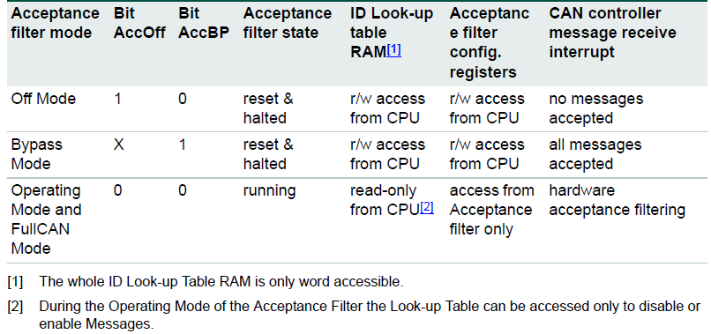
Embedded System Design Concepts - A simple approach
Programming CAN protocol
Full CAN mode
The Acceptance Filter is in Operating Mode when neither the AccOff nor the AccBP in the Configuration Register is set and the eFCAN = 1.

Slide 67
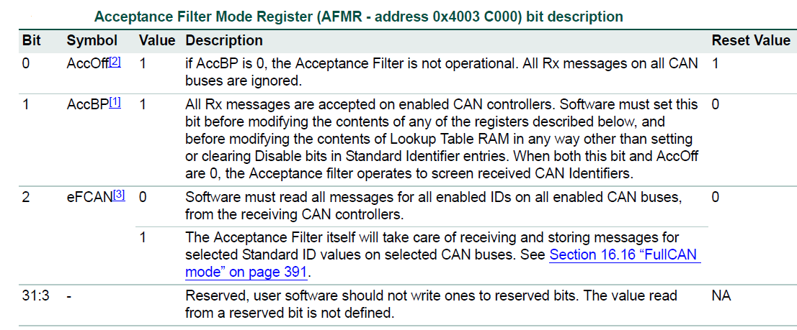
Acceptance Filter Mode Register (AFMR)
Embedded System Design Concepts - A simple approach
Programming CAN protocol
The AccBP and AccOff bits of the acceptance filter mode register are used for putting the acceptance filter into the Bypass and Off mode.

Slide 68
ID look-up table RAM
Embedded System Design Concepts - A simple approach
Programming CAN protocol
Five 12-bit section configuration registers
Standard Frame Individual Start Address register (SFF_sa).
Standard Frame Group Start Address register (SFF_GRP_sa).
Extended Frame Start Address register (EFF_sa).
Extended Frame Group Start Address register (EFF_GRP_sa).
End of AF Tables register (ENDofTable).
Note: Write access to the look-up table section configuration registers are possible only during the Acceptance filter bypass mode or the Acceptance filter off mode.

Slide 69
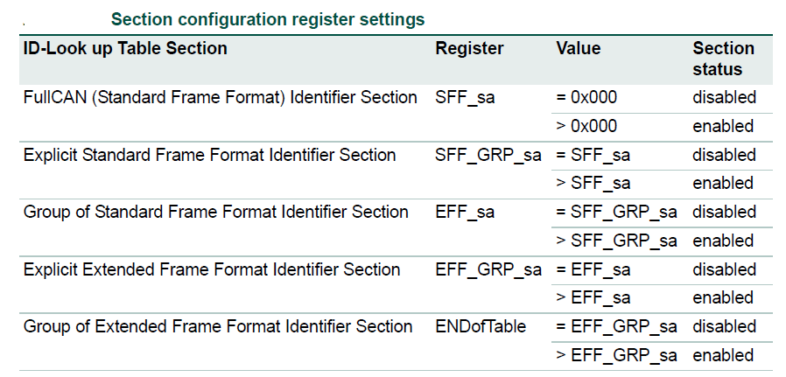
ID look-up table RAM
Embedded System Design Concepts - A simple approach
Programming CAN protocol

Slide 70
Standard Frame Individual Start Address register (SFF_sa)
Embedded System Design Concepts - A simple approach
Programming CAN protocol
Bit | Symbol | Description
1:0 | - | Reserved, user software should not write ones to reserved bits. The value read from a reserved bit is not defined.
10:2 | SFF_sa | The start address of the table of individual Standard Identifiers in AF Lookup RAM. If the table is empty, write the same value in this register and the SFF_GRP_sa register. write zeroes in bits 31:11 and 1:0 of this register.
31:11 | - | Reserved, user software should not write ones to reserved bits. The value read from a reserved bit is not defined.

Slide 71
2. Standard Frame Group Start Address register (SFF_GRP_sa)
Embedded System Design Concepts - A simple approach
Programming CAN protocol
Bit | Symbol | Description
1:0 | - | Reserved, user software should not write ones to reserved bits. The value read from a reserved bit is not defined.
10:2 | SFF_GRP_sa | The start address of the table of grouped Standard Identifiers in AF Lookup RAM.. .If the table is empty, write the same value in this register and the EFF_sa register. write zeroes in bits 31:11 and 1:0 of this register.
31:11 | - | Reserved, user software should not write ones to reserved bits. The value read from a reserved bit is not defined.

Slide 72
3. Extended Frame Start Address register (EFF_sa)
Embedded System Design Concepts - A simple approach
Programming CAN protocol
Bit | Symbol | Description
1:0 | - | Reserved, user software should not write ones to reserved bits. The value read from a reserved bit is not defined.
10:2 | EFF_sa | The start address of the table of individual Extended Identifiers in AF Lookup RAM. .If the table is empty, write the same value in this register and the EFF_GRP_sa register write zeroes in bits 31:11 and 1:0 of this register.
31:11 | - | Reserved, user software should not write ones to reserved bits. The value read from a reserved bit is not defined.

Slide 73
4. Extended Frame Group Start Address register (EFF_GRP_sa)
Embedded System Design Concepts - A simple approach
Programming CAN protocol
Bit | Symbol | Description
1:0 | - | Reserved, user software should not write ones to reserved bits. The value read from a reserved bit is not defined.
10:2 | Eff_GRP_sa | The start address of the table of grouped Extended Identifiers in AF Lookup RAM.. If the table is empty, write the same value in this register and the ENDofTable register write zeroes in bits 31:11 and 1:0 of this register.
31:11 | - | Reserved, user software should not write ones to reserved bits. The value read from a reserved bit is not defined.

Slide 74
5. End of AF Tables register (ENDofTable)
Embedded System Design Concepts - A simple approach
Programming CAN protocol
Bit | Symbol | Description
1:0 | - | Reserved, user software should not write ones to reserved bits. The value read from a reserved bit is not defined.
10:2 | Eff_GRP_sa | The address above the last active address in the last active AF table. write zeroes in bits 31:11 and 1:0 of this register.
31:11 | - | Reserved, user software should not write ones to reserved bits. The value read from a reserved bit is not defined.

Slide 75
ID look-up table RAM
Embedded System Design Concepts - A simple approach
Programming CAN protocol
The Whole ID Look-up Table RAM is only word accessible.
A write access is only possible during the Acceptance Filter Off or Bypass Mode.
Read access is allowed in all Acceptance Filter Modes.

Slide 76
Embedded System Design Concepts - A simple approach
Programming CAN protocol
Standard (11-bit) Identifiers
If Standard (11-bit) Identifiers are used in the application, at least one of 3 tables in Acceptance Filter RAM must not be empty.
If the optional “FullCAN mode” is enabled, the
First table contains Standard identifiers for which reception is to be handled in this mode.
The next table contains individual Standard Identifiers
The third contains ranges of Standard Identifiers
The tables of FullCAN and individual Standard Identifiers must be arranged in ascending numerical order, one per halfword, two per word.

Slide 77
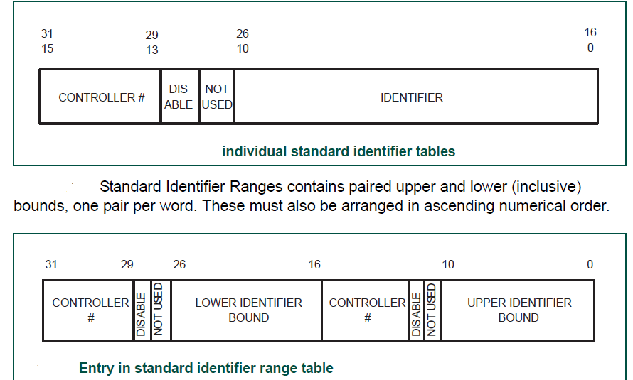
CAN Controller (SCC = 000(CAN1) SCC = 001 (CAN2)) .
Embedded System Design Concepts - A simple approach
Programming CAN protocol

Slide 78

Embedded System Design Concepts - A simple approach
Programming CAN protocol
Extended (29-bit) Identifiers
If Extended (29-bit) Identifiers are used in the application, at least one of the other two tables in Acceptance Filter RAM must not be empty.
One for individual Extended Identifiers
One for ranges of Extended Identifiers.
The table of individual Extended Identifiers
Must be arranged in ascending numerical order.

Slide 79
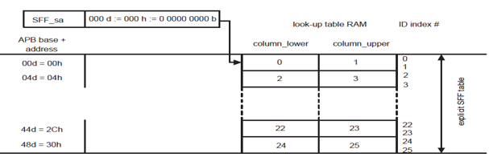
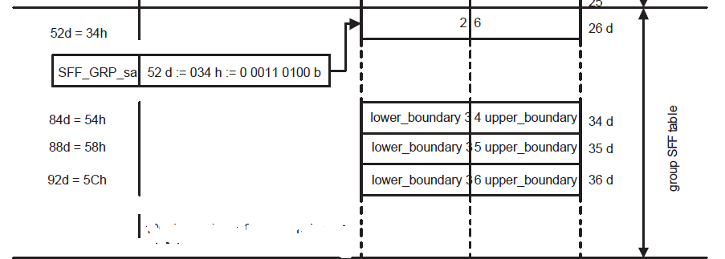
Example of acceptance filter tables and ID index values
Embedded System Design Concepts - A simple approach
Programming CAN protocol

Slide 80
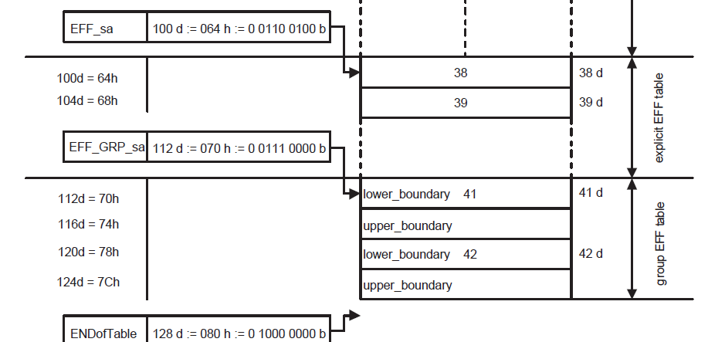
Example of acceptance filter tables and ID index values
Embedded System Design Concepts - A simple approach
Programming CAN protocol

Slide 81
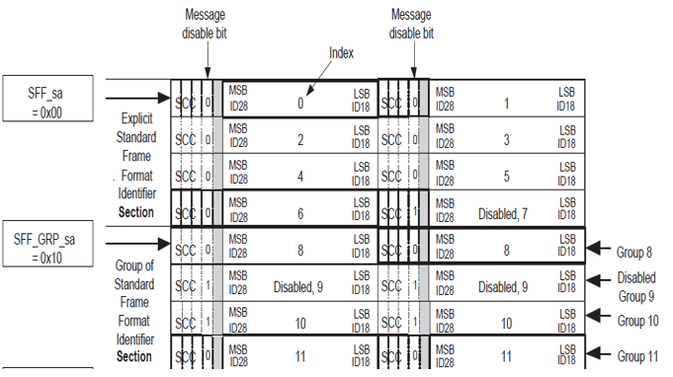
Example of acceptance filter tables and ID index values
Embedded System Design Concepts - A simple approach
Programming CAN protocol

Slide 82
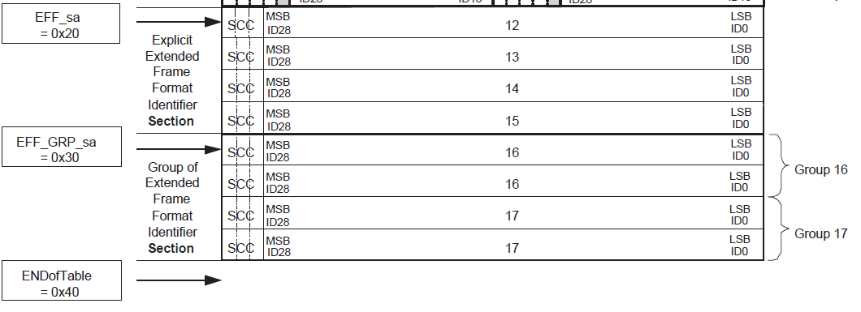
Example of acceptance filter tables and ID index values
Embedded System Design Concepts - A simple approach
Programming CAN protocol

Slide 83
CAN TRANSMITTER ALGORITHM
Embedded System Design Concepts - A simple approach
Programming CAN protocol
Enable CAN BLOCK in PCONP Register
Configure CAN Peripheral clock in PCLK register.
Make pin numbers P0.0 and P0.1 as CAN pins
Enter the CAN in disable mode using CANMODE REGISTER
Clear all bits in command register
Set the appropriate bits in BTR register
Enable receiver interrupt in IIER register.
Clear global register. GSR register.
Make CAN block in operating mode using CAN mode register.

Slide 84
Application 1 –Fire Detection & Alerting System
Embedded System Design Concepts - A simple approach
FIRE DETECTOR
ARM Cortex M3
GSM 900A
DRIVER
RELAY
MOTOR

Slide 85
Embedded System Design Concepts - A simple approach
Application 2 – SMS based Alerting and Controlling System
A Moisture Level Detector/ LM35
ARM Cortex M3
GSM 900A
ADC
DRIVER
RELAY
MOTOR

Slide 86
THANK YOU
Mahesh Awati
Department of Electronics and Communication
mahesha@pes.edu
+91 9741172822

Slide 87
