Slide 1

Exploratory Data Analysis – IMDB Movies Data

Slide 2
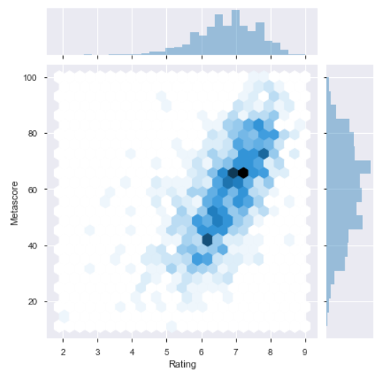
Graphical representation of critics ratings (Metascore) based on audience ratings (Rating)
We can see the high concentration of the points, where audience ratings are in agreement with critics rating. As per the above graph, audience rating from 6/10 to 8/10 and the critics rating 50/100 to 80/100.
For few of the movies there is differences in audience rating 5.5/10 to 6.5/ 100 and critics rating below 40/100. Even for audience rating from 7/10 to 8/10, critics gave rating 30/100 to 50/100
From the distribution, we can see in most of the cases if audience is happy they give rating 7/10, the audience rating curve is leptokurtic.
Critics are not giving higher rating to all the movies, the curve for the critics rating is mesokurtic.

Slide 3
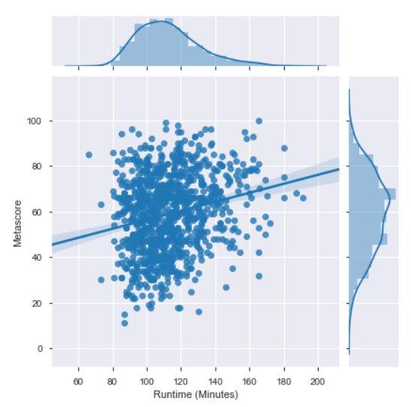
Graphical representation of the Metascore according to the duration of the film.
On this graph, we can see that for movies between 100 minutes and 120 minutes, the ratings of the critics are more concentrated and vary between 20/100 and 98/100.

Slide 4
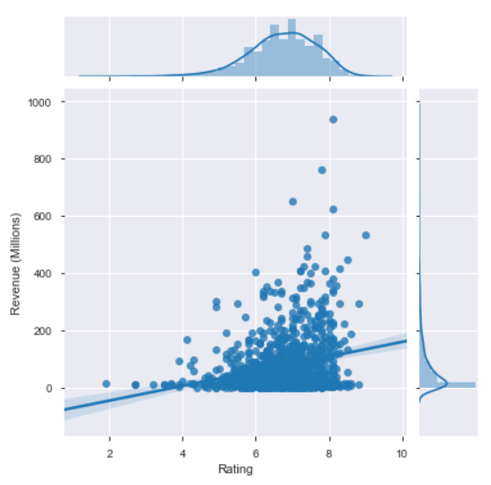
Graphical representation of the Revenue of the films according to the Rating from audience
We can see from the above graph that the most concentrated part where audience rating is from 6/10 to 8/10. Most of the movies earned 10 million to 100 million. Few of them within this rating earned within the range of 200 million to 400 million.

Slide 5
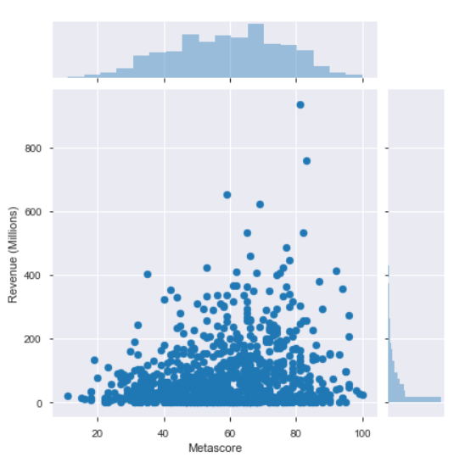
Graphic representation of the Revenue of the films according to the Metascore
We can see from the graph that, the most concentrated part is from 40/100 to 80/100 of critics rating. Movies earned more money for the higher rating.

Slide 6
Analysis of Genre

Slide 7
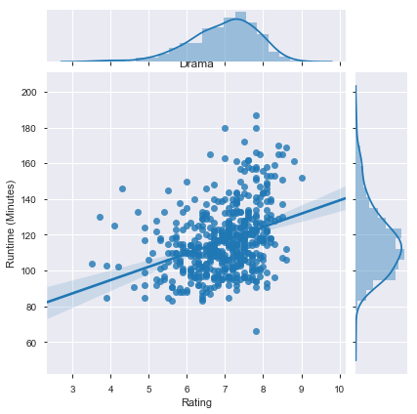
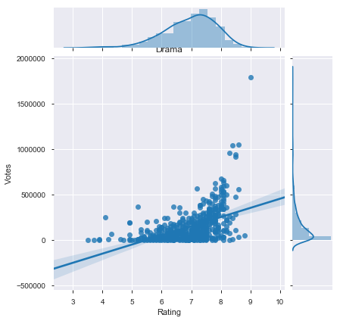
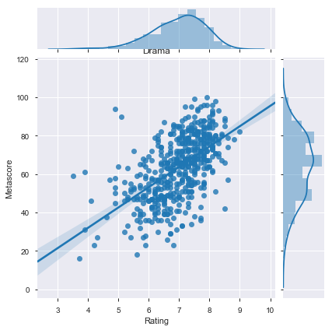
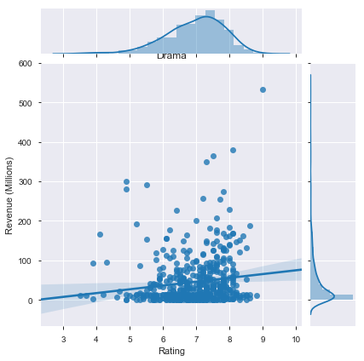
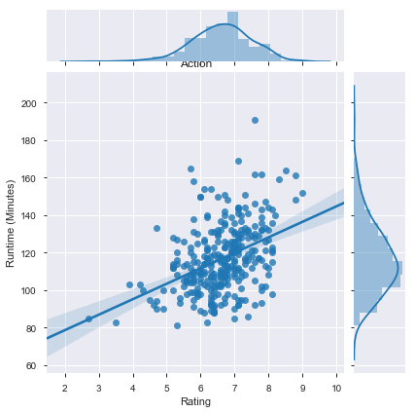
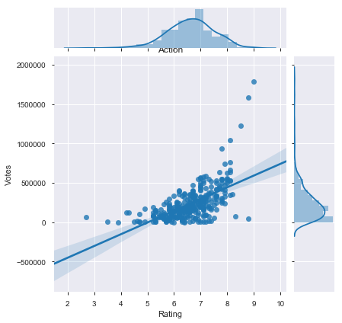
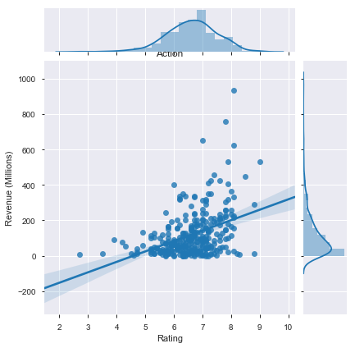
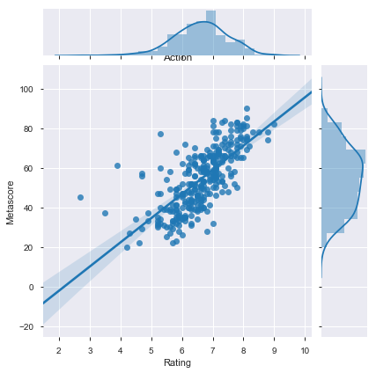
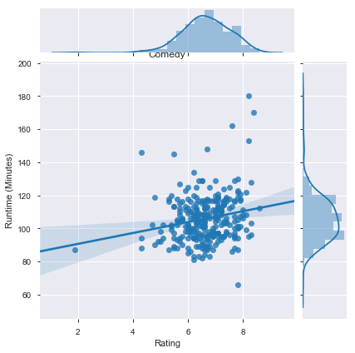
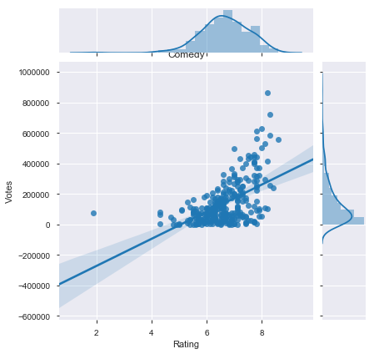
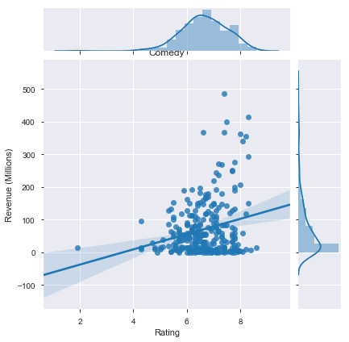
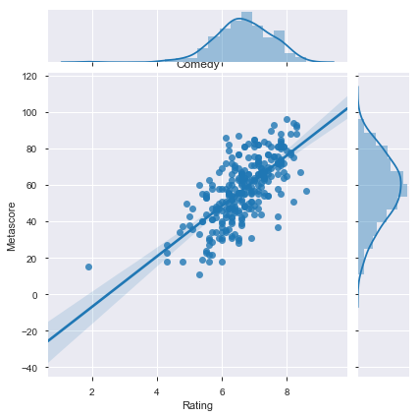

Slide 8
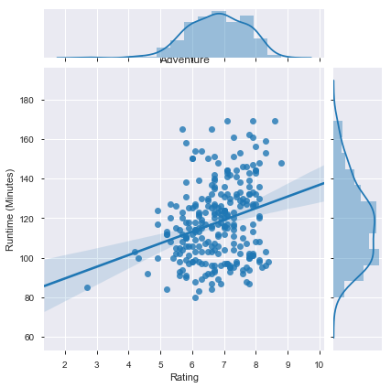
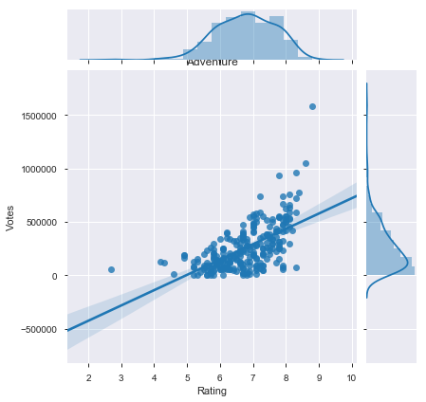
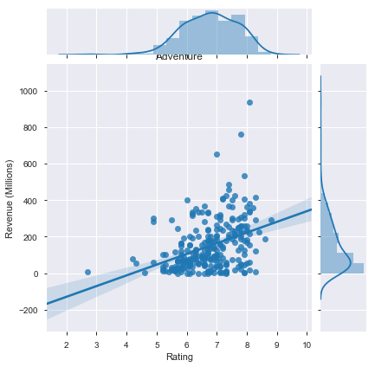
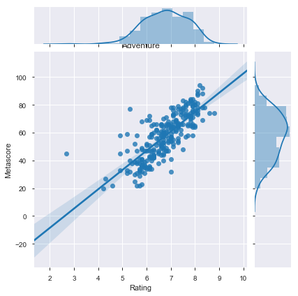
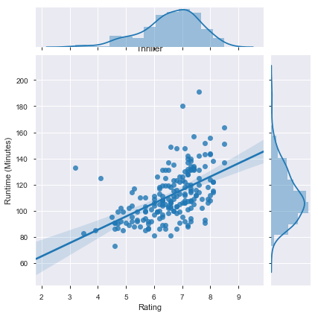
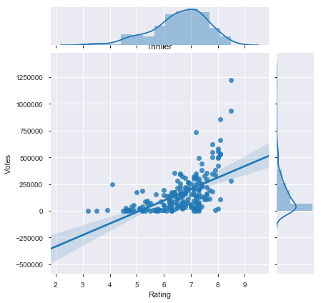
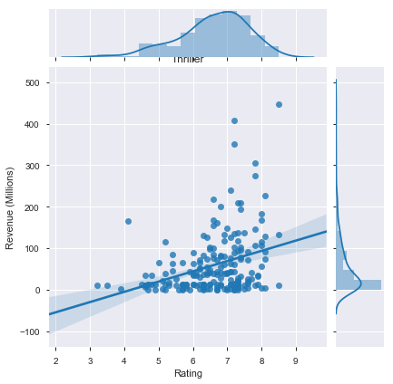
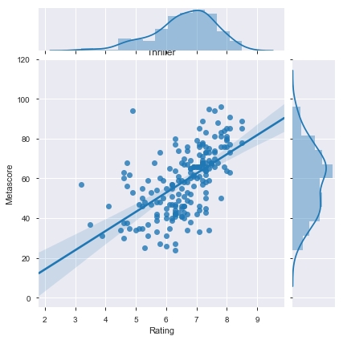

Slide 9
Maximum movie released for all categories (genre) in 2016 and then 2015.
Among all the categories highest number of movie released for Drama, the second highest category is Action and third highest category is Comedy. Also good number of movies released for Adventure and Thriller from 2006 to 2016.
Runtime vs Rating graph - for these 5 movie category the most concentrated part is for rating 6/10 - 8/10 and runtime is 100 mins to 130mins mostly
Votes vs Rating graph -- for Drama, Action, Adventure, and Thriller near 5 lakhs for comedy votes are near 4lakhs. In graph most concentrated part of 6/10 to 8/10 of the rating
Revenue vs Rating graph shows that mostly Action movies earned better revenue among al other categories, it earned mostly 200 million. For other category they earned below 100 million.
Metascore vs Rating graph shows that -- most concentrated part in the graph is 6/10 to 8/10 and Metascore is mostly 40/100 to 80/100, except Thriller it is 50/100 to 70/100

Slide 10
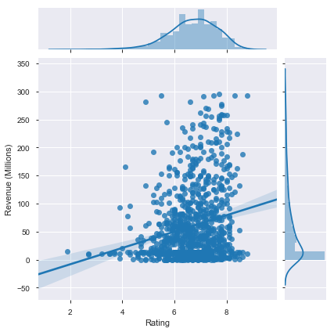
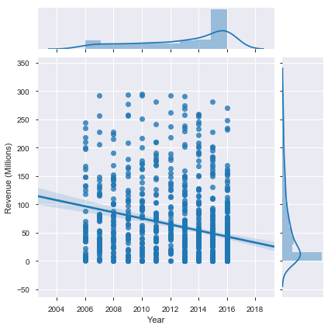
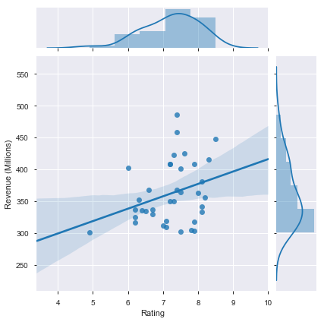
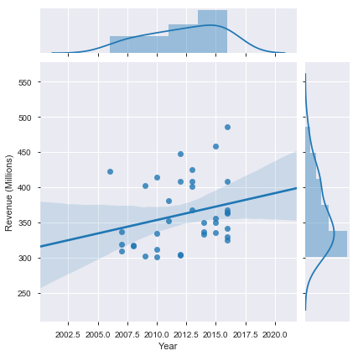
Revenue Analysis for lower, medium and higher range
Revenue below 300 million - There are 957 movies comes under the lower Revenue range, showing most concentrated part is for the rating range from 6/10 to 8/10, however most of the movies earned from 10 to 100 million, few of them between 100 to 200 million, and very few are above 200 million.
Revenue between 300 to 500 million - The medium Revenue range, showing the rating range from 6/10 to 8/10 and most of the movies earned from 300 to 375 million, few of them above 400 million.
Revenue More than 500 million - There are 6 movies earned more that 500 millions

Slide 11
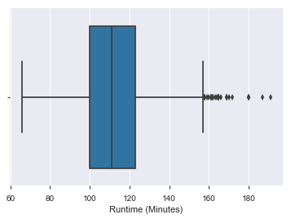
Runtime Analysis
Most of the movies run time is from 100 minutes to 120 minutes.

Slide 12

Actor Analysis
In this graph we can see that, the size of the name the actors are showing the frequency of words in actors column in the data set.

Slide 13
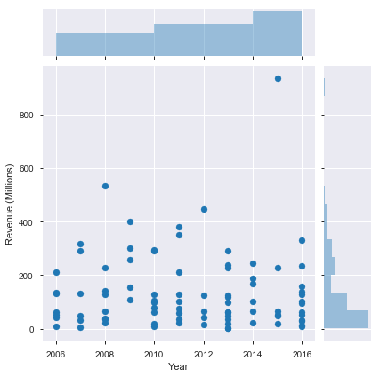
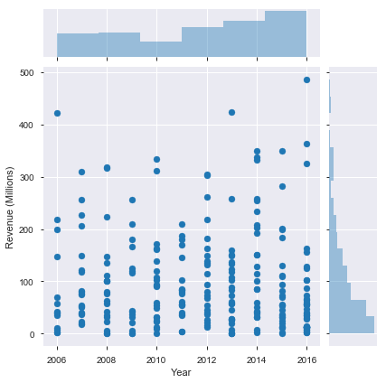
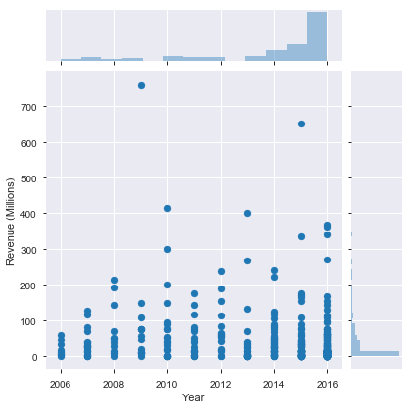
Director Analysis
DDDD
Director_1 category
Director_1 category - number of movies (5 to 8) - Mostly they earn the revenue near 200 millions and few of them earned near 400 million. But in 2015 J.J. Abrams crossed all the records and for his movie Star Wars: Episode VII - The Force Awakens, he earned revenue of 936 millions
Director_2 category - number of movies (3 to 4) - Mostly they earn the revenue near 200 millions and few of them earned from 200 to 300 million and very vey few from 300 to 400.
Director_2 category - number of movies (1 to 2) - Mostly they earn the revenue below 100 millions and few of them earned from 100 to 200 million. In the year 2009 James Cameron earned the revenue 760 million for his movie Avatar, this movie got critics rating 83/100. Also, In the year 2015 Colin Trevorrow earned 652 million for his movie Jurassic World, this movie got the critics rating 59/100.
Director_2 category
Director_3 category

Slide 14
Conclusions
Audience ratings of the movies are quite close to the critics ratings for most of the movies but for few of the movies the rating differences are present for audience and those to critics.
From the distribution, we can see in most of the cases if audience is happy they give rating 7/10, the audience rating curve is leptokurtic.
Critics are not giving higher rating to all the movies, the curve for the critics rating is mesokurtic. Critics rate more severely than the public.
Most movies last between 100 minutes and 120 minutes
Mostly movies that are well rated by public and critics make the most money.
The more the public appreciates a film, the more they vote and give a good rating
Maximum movie released for all categories (genre) in 2016 and then 2015.
Among all the categories highest number of movie released for Drama, the second highest category is Action and third highest category is Comedy. Also good number of movies released for Adventure and Thriller from 2006 to 2016.
Drama, Action, Comedy, Adventure, Thriller, Crime are highest rated movies from public.
Mostly Action movies earned better revenue among all other categories.

Slide 15
Thank you !!

