Slide 1
CSI TECHNOLOGY GROUP
Premier Software Solutions for eGovernment

Slide 2
AGENDA
Introduction
CJIS Security
Support & Maintenance
Implementation & Testing Approach
Data Migration Services
02
23
27
32
40

Slide 3
TECHNICAL
ARCHITECTURE & SECURITY
Cloud/On-premise, Uptime, Dependability, Performance, Continuity of
operations/Hot fail-over, Disaster Recovery

Slide 4
TECHNICAL
ARCHITECTURE & SECURITY
Cloud/On-premise, Uptime, Dependability, Performance, Continuity of operations/Hot fail-over, Disaster Recovery

Slide 5
TECHNICAL
ARCHITECTURE & SECURITY
Cloud/On-premise, Uptime, Dependability, Performance, Continuity of operations/Hot fail-over, Disaster Recovery

Slide 7
Heading

Slide 8
REGIONAL CONCEPT
Single RMS Operation Independently
Permission Control
UI and Function Design
Data sharing
Master Indices Data (Person, Vehicle, Location)
Big Data Analysis
Hardware Costs
HR Costs
Single Unit
Yes
Single RMS internal permission setup
N/A
Higher cost (share by interface)
Updating data between systems via a point-to-point interface; more costly
Lesser benefit (collecting data from single agency)
Higher cost (one set of hardware system for one agency)
Higher cost (one IT department for one agency)
Regional (InfoShare)
Yes
Cross-Region RMS permission control by agencies at different levels
Customizable UI and function fulfill agencies’ needs
Central data management, data accessible by permission control
Data sharing with all agencies
More benefit (collecting data from all agencies)
Lower cost (only one set of hardware system for all agencies)
Lower cost (only one IT department to maintain)

Slide 9
STANDARD TABLE

Slide 10
LOW-CODE DEVELOPMENT PLATFORM
A low-code development platform enables developers—and anyone with simple database knowledge—to create applications with minimal coding, exponentially accelerating the development lifecycle. This frees up significant time to focus on responsibilities that really matter. Traditional coding is complex, time-consuming, and not to mention, expensive. In the long run, CSI's low-code proprietary technology significantly lowers training, deployment, modification, and maintenance costs.

Slide 11
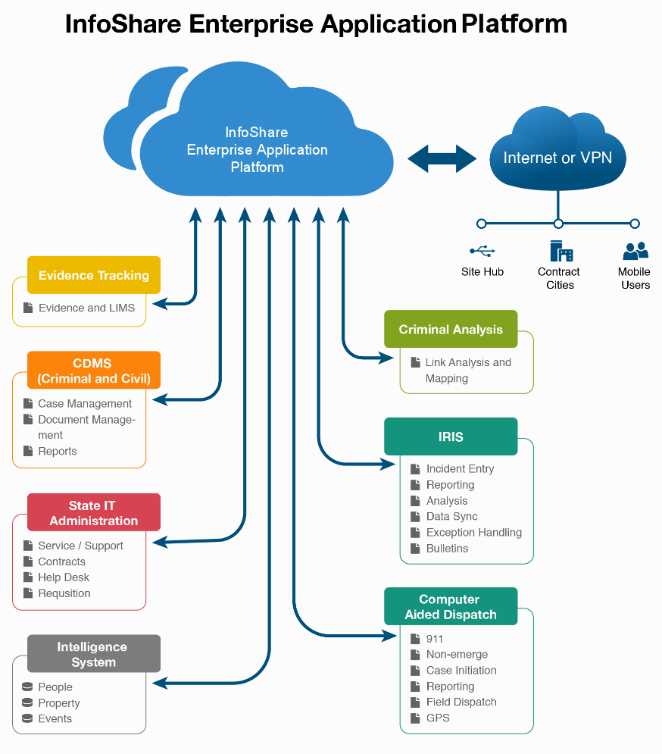
ENTERPRISE GOVERNMENT APPLICATION
Regional System
The Regional Approach with a Local Feel
Data be shared, but not lose an agency’s identity in the process
Platform
Patented Engine Technology
Cost-Effectiveness
Quality Assurance
Standardization
Modularization
Flexibility
Security

Slide 12
SINGLE DEVELOPMENT PLATFORM
“InfoShare Engine® is a low code development platform that empowers government application development across multiple categories. Other vendors design and code disparate applications that lack true integration, leading to large overhead expenses, inefficiencies, and additional training down the road. Other complications include high customization costs, limited scalability, and frequent delays. In contrast, CSI’s Engine® can be summarized as high speed, low cost. “

Slide 13
Thank you

