Slide 1
HCV PREDICTION
Made By
Joyita Hazra

Slide 2
definition
Hepatitis C (HCV) is a virus that causes an infection of the liver that is marked by liver inflammation and damage.
Hepatitis C tests are a group of tests that are performed to diagnose hepatitis C infection and to guide and monitor treatment of the infection.

Slide 3
introduction
This dataset is laboratory record of Hepatitis C Virus test which contains 14 attributes.
Patient ID/No.
Category (diagnosis) (values: '0=Blood Donor', '0s=suspect Blood Donor', '1=Hepatitis', '2=Fibrosis', '3=Cirrhosis')
Age
Sex
ALB - Albumin
ALP - Alkaline Phosphatase
ALT - Alanine Aminotransferase

Slide 4
AST - Aspartate Aminotransferase
BIL - Bilirubin
CHE - Acetylcholinesterase
CHOL - Cholesterol
CREA - Creatinine
GGT - Gamma-Glutamyl Transferase
PROT - Protein
Category (blood donors vs. Hepatitis C (including its progress ('just' Hepatitis C, Fibrosis, Cirrhosis) is the Target feature

Slide 5
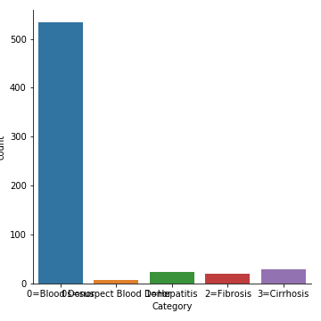
EDA
Inference:
according to the above graph, we can say that maximum patients are suffering from Cirrhosis disease in this dataset, followed by Hepatitis C and Fibrosis diseases.
Least number of patients are there under Suspect Blood Donor Category

Slide 6
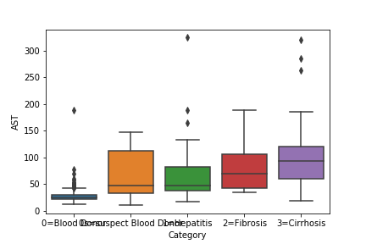
Inference:
The reference range for aspartate aminotransferase (AST) is as follows: Males: 6-34 IU/L. Females: 8-40 IU/L.
Blood donors have AST level between 20-40
Suspect blood donors have AST level between 45-115
Hepatitis C patients have AST level between 49-80
Fibrosis patients have AST level between 50-110
Cirrhosis patients have AST level between 70-120

Slide 7
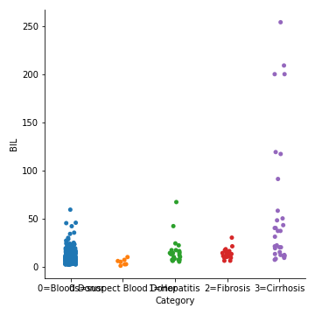
Inference:
It is normal to have some bilirubin in the blood. A normal level is: Direct (also called conjugated) bilirubin: less than 0.3 mg/dL (less than 5.1 µmol/L) Total bilirubin: 0.1 to 1.2 mg/dL (1.71 to 20.5 µmol/L)
blood donors have BIL amount between 0-30
suspect blood donors have BIL amount less than 15
Hepatitis C patients have BIL amount between 10-30
Fibrosis patients have BIL amount between 10-35
Cirrhosis patients have BIL amount between 10-60

Slide 8
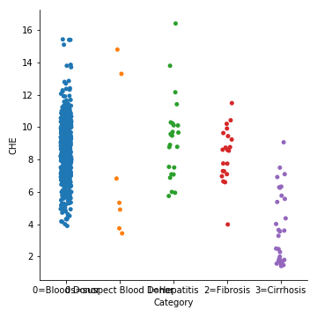
Inference:
Typically, normal pseudocholinesterase values range between 8 and 18 units per milliliter (U/mL) or 8 and 18 kilounits per liter (kU/L).
blood donors have Acetylcholinesterase level between 5-12.7
suspect blood donor have CHE level between 3-5
Hepatitis C patients have CHE level between 6-10.2
Fibrosis patients have CHE level between 6.8-10.7
Cirrhosis patients have CHE level between 1-8.6

Slide 9
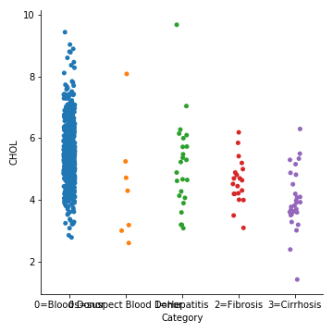
Inference:
Normally Cholesterol level should be less than 200 mg/dL blood donors have cholesterol level between 3.7-7.8
suspect blood donors have Chol level between 2.5-3.5
Hepatitis C patients have Chol level between 3-6.3
Fibrosis patients have Chol level between 4-6
Cirrhosis patients have Chol level between 3-5.9

Slide 10
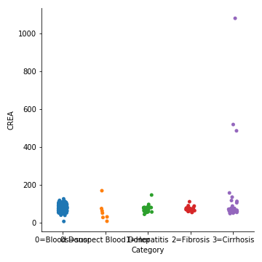
Inference:
Normally creatinine level should be less than 1.2 milligrams/deciliter (mg/dL) for women and 1.4 mg/dL for men
blood donors have crea level between 20-130
suspect blood donors have crea level between 0-90
Hepatitis C patients have crea level between 70-110
Fibrosis patients have crea level between 75-90
Cirrhosis patients have crea level between 20-160

Slide 11
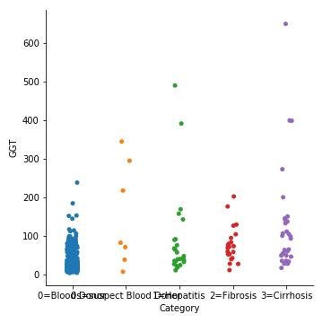
Inference:
the normal range for GGT levels is 9–48 units per liter (U/L). Normal values can vary due to age and sex. The GGT test can diagnose liver damage, but it can't determine the cause.
blood donors have GGT level between 0-100
suspect blood donors have GGT level between 0-95
Hepatitis C patients have GGT level between 10-110
Fibrosis patients have GGT level between 20-150
Cirrhosis patients have GGT level between 10-165

Slide 12
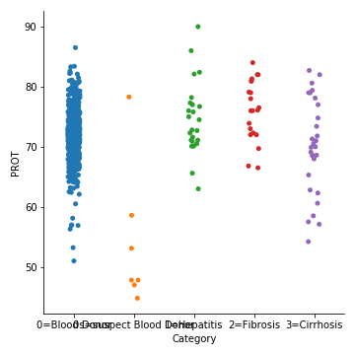
Inference:
The normal range for total protein is between 6 and 8.3 grams per deciliter (g/dL).
blood donors have protein amount between 64-81
suspect blood donors have protein amount less than 40
Hepatitis C patients have protein amount between 70-79
Fibrosis patients have protein amount between 71-82
Cirrhosis patient have protein amount between 59-82

Slide 13
Feature engineering
In this dataset, null values are present which are less than 1%. Hence rows containing null values can be removed, but it is reducing the accuracy of the model.
Null values have been filled with “ffill” method in python.
According to Variance Inflation Factor, we found that features “ALB” and “CHOL” have VIF values 34.49 and 31.29
Dropping these two features is reducing VIF values of rest of the features normal (i.e. <= 5 approximately). But the accuracy and precision values of the model are gradually decreasing by removing these 2 features.

Slide 14
Machine learning
Here Logistic Regression algorithm has been used as it is giving the best results compared to other algorithms.
With Logistic Regression, we are getting following error matrix values:
- Accuracy = 96.7479 %
- Precision = 97.6701%
- Recall Score = 96.7479%

Slide 15
conclusion
Null values have been filled with “ffill” method in python.
According to VIF, removing features “ALB” and “CHOL” were reducing the accuracy of the model.
Hence we found that Maximum Accuracy is obtained without removing any of the features of the dataset.
We can conclude that we are getting best results with Logistic Regression Algorithm as it is providing Maximum Accuracy.

Slide 16
reference
https://labtestsonline.org/tests/hepatitis-c-testing#:~:text=An%20HCV%20antibody%20test%20is,or%20a%20previous%20HCV%20infection.
https://www.urmc.rochester.edu/encyclopedia/content.aspx?contenttypeid=167&contentid=albumin_blood#:~:text=A%20normal%20albumin%20range%20is,surgery%20or%20a%20heart%20attack.
https://www.healthline.com/health/alp#:~:text=The%20normal%20range%20of%20ALP,children%20and%20decreases%20with%20age.
https://www.healthline.com/health/alt#:~:text=The%20normal%20value%20for%20ALT,factors%2C%20including%20gender%20and%20age.
https://emedicine.medscape.com/article/2087224-overview#:~:text=The%20reference%20range%20for%20aspartate,%3A%208%2D40%20IU%2FL
https://medlineplus.gov/ency/article/003479.htm#:~:text=Normal%20Results&text=It%20is%20normal%20to%20have,1.71%20to%2020.5%20%C2%B5mol%2FL)

Slide 17
https://medlineplus.gov/ency/article/003358.htm#:~:text=Normal%20Results&text=Typically%2C%20normal%20pseudocholinesterase%20values%20range,of%20your%20specific%20test%20results.
https://www.healthline.com/health/gamma-glutamyl-transpeptidase#:~:text=According%20to%20the%20Mayo%20Clinic,have%20to%20undergo%20more%20tests.
https://www.healthline.com/health/total-protein#:~:text=The%20normal%20range%20for%20total,may%20vary%20slightly%20among%20laboratories.
https://medlineplus.gov/cholesterollevelswhatyouneedtoknow.html
https://www.mayoclinic.org/tests-procedures/creatinine-test/about/pac-20384646#:~:text=The%20normal%20range%20for%20creatinine,and%20women%2C%20and%20by%20age.

Slide 18
THANK YOU

