Slide 1
HEART FAILURE PREDICTION
Made By
Joyita Hazra

Slide 2
DEFINITION
It is a pathophysiological process in which the heart as a pump is unable to meet the metabolic requirements of the tissue for oxygen and substrates despite the venous return to heart is either normal or increased.
Heart failure is defined as “A complex clinical syndrome that results from any structural or functional Impairment of Ventricular filling (Diastole) or Ejection of Blood (Systole).”

Slide 3
INTRODUCTION
The various features in this dataset are as follows:
Age : age of the patient
Anemia : decrease of red blood cells or hemoglobin
High Blood Pressure : if the patient has hypertension
Creatinine Phosphokinase (CPK) : level of the CPK enzyme in the blood (mcg/L)
Diabetes : if the patient has diabetes
Ejection Fraction : percentage of blood leaving the heart at each contraction

Slide 4
Platelets : platelets in the blood (kilo-platelets/mL)
Sex : woman or man
Serum Creatinine : level of serum creatinine in the blood (mg/dL)
Serum Sodium : level of serum sodium in the blood (mEq/L)
Smoking : if the patient smokes or not
Time : follow-up period (days)
Death event : if the patient deceased during the follow-up period
Death Event is the Target feature in this dataset which depends upon the other independent features.

Slide 5
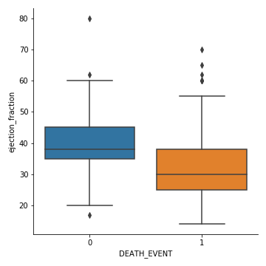
EDA
Inference:
by seeing this graph, we can say that ejection fraction level should be more than 38%
death event is likely to happen for people having ejection fraction level less than 38%

Slide 6
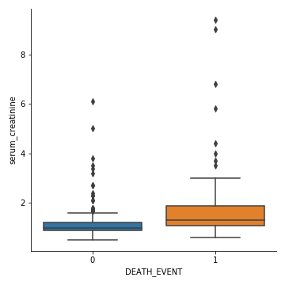
Inference:
serum creatinine amount should be between 0.7 - 1.1 mg/dL for males and 0.6 - 0.9 mg/dL for females
in general, creatinine level should be less than 1.2 milligrams/deciliter (mg/dL) for women and 1.4 mg/dL for men
according to the graph, death event is not happening for people having serum creatinine level 1.2 mg/dL
and death event is happening for people having serum creatinine level more than 1.2 mg/dL

Slide 7
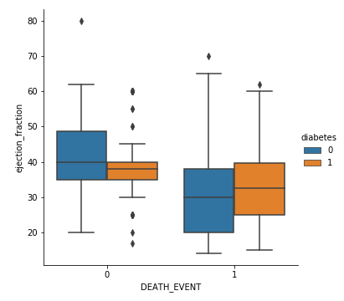
Inference:
by seeing the above graph, we can conclude that normally ejection fraction should be more than 38%
patients with ejection fraction less than 38% are prone to death event.
Also, patients who are diabetic and have ejection fraction less than 38% are more likely to get heart failure

Slide 8
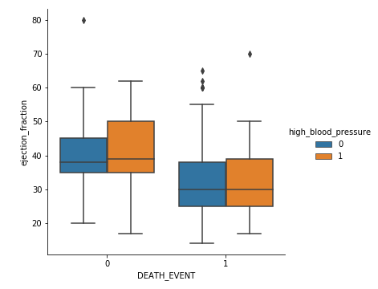
Inference:
People having high blood pressure are more prone to Heart Diseases.
according to the graph, patients having ejection fraction less than 38% and having high blood pressure are more likely to get heart failure

Slide 9
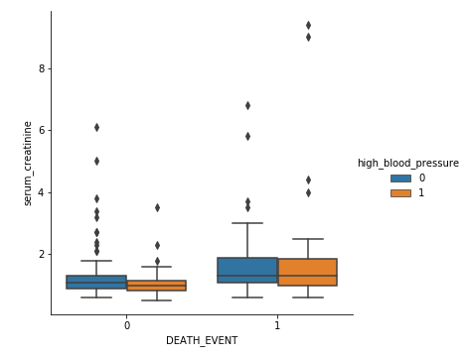
Inference:
according to the graph, patients having serum creatinine level more than 1.2 mg/dL and having high blood pressure are more likely to get heart failure.

Slide 10
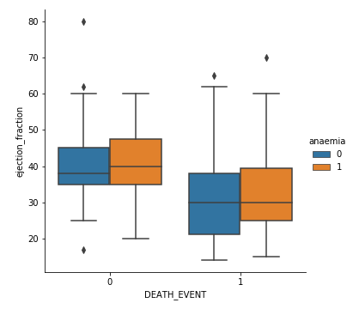
Inference:
by seeing the graph, we can clearly say that Anaemia is not having much impact on heart failure
according to the graph, patients having ejection fraction less than 38% and having anaemia are more prone to heart diseases

Slide 11
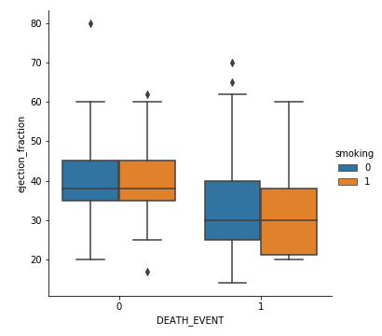
Inference:
by seeing the graph, we can clearly say that patients having ejection fraction less than 38% and are Smokers are more prone to heart diseases or heart failure.

Slide 12
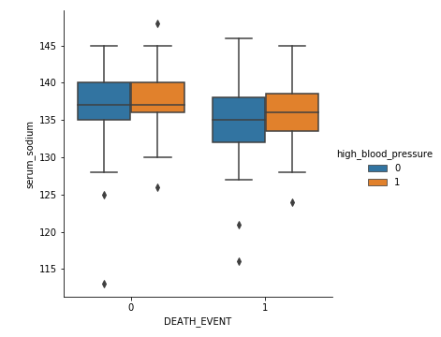
Inference:
According to the graph, patients with serum sodium level less than 135 mEq/L and having high blood pressure are more likely to get heart diseases or heart failure

Slide 13
FEATURE ENGINEERING
Based on the visualization done on this dataset, we can clearly conclude that features “Anemia and Creatinine Phosphokinase” were not affecting the Target feature much, hence these 2 features can be removed, but we are not getting better results.
According to Variance Inflation Factor, we found that features “Serum Sodium” and “Age” have VIF values 59 and 30.
Hence we have dropped of each of the features (as mentioned in previous point) one by one and checked the Error Metrices.
We found that maximum Accuracy is achieved by removing the features “Age” and “Serum Sodium”.

Slide 14
MACHINE LEARNING
Here 3 machine learning algorithms has been used and they are as follows:
- Logistic Regression
- Naïve Bayes
- Decision Tree
With Logistic Regression, we are getting following error matrix values:
- Accuracy = 73.3333 %
- Precision = 88. 8889%
- Recall Score = 34.7826%

Slide 15
With Naïve Bayes,
- Accuracy = 70.0%
- Precision = 72. 7273%
- Recall Score = 34.7826%
With Decision Tree,
- Accuracy = 88.3333%
- Precision = 80. 7692%
- Recall Score = 91.3043%
Hence, we can conclude that we are getting best results from Decision Tree Algorithm.

Slide 16
CONCLUSION
As per the studies and EDA, we can conclude that the Target feature is majorly dependent on the features Ejection Fraction, High Blood Pressure, Serum Creatinine , Smoking, Diabetes.
As per the visualization, features such as Age, Sex and Time are partially impacting the Death Event. But these can’t be the exact or appropriate reasons for the occurrence of Heart Failure.
We found that maximum Accuracy is achieved by removing the features “Age” and “Serum Sodium”.
We can conclude that we are getting best results from Decision Tree Algorithm as it is providing Maximum Accuracy.

Slide 17
REFERENCE
https://www.ucsfhealth.org/medical-tests/003481#:~:text=The%20normal%20range%20for%20blood,of%20your%20specific%20test%20results.
https://www.pharmacytimes.com/news/mild-coronary-artery-disease-puts-diabetics-at-cardiovascular-risk
https://www.pharmacytimes.com/news/prostate-cancer-treatment-decreases-survival-in-men-with-longer-life-expectancy
https://www.pharmacytimes.com/news/Mild-Coronary-Artery-Disease-Puts-Diabetics-at-Cardiovascular-Risk
https://www.healthline.com/health/kidney-function-tests#procedures
https://medlineplus.gov/ency/article/003435.htm#:~:text=Kidney%20function%20tests%20are%20common,Creatinine%20clearance
https://labtestsonline.org/tests/urinalysis#
https://www.healthline.com/health/frequent-or-urgent-urination#causes
https://www.healthline.com/health/glucose-test-blood

Slide 18
https://www.healthline.com/health/high-cholesterol
https://www.healthline.com/health/high-blood-pressure-hypertension#overview
https://www.healthline.com/health/hdl-test#risks
https://www.healthline.com/nutrition/high-cholesterol-foods
https://www.healthline.com/health/ldl-cholesterol
https://www.healthline.com/health/ldl-cholesterol
https://www.healthline.com/health/kidney-failure#diabetes
https://www.healthline.com/health/triglyceride-level#treatments
https://www.healthline.com/health/diabetes/insulin-resistance-symptoms#TOC_TITLE_HDR_1
https://www.healthline.com/health/heart-disease/causes-risks#risk-factors
https://www.healthline.com/health/depression
https://www.medicalnewstoday.com/articles/237191#prevention
https://www.healthline.com/health/high-cholesterol

Slide 19
THANK YOU

