Slide 1

Customer Shopping Behavior Analysis
3,900 transactions · 18 features · Strategic insights into spending, segments & subscriptions

Slide 2
Dataset at a Glance
3,900
18
37
Purchases
Features
Missing Values
Review Rating only
Demographics
Purchases
Behavior
Age, Gender, Location, Subscription
Item, Category, Amount, Season
Discount, Frequency, Reviews

Slide 3

Data Preparation in Python
01
Load & Explore
Imported via pandas; df.info(), .describe()
02
Clean Missing Data
Imputed Review Rating using median by category
03
Feature Engineering
Built age_group & purchase_frequency_days
04
Load to PostgreSQL
Cleaned DataFrame loaded for SQL analysis

Slide 4
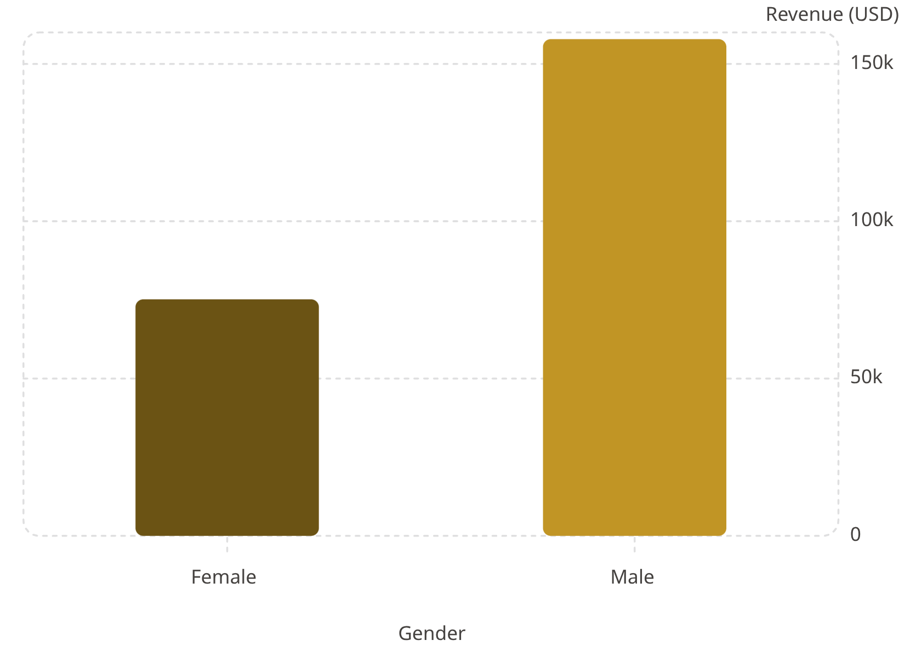

Revenue by Gender
Male Customers Drive 2× Revenue
Male shoppers generated $157,890 vs. $75,191 from females — a key targeting insight.
Males: 2,652 customers · Females: 1,248 customers

Slide 5
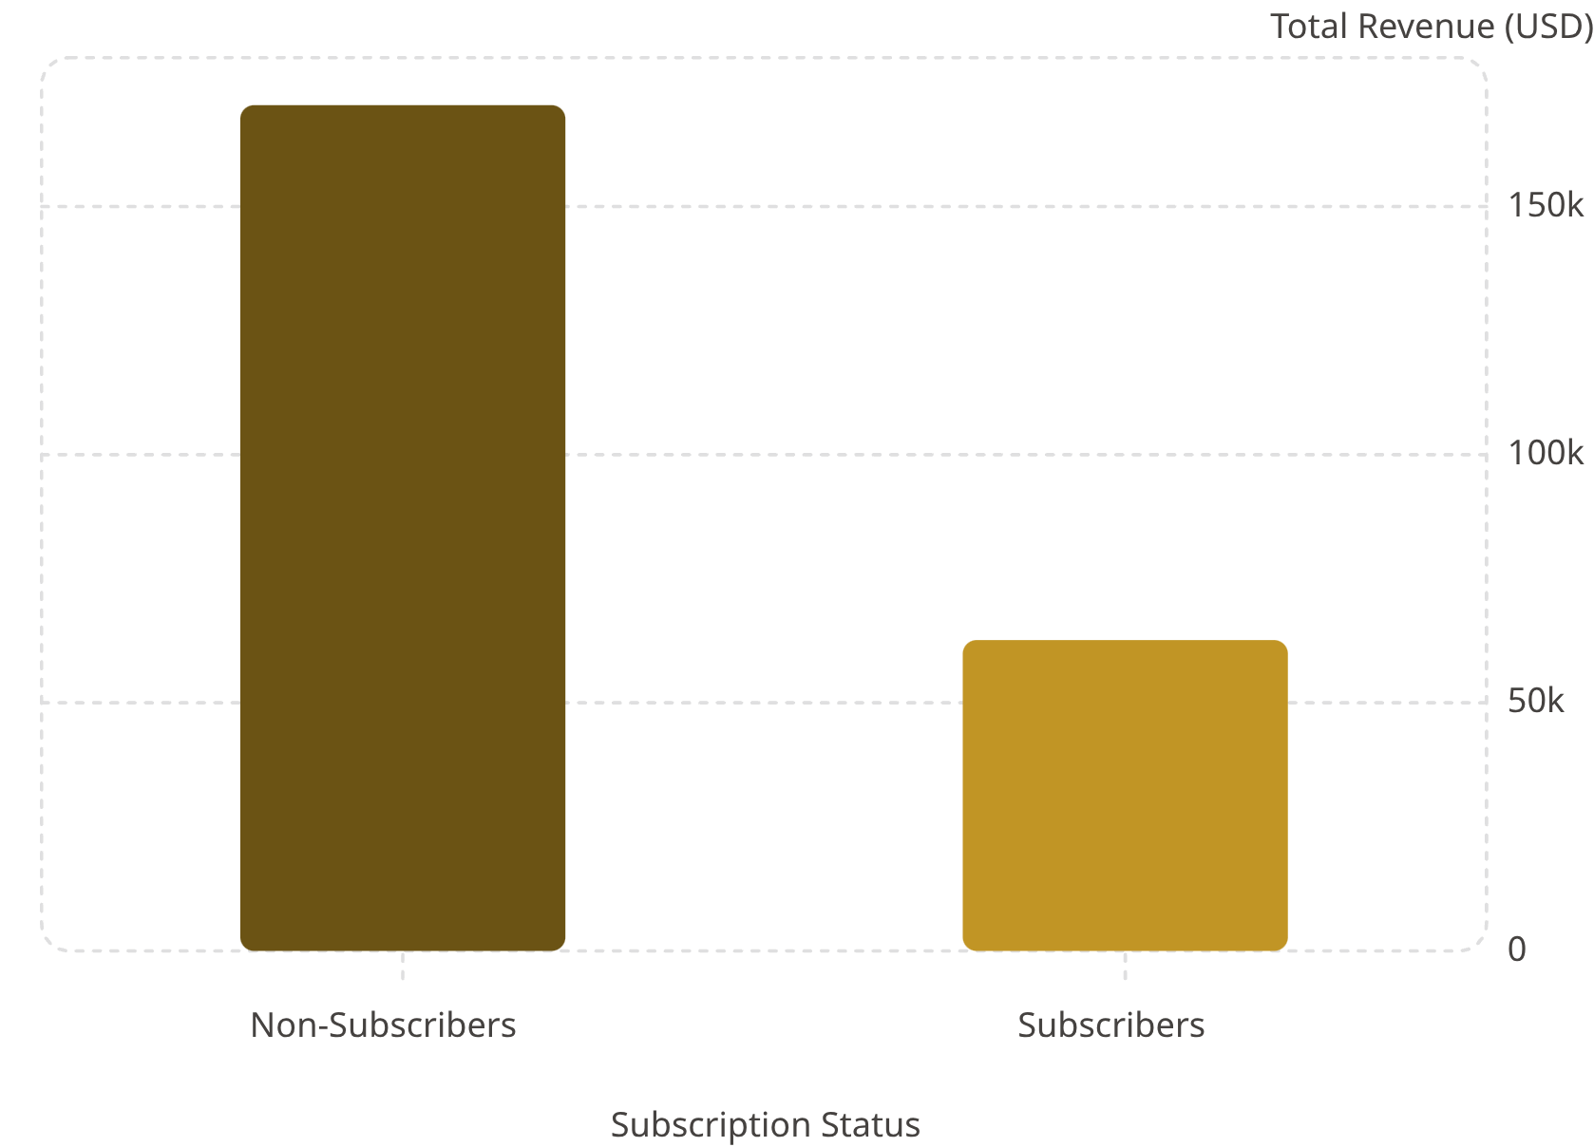
Subscribers vs. Non-Subscribers
73% Are Non-Subscribers
Non-subscribers generate $170K total revenue, yet average spend is nearly identical (~$59).
27% Subscribers
73% Non-Subscribers
1,053 customers
2,847 customers

Slide 6
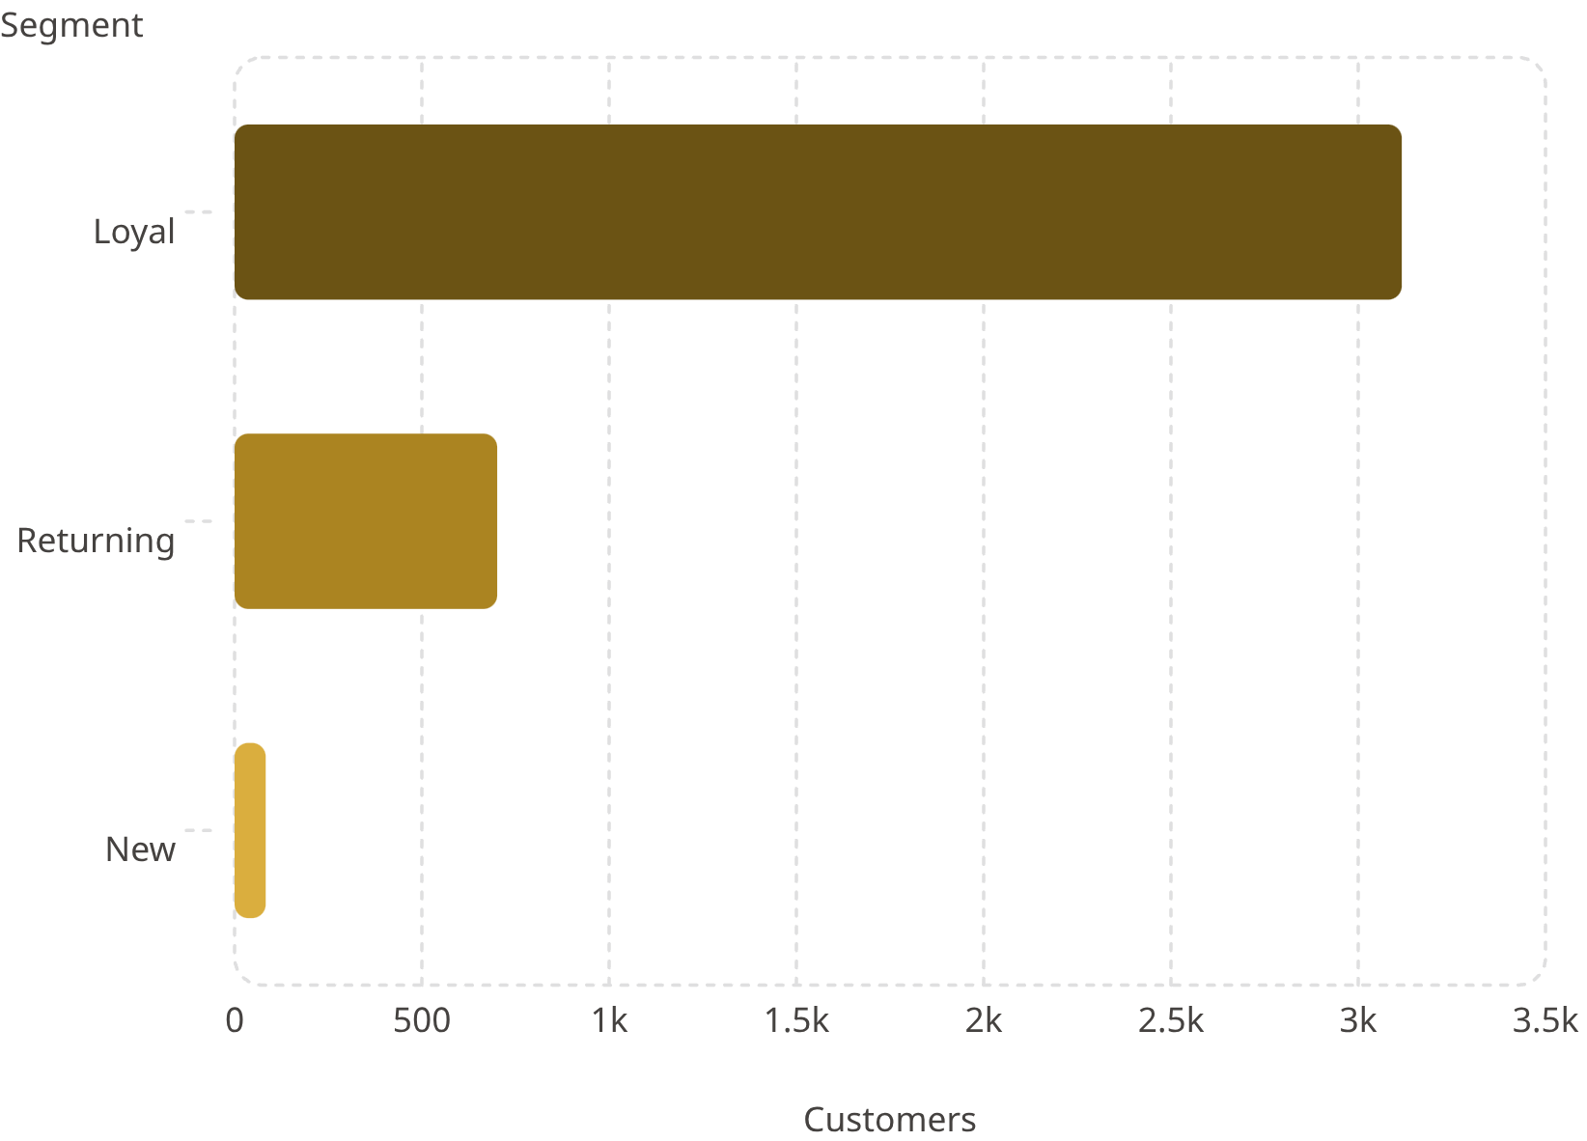

Customer Segmentation
Loyal Customers Dominate
80% of customers are classified as Loyal. Only 83 are New — growth opportunity.
958 repeat buyers (5+ purchases) subscribe
2,518 repeat buyers do not subscribe

Slide 7

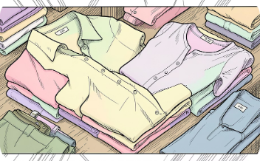
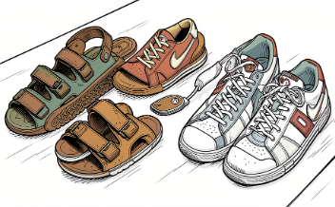

Top Products & Categories
Accessories
Clothing
Footwear
Outerwear
Jewelry · Sunglasses · Belt
Blouse · Pants · Shirt
Sandals · Shoes · Sneakers
Jacket · Coat
Highest-rated: Gloves (3.86★). Most discounted: Hat (50%).

Slide 8
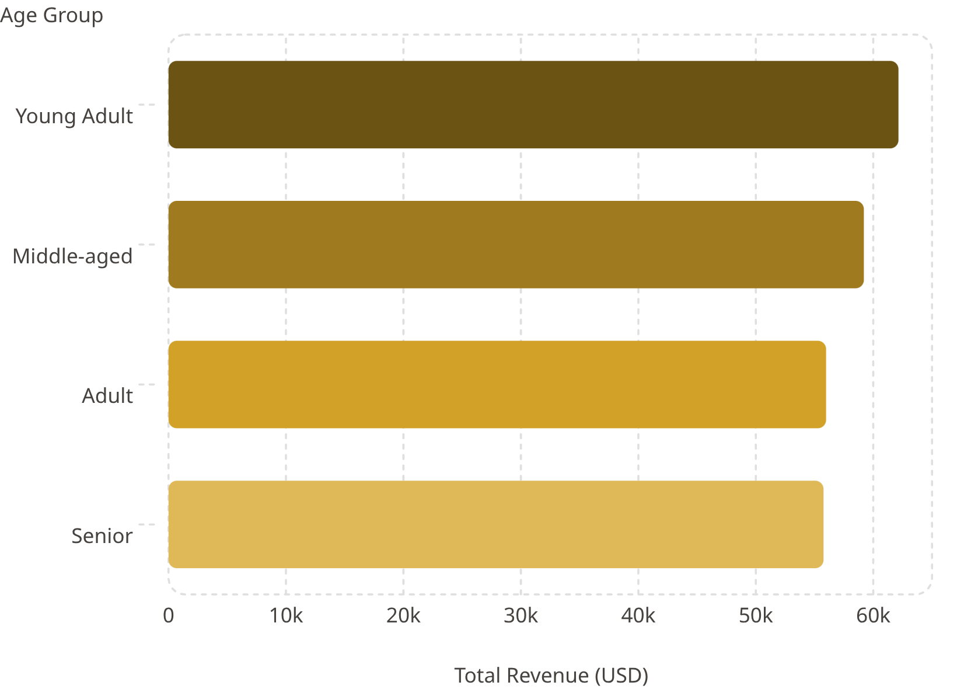

Revenue by Age Group
Young Adults Lead Revenue
Young Adults contribute $62,143 — highest among all age groups. Revenue is relatively balanced across segments.
Express shipping averages $60.48 vs. Standard $58.46

Slide 9
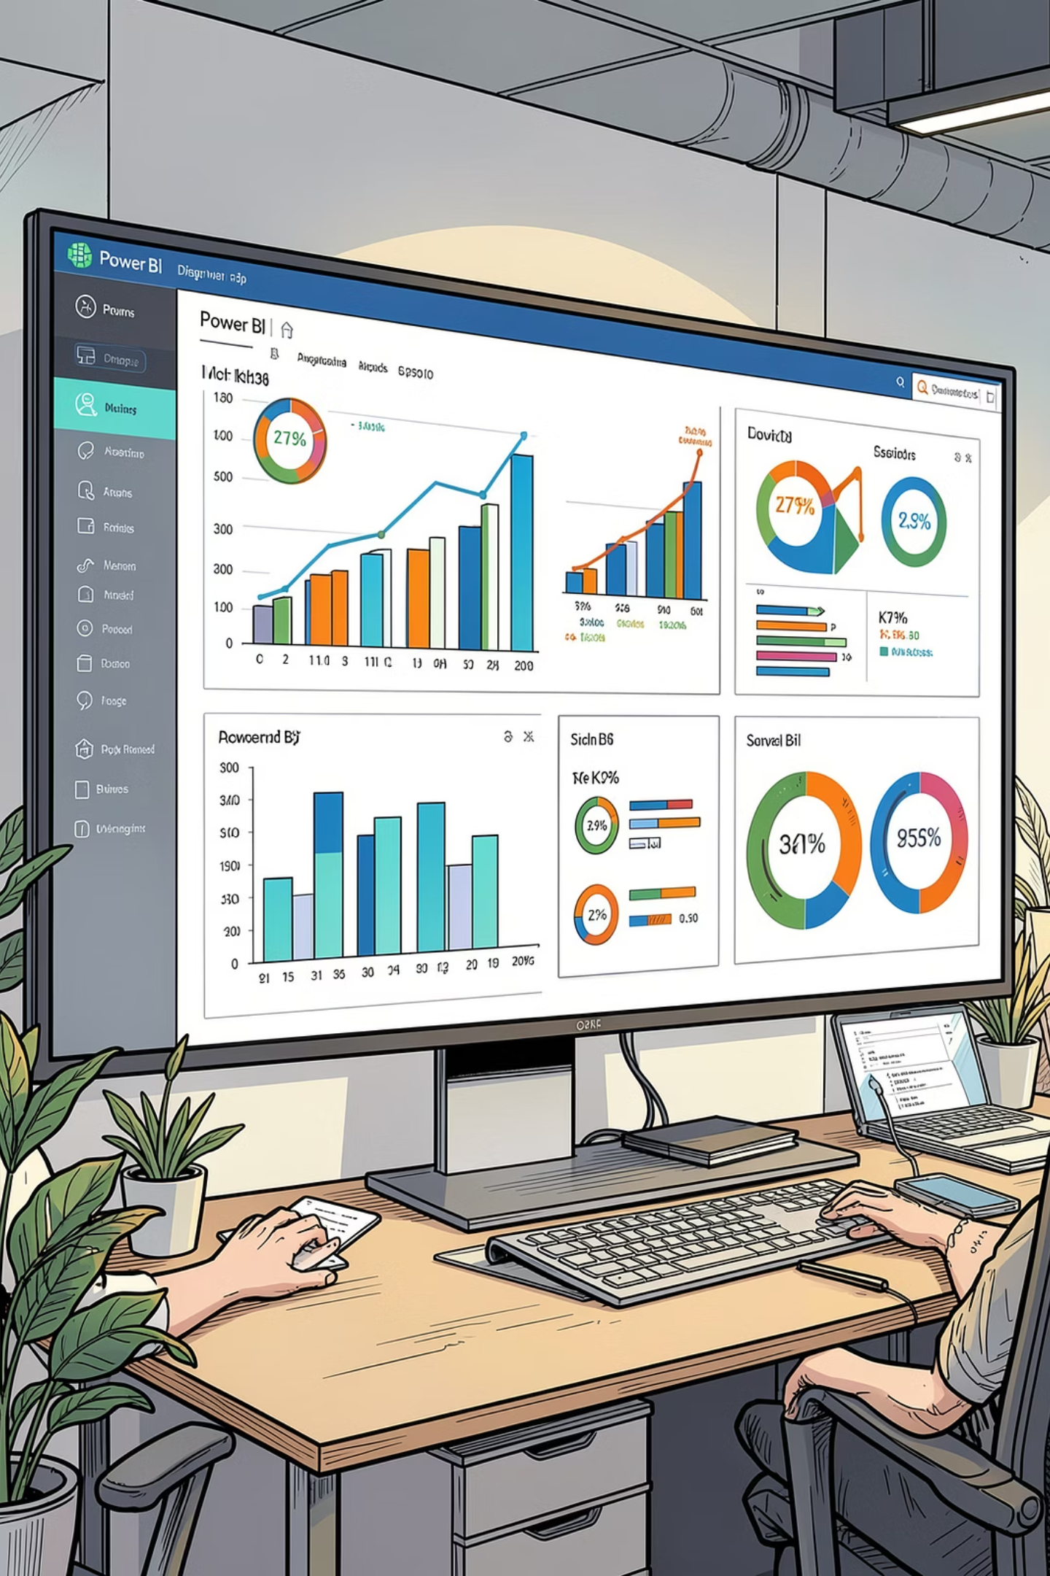
Power BI Dashboard
3.9K Customers
$59.76 Avg. Purchase
3.75 Avg. Rating
Filters
Subscription, Gender, Category, Shipping
Visuals
Revenue & Sales by Category & Age Group

Slide 10

Business Recommendations
Boost Subscriptions
Promote exclusive subscriber benefits
Loyalty Programs
Reward repeat buyers toward "Loyal" segment
Review Discount Policy
Balance sales lift with margin control
Targeted Marketing
Focus on high-revenue age groups & express-shipping users

