Slide 1
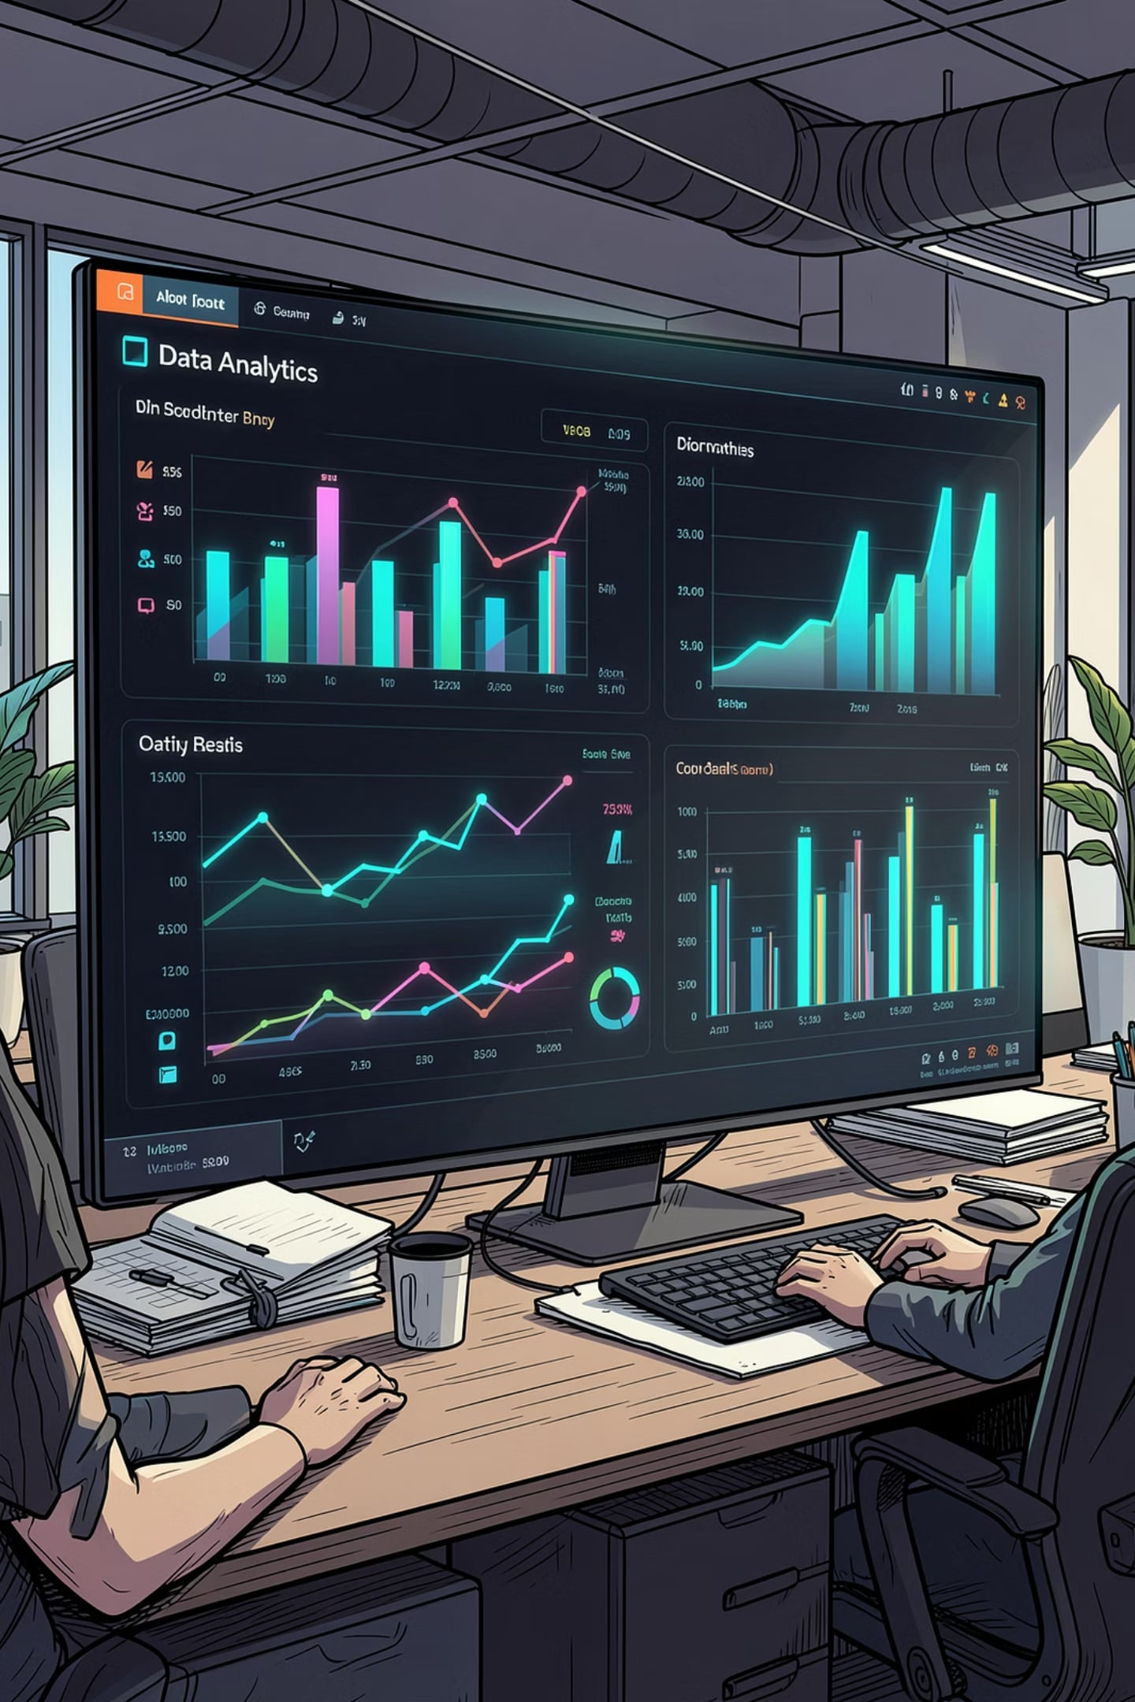
Employee Workforce Data Cleaning & Analysis
A full pipeline from raw, messy records to actionable HR insights
PREPARED BY: JOYKIRAN CHAKRABORTY
28TH JUNE 2026

Slide 2

Executive Summary
This engagement transformed a deliberately messy, inconsistent employee dataset into a clean, analysis-ready resource — then extracted meaningful workforce insights on performance, compensation, remote work, and hiring trends.
1,020
13
5
Employee records processed
Visualizations produced
Phases of workflow

Slide 3





Project Scope & Methodology
The engagement followed a standard, industry-proven analytics workflow using Python (pandas, matplotlib, seaborn) and PostgreSQL.
Data Acquisition
Import raw dataset
Data Profiling
Identify quality issues
Cleaning & Transformation
Correct and restructure
Data Loading
Persist to PostgreSQL
Analysis & Visualization
Build targeted charts

Slide 4


Data Cleaning: Key Steps
Missing Age Values (211 records)
Missing Salary Values (24 records)
Department-Region Split
Filled with median age of 30 years — preserving all 1,020 records.
Filled using group-aware median by department and region.
Combined field (e.g., "DevOps-California") split into two independent columns.
PII Removal & Name Consolidation
Performance Score Standardization
Email and phone removed; first/last names merged into a single employee_name field.
Text categories mapped to numeric scale (1–4) for calculations, then restored to labels for reporting.

Slide 5
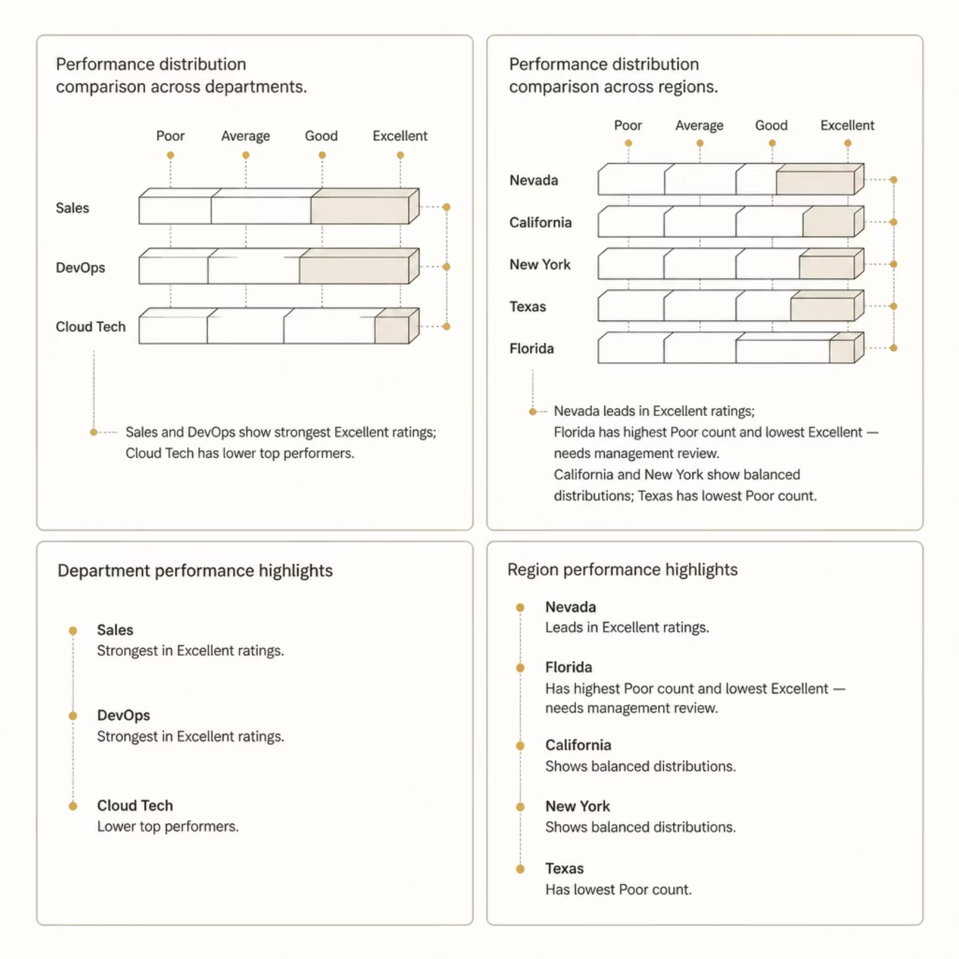
Performance Distribution by Department & Region
Department Highlights
Sales and DevOps show the strongest "Excellent" ratings. Cloud Tech has fewer top performers. HR has the widest performance spread.
Regional Highlights
Nevada leads in "Excellent" performers. Florida has the highest "Poor" count — warranting management review. Texas has the lowest "Poor" count.

Slide 6
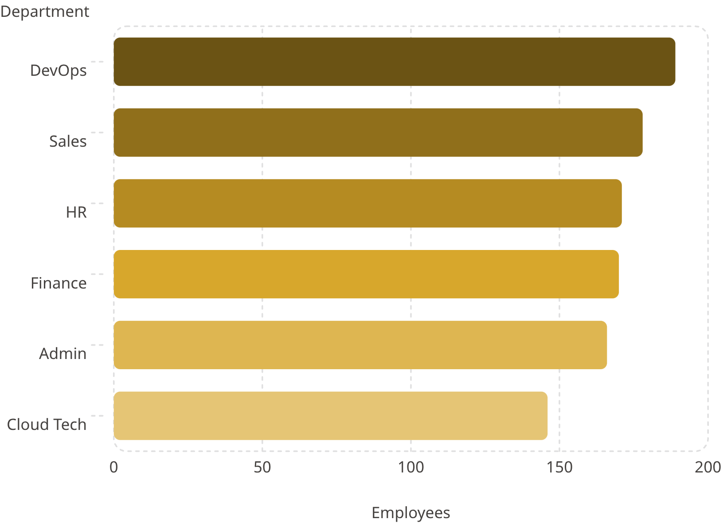
Employee Distribution & Demographics
By Region
California (187) and Florida (185) are the largest regions. Texas is smallest (153). Regional spread is balanced — only 18% gap between largest and smallest.
By Status
Pending (356) is the largest status group, just ahead of Active (352). Inactive: 312. The high Pending count may signal onboarding bottlenecks.
By Age Group
Performance is evenly spread across Young-Adult (2.60), Adult (2.53), and Middle-Aged (2.54) — age does not drive performance outcomes.

Slide 7

Remote Work Patterns
Remote work adoption varies widely by location and department — no single company-wide pattern.
Most Remote
Florida DevOps: 24 remote vs. 10 onsite
Most Onsite
New York Cloud Tech: 5 remote vs. 19 onsite
Performance Parity
Remote and onsite performance distributions are nearly identical — no evidence that work mode affects outcomes

Slide 8
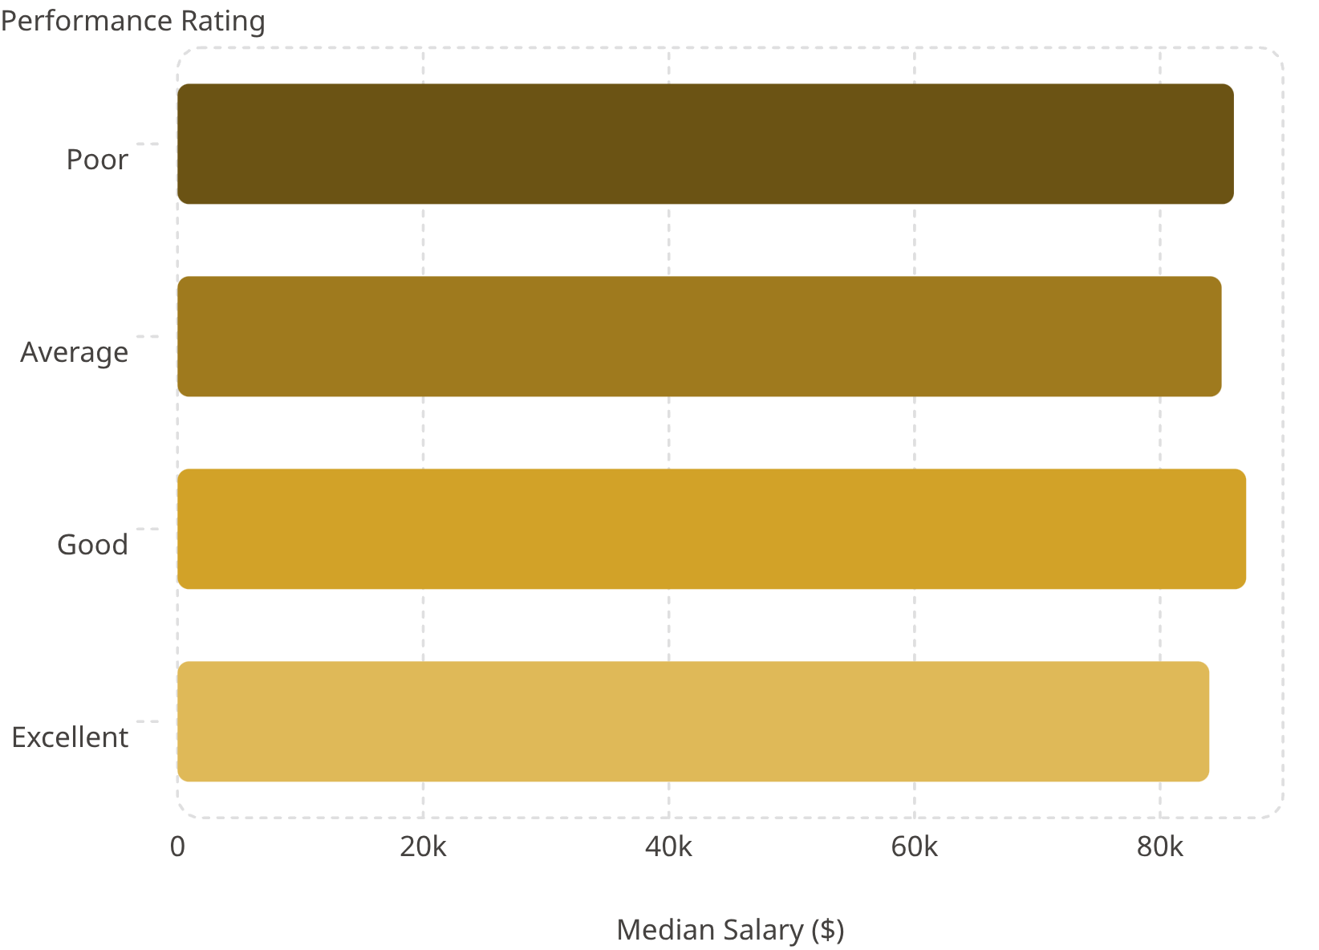
Salary Insights
Pay Does Not Track Performance
Median salaries across all four performance tiers fall within $84K–$87K. "Excellent" performers do not earn meaningfully more than "Poor" performers — compensation appears driven by role, department, or tenure rather than individual performance.
Top Pay by Department × Region
Admin in Illinois ($92,417) and Cloud Tech in Florida ($92,126) are the highest-paid combinations. Finance in Illinois and Nevada are the lowest (~$75,700–$76,000).
Remote vs. Onsite Pay
Near-identical salary distributions — median $86,500 (onsite) vs. $85,000 (remote). Work mode is not a major pay driver.

Slide 9
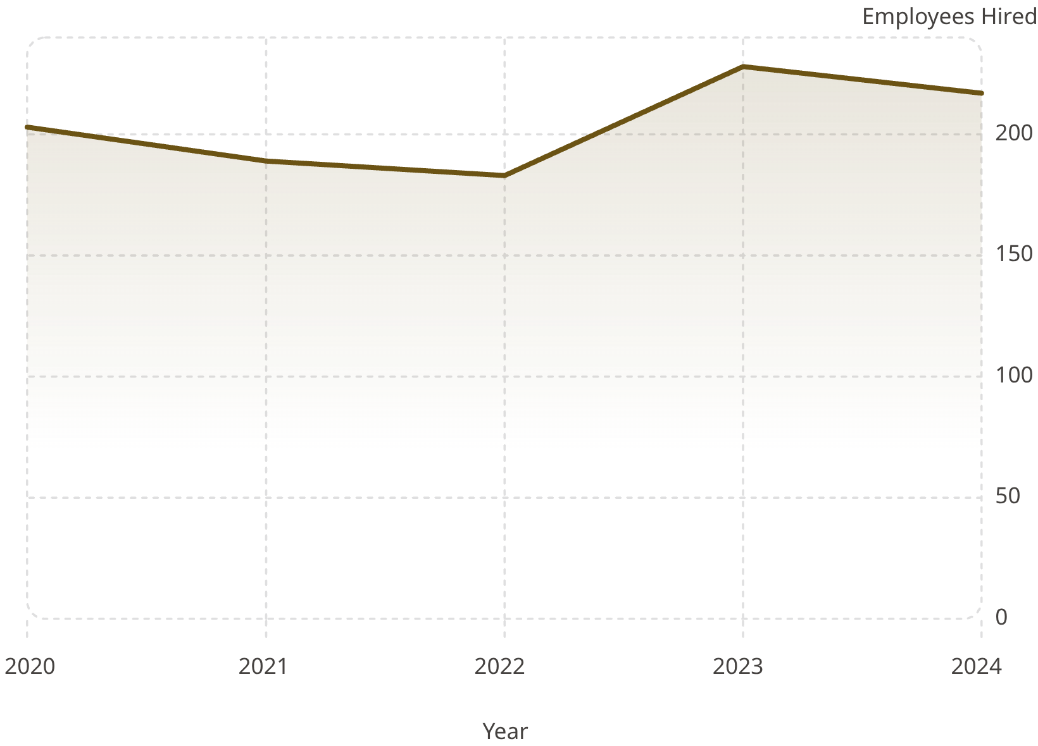
Hiring Trend & Overall Performance
Hiring Trend
Hiring dipped from 203 (2020) to a low of 183 in 2022, then surged to 228 in 2023 — the highest year — before easing to 217 in 2024. This pattern suggests recovery from a constrained period.
Performance Distribution
Ratings are evenly spread: Good (270), Average (267), Excellent (267), Poor (216). The balanced distribution suggests a credible performance evaluation process.

Slide 10
Key Findings & Recommendations
1
Investigate pay-performance disconnect
Salary does not track performance rating — consider a formal compensation review.
2
Review Florida's performance profile
Highest "Poor" rating count of any region — management review warranted.
3
Examine the Pending status backlog
356 employees in Pending status — confirm whether this reflects onboarding bottlenecks.
4
Use heatmaps for workforce planning
Department × Region concentrations (e.g., HR in Florida) can inform resourcing decisions.
5
Maintain PostgreSQL as single source of truth
Future reporting should build on the cleaned employee_details table.

