Slide 1

PyChess – Chess using PyGame

Slide 2
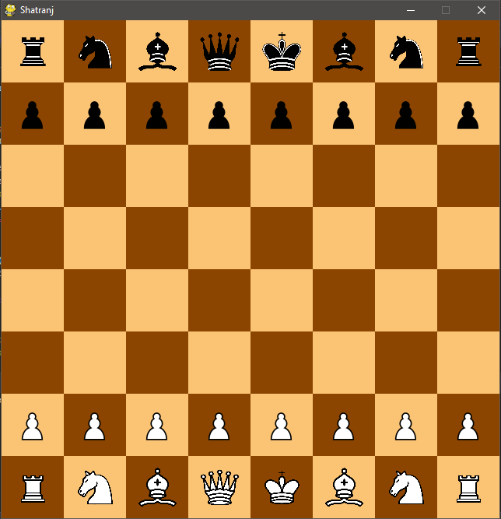
Chess – About the Game
Chess is a two-player strategy board game played on a chessboard, a checkered game board with 64 squares arranged in an 8×8 grid. The game is played by millions of people worldwide.
Each player begins with 16 pieces: one king, one queen, two rooks, two knights, two bishops, and eight pawns.
Each of the six piece types moves differently, with the most powerful being the queen and the least powerful the pawn.
The objective is to checkmate the opponent's king by placing it under an inescapable threat of capture.

Slide 3
System Requirements
Python3 with module - PyGame

Slide 4
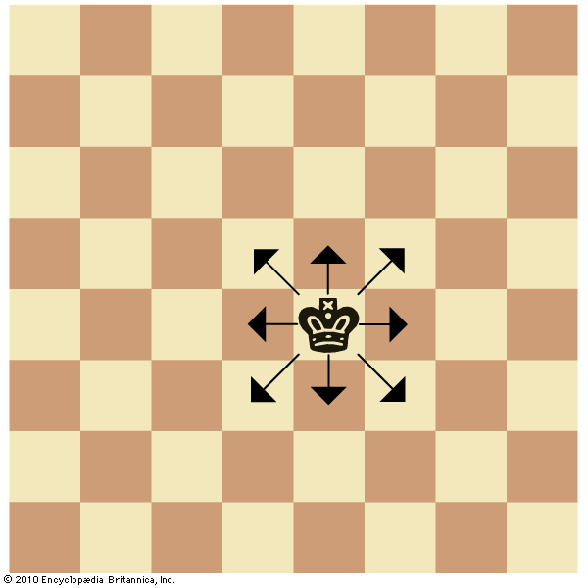
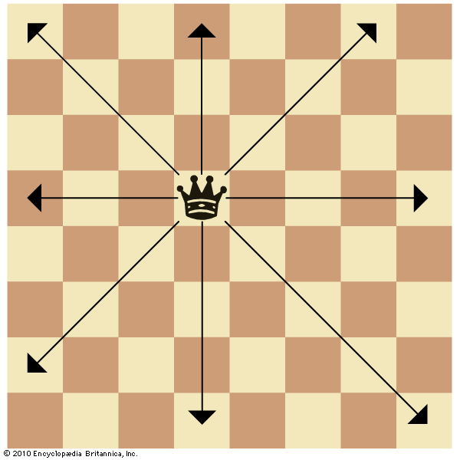
Movement of pieces
King
Angles of Movements: 0, 45, 90, … , 315
Distance: 1 block
Queen
Angles of Movements: 0, 45, 90, … , 315
Distance: No Limit

Slide 5
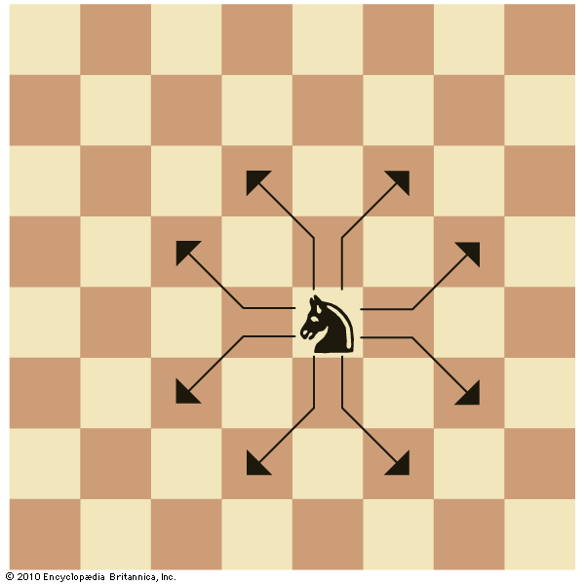
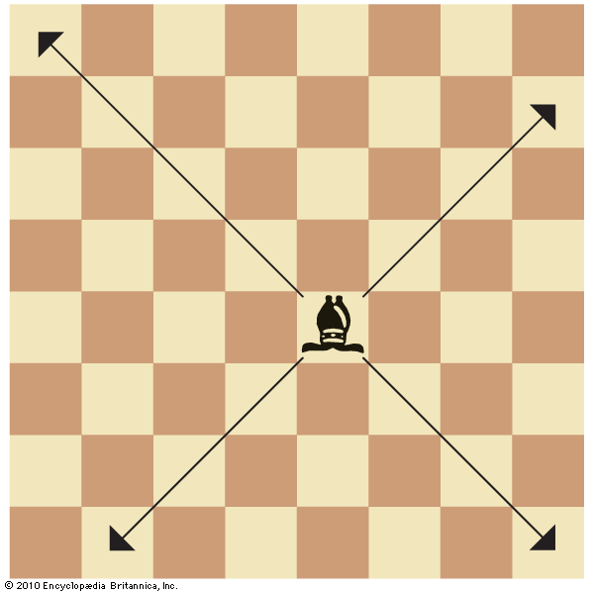
Movement of pieces
Knight
Angles of Movements:
tan⁻¹(1/2), tan⁻¹(2), .., tan⁻¹(-1/2), tan⁻¹(-2)
Distance: 2 blocks
Bishop
Angles of Movements: 45, 135, 225, 315
Distance: No Limit

Slide 6
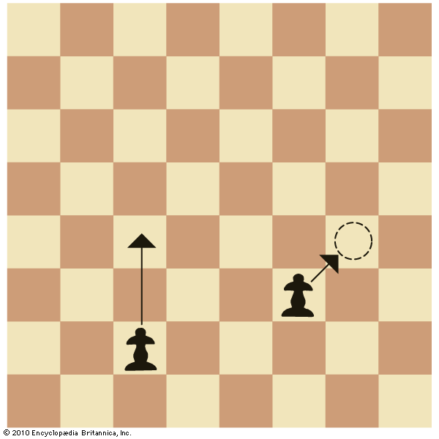
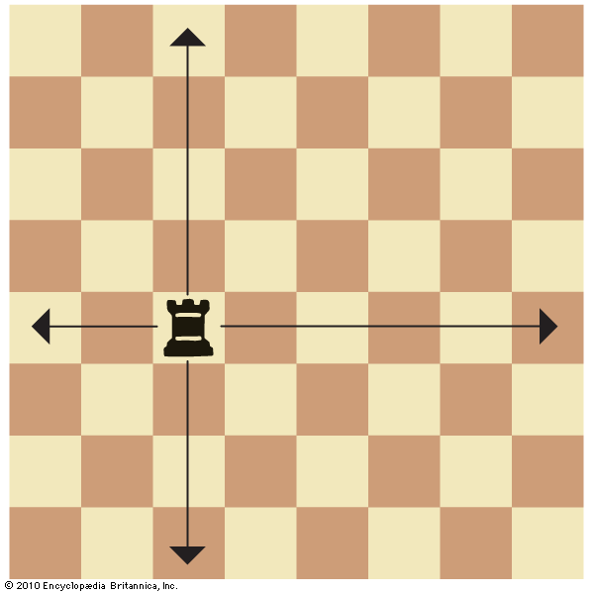
Movement of pieces
Pawn
Angles of Movements: 0, 45
Distance: 1 block / 2 blocks on first move
Queen
Angles of Movements: 0, 90, 180, 270
Distance: No Limit

Slide 7
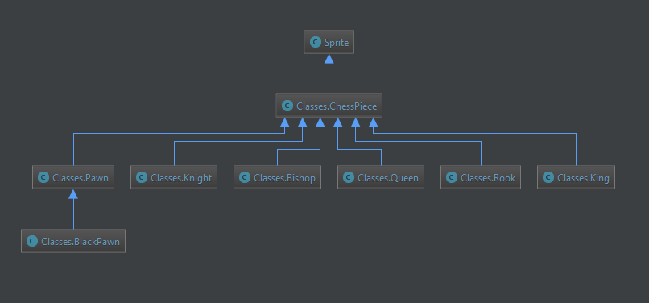
Class Diagram – Chess Pieces

Slide 8
Library Functions Used
pygame.Sprite() – Basic game object (draw, drag and update functions available)
draw()
drag()
update()
pygame.locals
MOUSEBUTTONDOWN
MOUSEBUTTONUP
Rect
pygame.draw.rect()
sys.exit()
Tkinter.messagebox.showinfo()
pygame.display.set_caption()
math
pi()
sqrt()
atan2()

Slide 9
User-Defined Functions
game() – the actual game loop
drawboard(colors) – draws the chess board
make_lines(position, position list, angle list) – find squares at a particular angle from given position

Slide 10
User-Defined Functions
distance_formula(pos1, pos2) – calculate distance between two points on the board
isfarther(start, pos1, pos2) – get the point farthest from start
nearest_piece(position, listofPieces) – calculate nearest piece from a given point

Slide 11
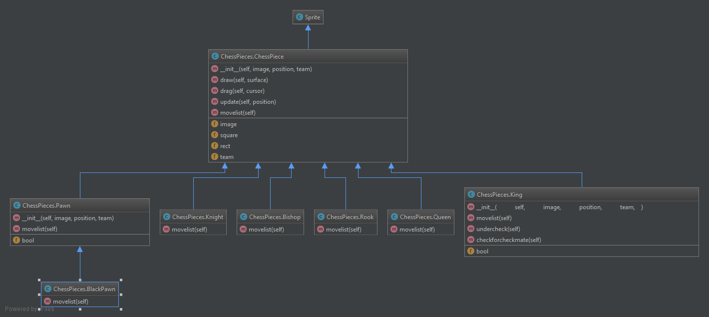

Slide 12
☺

