Slide 2
System Requirements
Python 3
pygame
math
sys

Slide 3
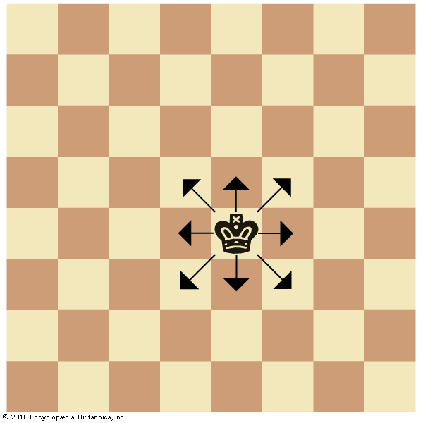
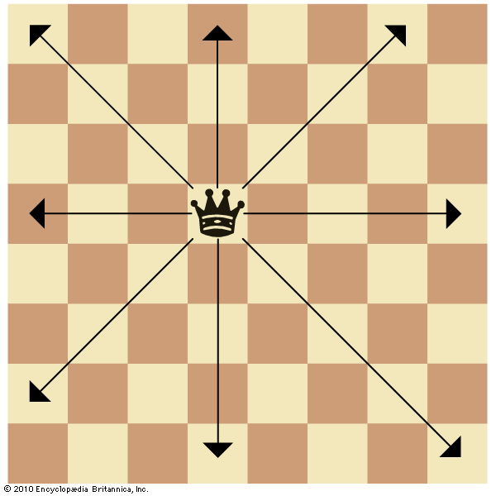
Movement of pieces
King
Angles of Movements: 0, 45, 90, … , 315
Distance: 1 block
Queen
Angles of Movements: 0, 45, 90, … , 315
Distance: No Limit

Slide 4
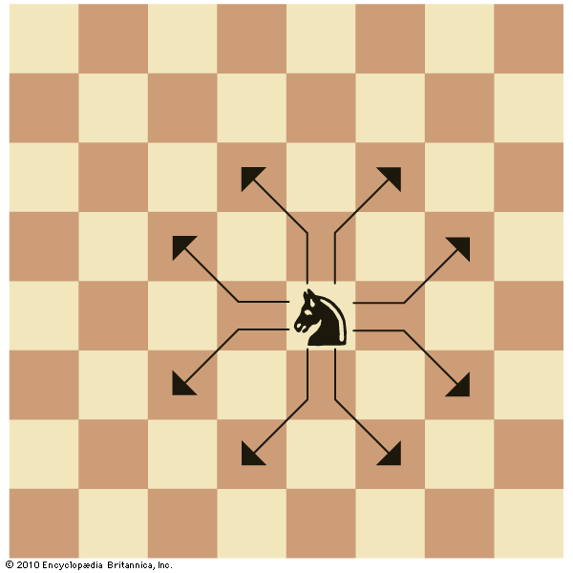
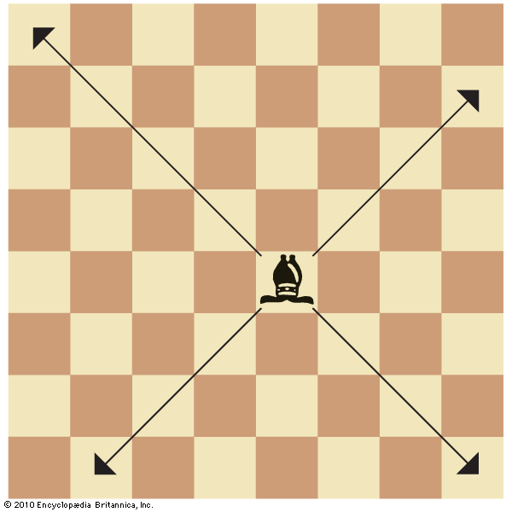
Movement of pieces
Knight
Angles of Movements: tan⁻¹(1/2), tan⁻¹(2), … , tan⁻¹(-1/2), tan⁻¹(-2)
Distance: 2 blocks
Bishop
Angles of Movements: 45, 135, 225, 315
Distance: No Limit

Slide 5
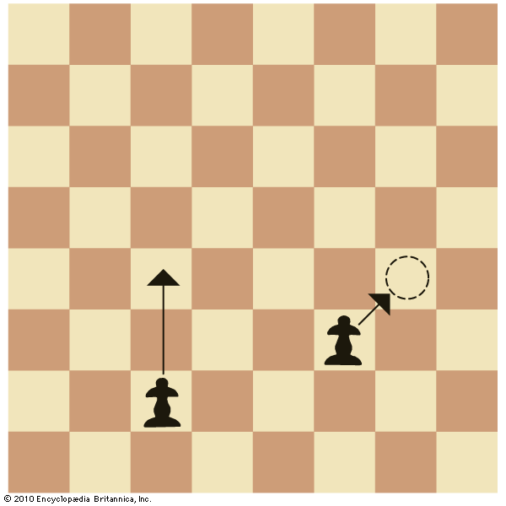
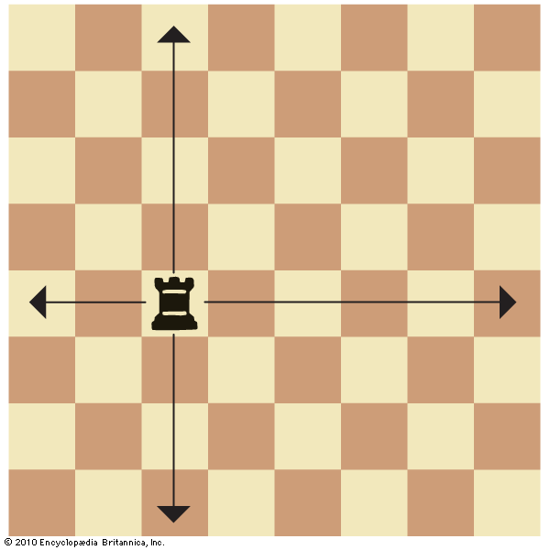
Movement of pieces
Pawn
Angles of Movements: 0, 45
Distance: 1 block / 2 blocks on first move
Queen
Angles of Movements: 0, 90, 180, 270
Distance: No Limit

Slide 6
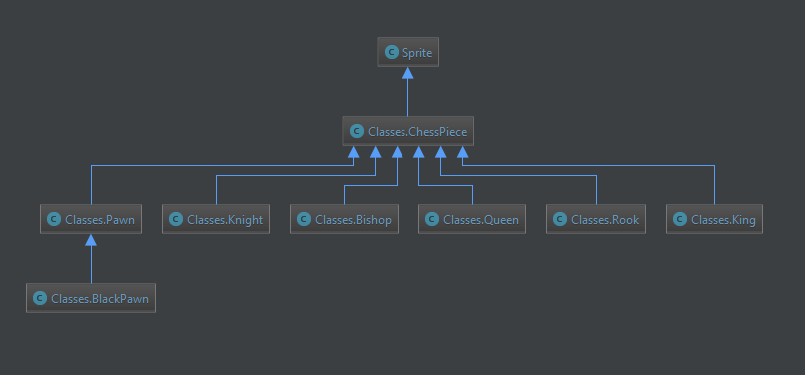
Class Diagram

Slide 7
Library Functions Used

Slide 8
User-Defined Functions
game()
checkquitgame()
drawboard(_colors)
make_lines(position, positionlist, anglelist)
square(x)
distance_formula(pos1, pos2)
isfarther(start, pos1, pos2)
nearest_piece(position, listof)

Slide 9
