Slide 1
Lab_8 Javadoc & File IO
COMP 2021
Mr YANG Lingxiao
07 Nov 2016

Slide 2
Contents
Javadoc
Why we need javadoc – page 2
Javadoc key word “@” – page 3, 4
Javadoc CMD – page 5
Javadoc Comments – page 6
File IO in Memory
a. Classes – page 7
b. Importance – page 8
Page 1

Slide 3
Why we need Comments
Good documents for users (do not check the original code in src).
Reusable for other developers (e.g. use or modify in the future).
Remember what you have done at that time.
Page 2

Slide 4
Javadoc Key Word “@”
@author -- The developer
@version -- The version of software
@see -- Other related things (e.g. similar method)
@param -- The arguments (parameters) of method
@return -- The returns of method
@exception -- The possible error
Page 3

Slide 5
Javadoc Key Word “@”
@param, @return and @exception are only used for the purpose of descripting the method
Page 4

Slide 6
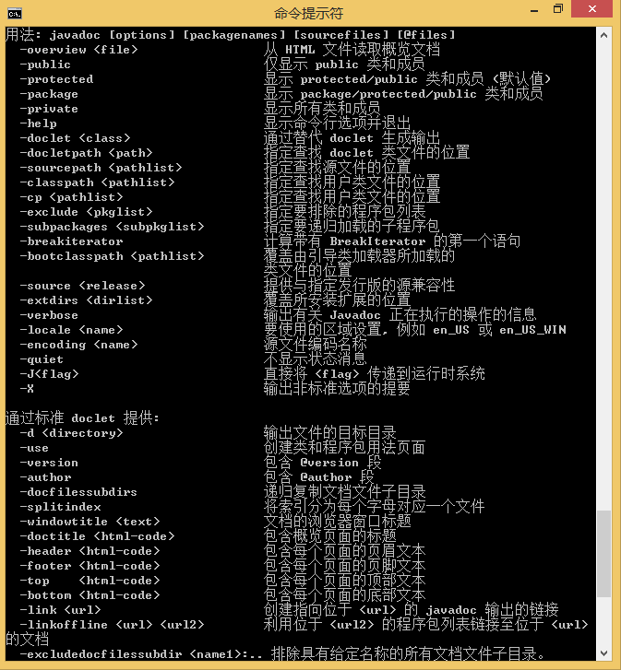
Javadoc CMD
Open CMD, try javadoc -help
Please make sure your javapath in the right evn path.
Page 5

Slide 7
Javadoc Comments
File header
Class or Interface
/**
* Created by LX.Conan on 2016/10/30.
*/
/**
* [description]
* @return [description]
*/
A simple example is shown in Lab8 (“SFile” class)
Method
Other
/**
* [method description]
* @param [description]
* @return [description]
*/
Please see Javadoc for more details
http://docs.oracle.com/javase/8/docs/technotes/tools/windows/javadoc.html
Page 6

Slide 8
Classes
File Class – SFile
Methods:
Create / Copy
Swap / Delete
Setter / Getter
Doc Class – SDocument
Methods:
Create / Copy
Swap / Delete
Setter / Getter
Folder Class – SFolder
Methods:
Create / Copy
Swap / Delete
Setter / Getter
A Document should contain a list of files (SFile)
A Folder should contain a list of document (SDocument)
Page 7

Slide 9
Importance
Change all “sig”, “arg” and related words into proper names
Choose proper modifier for variables in each class
Not all things are right, you need debug by yourself
Please Check Methods in Vector and String, and apply some of them in your code (e.g. clear all in a Vector, vector.clear())
Test all your methods in TestMain.java
After comments, please use javadoc “filename”.java in CMD, and check the index.html by yourself
Page 8

