Slide 1
J2ME Porting on EMPOS II
Jin, Guang-yao
Internet Computing Lab
October 18th, 2005

Slide 2
Contents
System Structure
CLDC Porting
MIDP Porting
Preview of Advanced MIDP Porting

Slide 3
System Structure

Slide 4

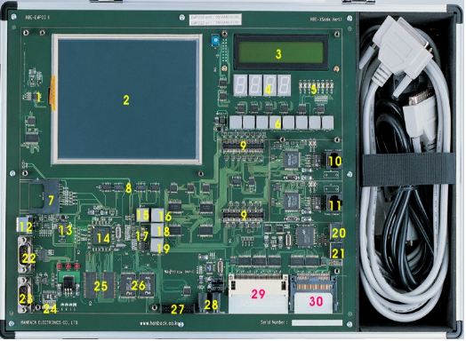
System Composition
To develop J2ME Porting, we need to set control system to handle Target Board
- Linux 2.4.20
X-Windows
192.168.123.200
- Linux 2.4.19
QT 2.3.2
192.168.123.165
LAN
ㅣ
ㅣ
ㅣ
ㅣ
Serial
Control System
EMPOS-II

Slide 5
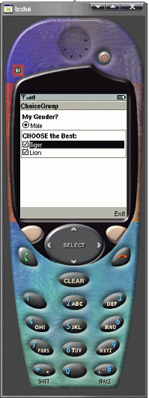
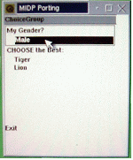
J2ME Screen View
Goal of J2ME Porting
QT based J2ME Screen
on EMPOS Board
X11 based J2ME Screen
On Host PC

Slide 6
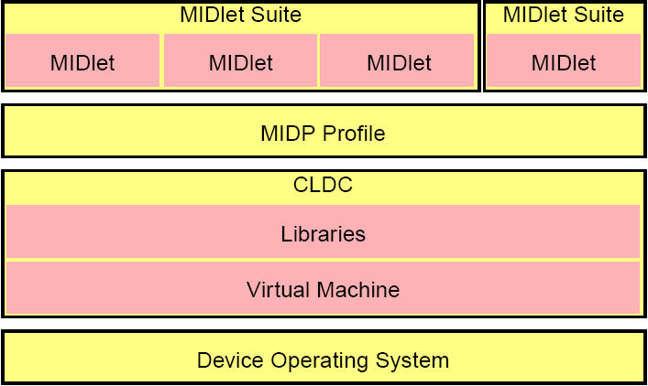
J2ME Structure
J2ME environment architecture
MIDlet (Application)
QT UI Porting
QT Library Layer to support EMPOS Board
MIDP
Porting
CLDC (KVM)
Porting
EMPOS Setting

Slide 7
J2ME Structure
EMPOS supporting parts of J2ME Architecture
Codes Should be Modified to Support EMPOS Board
MIDP Applications
Extended-
MIDP Applications
I18N
Games
Over the Air Provisioning (OTN)
Extended-
Specific
Classes
Graphics and Event Handling (LCDUI)
MIDP
Networking
CLDC Class Library
Application Management System (AMS)
Record Management System (RMS)
Persistent Storage
K Virtual Machine
MIDP Structure
EMPOS do not support X11 libraries
➔ X11 libraries are too heavy to load on a small amount memory of Embedded System
➔ Instead, EMPOS support simple Graphic Interface called QT.

Slide 8
J2ME Structure
Application Management System (AMS)
START
⑤
MIDlet Suites
Storage
(AMS)
①
⑥
main.c
②
⑦
③
Graphic
Installer
Command
Line
Interpreter
MIDlet
SCREEN View
Network
I/O
GUI
Pushopen()
KVM (com.sun.midp.main.Main)
④
Emulator
loop
⑧
EVENT
Ex) key press
pen press
…
Pushclose()
JAVA::CommandState
C::midpCommandState
Java ⬅ translate ➔ C code
Load “MIDlet” on the memory
Pass control-right to KVM
END
⑨

Slide 9
J2ME Structure
Actions of Application Management System
Command can make Graphic Installer to save data on Mobile Storage (MIDlet application, HTTPS Keys, Record data…)
From the Storage, MIDlet application can be loaded
From the Graphic Installer, some commands can be converted to native C codes to show on Mobile Device.
Some native codes can be sent to KVM to handle or control Processes.
In AMS module, main function is called to process command.
In the main function, a certain process (GUI) can be drown on Mobile Screen view.
Interpreted Command can be transferred to control process.
(ex. RMS supporting command)
In the looping, some stacked commands can be transferred to control process
In Mobile Emulator, Called Events can be transferred to KVM

Slide 10
CLDC Porting
Java 2 SDK Installing
CLDC Installing
Porting KVM on EMPOS Board

Slide 11
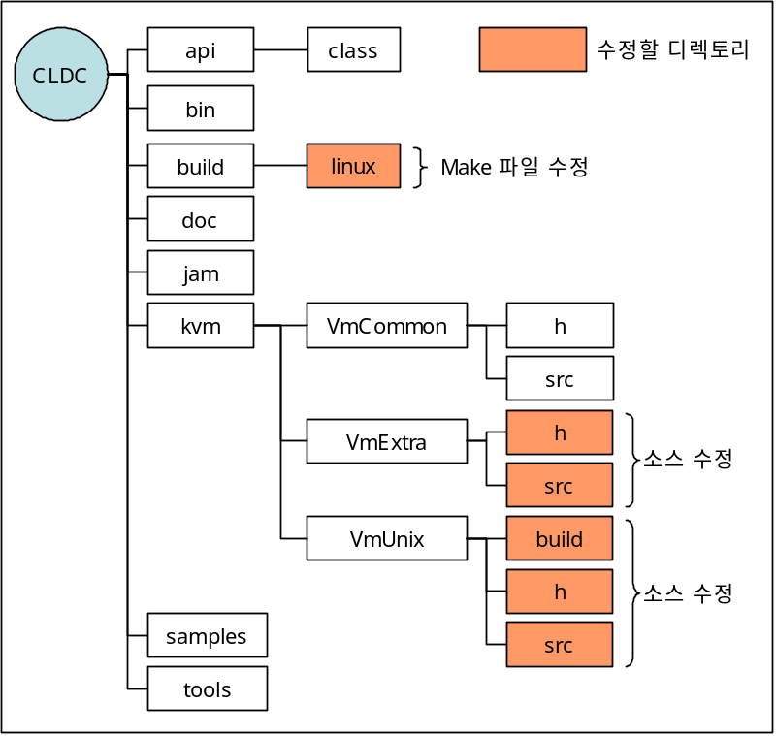
CLDC Structure
Directory
Modified
Section
Directory Name | Included Contents
api | Java Library Execution Codes
bin | Executable Binary Files & Java Library Classes
build | Makefile to create KVM
doc | Porting guides, KNI(K Native Intergace) Specs.
jam | 'Java Application Management' Source Codes
kvm | KVM Source Codes
tools | Source Codes of various Tools (ex. Preverifier…)
Modify Makefile
Modify
codes
Modify
codes
CLDC builds KVM module based on
developing platform (Embedded Linux…)

Slide 12
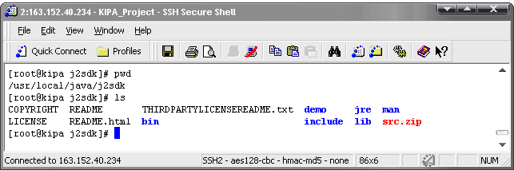
CLDC Porting (1/4)
Java 2 SDK Installing
$ mkdir /working/J2ME
$ cd /working/J2ME
$ cp /mnt/cdrom/J2ME/j2sdk-1_4_2_08-linux-i586.bin /working/J2ME/
$ chmod +x j2sdk-1_4_2_08-linux-i586.bin
$ ./j2sdk-1_4_2_08-linux-i586.bin
$ mkdir /usr/local/java
$ mv j2sdk1.4.2_08 /usr/local/java
$ ln -s /usr/local/java/j2sdk1.4.2_08 /usr/local/java/j2sdk
$ ln -s /usr/local/java/j2sdk /usr/local/java/jdk1.3
$ echo "export PATH=/usr/local/java/j2sdk/bin:$PATH" >> /etc/profile
$ echo "export JAVA_HOME="/usr/local/java/j2sdk" >> /etc/profile
$ source /etc/profile

Slide 13
CLDC Porting (2/4)
CLDC Installing – Modifying Makefile
$ cd /working/J2ME/
$
$ unzip /mnt/cdrom/J2ME/j2me_cldc-1_0_4-src-winunix.zip
$ ln –s j2me_cldc kvm
$ cd /working/J2ME/j2me_cldc/
$ vi ./kvm/VmUnix/build/Makefile
Set TOP path as
what we’ve already linked with symbolic link “KVM”
- Line 15
TOP=/working/J2ME/kvm
PLATFORM=linux
.
.
.
- Line 109
ifeq ($(GCC), true)
# CC = gcc
CC = arm-linux-gcc
CFLAGS = -Wall $(CPPFLAGS) $(ROMFLAGS) $(OTHER_FLAGS)
DEBUG_FLAG = -g
OPTIMIZE_FLAG = -DXX
else
.
endif
Cross Compiler should be “arm-linux-gcc” for ARM platform

Slide 14
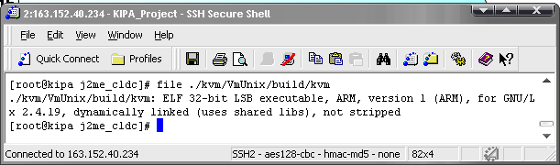
CLDC Porting (3/4)
CLDC Installing – Compiling Modified Codes
$ cd /working/J2ME/j2me_cldc/build/linux
$ make clean
$ make
$ file /working/J2ME/j2me_cldc/kvm/VmUnix/build/kvm

Slide 15
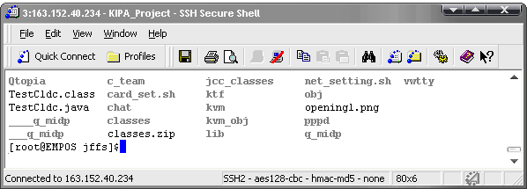
CLDC Porting (4/4)
Building CLDC on EMPOS Board
- Host PC
$ cd /working/J2ME/j2me_cldc/kvm/VmUnix/build/
$ cp kvm /nfs_resource
Through NFS, move KVM file to EMPOS Board
- Target PC
[root@EMPOS]$ cd /jffs/
[root@EMPOS]$ mount –t nfs 192.168.123.200:/nfs_resource /mnt/nfs
[root@EMPOS]$ cp /mnt/nfs/kvm /jffs

Slide 16
MIDP Porting
MIDP Installing
X11-Based Environment Setting
ARM-Based Environment Setting

Slide 17
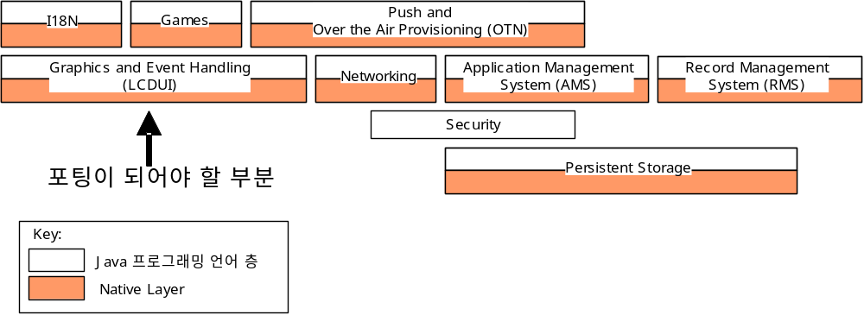
MIDP Structure
Structure
Modified Section
Java Program Layer
Native Layer ( C )
I18N
Games
Over the Air Provisioning (OTN)
Graphics and Event Handling (LCDUI)
J2ME Application can be executed on EMPOS Board by
Changing Graphics and Handling Methods to QT Libraries
Each Section is consist of two layers
- Java code Layer
- Native C code Layer
Networking
Application Management System (AMS)
Record Management System (RMS)
Persistent Storage
MIDP Structure

Slide 18
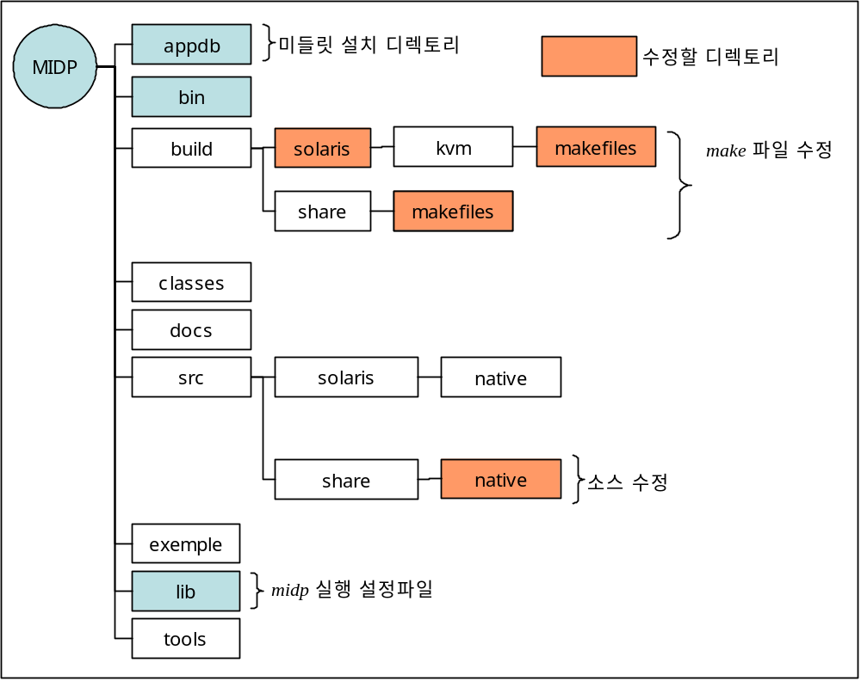
MIDP Structure
Directory
MIDlet Application Installing Directory
Modified
Section
Directory Structure to support a
specific Platform
- <midpInstallDir>/build/newPlatform
- <midpInstallDir>/src/newPlatform
EMPOS support Linux which is
familiar with Solaris Source Codes
Modify
MAKE
file
Directory Name | Included Contents
appdb | A space to save KEYS for HTTPS & to be installed MIDlet
lib | Basic Setting Files
bin | Executable Binary Files
classes | Compiled Java Classes
example | Examples of jad / jar files
src | Full Source Codes for MIDP poring
build | Platform-Based necessary files to be compiled
tools | Source codes of tools for executing MIDP
Modify
codes
MIDP Execution Setting File

Slide 19
MIDP Porting (1/11)
MIDP Installing
$ cd /working/J2ME/
$ unzip /mnt/cdrom/J2ME/midp-2_0-src-linux-i686.zip
$ cd /working/J2ME/midp2.0fcs
$ mkdir ./build/qplus
$ mkdir ./src/qplus
$ mkdir ./src/qplus/native
$ cd /working/J2ME/midp2.0fcs/src
$ cp -r solaris/* qplus
$ cd /working/J2ME/midp2.0fcs/build
$ cp -f solaris/GNUmakefile qplus
$ cp -f solaris/Platform.gmk qplus
$ cp -rf solaris/makefiles qplus
We will set New Platform name as “qplus”
Copying solaris files to qplus
Copying Makefile…
In MIDP source codes, linux source code is not supported
Instead, Solaris Code is very similar with Linux Code.

Slide 20
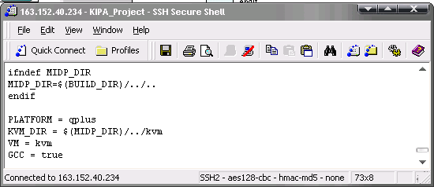
MIDP Porting (2/11)
MIDP Installing – Modifying Codes for X11 Platform
$ cd /working/J2ME/midp2.0fcs/build/qplus/
$ vi Platform.gmk
Modify Platform Info.
ifndef MIDP_DIR
MIDP_DIR=$(BUILD_DIR)/../..
endif
PLATFORM = qplus
KVM_DIR = $(MIDP_DIR)/../kvm
VM = kvm
GCC = true

Slide 21
MIDP Porting (3/11)
MIDP Installing – Modifying Codes for X11 Platform
$ cd /working/J2ME/midp2.0fcs/build/qplus/makefiles
$ vi Defs-pre.gmk
Modify Predefined Info.
EXTRA_INCLUDES += -I/usr/openwin/include < Line 22 >
==> EXTRA_INCLUDES += -I/usr/X11R6/include
EXTRA_CFLAGS += -Xa -mt < Line 39 >
==> EXTRA_CFLAGS += -m
EXTRA_CFLAGS += -xO2 < Line 43 >
==> EXTRA_CFLAGS += -D
EXTRA_CFLAGS += -D$(ARCH) -DSOLARIS2 -D_REENTRANT -DUNIX -DSOLARIS < Line 58 >
==> EXTRA_CFLAGS += -D$(ARCH) -DLINUX -D_REENTRANT -DUNIX
PLATFORM_SRC_DIR = $(MIDP_DIR)/src/solaris < Line 60 >
PLATFORM_CLASS_DIR = $(MIDP_DIR)/src/solaris/classes < Line 61 >
PLATFORM_CONFIG_DIR = $(MIDP_DIR)/build/solaris/config < Line 62 >
==> PLATFORM_SRC_DIR = $(MIDP_DIR)/src/$(PLATFORM)
==> PLATFORM_CLASS_DIR = $(MIDP_DIR)/src/$(PLATFORM)/classes
==> PLATFORM_CONFIG_DIR = $(MIDP_DIR)/build/$(PLATFORM)/config
LIBS = -L$(MIDP_DIR)/build/solaris/tools/$(ARCH) -lXpm \ < Line 67 >
==> LIBS = -L$(MIDP_DIR)/build/$(PLATFORM)/tools/$(ARCH) -lXpm \
...

Slide 22
MIDP Porting (4/11)
MIDP Installing – Compiling Modified Codes
$ cd /working/J2ME/midp2.0fcs/build/qplus/
$ make all
Compile modified Codes
... kvm_obj/check_class.o
make: *** [/working/J2ME/J2ME_Porting_2003/midp2.0fcs/build/qplus/bin/preverify] 오류 1
[root@kipa qplus]# cp ../_add_qplus/preverify ./
[root@kipa qplus]# chmod +x preverify
[root@kipa qplus]# cp preverify ./bin
[root@kipa qplus]# make all
... /working/J2ME/J2ME_Porting_2003/midp2.0fcs/build/qplus/jcc_classes/JavaCodeCompact.class
.. ..
make: *** [classes.zip] 오류 1
[root@kipa qplus]# cp -rf ../_add_qplus/classes/ ./
[root@kipa qplus]# make all
... /working/J2ME/J2ME_Porting_
.. ..
make: *** [/working/J2ME/J2ME_Porting_2003/midp2.0fcs/build/qplus/bin/extractOffsets] 오류 1
[root@kipa qplus]# cp ../_add_qplus/extractOffsets ./
[root@kipa qplus]# chmod +x extractOffsets
[root@kipa qplus]# cp extractOffsets ./bin
[root@kipa qplus]# cp preverify ./bin
[root@kipa qplus]# make all
... searching updated .java files
[root@kipa qplus]# cp -rf ../_add_qplus/kvm/ssl_obj.old/* ./ssl_obj/
[root@kipa qplus]# ls ssl_obj/

Slide 23
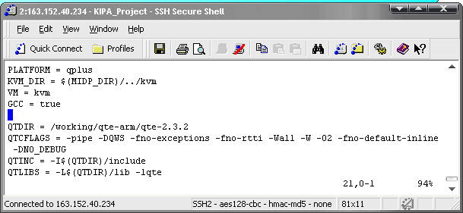
MIDP Porting (5/11)
MIDP Installing – Modifying Codes for ARM Platform
$ cd /working/J2ME/midp2.0fcs/build/qplus/
$ vi Platform.gmk
Modify Platform Info.
PLATFORM = qplus
...
QTDIR = /working/qte-arm/qte-2.3.2
QTCFLAGS = -pipe -DQWS -fno-exceptions -fno-rtti -W -O2 -fno-default-inline -DNO_DEBUG
QTINC = -I$(QTDIR)/include
QTLIBS = -L$(QTDIR)/lib -lqte

Slide 24
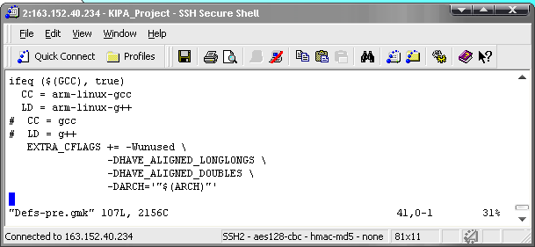
MIDP Porting (6/11)
MIDP Installing – Modifying Codes for ARM Platform
$ cd /working/J2ME/midp2.0fcs/build/qplus/kvm/makefiles
$ vi Defs-pre.gmk
Modify Predefined Info.
CC = arm-linux-gcc
LD = arm-linux-g++
# CC = gcc
# LD = g++
#LIBS = -L/usr/X11R6/lib -lXpm -lXt -lx11 -lm -lnsl -lICE -lSM -lpthread
LIBS = -lm -lnsl -lpthread
PLATFORM_SRC_DIR = $(MIDP_DIR)/src/$(PLATFORM)
PLATFORM_CLASS_DIR = $(MIDP_DIR)/src/$(PLATFORM)/classes
PLATFORM_CONFIG_DIR = $(MIDP_DIR)/build/$(PLATFORM)/config

Slide 25
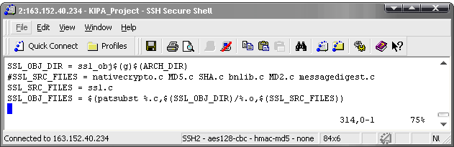
MIDP Porting (7/11)
MIDP Installing – Modifying Codes for ARM Platform
$ cd /working/J2ME/midp2.0fcs/build/share/makefiles
$ vi Defs.gmk
Add qtUI.cc related Setting to support EMPOS
MIDP_DEF_SRC += qtUI.cc
MIDP_OBJ_FILES = obj/lcWin.o obj/lcWinJa.o obj/sjis.o obj/eucjp.o obj/midpServices.o obj/localeMethod.o obj/conv.o obj/locale.o obj/genConv.o obj/screengrab.o obj/crc32.o
…
obj/vibrate.o obj/pvibrate.o obj/qtUI.o
#SSL_SRC_FILES = nativecrypto.c MD5.c SHA.c bnlib.c MD2.c messagedigest.c
SSL_SRC_FILES = ssl.c

Slide 26
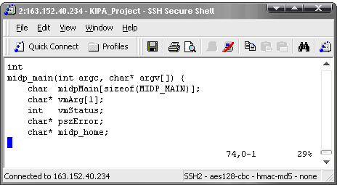
MIDP Porting (8/11)
MIDP Installing – Modifying Codes for ARM Platform
$ cd /working/J2ME/midp2.0fcs/src/share/native/kvm/
$ vi main.c
In order to intercept the control, midp_main() is called.
int
main(int argc, char* argv[]) { -> midp_main(int argc, char* argv[]) {
char midpMain[sizeof(MIDP_MAIN)];
char* vmArg[1];
int vmStatus;
char* pszError;
char* midp_home;
char* stdbuff = NULL;
char* errbuff = NULL;
int bufsiz = 0;
int bufmode = _IONBF;
midpInitializeMemory(-1);

Slide 27
MIDP Porting (9/11)
MIDP Installing – Modifying Codes for ARM Platform
$ cd /working/J2ME/midp2.0fcs/src/share/native
$ vi ssl.c
#include <kni.h>
#include <stdio.h>
#include <midpMalloc.h>
#include "socketProtocol.h"
#include "datagramProtocol.h"
#include "pushregistry.h"
#include "defaultLCDUI.h"
KNIEXPORT KNI_RETURNTYPE_INT Java_com_sun_midp_ssl_MD5_nativeUpdate() { }
KNIEXPORT KNI_RETURNTYPE_INT Java_com_sun_midp_ssl_MD5_nativeFinal() { }
KNIEXPORT KNI_RETURNTYPE_INT Java_com_sun_midp_ssl_MD2_nativeUpdate() { }
KNIEXPORT KNI_RETURNTYPE_INT Java_com_sun_midp_ssl_MD2_nativeFinal() { }
KNIEXPORT KNI_RETURNTYPE_INT Java_com_sun_midp_ssl_SHA_nativeUpdate() { }
KNIEXPORT KNI_RETURNTYPE_INT Java_com_sun_midp_ssl_SHA_nativeFinal() { }
KNIEXPORT KNI_RETURNTYPE_INT Java_com_sun_midp_ssl_Alg3_nativetx() { }
KNIEXPORT KNI_RETURNTYPE_INT Java_com_sun_midp_ssl_Alg2_modExp() { }
This is a dummy function to be called in native code
- No actions on each function.
- When matched function is called, then return its own type.

Slide 28
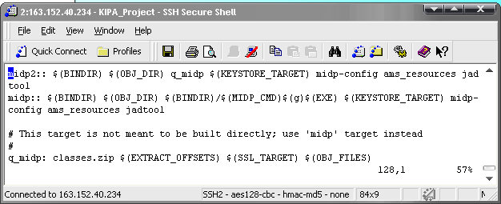
MIDP Porting (10/11)
MIDP Installing – Modifying Codes for ARM Platform
$ cd /working/J2ME/midp2.0fcs/build/share/makefiles
$ vi MIDP.gmk
midp2:: $(BINDIR) $(OBJ_DIR) q_midp $(KEYSTORE_TARGET)
midp-config ams_resources jadtool
q_midp: classes.zip $(EXTRACT_OFFSETS) $(SSL_TARGET) $(OBJ_FILES)
echo "Linking ... $@"
$(LD) $(LD_FLAGS) $(OBJ_FILES) $(LINKER_OUTPUT)$@ \
$(LIBS) $(QTLIBS)
$(OBJ_DIR)/qtUI.o: qtUI.cc
echo " ... $@"
$(LD) $(QTCFLAGS) $(QTINC) -c $(CC_OUTPUT)$@ $<
* midp : a J2ME file to support X11-Based Environment on HOST
* q_midp : a J2ME file to support QT-Based Environment on EMPOS

Slide 29
MIDP Porting (11/11)
MIDP Installing – Compiling Modified Codes
$ cd /working/J2ME/midp2.0fcs/build/qplus/
$ make clean
$ rm –rf q_midp ssl.jar kvm_obj ssl_obj jcc_classes
$ cp kvm/ssl.jar ./
$ make midp2
... searching updated .java files
make: *** [classes.zip] 오류 1
[root@kipa qplus] # cp -f/working/J2ME/preverify ./bin
[root@kipa qplus]# make midp2
.. ..
make: *** [classes.zip] 오류 1
[root@kipa qplus]# cp kvm/ssl.jar .
[root@kipa qplus]# make midp2
... searching updated .java files
.. ..
make: *** [extractOffsets] 오류 126
[root@kipa qplus]# cp -f/working/J2ME/extractOffsets ./bin
[root@kipa qplus]# make midp2
[root@kipa qplus]# file q_midp
q_midp: ELF 32-bit LSB executable, ARM, version 1 (ARM), for GNU/Linux 2.4.19, dynamically linked (uses shared libs), not stripped
[root@kipa qplus]#

