Slide 1
J2ME Porting on EMPOS-II
Jin, Guang-yao
Internet Computing Lab.
October 25th, 2005

Slide 2
Porting the GUI
MIDP Graphics GUI
Approach Description
Practice

Slide 3
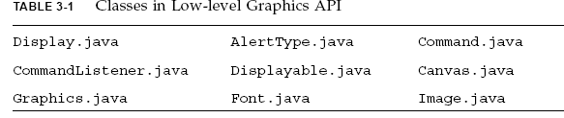
Porting the GUI
MIDP Graphics GUI
  The MIDP graphics API is in the package javax.microedition.lcdui.
Notes:
The MIDP graphics API is in the package javax.microedition.lcdui. This API is conceptually divided between high-level and low-level.

Slide 4
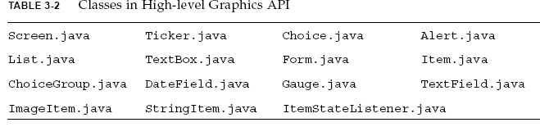
Porting the GUI
MIDP Graphics GUI
Notes:
The MIDP graphics API is in the package javax.microedition.lcdui. This API is conceptually divided between high-level and low-level.

Slide 5
Porting the GUI
Approach Description
1. Remove most of the code for implementation. Leave only
empty copies of the public methods.
2. Add package-private native methods for showNotify and hideNotify.
native void showNotify();
native void hideNotify();
Depending on system, we may also want to handle the method
void paint(Graphics g);
3. Add private native methods for passing data back and forth between
your native GUI and the public API
4. Fill in the public methods so that they call your natives appropriately.
5. Implement the native methods to communicate with your native GUI.
Notes:
consistent with the rest of the GUIs on your device, so as part of a degree 3 or 4 implementation, you will probably want to replace some
or all of the high-level Screens with native equivalents.

Slide 6
Porting the GUI
Original file
void
LCDUIdrawRect(int pixel, short *clip, void* dst, int dotted,
int x, int y, int width, int height)
{
if ((width < 1) || (height < 1)) {
if ((width >= 0) && (height >= 0)) {
……..
……..
refreshPaintWindow(x, y, x + width, y + height);
}
}
}
After modification
void
LCDUIdrawRect(int pixel, short *clip, void* dst, int dotted,
int x, int y, int width, int height)
{
qt_drawrect(x, y, width, height);
printf("%d,%d,%d,%d, %06X\n",x,y,width,height, pixel);
}
Notes:
consistent with the rest of the GUIs on your device, so as part of a degree 3 or 4 implementation, you will probably want to replace some
or all of the high-level Screens with native equivalents.

Slide 7
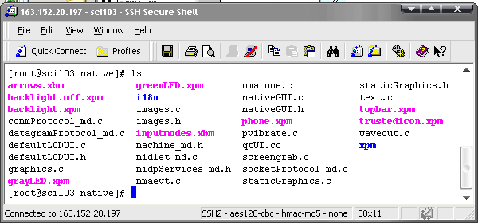
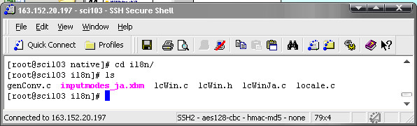
Porting the GUI
Practice
  Files to modify
/working/J2ME/midp2.0fcs/src/qplus/native

Slide 8
Porting the GUI
Practice
cd /working/J2ME/midp2.0fcs/src/qplus/native/i18n
vi lcWinJa.c (line242)
while (--num >= 0) {
sprintf(fontName, cur_faces[num], height);
// sprintf(fontName, cur_faces[num], height);
fonts[fontIndex][num] = XLoadQueryFont(thisDisplay, fontName);
if (fonts[fontIndex][num] == NULL) {
sprintf(fontName, defFonts[num], height);
fonts[fontIndex][num] = XLoadQueryFont(thisDisplay, fontName);
// fonts[fontIndex][num] = XLoadQueryFont(thisDisplay, fontName);
if (fonts[fontIndex][num] == NULL) {
fprintf(stderr, "Could not load a font: %s\n", fontName);
exit(1);
}
}
}
Notes:
i18n Directory is related with..language supporting purpose...
Font will be needed to draw characters on screen..

Slide 9
Porting the GUI
Practice
Files and Functions going to modified
Graphics and Event Handling (LCDUI) | Image.c | LCDUIgetPixel, LCDUIgetDisplayColor, LCDUIdrawRegionTransform, LCDUIcreateImageDst, LCDUICopyArea
 | Graphics.c | LCDUIdrawLine, LCDUIdrawRect, LCDUIfillRect, LCDUIdrawRoundRect, LCDUIfillRoundRect, LCDUIdrawArc, LCDUIfillArc, LCDUIfillTriangle
 | Mmaevt.c | injectNativeEvent
 | Text.c | LCDUIdrawChars,
 | NativeGUI.c | keys[], LCDUIgetKeyName, LCDUIrefresh, LCDUIsetSoftButton, GetAndStoreNextKVMEvent, qt_key_down, qt_key_up, qt_exit
Notes:
NativeGUI.c

Slide 10
Porting the GUI
Practice
Native File | Native Function | qt_calling function | MidpWidget SubClass
graphics.c | LCDUIdrawLine | qt_drawline() | LCD_drawline()
graphics.c | LCDUIdrawRect | qt_drawrect() | LCD_drawrect()
graphics.c | LCDUIfillRect | qt_drawfillrect() | LCD_drawfillrect()
graphics.c | LCDUIdrawRoundRect | qt_drawroundrect() | LCD_drawroundrect()
graphics.c | LCDUIfillRoundRect | qt_fillroundrect() | LCD_fillroundrect()
graphics.c | LCDUIdrawArc | qt_drawarc() | LCD_drawarc()
graphics.c | LCDUIfillArc | qt_fillarc() | LCD_fillarc()
graphics.c | LCDUIfillTriangle | qt_filltriangle() | LCD_filltriangle()
text.c | LCDUIdrawChars | qt_drawchars() | LCD_drawchars()
nativeGUI.c | LCDUIrefresh | qt_refresh() | repaint()
nativeGUI.c | keyDownKVMEvent | qt_key_down()
nativeGUI.c | keyUpKVMEvent | qt_key_up()
nativeGUI.c | systemKVMEvent | qt_exit() | quit()
nativeGUI.c | GetAndStoreNextKVMEvent | qt_process() | processEvents()
images.c | LCDUIgetPixel | qt_setcolor() | LCD_setcolor()
images.c | LCDUIgetDisplayColor | qt_getcolor() | LCD_getcolor()
images.c | LCDUIgetRGB | qt_setcolor_rgb() | LCD_setcolor_rgb()
Fuciton relationship
MIDlet.code.java
MIDP API
Native Function
QT function
MidpWidget SubClass

Slide 11
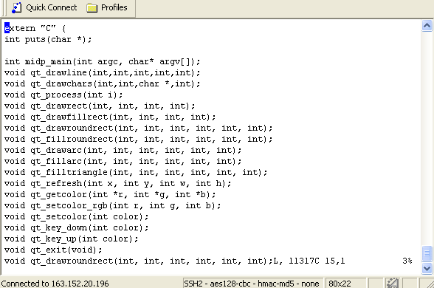
Porting the GUI
Practice
Vi /working/J2ME/midp2.0fcs/src/qplus/native/qtUI.cc
Notes:
With the function we need from the qt library, we create the file qtui.cc…with the purpose to provide all the function the native function need to call

Slide 12
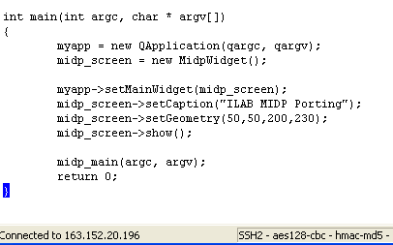
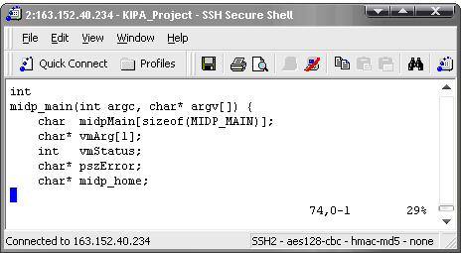
Porting the GUI
Practice
Vi /working/J2ME/midp2.0fcs/src/qplus/native/qtUI.cc
Line 444
$ vi/working/J2ME/midp2.0fcs/src/share/native/kvm/main.c
Notes:
With the function we need from the qt library, we create the file qtui.cc…with the purpose to provide all the function the native function need to call

Slide 13

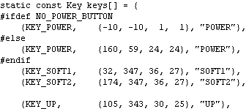
Porting the GUI
Practice
vi /working/J2ME/midp2.0fcs/src/qplus/native/nativeGUI.c
Line 163
Definition of key structure
char *LCDUIgetKeyName(int keyCode)
{
switch (keyCode) {
case KEY_POWER: return keys[0].name;
case KEY_SEND: return keys[8].name;
…
case KEY_1: return keys[11].name;
…
case KEY_POUND: return keys[22].name;
default: return NULL;
}
}
Line 1312
Line 169
Return the key name corresponding to the given key code.
Defined as::KeyType,Xrectangle_Range,name
Position set as(axix_X,axis_y,width,height)
Notes:
The purpose to do this modification is to map the key from your keyboard to control the mobile devices stimulating on empos board.
To do this we can realize the synchronized operation between keyboard and mobile devices stimulating on empos board.

Slide 14
Porting the GUI
Practice
vi /working/J2ME/midp2.0fcs/src/qplus/native/images.c
/* LCDUIgetPixe
* getPixelParts scales 16 bit xcolor componets for red, green, blue
* to 8 bit values. Thus the red/green/blue values returned in
* xcolor correspond to 8 bit rgb values of the color displayed.
*/
#define NTSC(r, g, b) ((r*78 + g*150 + b*29) >> 8)
Line 143
int
LCDUIgetPixel(int rgb, int gray, int isGray) {
qt_setcolor(rgb);
printf("[LCDUIgetPixel] %06X\n", rgb);
return rgb;
}
int
LCDUIgetPixel(int rgb, int gray, int isGray) {
return numColors < 256 ? getGrayPixel(rgb, gray, isGray) :
getColorPixel(rgb, gray, isGray);
}

Slide 15
Porting the GUI
Practice
vi /working/J2ME/midp2.0fcs/src/qplus/native/images.c
int
LCDUIgetDisplayColor(int color) {
int r = (color >> 16) & 0xff;
int g = (color >> 8) & 0xff;
int b = (color >> 0) & 0xff;
int pix;
pix = getPixelValue(r, g, b);
/* the returned values are X's Xcolor.pixel
stored as BGR */
b = (pix >> 16) & 0xff;
g = (pix >> 8) & 0xff;
r = (pix >> 0) & 0xff;
pix = ((r << 16) | (g << 8) | b)
& 0xFFFFFF;
return (pix);
}
Line 148
int
LCDUIgetDisplayColor(int color) {
int r = (color >> 16) & 0xff;
int g = (color >> 8) & 0xff;
int b = (color >> 0) & 0xff;
int rgb=qt_getcolor(r, g, b);
printf("[LCDUIgetDisplayColor] %06X\n", rgb);
return rgb;
}

Slide 16
Porting the GUI
Practice
vi /working/J2ME/midp2.0fcs/src/qplus/native/images.c
/*LCDUIdrawRegionTransform
* Draw the specified region of the given image data,
* locating its anchor point at x, y
*/
Line 1162
void
LCDUIdrawRegionTransform(jshort *clip, void *dst, void *img, jint x_dest, jint y_dest, jint anchor, jint x_src, jint y_src, jint srcWidth, jint srcHeight, jint transform, jboolean isRegion) {
puts("LCDUIdrawRegionTransform");
printf("clip data is %u", clip);
qt_drawimage(clip, x_dest, y_dest, anchor);
printf("[LCDUIdrawRegionTransform] x:%d y:%d z:%d \n", x_dest, y_dest, anchor);
}
void
LCDUIdrawRegionTransform(jshort *clip, void *dst, void *img, jint x_dest, jint y_dest, jint anchor, jint x_src, jint y_src, jint srcWidth, jint srcHeight, jint transform, jboolean isRegion) {
Drawable drawable = setupGC(gc, 0, clip, dst, 0);
XImage *image;
myBitmapStruct *p = (myBitmapStruct *)img;
….
}

Slide 17
Porting the GUI
Practice
vi /working/J2ME/midp2.0fcs/src/qplus/native/graphics.c
/*LCDUIdrawLine
* Draw a line between two points (x1,y1) and (x2,y2).
*/
Line 15
void
LCDUIdrawLine(int pixel, short *clip, void* dst, int dotted,int x1, int y1, int x2, int y2)
{
XPoint pts[2];
Drawable drawable = setupGC(gc, pixel, clip, dst, dotted);
……
XDrawPoints(display, drawable, gc, pts, 2, CoordModeOrigin);
if (!doubleBuffer && (drawable == paintDrawable)) {
refreshPaintWindow(x1, y1, x2, y2);
}
}
void
LCDUIdrawLine(int pixel, short *clip, void* dst, int dotted,
int x1, int y1, int x2, int y2)
{
qt_drawline(x1, y1, x2, y2, pixel);
printf("%d,%d,%d,%d, %06X\n",x1,y1,x2,y2, pixel);
}

Slide 18
Porting the GUI
Practice
vi /working/J2ME/midp2.0fcs/src/qplus/native/graphics.c
/*LCDUIdrawRect
* Draw a rectangle at (x,y) with the given width and height.
*/
Line 36
void
LCDUIdrawRect(int pixel, short *clip, void* dst, int dotted, int x, int y, int width, int height)
{
if ((width < 1) || (height < 1)) {
if ((width >= 0) && (height >= 0)) {
…..
if (!doubleBuffer && (drawable == paintDrawable)) {
refreshPaintWindow(x, y, x + width, y + height);
}
}
}
void
LCDUIdrawRect(int pixel, short *clip, void* dst, int dotted, int x, int y, int width, int height)
{
qt_drawrect(x, y, width, height);
printf("%d,%d,%d,%d, %06X\n",x,y,width,height, pixel);
}

Slide 19
Porting the GUI
Practice
vi /working/J2ME/midp2.0fcs/src/qplus/native/graphics.c
/*LCDUIfillRect
* Fill a rectangle at (x,y) with the given width and height.
*/
Line 72
void
LCDUIfillRect(int pixel, short *clip, void* dst, int dotted,
int x, int y, int width, int height)
{
qt_drawfillrect(x, y, width, height);
printf("%d,%d,%d,%d, %06X\n",x,y,width,height, pixel);
}
void
LCDUIfillRect(int pixel, short *clip, void* dst, int dotted, int x, int y, int width, int height)
{
if ((width < 2) || (height < 2)) {
if ((width > 0) && (height > 0)) {
…….
if (!doubleBuffer && (drawable == paintDrawable)) {
refreshPaintWindow(x, y, x + width, y + height);
}
}
}

Slide 20
Porting the GUI
Practice
vi /working/J2ME/midp2.0fcs/src/qplus/native/graphics.c LCDUIdrawRoundRect
/*Draw a rectangle at (x,y) with the given width and height. arcWidth and
* arcHeight, if nonzero, indicate how much of the corners to round off.
*/
line 196
void
LCDUIdrawRoundRect(int pixel, short *clip, void* dst, int dotted, int x, int y, int width, int height, int arcWidth, int arcHeight)
{
Drawable drawable = setupGC(gc, pixel, clip, dst, dotted);
……..
if (!doubleBuffer && (drawable == paintDrawable)) {
refreshPaintWindow(x, y, x + width, y + height);
}
}
void
LCDUIdrawRoundRect(int pixel, short *clip, void* dst, int dotted,
int x, int y, int width, int height,
int arcWidth, int arcHeight)
{
qt_drawroundrect(x, y, width, height, arcWidth, arcHeight);
printf("%d,%d,%d,%d, %06X\n",x,y,width,height, pixel);
}

Slide 21
Porting the GUI
Practice
vi /working/J2ME/midp2.0fcs/src/qplus/native/graphics.c LCDUIfillRoundRect
/*Fill a rectangle at (x,y) with the given width and height. arcWidth and
* arcHeight, if nonzero, indicate how much of the corners to round off.
*/
line 239
void
LCDUIfillRoundRect(int pixel, short *clip, void* dst, int dotted, int x, int y, int width, int height, int arcWidth, int arcHeight)
{
Drawable drawable = setupGC(gc, pixel, clip, dst, dotted);
…
if (!doubleBuffer && (drawable == paintDrawable)) {
refreshPaintWindow(x, y, x + width, y + height);
}
}
void
LCDUIfillRoundRect(int pixel, short *clip, void* dst, int dotted, int x, int y, int width, int height int arcWidth, int arcHeight)
{
qt_fillroundrect(x, y, width, height, arcWidth, arcHeight);
printf("%d,%d,%d,%d, %06X\n",x,y,width,height, pixel);
}

Slide 22
Porting the GUI
Practice
vi /working/J2ME/midp2.0fcs/src/qplus/native/graphics.c
/*LCDUIdrawArc
*Draw an elliptical arc centered in the given rectangle.
*/
line 281
void
LCDUIdrawArc(int pixel, short *clip, void* dst, int dotted, int x, int y, int width, int height, int tartAngle, int arcAngle)
{
Drawable drawable = setupGC(gc, pixel, clip, dst, dotted);
…….
if (!doubleBuffer && (drawable == paintDrawable)) {
refreshPaintWindow(x, y, x + width, y + height);
}
}
void
LCDUIdrawArc(int pixel, short *clip, void* dst, int dotted, int x, int y, int width, int height, int startAngle, int arcAngle)
{
qt_drawarc(x, y, width, height, startAngle*16, arcAngle*16);
printf("%d,%d,%d,%d, %06X\n",x,y,width,height, pixel);
}
Notes:
Draw an elliptical arc centered in the given rectangle. The portion of the arc to be drawn starts at startAngle (with 0 at the 3 o'clock position) and proceeds counterclockwise by <arcAngle> degrees. arcAngle may not be negative.

Slide 23
Porting the GUI
Practice
vi /working/J2ME/midp2.0fcs/src/qplus/native/graphics.c
/*LCDUIfillArc
*Fill an elliptical arc centered in the given rectangle.
*/
line
314
void
LCDUIfillArc(int pixel, short *clip, void* dst, int dotted, int x, int y, int width, int height, int startAngle, int arcAngle)
{
Drawable drawable = setupGC(gc, pixel, clip, dst, dotted);
…….
if (!doubleBuffer && (drawable == paintDrawable)) {
refreshPaintWindow(x, y, x + width, y + height);
}
}
void
LCDUIfillArc(int pixel, short *clip, void* dst, int dotted,
int x, int y, int width, int height,
int startAngle, int arcAngle)
{
qt_fillarc(x, y, width, height, startAngle*16, arcAngle*16);
printf("%d,%d,%d,%d, %06X\n",x,y,width,height, pixel);
}
Notes:
Fill an elliptical arc centered in the given rectangle. The portion of the arc to be drawn starts at startAngle (with 0 at the 3 o'clock position) and proceeds counterclockwise by <arcAngle> degrees. arcAngle may not be negative.

Slide 24
Porting the GUI
Practice
vi /working/J2ME/midp2.0fcs/src/qplus/native/graphics.c
/*LCDUIfillTriangle
* Fill a triangle defined by the given three points (x1,y1) (x2,y2)* and (x3,y3) with the current color.
*/
line
344
void
LCDUIfillTriangle(int pixel, short *clip, void* dst, int dotted, int x1, int y1, int x2, int y2, int x3, int y3)
{
XPoint pts[3];
int xmin, xmax, ymin, ymax;
Drawable drawable = setupGC(gc, pixel, clip, dst, dotted);
……….
refreshPaintWindow(xmin, ymin, xmax, ymax);
}
}
void
LCDUIfillTriangle(int pixel, short *clip, void* dst, int dotted, int x1, int y1, int x2, int y2, int x3, int y3)
{
qt_filltriangle(x1, y1, x2, y2, x3, y3);
}

Slide 25
Porting the GUI
Practice
vi /working/J2ME/midp2.0fcs/src/qplus/native/mmaevt.c
/*injectNativeEvent
*/
#include <X11/Xlib.h>
extern Display *display;
extern Window outerWindow;
extern Atom mmEOMAtom;
void injectNativeEvent(int pID, int curMTime) {
XEvent xevt;
xevt.xclient.type = ClientMessage;
xevt.xclient.message_type = mmEOMAtom;
xevt.xclient.format = 32;
xevt.xclient.data.l[0] = pID;
xevt.xclient.data.l[1] = curMTime;
XSendEvent(display, outerWindow, False, 0, &xevt);
return;
}
void injectNativeEvent(int pID, int curMTime) {
printf ("[mmaevt.c] injectNativeEvent %d, %d\n", pID, curMTime);
return;
}

Slide 26
Porting the GUI
Practice
vi /working/J2ME/midp2.0fcs/src/qplus/native/text.c
/*LCDUIdrawChars
* Draw the first n characters in chararray, with the anchor point of the entire (sub)string located at x, y.
*/
Line 239 remove
From line 242--254
line
234
void
LCDUIdrawChars(int pixel, short *clip, void* dst, int dotted, FONTPARAMS_PROTO, int x, int y, int anchor, const unicode *chararray, int n)
{ Drawable drawable = setupGC(gc, pixel, clip, dst, dotted);….
int width, ascent, descent;
…….
convertText(FONTPARAMS, chararray, n, &items, &numItems, itemBuf, 4, charBuf, 80);
getTextBounds(items, numItems, &width, ascent, &descent);
……
y2 = y + descent; ……..
}
Void
LCDUIdrawChars(int pixel, short *clip, void* dst, int dotted, FONTPARAMS_PROTO, int x, int y, int anchor, const unicode *chararray, int n)
{………
int width, ascent, descent;
int numItems = n;
getTextBounds(numItems, &width, &ascent, &descent);
…………..
y2 = y + descent;
qt_drawchars(x,y, chararray, n);
printf("[text.c] LCDUIdrawChars %d,%d,%s, %06X\n",x,y,chararray,pixel);
printf("%d\n", face);
}
From line 285--end

