Slide 1
J2ME 플랫폼 모바일
애플리케이션 서비스 구조
인터넷 컴퓨팅 연구실
김광요
2005.10.11

Slide 2
목차
MIDlet LifeCycle
MIDP User Interface
MIDP Networking
MIDP Storage
MIDP Programming

Slide 3
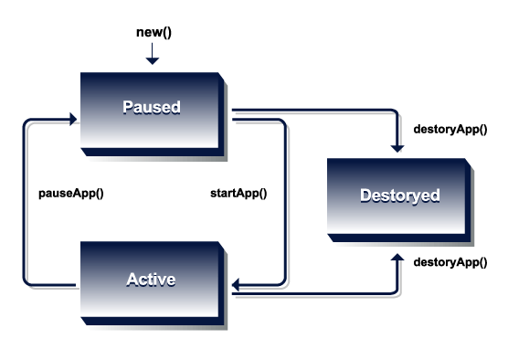
MIDlet Life Cycle
default constructor
Virtual methods

Slide 4
MIDP User Interface

Slide 5
MIDP User Interface (1/4)
javax.microedition.lcdui 패키지에 정의
두가지 레벨의 클래스
  High level
    이기종 디바이스들에 쉽게 포팅될 수 있는 애플리케이션 개발을 지원
  Low level
    개발자들에게 디바이스의 디스플레이를 완전히 컨트롤할 수 있는 기능을 제공한다. 예를 들면 점을 찍거나 기본 모양을 그리거나 특정된 폰트로 글을 그림.

Slide 6
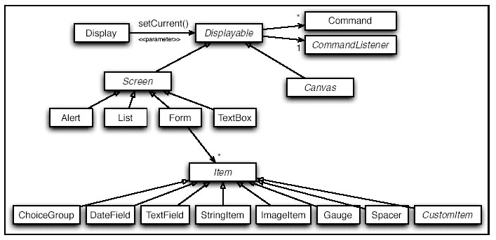
MIDP User Interface (2/4)

Slide 7
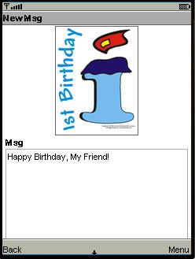
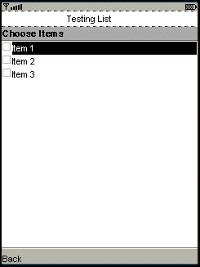
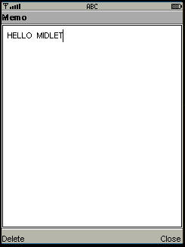
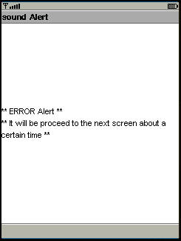
MIDP User Interface (3/4)
Form
List
Textbox
Alert

Slide 8
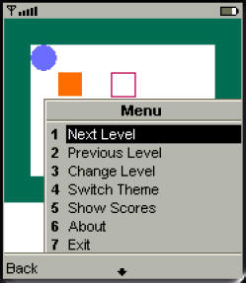
MIDP User Interface (4/4)
Canvas
  애플리케이션에 Low-level 이벤트를 핸들링하고 Display 그래픽을 그리는 기능을 제공하는 Base class
  Low level, 이식성이 낮음.
Command
  특정된 액션(이벤트)를 묘사한다.
  커맨드를 처리하기 위해서는 MIDlet에서 CommandListener라는 인터페이스를 실현해야 한다.

Slide 9
MIDP Networking

Slide 10
MIDP Networking (1/5)
javax.microedition.io 패키지에 정의
지원되는 프로토콜
  http://, socket://, datagram://, comm://, file://
Connector 클래스
  새로운 커낵션을 만드는 Factory 클래스

Slide 11
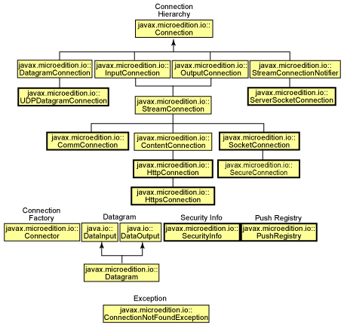
MIDP Networking (2/5)
http://www-128.ibm.com/developerworks/wireless/library/wi-prep/

Slide 12
MIDP Networking (3/5)
HTTP communication:
  Connection hc = Connector.open("http://www.wirelessdevnet.com");
Stream-based Socket communication:
  Connection sc = Connector.open("socket://localhost:9000");
Datagram-based socket communication:
  Connection dc = Connector.open("datagram://:9000");
Serial port communication:
  Connection cc = Connector.open("comm:0;baudrate=9000");
File I/O
  Connection fc = Connector.open("file://foo.dat");

Slide 13

MIDP Networking (4/5)
Interface Connection
HttpConnection
  This interface defines the necessary methods and constants for an HTTP connection.
Obtain a HttpConnection Object from a Connection Object
  HttpConnection hc = (HttpConnection)Connector.open("http://www.wirelessdevnet.com");

Slide 14
MIDP Networking (5/5)
HttpConnection Advanced
  It inherits all I/O stream methods from StreamConnection, all the MIME handling methods from ContentConnection and adds several additional methods for handling http protocol specific needs.
  I/O methods available in HttpConnection
    DataInputStream openDataInputStream()
    InputStream openInputStream()
    DataOutputStream openDataOutputStream()
    OutputStream openOutputStream()

Slide 15
MIDP Storage

Slide 16
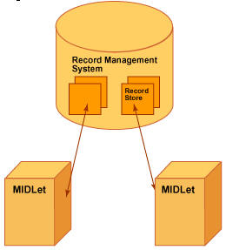
MIDP Storage (1/2)
Record Management system (RMS)
  javax.microedition.rms 패키지에 정의
  데이터베이스처럼 MIDlet에 영속적인 데이터 저장 및 검색 기능을 제공한다.
  모든 MIDlet에 의해 공유되고 각 기록은 유일한 ID로 표시됨.
  기록 저장공간을 관리하는 기능을 제공 (Open, Close, Delete)
  기록 저장공간내의 데이터 관리 기능을 제공 (Insert, Update, Delete)
  Byte를 단위로 데이터 입/출력
http://www.ciol.com/content/search/showarticle1.asp?artid=38774

Slide 17
MIDP Storage (2/2)
기록 저장공간 관리
  Open/Create a RecordStore
    RecordStore rs = RecordStore.openRecordStore("MyRecordStore",true);
  Close a RecordStore
    rs.closeRecordStore();
  Delete a RecordStore
    RecordStore.deleteRecordStore(" MyRecordStore ");
기록 저장공간 내에서의 데이터 관리
  Insert a record
    rs.addRecord(bytes,offset,bytes.length);
  Update a record
  rs.setRecord(uid, bytes, offset, bytes.length);
  Delete a record
    rs.deleteRecord(uid);

Slide 18
MIDP Programming

Slide 19
MIDP Programming
프로그래밍의 3개 단계
  사용할 Screens 결정
    javax.microedition.lcdui.form
    javax.microedition.lcdui.list
    javax.microedition.lcdui.alert
    javax.microedition.lcdui.textbox
  필요한 Commands 결정
    javax.microedition.lcdui.command
  Coding 방식 결정
    Ruled coding
    Supporting coding

Slide 20
MIDP Programming – 1st Step
예: 상자 밀기 게임
  지원되어야 할 기능
  이동,
  무르기,
  레벨 다시 시작하기,
  게임을 처음부터 다시 시작하기,
  레벨을 설정하기,
  성적 보기,
  게임 정보 보기.
  이상의 태스크들은 다음의 4개의 Screen으로 조직될 수 있다.

Slide 21
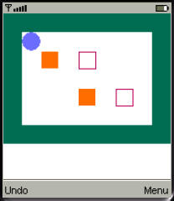
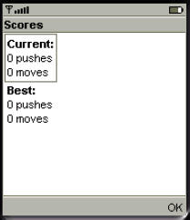
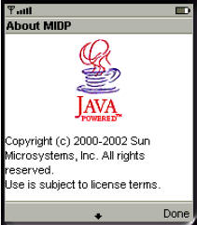
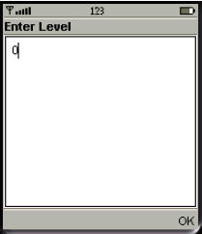
MIDP Programming – 1st Step
A screen for playing the game
A screen for seeing high scores
“About box” for the application.
A screen for setting the level of play

Slide 22
MIDP Programming – 2nd Step
사용자는 Command를 이용하여 Screen과 Interact함으로 아래의 Command가 필요할 수 있다.
  Turn to another level
  Switch the theme
  Show your scores
  Show the about box
  Exit
Command를 정한 후 MIDlet에서 CommandListener 인터페이스를 실현하여 해당 액션을 처리하여야 한다.

Slide 23
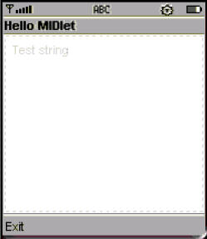
MIDP Programming – 3rd Step
Coding 방식
  Ruled Coding
    Create MIDlet object
    Implement MIDP lifecycle
    Add screens and commands
    Implement listener
  Support Coding
    MIDlet Networking
    MIDlet RMS
예: HelloMIDlet

Slide 24
MIDP Programming – 3rd Step
    Create MIDlet object
    Implement MIDP lifecycle
    Add screens and commands
    Implement listener
Extend the class MIDlet
Add the constructor
Add the default display object
  import javax.microedition.midlet.MIDlet;
  public class HelloMIDlet extends MIDlet
  {
  private Display display;
      public HelloMIDlet()
      {
      super();
      }
    }

Slide 25
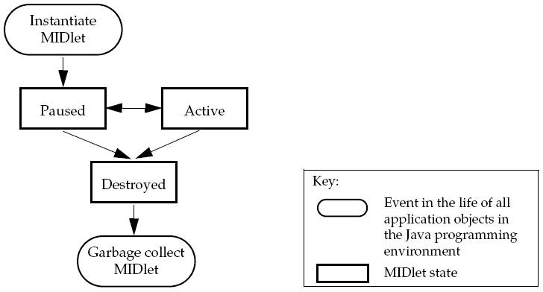
MIDP Programming – 3rd Step
    Create MIDlet object
    Implement MIDP lifecycle
    Add screens and commands
    Implement listener
MIDlet 상태와 관련한 Methods
3 protected methods in MIDlet class
startApp();
pauseApp();
destroyApp(boolean arg0);
pauseApp();
startApp();
destroyApp(boolean arg0);

Slide 26
MIDP Programming – 3rd Step
    Create MIDlet object
    Implement MIDP lifecycle
    Add screens and commands
    Implement listener
Codes to implement MIDlet Lifecycle
  import javax.microedition.midlet.MIDlet;
  import javax.microedition.midlet.MIDletStateChangeException;
  public class HelloMIDlet extends MIDlet {
  private Display display;
      public HelloMIDlet() {
      super();
      }
      protected void startApp() throws MIDletStateChangeException {
      }
      protected void pauseApp() {
      }
      protected void destroyApp(boolean arg0) throws MIDletStateChangeException {
      }
    }

Slide 27
Ruled Coding
    Create MIDlet object
    Implement MIDP lifecycle
    Add screens and commands
    Implement listener
Screens
  Hello MIDlet TextBox
    Class: TextBox
    Title: “Hello MIDlet”
    Initial Text: “Test string”
Commands
  Exit Button
    Class: Command
    Associated with TextBox
    Label: “Exit”
    Type: Command.EXIT

Slide 28
Ruled Coding
    Create MIDlet object
    Implement MIDP lifecycle
    Add screens and commands
    Implement listner
Instantiate the screen – HelloMIDlet TextBox
  Declare a field for the TextBox
  Create the TextBox
  public class HelloMIDlet extends MIDlet
  {
  private Display display;
    Private TextBox textBox;
    public HelloMIDlet() {
    super();
    textBox = new TextBox("Hello MIDlet", "Test string",256,TextField.ANY | TextField.UNEDITABLE);
    }
  }

Slide 29
Ruled Coding
    Create MIDlet object
    Implement MIDP lifecycle
    Add screens and commands
    Implement listener
Instantiate the Command – Exit Button
  Declare a field for the Button
  Create the Button
  public class HelloMIDlet extends MIDlet
  {
  private Display display;
  private TextBox textBox;
    private Command exitCommand;
    public HelloMIDlet() {
    super();
    exitCommand = new Command("Exit", Command.EXIT, 1);
    textBox = new TextBox("Hello MIDlet", "Test string",256,TextField.ANY | TextField.UNEDITABLE);
    }
  }

Slide 30
Ruled Coding
    Create MIDlet object
    Implement MIDP lifecycle
    Add screens and commands
    Implement listener
Associate screens with their commands
Set the MIDlet’s display to its initial screen
  public class HelloMIDlet extends MIDlet {
  private Display display;
    private TextBox textBox;
      private Command exitCommand;
      public HelloMIDlet() {
      super();
      exitCommand = new Command("Exit", Command.EXIT, 1);
      textBox = new TextBox("Hello MIDlet", "Test string",256,TextField.ANY | TextField.UNEDITABLE);
      textBox.addCommand(exitCommand);
      display = Display.getDisplay(this);
      display.setCurrent(textBox);
  }
  }

Slide 31
Ruled Coding
    Create MIDlet object
    Implement MIDP lifecycle
    Add screens and commands
    Implement listener
Assign a listener to the screen and define the actions
  The listener is the class that implements the CommandListener interface; Here it’s the HelloMIDlet class
  public class HelloMIDlet extends MIDlet {
    Private TextBox textBox;
    Private Command exitCommand;
    public HelloMIDlet() {
  super();
    exitCommand = new Command("Exit", Command.EXIT, 1);
    textBox = new TextBox("Hello MIDlet", "Test string",256,
    TextField.ANY | TextField.UNEDITABLE);
    textBox.addCommand(exitCommand);
    textBox.setCommandListener(this);
  }
  }
implements CommandListener
      public void commandAction(Command command, Displayable screen) {
      if (command == exitCommand) {
    destroyApp(false);
        notifyDestroyed();
        }
      }

Slide 32
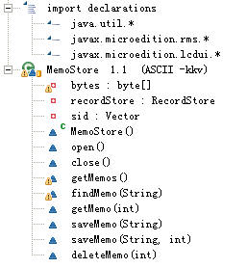
Support Coding
네트워크, 스토리지 등 기능을 사용할 수 있음.
프로그래밍 시 보통 기능적 클래스들로 조직함.
  예, 메모패드 클래스
This class is from the open source project “Memopad”” on sourceforge.net

