Slide 1


Elevator With 3 Floors
Group No:- 08
Prepared by:-
Joy Saha (1706189)
Ishtiaque Ahmed (1706190)
Tasnim Rahman (1706191)
Aong Shay Sing Marma (1706195)

Slide 2
Components:
Keypad
Arduino Uno
Reed Switch Sensor
Magnet
DC motor
L293D motor driver
Breadboard
Jumper wires
Resistors

Slide 3
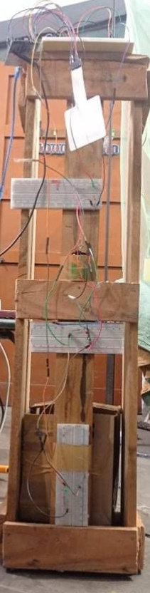
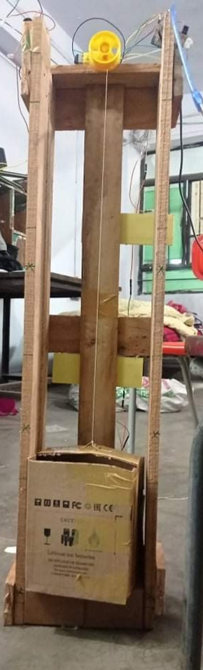
Frame of the Elevator:
The frame is made of wood.
We have built an elevator with 3 floors.

Slide 4
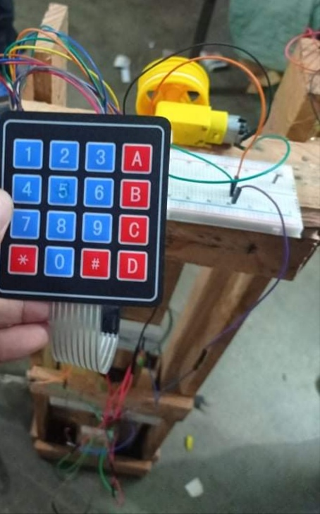
Keypad:
We have used only three buttons of the keypad for the 3 floors of the elevator.
These buttons are connected to three pins of the Arduino Uno.

Slide 5
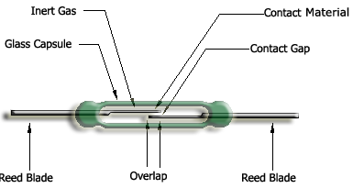
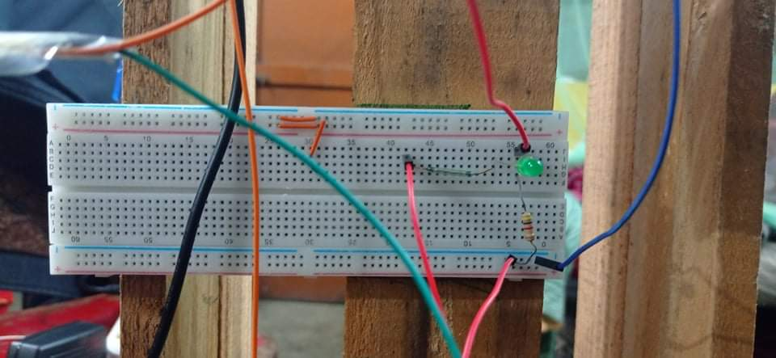
Reed Switch Sensor:
They are a kind of magnetic sensor.
This sensor is used here to detect the elevator position.
Total three reed switch sensors are used here.

Slide 6
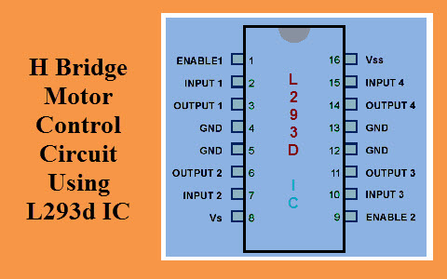
L293D motor driver:
L293D consists of two H-bridge.
Motor driver IC receives signals from the microprocessor and transmits the relative signal to the motors.
Microprocessors operate at low voltages and require a small amount of current to operate while motor requires higher voltages and current. As current cannot be supplied to the motors from the microprocessor, motor driver is needed.

Slide 7
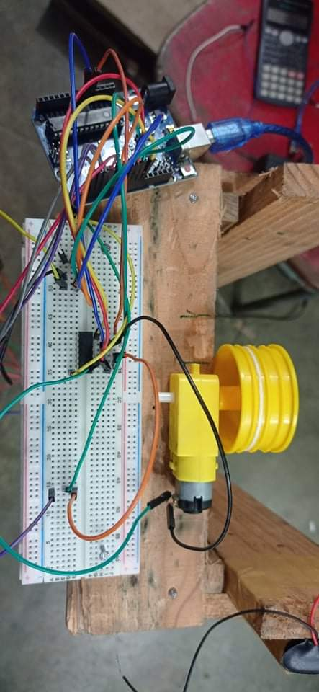
DC motor along with L293D motor driver:
In a DC motor, the input electrical energy is the direct current which is transformed into the mechanical rotation.
For the off state of the elevator, we have used a PWM of 50. For the upward moving of the elevator, we have used a PWM of 175. For the downward moving of the elevator, we have used a PWM of 30.

Slide 8

Hardware Demonstration

Slide 9
Thank You

