Slide 1
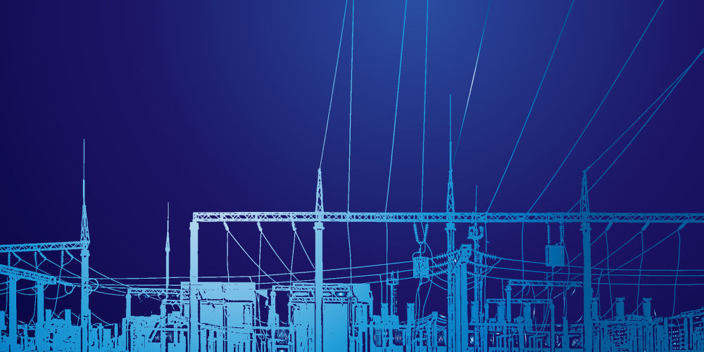
Project Presentation
EEE 306
Power System Laboratory
Group: 06

Slide 2
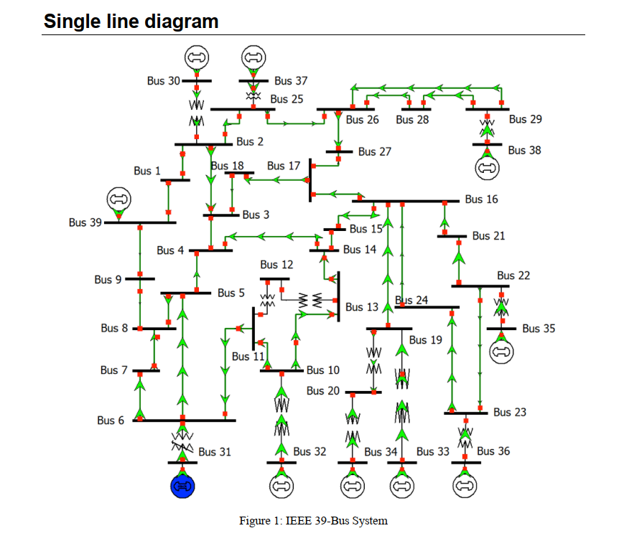
Load Flow Analysis on
IEEE 39 Bus System at 50Hz

Slide 3
Solution Steps
Simulating the system with Given Data , with out any DC Line, Induction Motors, TCUL Xmer
Step 01:
Simulation result
No Overloading Occurred.
Couple of Line underloading and under loaded Transformer was observed

Slide 4
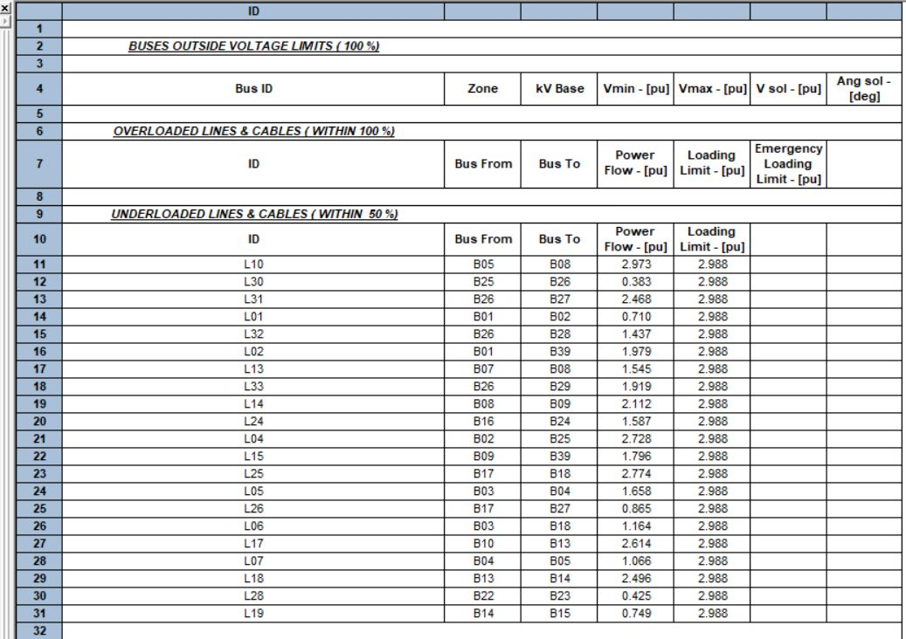
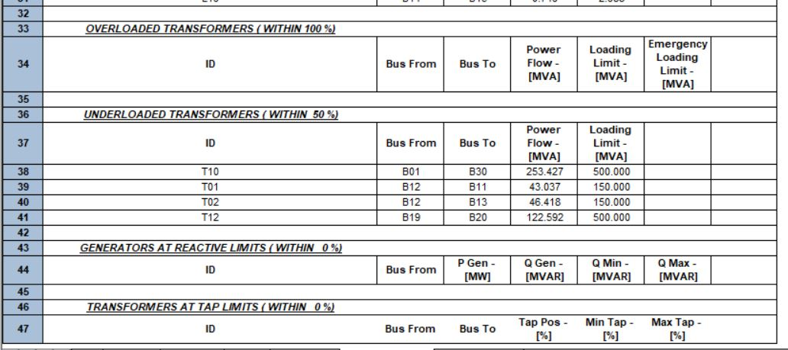

Slide 5
Simulating the system with Given Data , with a DC Line between B39_Rec to B9_INV bus, 10 Induction Motors, two TCUL Xmer, Removing L15 AC line
Step 02:
Simulation result
Some bus was out of their voltage limit
At L22, L14, L17,L07,L18,L09 line Overloading Occurred.
Transformer 03 was highly overloaded
G03,G06,G07 crossed their Reactive Limits

Slide 6
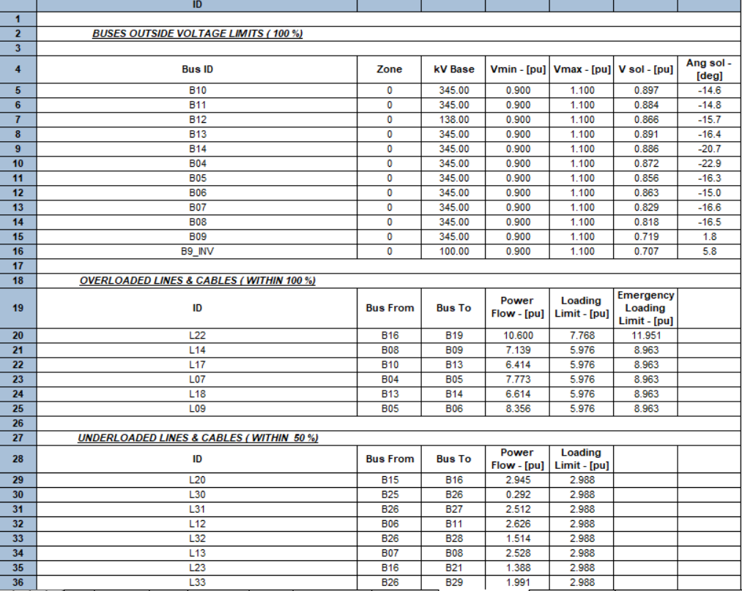
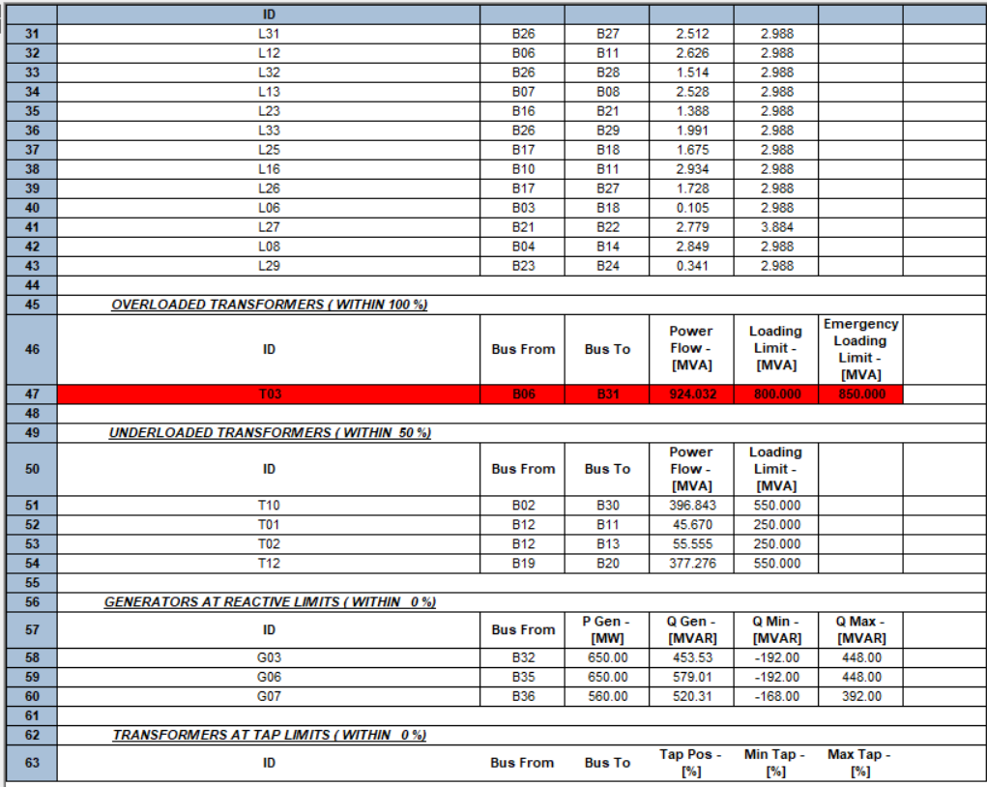
After
Step 02

Slide 7
Step 03:
To solve Generators at reactive limits problem, one SVC was connected B23
Simulation result
No Gen have crossed their Reactive Limits
Some bus was out of their voltage limit
Transformer 03 was overloaded as before
Line Overloading remained same at six line
Explanation
SVC can absorb or deliver reactive power . So, one SVC was connected at B23. SVC has solved the problem of Generator reactive limits

Slide 8
Mathematical Reasoning
Another approach: connect SVC in all three gen. bus individually
Total reactive power at B23 is = Q_{load} + Q_{motor}
=84.6+600
=684.6 MVAR
We have placed a 700MVAR SVC at B23.
SVC rating Qmax=700Mvar, Qmin= -10Mvar

Slide 9
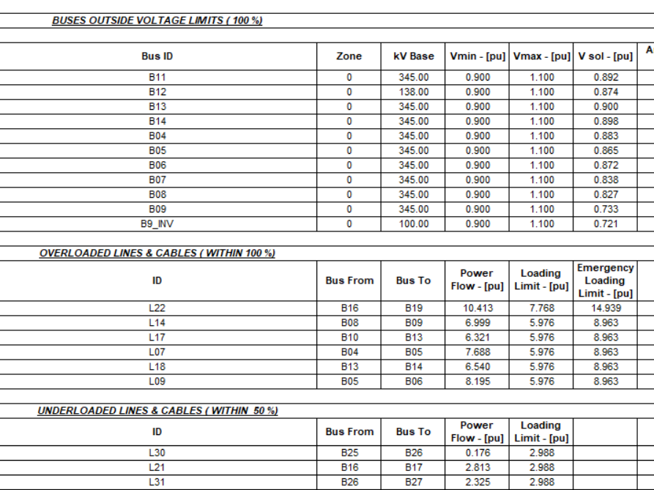
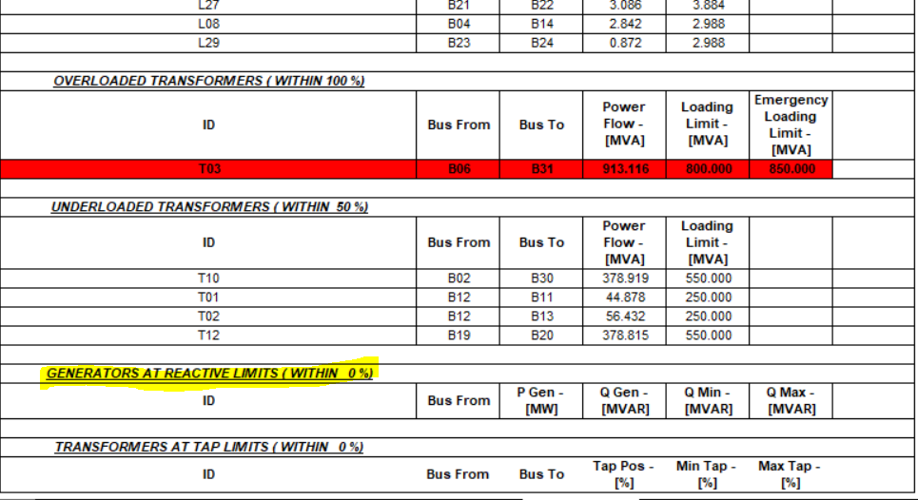

Slide 10
Step 04:
To solve bus out of voltage limit , we have connected couple of shunt capacitor at different buses, instead of SVC, as shunt capacitor are cheaper than SVC
Simulation result
No Gen has crossed their Reactive Limits
No buses were out of their voltage limits
Transformer 03 was overloaded as before
Line Overloading was only at L22,L07,L18,L09, two line’s problem was solved
Explanation
Some buses were out of voltage limits. There voltage (pu) was less than minimum. So , shunt capacitor was connected at different buses. Reactive power will increase bus voltage. Thus, all bus voltage will stay in their corresponding limits.

Slide 11
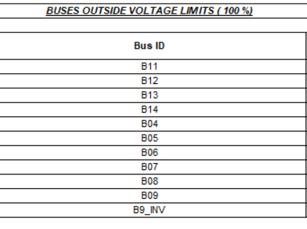
Mathematical Reasoning
1st Shunt Capacitor at B11
Our 1st problem was at B11.
Bus 11 was connected with L12,L16 and T01.
The sum of reactive power of all three things are =L12 + L16 + T01
= -218+247+35
= 64MVar
So, rating of Shunt capacitor at B11 was 70Mvar.
2nd Shunt Capacitor at B12
Here, reactive power at Bus 12 is 88MVar
So, a shunt capacitor rating of 90MVar was connected at B12
Thus problem of voltage limit was solved at B11 and B12

Slide 12
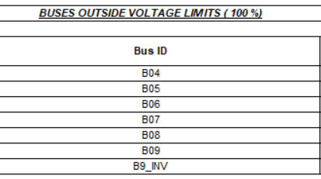
Mathematical Reasoning
3rd Shunt Capacitor at B04
Here, reactive power at Bus 04 is 184MVar
So, a shunt capacitor rating of 184 MVar was connected at B04
B04 problem was solved
4th Shunt Capacitor at B09
Finally we have connected a large shunt capacitor at B09 to compensate all other remaining buses.
The rating of shunt capacitor is 260MVar.
After this no other buses were out of their voltage limits

Slide 13
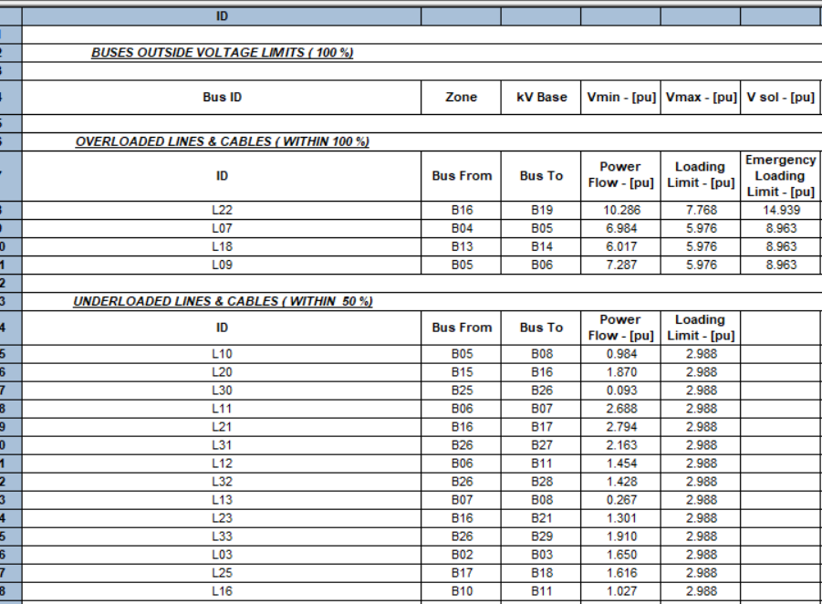
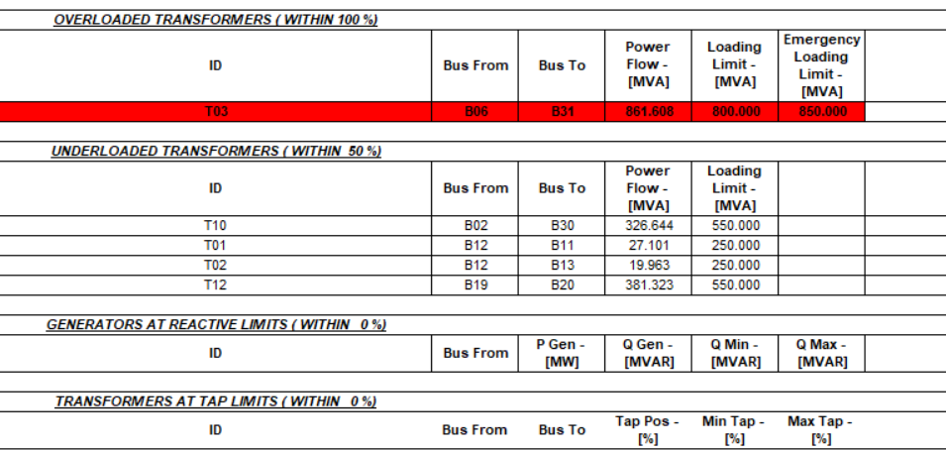

Slide 14
Step 05:
To solve the transformer overloading problem, active generation of G01, G03, G10 was increased by 50MW.
Simulation result
No Transformer overloading problem was occurred
Line Overloading remains same L22, L07, L09
T03 was connected between B31 and B06. Again, B31 is slack bus. Again, B06 is very closed to B31. So, high power is flowing through T03. To solve this, we have to increase the generation of some other generator, to release pressure of swing generator
Explanation

Slide 15
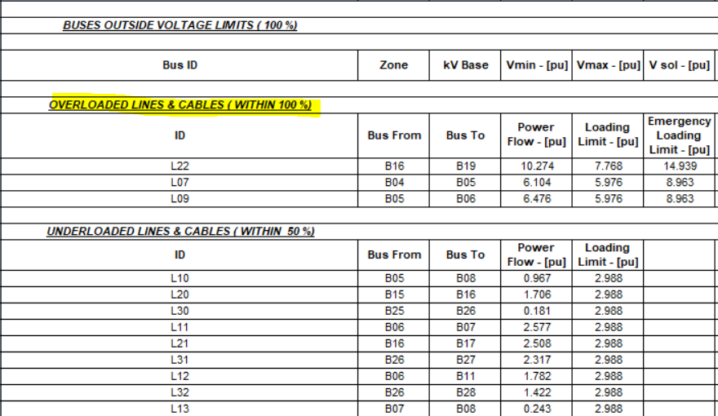
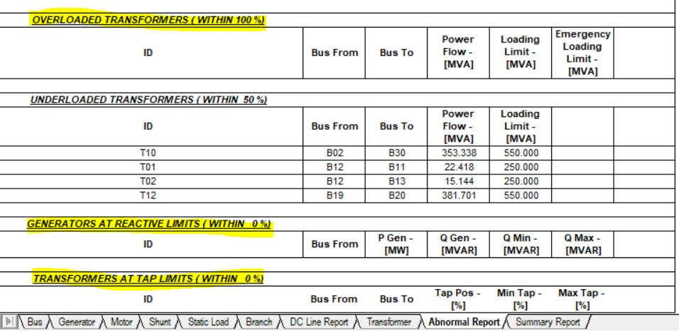

Slide 16
Step 06:
To solve L22 ,L07 L09 overloading problem we have increased the loading limit of L22 to 1800, L07 at 1200, L09 at 1200
After this step, only line underloading and transformer underloading was remained
By decreasing the loading limit of line , under loading problem of line was also solved
Simulation result

Slide 17
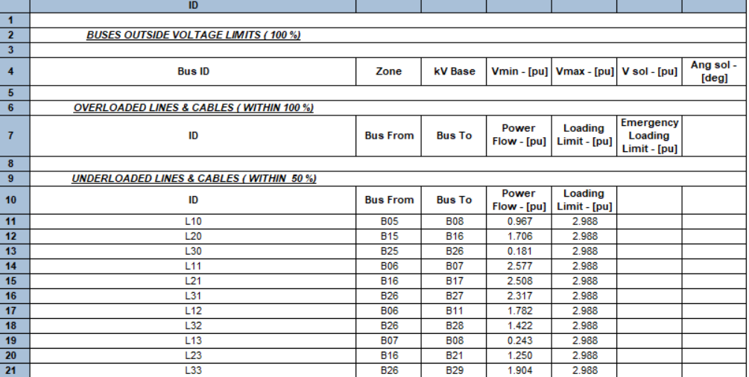
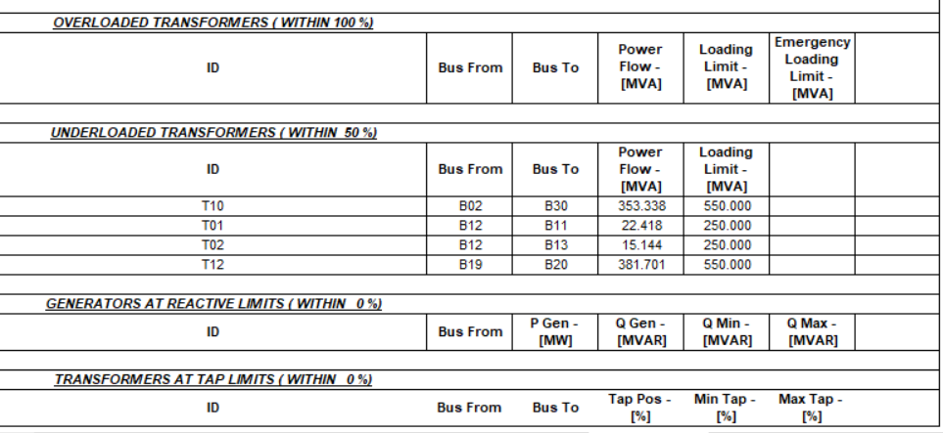

Slide 18
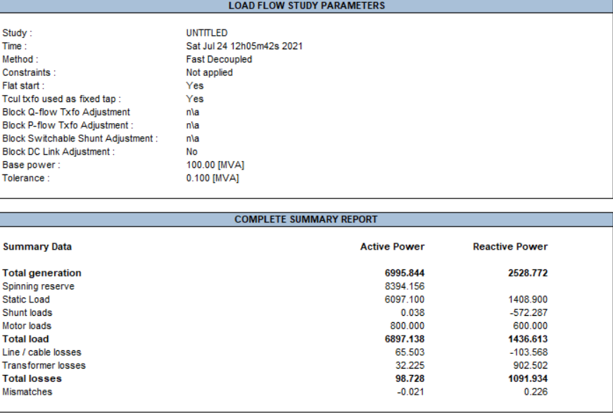

Slide 19
Contributions
1706150 , 1706152: Data entry & cross-checking
1706149 , 1706189: Placing corrective devices and problems solving and making presentation slide.

Slide 20
Thank You

