Slide 1
Laboratory Variable DC Power Supply
Group No:- 03
Prepared by:-
Joy Saha (1706189)
Ishtiaque Ahmed (1706190)
Tasnim Rahman (1706191)
Aong Shay Sing Marma (1706195)

Slide 2
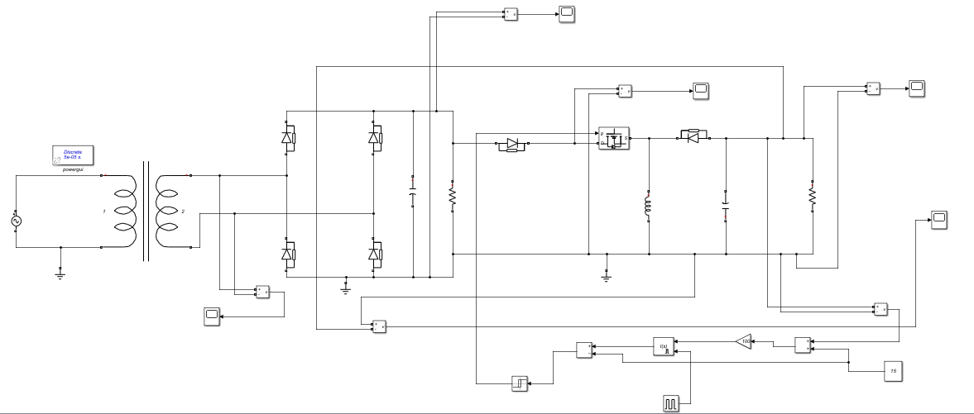
Objectives:
To step down the 220V (AC) to a lower level and then rectifying it to get a lower-level DC source.
To fix the output of the power DC source at a voltage level irrespective of load change.
Circuit Diagram:

Slide 3
Block Diagram:
AC Source Input
Step-down Transformer
Full bridge Rectifier
Buck-Boost Converter
Feedback
Controller
Measuring Error Voltage
Reference Voltage

Slide 4
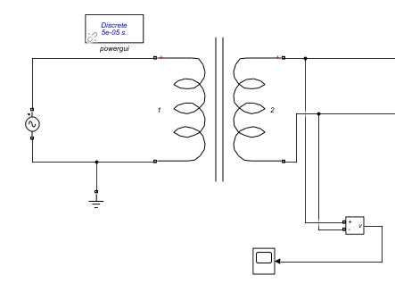
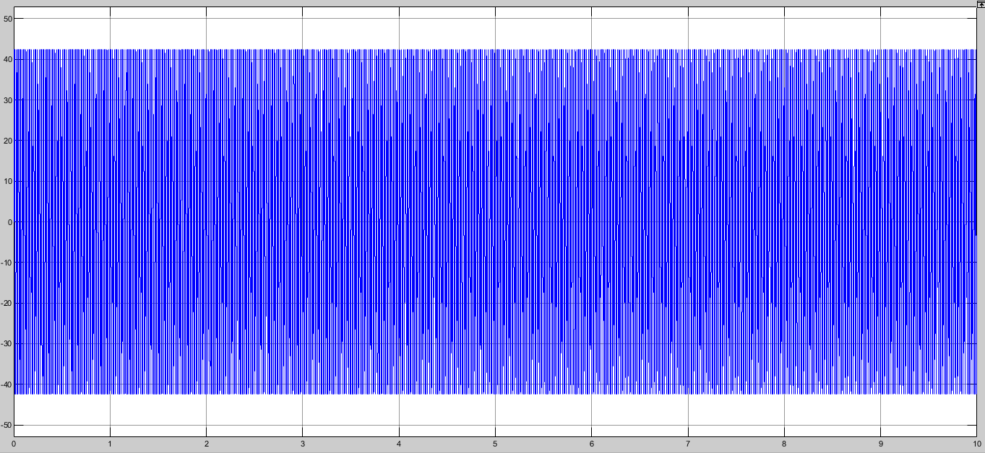
Step-down Transformer Block:
Here 220V(rms) AC voltage source is used i.e. the peak value of the source is 311V. Then a 220V(rms)/30V(rms) step-down transformer has been connected to lower the AC voltage.
The output peak voltage is 42.4V.

Slide 5
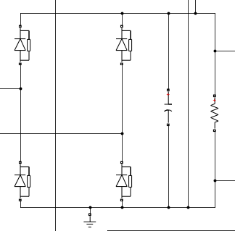
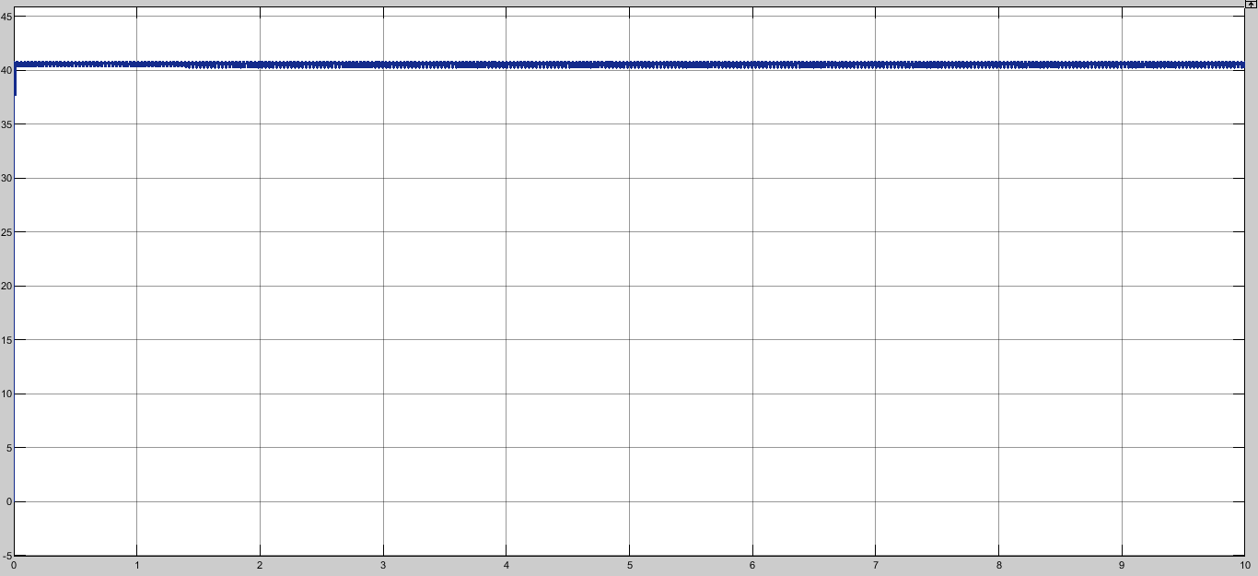
Rectifier Block:
The full wave bridge rectifier converts AC voltage to DC voltage.
RC filter filters out high frequency ripples.
Now output voltage is about 40.8V

Slide 6
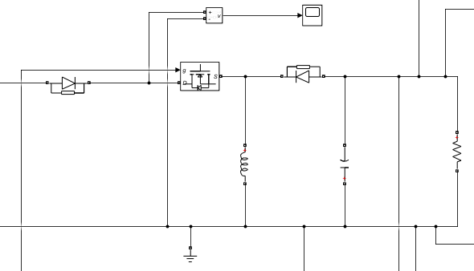
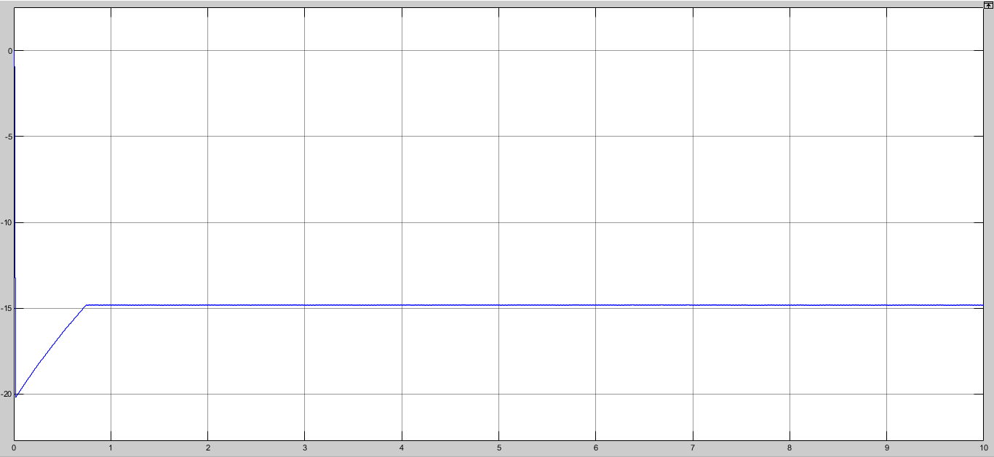
Buck-Boost Converter Block:
Buck-Boost converter is a step-down converter for D<0.5 and step-up converter for D>0.5
Output voltage=(-D/(1-D))*input voltage
where D=duty cycle
Here output voltage is now -14.8V.

Slide 7
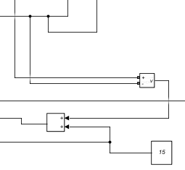
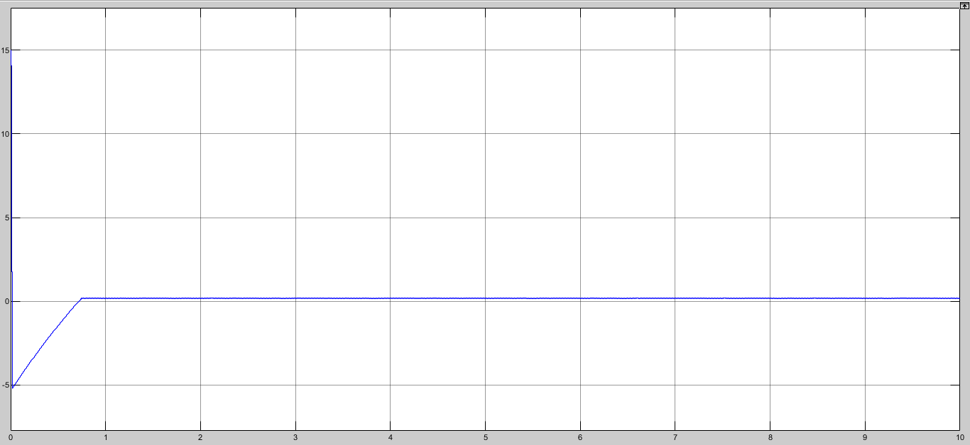
Measuring Error Voltage:
We have used a reference voltage of 15V
Error voltage is about 0.2V

Slide 8
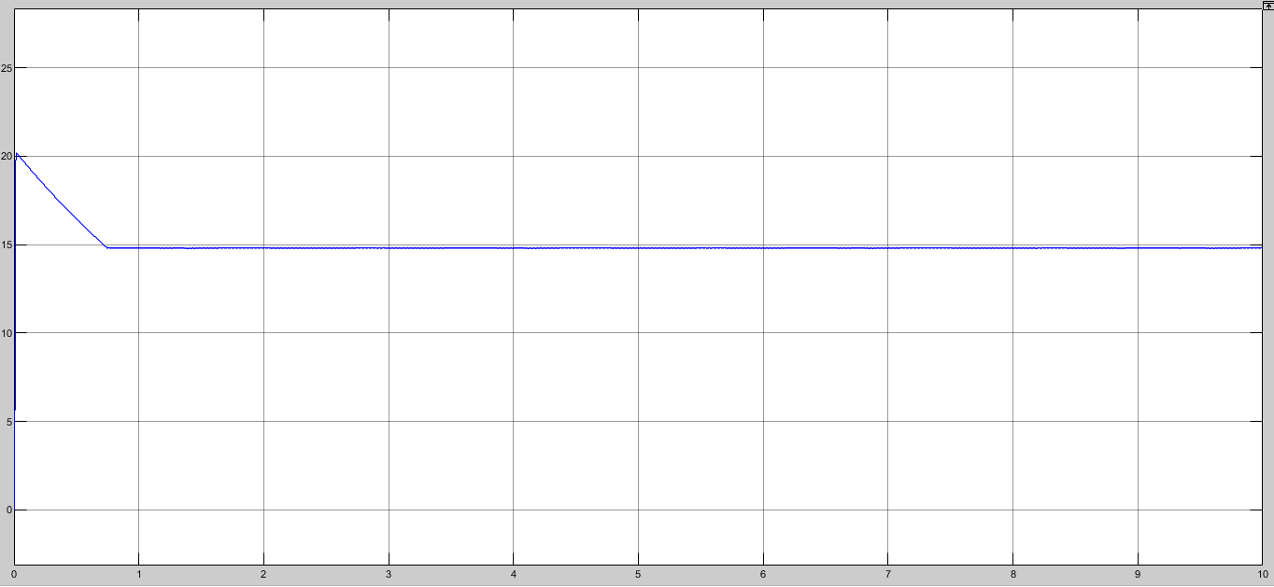
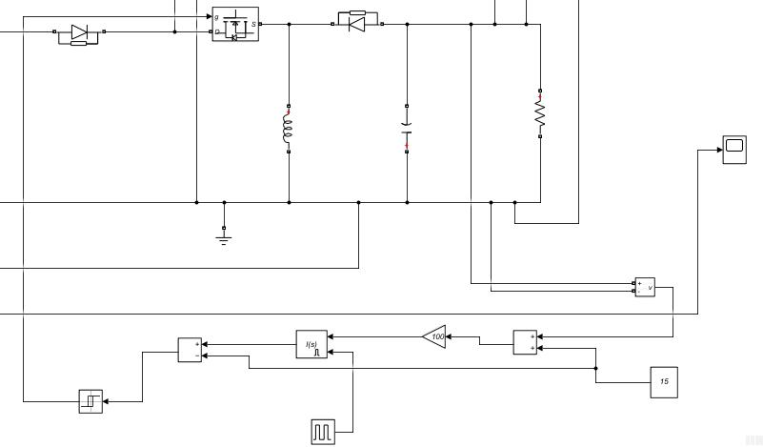
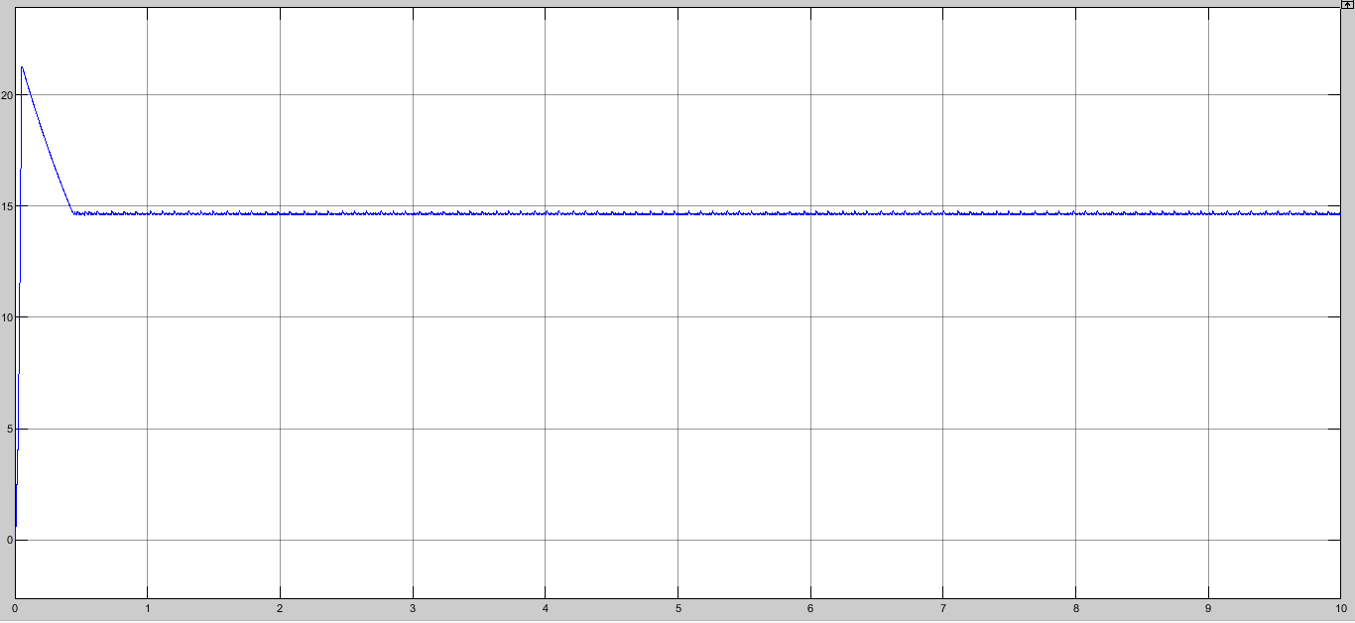
Feedback Controller:
Fig: Output voltage for Load=5k ohm and 15V reference
Feedback controller consists of a gain, a Integral controller, a relay and a feedback path.
Output voltage is approximately 15V for both 5k and 220 ohm.
Fig: Output voltage for Load=220 ohm and 15V reference

Slide 9
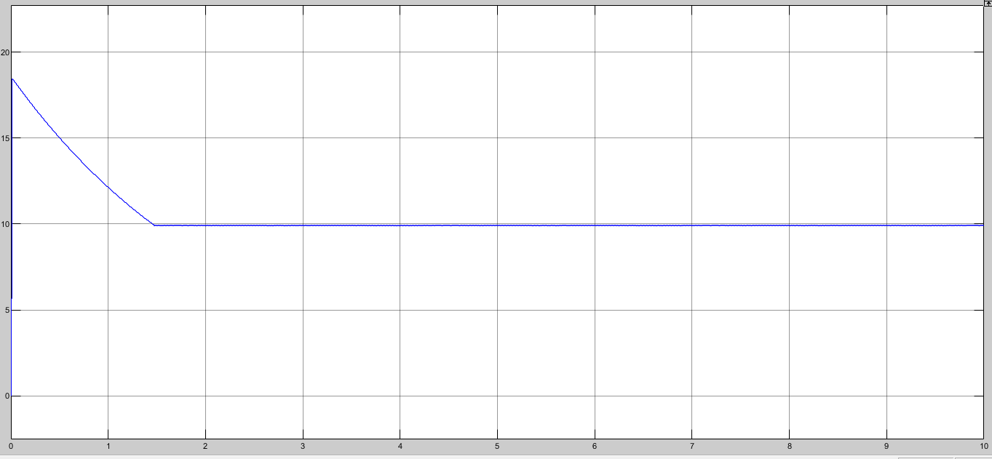
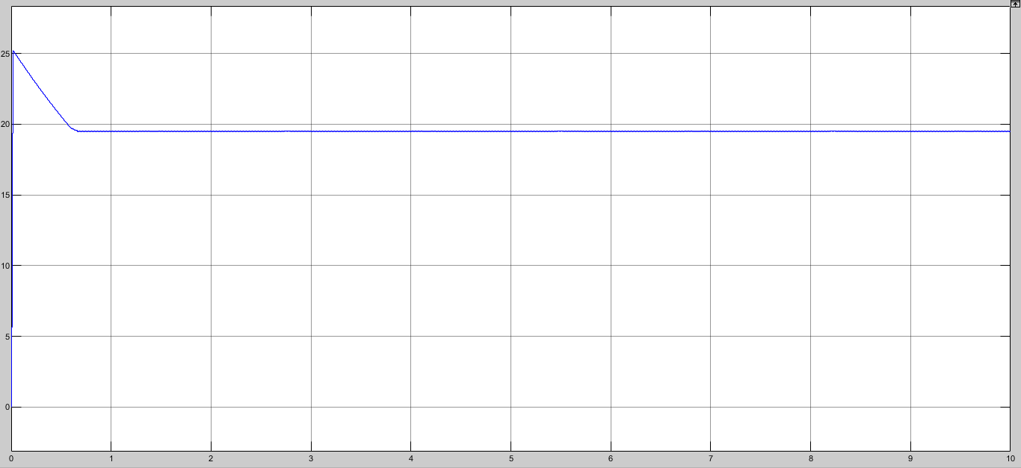
Variable DC voltage changing the reference voltage:
Fig: Output voltage for 20V reference
Fig: Output voltage for 10V reference
Fig: Output voltage for 15V reference

Slide 10
Thank You

