Slide 1
CSI 436/536 (Spring 2025)​
Machine Learning​
Final Presentation
Neural Networks: Project Code "N“
Investigating Effects of Layer Depth, Neuron Count, and Activation Functions
Presented By : Group 2
Ali Salehi Darjani (001657808)
Joy Saha (001657938)
Nowshin Tasnim (001649184)
Tajkia Nuri Ananna (001661229)
Presented To : Dr. Chong Liu
April 28, 2025

Slide 2
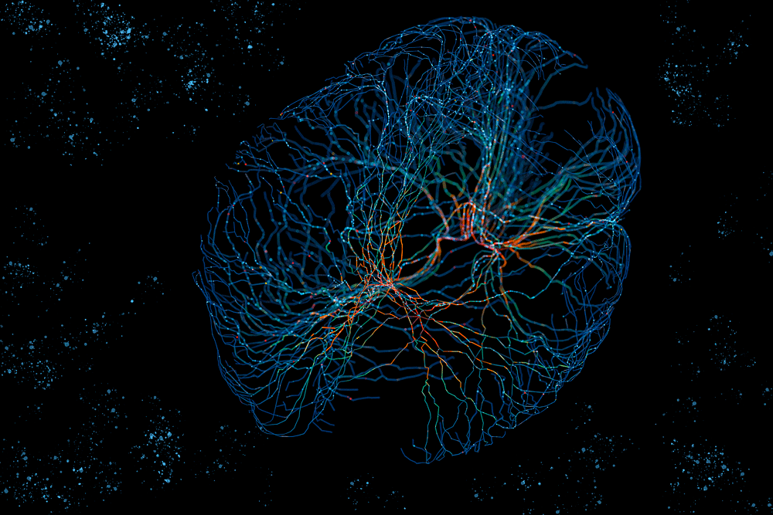
Introduction
What is a Neural Network?
A computational model inspired by the human brain.
Made up of neurons (nodes) connected in layers.
Learns by adjusting weights and biases.
Solves tasks like classification, prediction and pattern recognition.

Slide 3
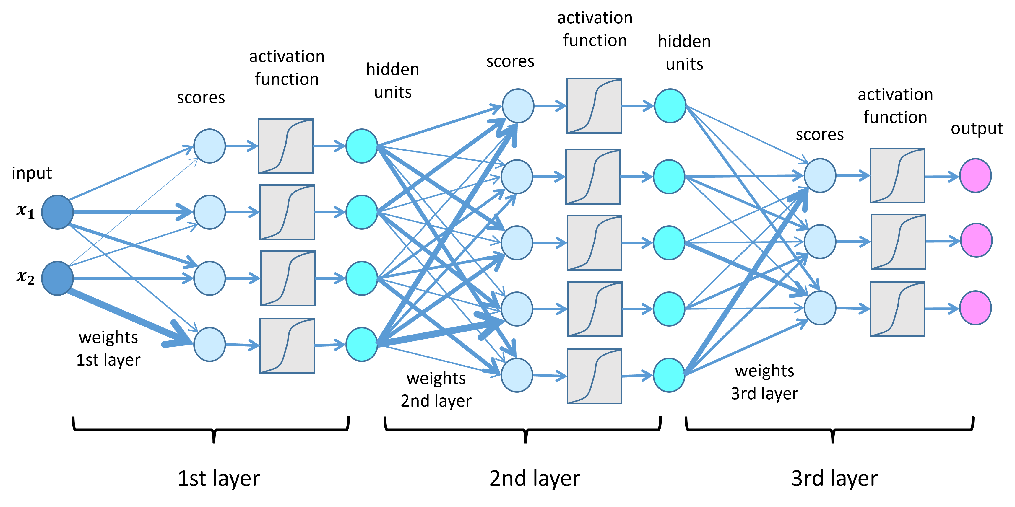
Problem Statement

Slide 4
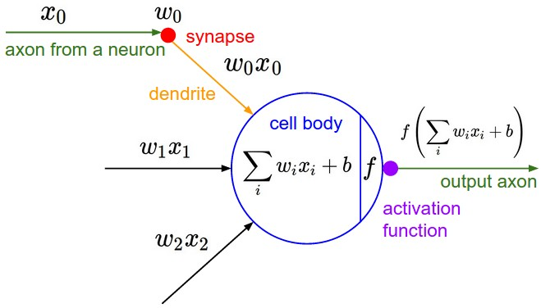
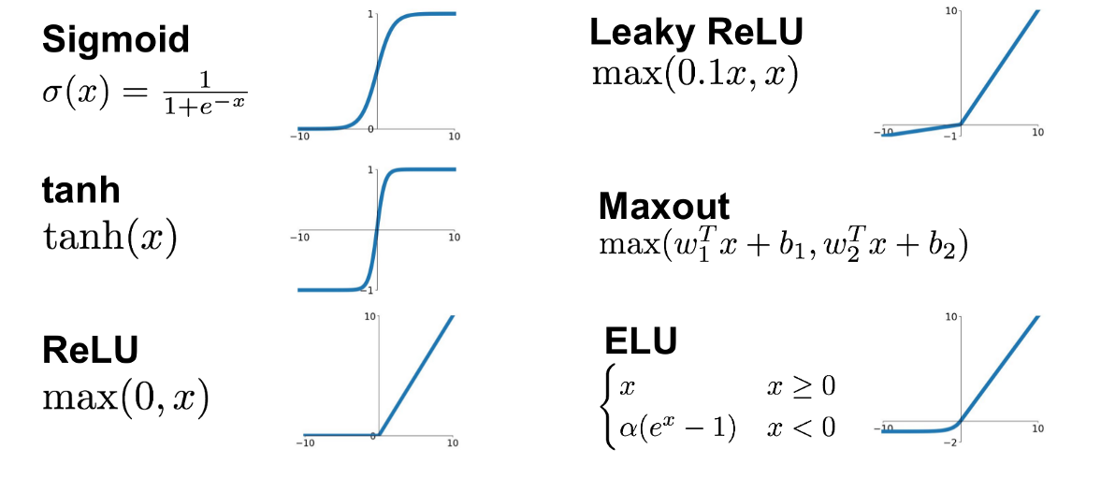
Problem Statement (Continued)
Build neural network from scratch
Explanation of neural network fundamentals
Investigate the impact of varying architecture and activation functions
Evaluate its performance on classification dataset.

Slide 5
Experimental Setup
Dataset | # Instances | # Features | #Class
F-MNIST | 70000 | 784 | 10
MNIST | 70000 | 784 | 10
IRIS | 150 | 4 | 3
MLL | 72 | 5848 | 3
Madelon | 2600 | 500 | 2
Leukemia | 72 | 7129 | 2
Training Details
Optimizer
Learning Rate
Batch Size
Epochs
Adam or BatchedGD
.001, .01
64
100

Slide 6
Experimental Setup (Continued)
Model Architecture
Hidden Layer Depth
2
Neuron Count
128
ReLu
1
3
64
32
Activation Functions
Leaky ReLu
Sigmoid
Evaluation Matrices
Accuracy
Loss
Generalization
Tools
Python
Numpy
Matplotlib

Slide 7
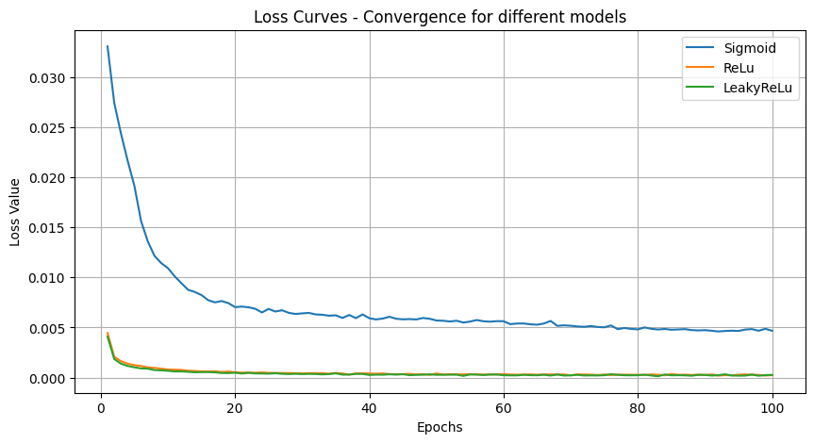
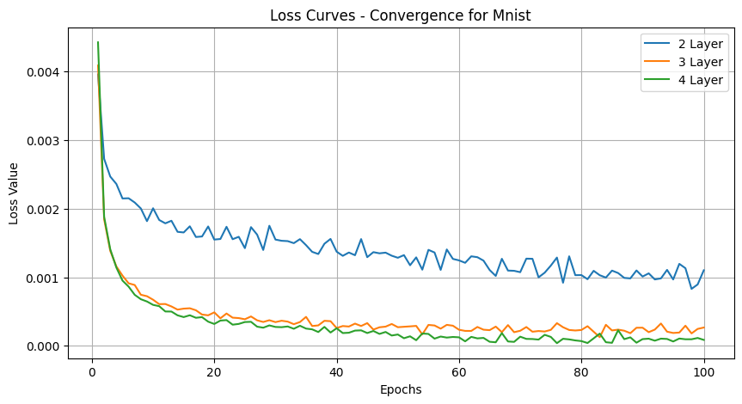
Results
For MNIST
Loss Curves for Different Activation
Loss Curves for Different number of Hidden Layer

Slide 8
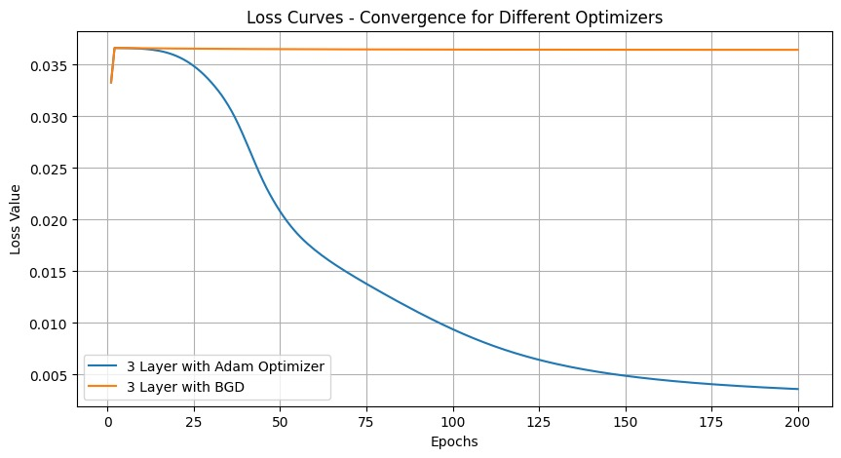
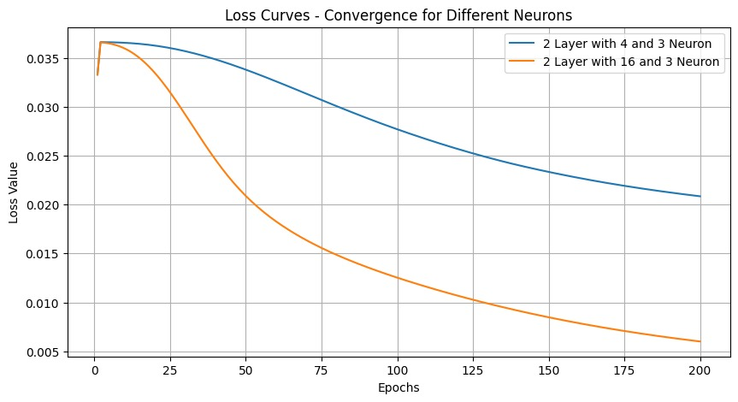
Results (Continued)
For Iris

Slide 9
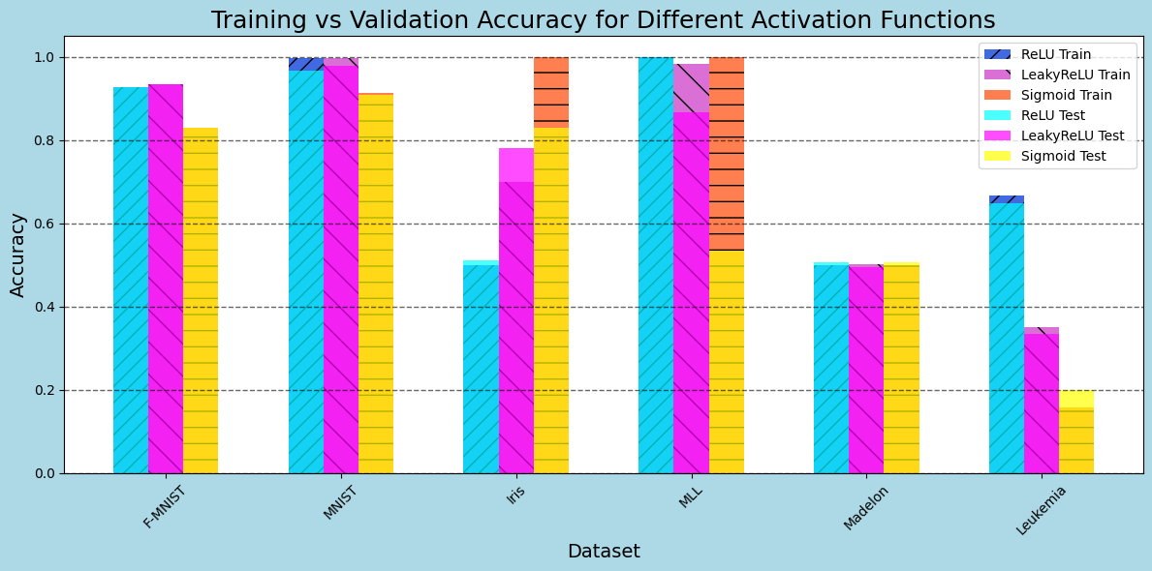
Results (Continued)

Slide 10
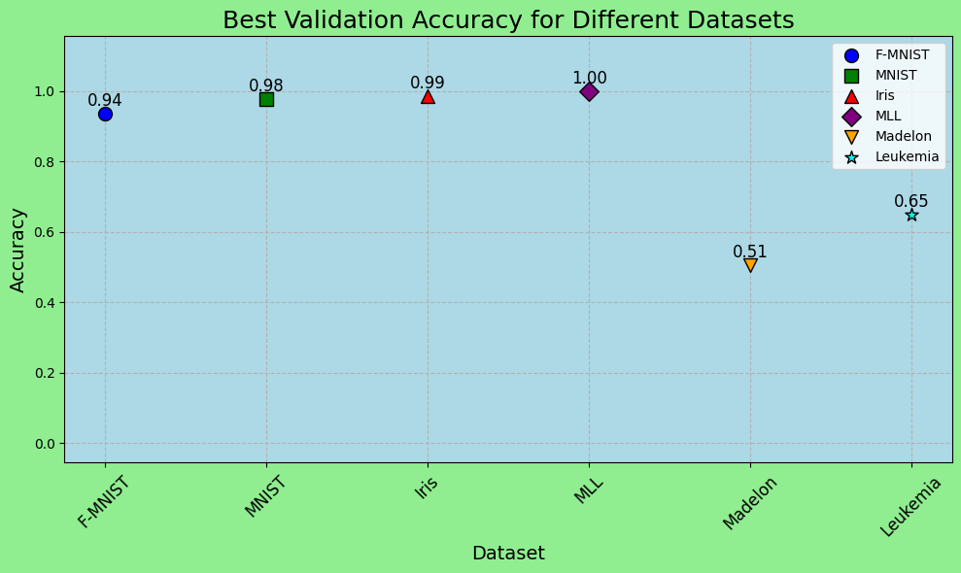
Results (Continued)

Slide 11
Conclusion
Architecture
Activation Functions and Neuron Count
Hyperparameter

Slide 12
Thank You!
Any Question?

