Slide 1
CSI 436/536 (Spring 2025)​
Machine Learning​
Midterm Presentation
Neural Networks: Project Code "N“
Investigating Effects of Layer Depth, Neuron Count, and Activation Functions
Presented By : Group 2
Ali Salehi Darjani (001657808)
Joy Saha (001657938)
Nowshin Tasnim (001649184)
Tajkia Nuri Ananna (001661229)
Presented To : Dr. Chong Liu
Mar 12, 2025

Slide 2
Introduction
What is a Neural Network?
A computational model inspired by biological neural networks
Composed of layers of interconnected nodes (neurons)
Project Goal:
Explanation of neural network fundamentals
Implement and analyze a two-layer neural network
Evaluate its performance on classification datasets
Investigate the impact of varying architecture and activation functions

Slide 3

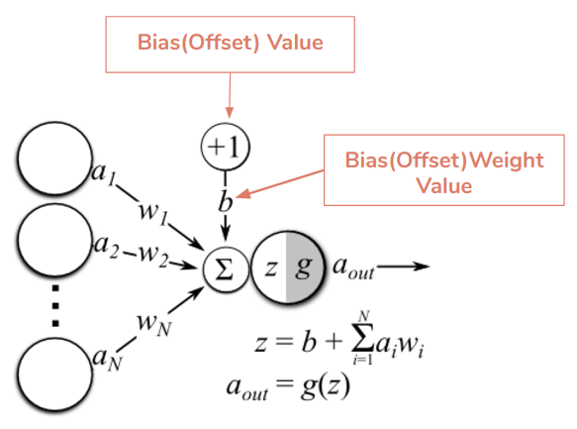
Problem Setup

Slide 4
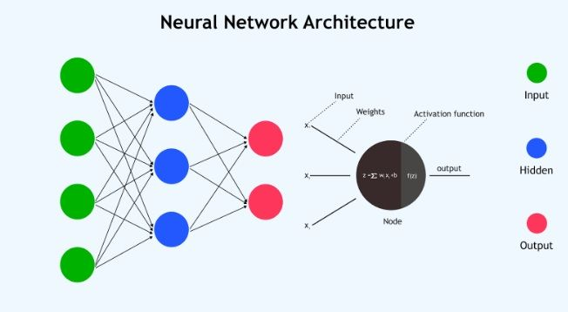
Experimental Setup
Dataset | Instances | Features
F-MNIST | 14000 | 784
MNIST | 14780 | 784
IRIS | 150 | 4
Dexter | 300 | 20000
Madelon | 2600 | 500
Spam-base | 4601 | 47
Leukemia | 72 | 7129

Slide 5
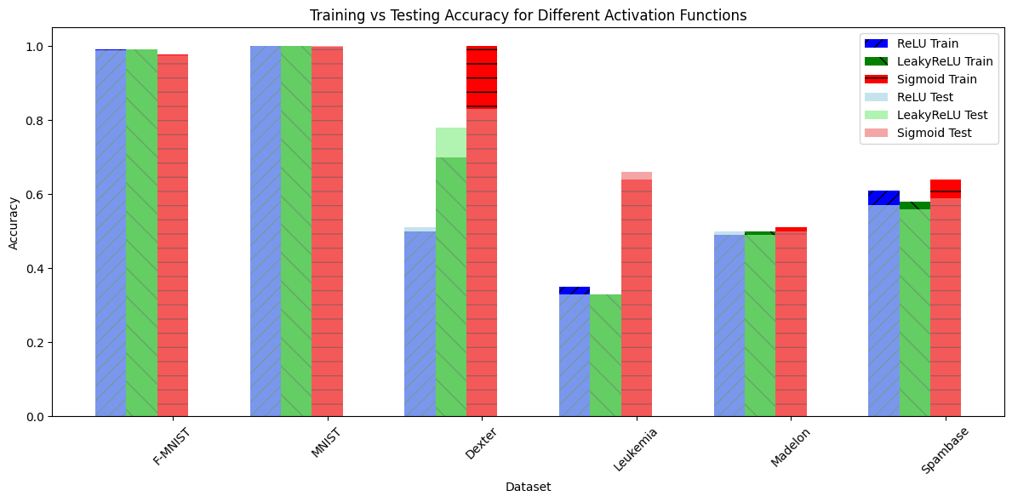
Results

Slide 6
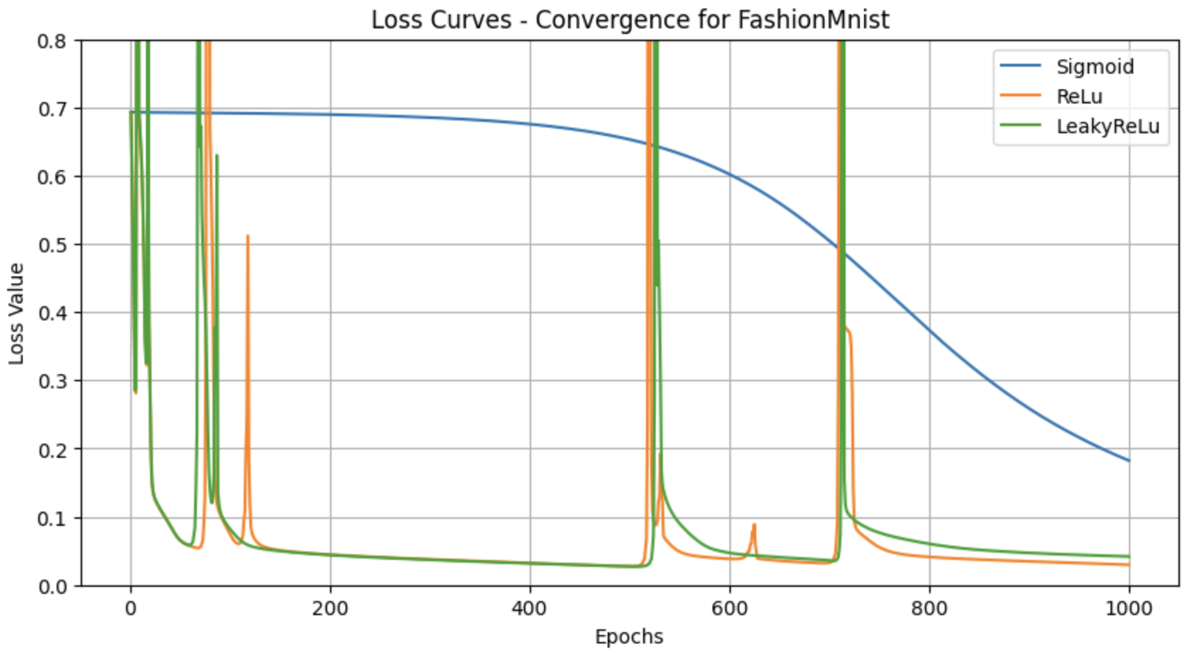
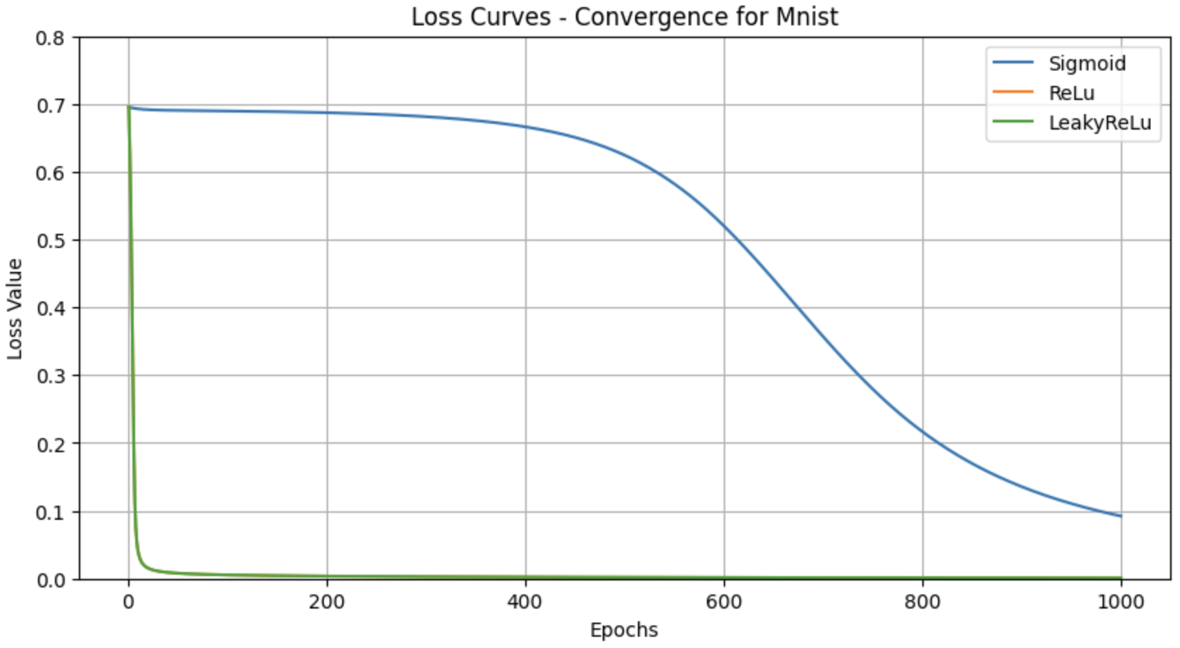
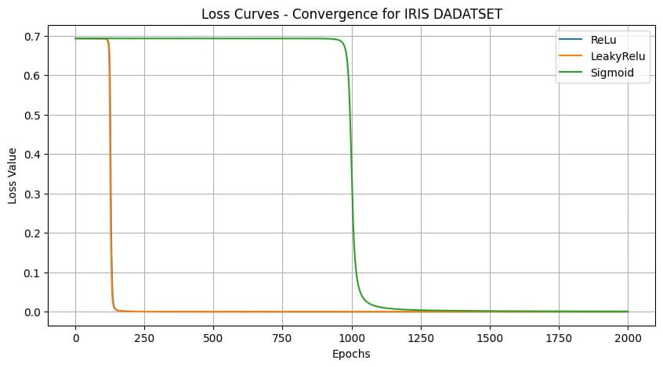
Results Continued

Slide 7
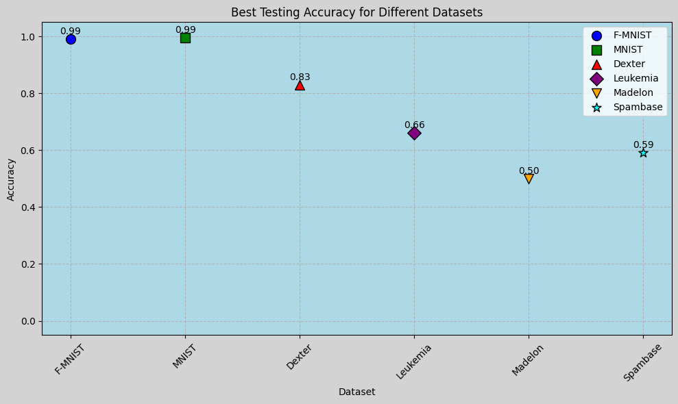
Results Continued

Slide 8
Challenges
Weight Initialization: Avoid poor convergence.
Backpropagation: Correct gradient application.
Learning Rate: Ensure efficient convergence.
Numerical Stability: Handle underflows/overflows.
Activation Function: Prevent vanishing gradients.
Overfitting: Apply regularization.
Optimization: Slow gradient descent.
Gradient Checking: Verify correctness.
Training Time: High computational cost.
Debugging: Detect subtle issues.

Slide 9
Future Work
Exploring different optimizers (e.g., Adam, RMSprop, Ada-Grad) instead of only GD
Replacing basic gradient descent with Stochastic Gradient Descent (SGD)
Testing different weight initialization strategies (e.g., Xavier, He initialization)
Experimenting with adaptive learning rate techniques
Evaluating the effect of different loss functions for imbalanced datasets
Work with multi-class
Different number of hidden layer​
Different number of neurons in each layer

Slide 10


