Slide 1

TDM - PCM
System
(In Proteus)
Group 13
1706149
1706150
1706152
1706189

Slide 2
TDM - PCM System Block Diagram
3 channel input
Analog To Digital Converter
Parallel to Serial Data converter
Multiplexer
Transmission channel
3 channel output
Serial to Parallel Data converter
Low Pass Filter
Demultiplexer
Decoder

Slide 3
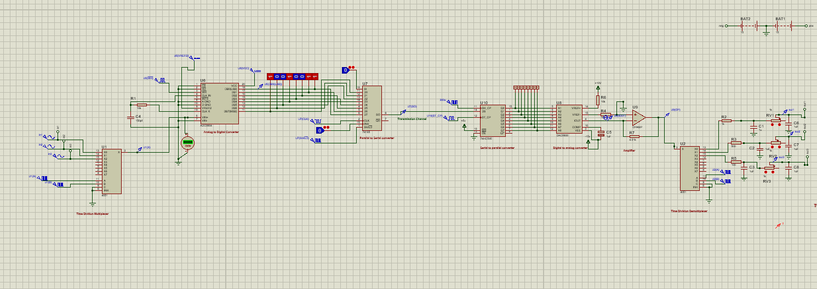
Main Circuit
Replace with your own text
Transmission
channel
ADC
PISO
SIPO
DAC
LPF
Multiplexer
Demultiplexer
Transmitter Side
Receiver Side

Slide 4
Input is three sinusoidal signals of three different frequency
Amplitude: Peak to Peak 10 voltage

Slide 5
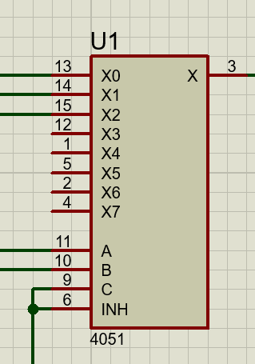
Multiplexer
CD4051 Multiplexer
Take input signal from 3 channels
Time division multiplexing occurred and generate data through a single channel
Output is Connected directly with ADC

Slide 6
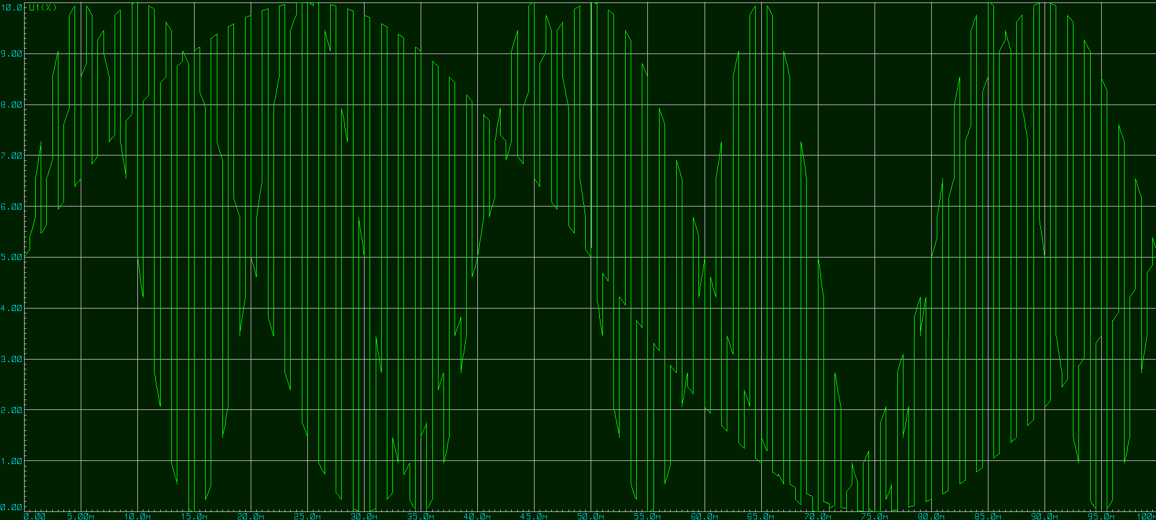
Output Of TDM block

Slide 7
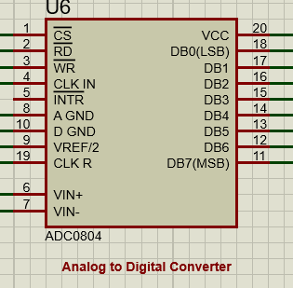
ADC
ADC0804 IC is used
Sampling, Quantization and Encoding happened here
Voltage range 0-10v is used.
Clock frequency 4k Hz.
Generate code word data stream in DB0 ~ DB7
Connected to parallel to serial converter block

Slide 8

$$v_{out}=\frac{V_{in}}{V_{max}}×2^{8}$$
Corresponding Decimal output for input signal formula

Slide 9
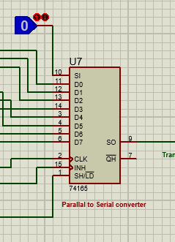
Parallel to Serial Converter
74165 IC is used here, a Parallel to serial 8 bit shift register
It takes parallel input, deliver serial data
32k Hz clock frequency is used
Output of this block is used for transmission

Slide 10
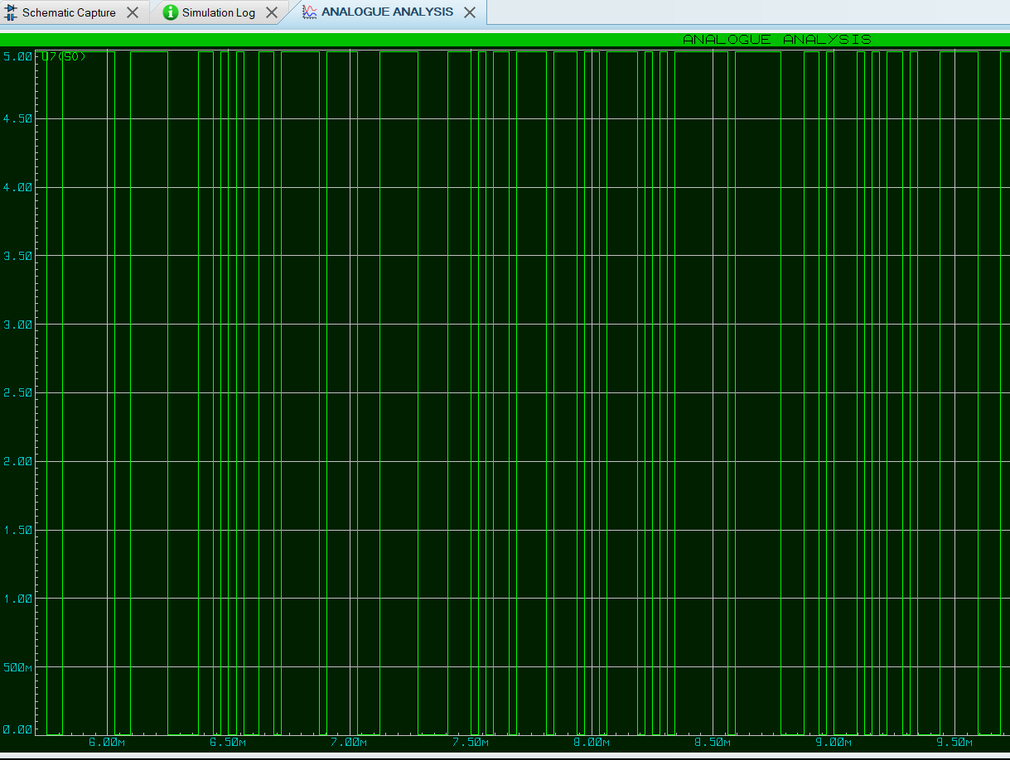
Output of parallel to serial converter

Slide 11
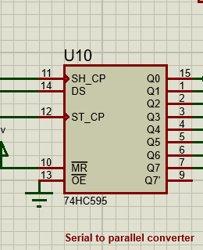
Serial To Parallel Converter
74HC595 IC is used for serial to parallel converter
This block receives the data from the input DS.
Convert Serial line code into parallel data by 8 bit frame
Feeds parallel data bits through Decoder

Slide 12
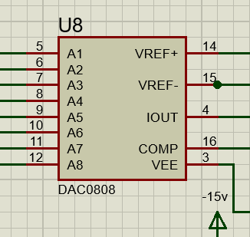
Serial To Parallel Converter
Decoder and Op Amp
DAC0808 decodes the data from each code word
Generate specific analog output level according to incoming code word
Output signal is inverted polarity and negatively biased

Slide 13
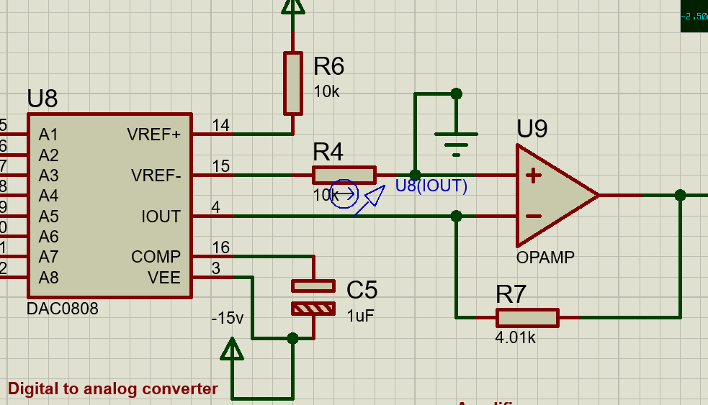
Op amp is used as current to voltage converter , working as transimpedance amplifier
DAC changes the digital input into current , Op amp converts this current to voltage.

Slide 14
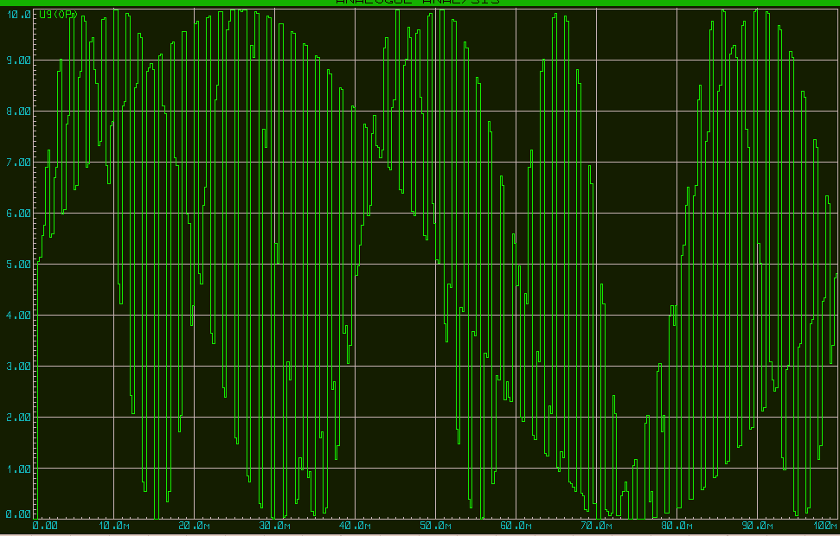
Output Of decoder and Op Amp

Slide 15
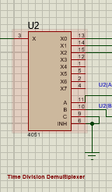
Time Division Demultiplexer
CD4051 demultiplexer
Complementary function of multiplexing
Extracts 3 channel outputs from incoming decoded signal
Same shape output is obtained , but high frequency components are present

Slide 16
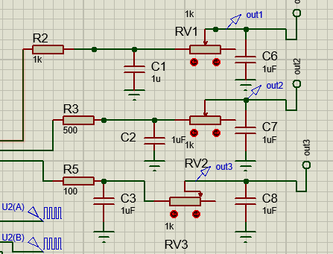
Two stage low Pass Filter
Low pass filter is used to make the three output signals smooth
Output is slightly attenuated compare to input signal. So, by amplifying we can solve this issue.

Slide 17
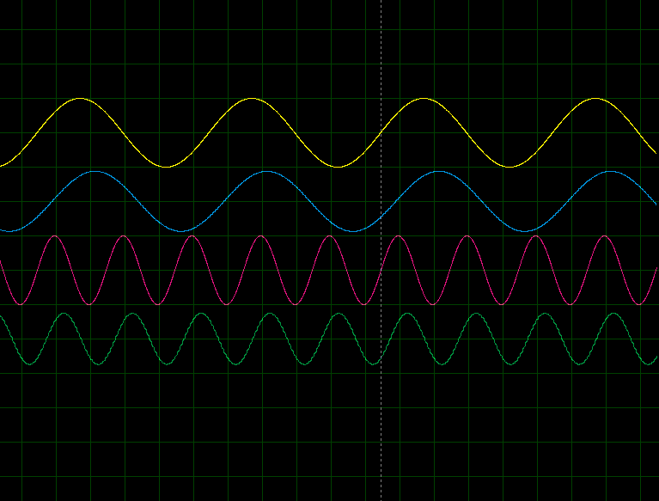
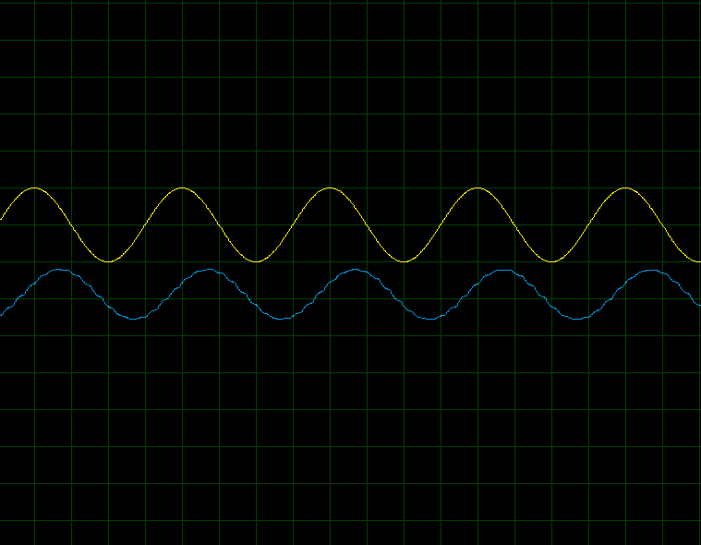
Output and Input Comparison
Input signal 1
Output signal 1
Input signal 3
Output signal 3
input signal 2
output signal 2

Slide 18
Contributions
1706149 : Decoding ,Demultiplexer , filtering, slide making
1706150 : parallel to serial and serial to parallel , decoding
1706152 : Idea and resource management ,report
1706189: multiplexing and encoding, report, slide

Slide 19

Thank
You

