Slide 1

Supervised Learning
Introduction to Machine Learning

Slide 2
Agenda
In this session, you will learn about:
Introduction to Machine Learning
Machine Learning Modelling Flow
Parametric and Non-parametric Algorithms
Types of Machine Learning
Performance Measures
Bias-Variance Tradeoff
Data Inconsistencies

Slide 3

Introduction to Machine Learning

Slide 4
What is Machine Learning?
Machine learning is a subset of artificial intelligence that often uses statistical techniques to give the ability to "learn" with data
Consideration to define a problem:
Problem definition
Define data requirements and its source
Define if whole dataset is considered or subset will do

Slide 5
Phases of Machine Learning
Training Phase: Training data is used to train the model by pairing the given input with the expected output
Validation and Test Phase: Goodness and properties of the trained model are measured and estimated
Application Phase: Model is subjected to real-world data for which the results need to be derived

Slide 6
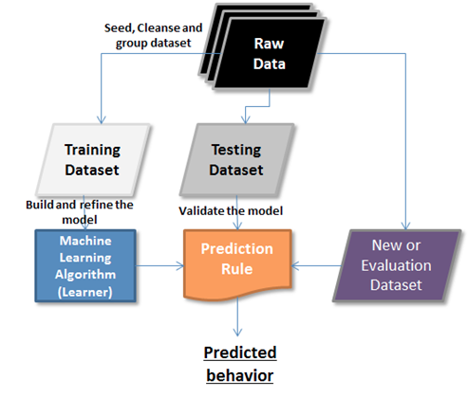
Phases of Machine Learning
The figure shows how learning can be applied to predict the behavior

Slide 7
Advantages of Machine Learning
Easily identifies trends and patterns
No human intervention needed
Cheap and flexible — can apply to any learning task
Automatic method to search for hypotheses explaining data
Continuous Improvement

Slide 8
Limitations of Machine Learning
Need a massive data to train
Error prone - usually impossible to get perfect accuracy

Slide 9

Applications of Machine Learning
Spam Detection
Speech Recognition
Language translation
Fraud detection
Product Recommendation

Slide 10
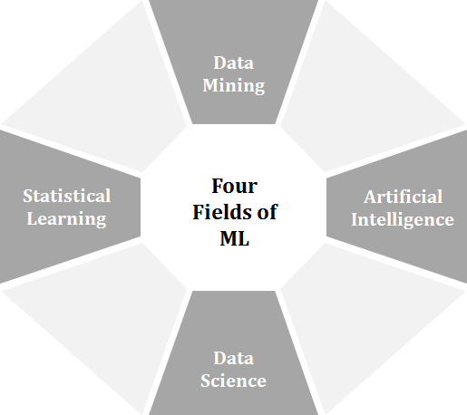
Complementing Fields of Machine Learning

Slide 11

ML is a subset of artificial intelligence that automates data mining:
Machine learning can be stated as more automated and continuous version of data mining. Data mining can often detect patterns in data sets that no human would be able to find. Machine learning is capable of generalizing information from large and dynamically changing data sets, and then detecting and extrapolating patterns in order to apply that information to new solutions and actions

Slide 12
Machine Learning Modeling Flow

Slide 13
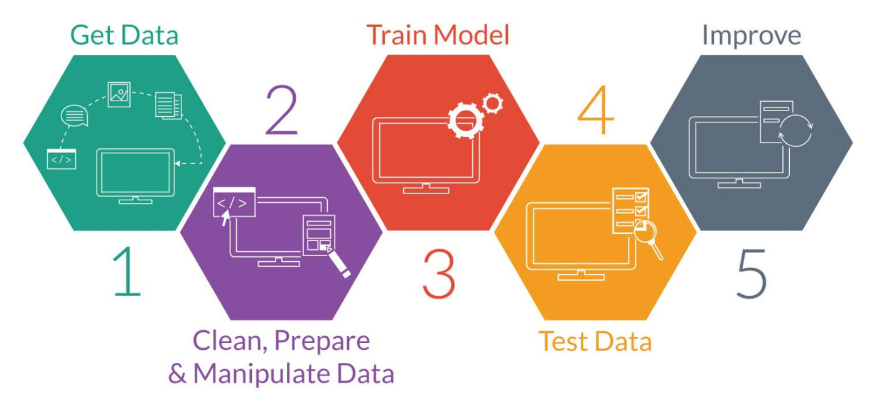
Modeling Flow

Slide 14
Modeling Flow
Get data: Gather data from different sources
Clean, prepare and Manipulate data: Check for the null values and outliers and clear
Train Model: Build a model using train data
Evaluation: Tweak the model using the test data
Improve: Optimize the model to increase its accuracy

Slide 15
Data in Machine Learning
Data forms the main source of learning in Machine Learning
The data that is being referenced here can be in any format, can be received at any frequency and can be of any size
Data in the ML context, can either be labeled or unlabeled

Slide 16
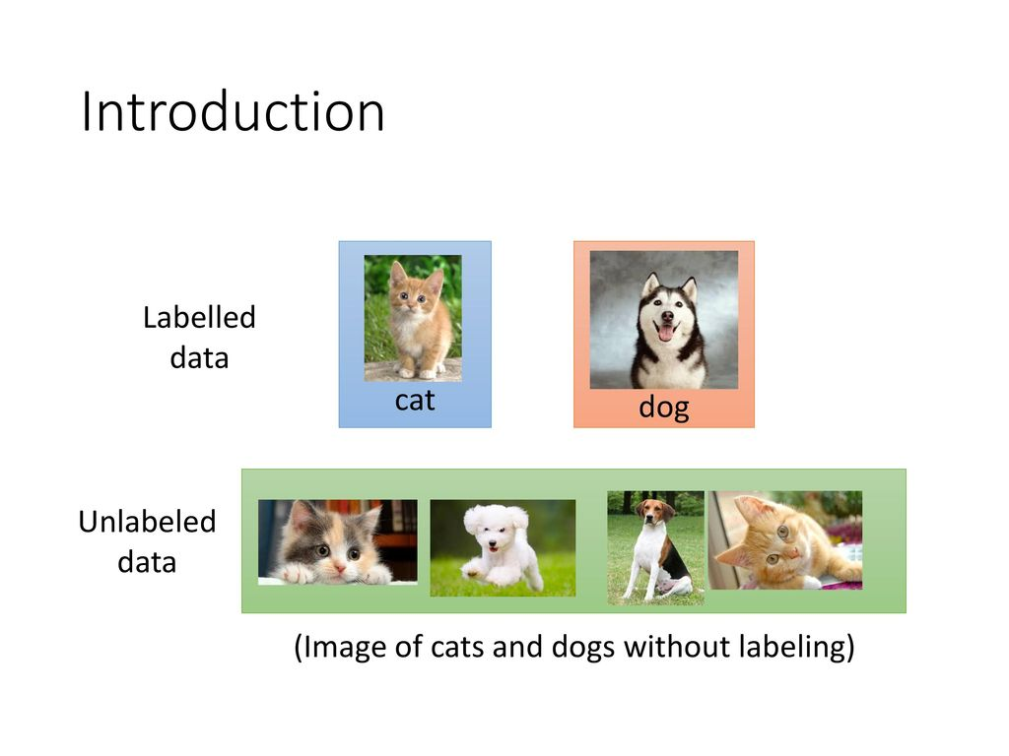
Labeled Data
Labeled Data takes a set of unlabeled data and augments each piece of that unlabeled data with some sort of meaningful "label"
For example, labels for the unlabeled data might be whether this photo contains a cat or a dog

Slide 17
Unlabeled Data
Unlabeled Data consists of samples of natural or human-created artifacts that you can obtain relatively easily from the world
Some examples of unlabeled data are photos, audio recordings, videos, news articles, tweets etc

Slide 18
Data Terminology
Column: Describes data of a single type. For example, column of weights or heights or prices. All the data in one column will have the same scale
Row: A row describes a single entity or observation whose properties are described by columns.
Cell: A cell is a single value in a row and column. It is represented as
Cell = dataset[ row ][ columns ]

Slide 19
Visualization of Data Terminology
A | B | C | D
 | Column 1 | Column 2 | Column 3
Row 1 | Cell11 | Cell12 | Cell13
Row 2 | Cell21 | Cell22 | Cell23
Row 3 | Cell31 | Cell32 | Cell33

Slide 20

Statistical Learning Perspective
The statistical perspective frames data in the context of a hypothetical function (f) that the machine learning algorithm is trying to learn
The columns that are the inputs are referred to as input variables
The column of data we would like to predict is called the output variable or response variable

Slide 21

Statistical Learning Perspective
The most common type of machine learning is to learn the mapping Y = f(X) to make predictions of Y for new X
This is called predictive modeling or predictive analytics and the goal is to make the most accurate predictions possible
If, there are more than one input variable.then they are referred as the Input Vector

Slide 22
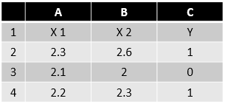

Statistical Learning Perspective
For example, a statistics text may talk about the input variables as independent variables and the output variable as the dependent variable.

Slide 23

Model gives the best results when tested on the same data on which it was trained. If you don’t have much data, you should stick to the simple models.

Slide 24
Parametric and Non-Parametric ML Algorithms

Slide 25
Parametric Machine Learning Algorithms
Algorithms that simplify the function to a known form are called parametric machine learning algorithms
A parametric algorithm involves two steps:
Select a form for the function
Learn the coefficients for the function from the training data

Slide 26
Parametric Machine Learning Algorithms
Consider a mapping function which is used in linear regression:
y = b0 + b1 * x1 + b2 * x2
Where
b0, b1 and b2 are the coefficients of the line
x1 and x2 are input variables
y is output variable
Estimate the coefficients of the line equation and we have a predictive model for the problem
Often the assumed functional form is a linear combination of the input variables and are called as linear machine learning algorithms

Slide 27
Benefits of Parametric ML Algorithms
Simpler: These methods are easier to understand and interpret results
Speed: Parametric models are very fast to learn from data
Less Data: They do not require as much training data and can work well even if the fit to the data is not perfect

Slide 28
Limitations of Parametric ML Algorithms
Constrained: By choosing a functional form these methods are highly constrained to the specified form
Limited Complexity: The methods are more suited to simpler problems
Poor Fit: In practice the methods are unlikely to match the underlying mapping function

Slide 29
Non-Parametric Machine Learning Algorithms
Algorithms that do not make strong assumptions about the form of the mapping function are called non-parametric machine learning algorithms
Free to learn any functional form from the training data
Assumes patterns as mapping function which are close and likely to have a similar output variable
Method works good when there is lot of data and becomes easier to choose the right feature

Slide 30
Benefits of Non-Parametric ML Algorithms
Flexibility: Capable of fitting a large number of functional forms
Power: No (or weak) assumptions about the underlying function
Performance: Can result in higher performance models for prediction

Slide 31
Limitations of Non-Parametric ML Algorithms
More data: Require a lot of training data to estimate the mapping function
Slower: Slower to train as they often have far more parameters to train
Overfitting: High risk to overt the training data and harder to explain why specific predictions are made

Slide 32
Types of Machine Learning

Slide 33
Types of Machine Learning
Machine Learning
Supervised Learning
Unsupervised Learning
Semi-Supervised Learning

Slide 34

Supervised Machine Learning
Data is labeled and the algorithms learn to predict the output from the input data
Learning stops when the algorithm achieves an acceptable level of performance
It is classified as
Regression
Classification

Slide 35
Supervised Machine Learning
Linear Regression
Regression
Decision Tree(RPART)
Supervised Learning
Logistic Regression
Classification
Support Vector Machines
Naive Bayes
Decision Tree(CART, (C5.0)

Slide 36
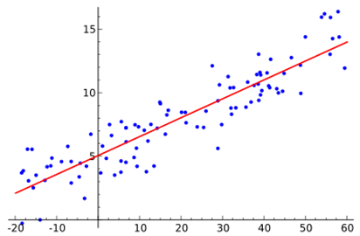
Regression
Regression is a technique from statistics used to predict values of a desired target quantity
A regression problem is when the output variable is a real or continuous value
Types of Regression
Simple Linear Regression
Multiple Linear Regression
Decision Tree(RPART)

Slide 37
Classification
Classification is a technique for determining which class the dependent belongs to based on one or more independent variables
A Classification problem is when output variable is category
Types of Classification
Logistic Regression
Support Vector Machine
Naive Bayes

Slide 38
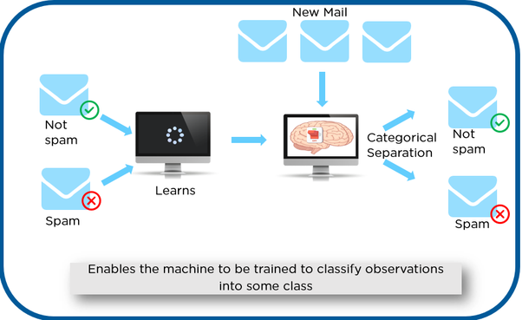
Classification
Example - Email filtering

Slide 39
Unsupervised Machine Learning
Data is unlabeled and the algorithms learn to inherent structure from the input data
Self learning algorithm
Deals with the unlabeled data
It is classified as
Clustering
Association

Slide 40
Unsupervised Machine Learning
Clustering
K-means Clustering
Unsupervised Learning
Association
Apriori Rules

Slide 41
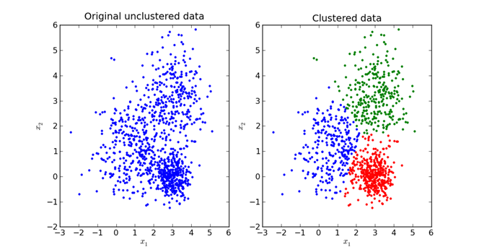
Clustering
It segregate groups with similar traits and assign them into clusters
Goal is to find the similar groups in data
Examples of Clustering
K-means Clustering
Hierarchical Clustering

Slide 42
Association
Rule based machine learning method for discovering relations between variables
It is intended to identify strong rules discovered in databases using some measures of interestingness
One Example of Association is:
Apriori algorithm

Slide 43
Semi-Supervised Machine Learning
A mixture of supervised and unsupervised techniques can be used
Allows neural networks to mimic human inductive logic
And sort unknown information fast and accurately without human intervention
Deals with the unlabelled data as well as labelled data

Slide 44
Although logistic regression has the term ‘regression’ in it, it is considered as classification algorithm.
Logistic regression is a classification algorithm. Because it is used to predict a binary outcome based on a set of independent variables. A binary outcome is one where there are only two possible scenarios either the event happens or not. So it's basically classifying the data.

Slide 45
Performance Measures

Slide 46
Performance Measure - Regression
Performance Measures for regression are used to evaluate learning algorithms and form an important aspect of machine learning
These measures can also be used as heuristics to build learning models
Performance Measures:
Mean Squared Error (MSE)
Mean Absolute Error (MAE)
Root Mean Square Error (RMSE)

Slide 47
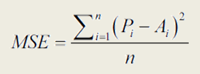
Mean-Squared Error
Measures the average of the squares of the errors
Always non-negative, and values closer to zero are better
Good performance metric
Pi - predicted values
Ai - observed values
n - number of observations

Slide 48
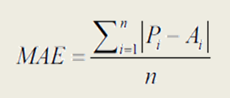
Mean-Absolute Error
Mean Absolute Error (MAE) is a measure of difference between two continuous variables
Average of the absolute errors
More intuitive and less sensitive to outliers
Pi - predicted values
Ai - observed values
n - number of observations

Slide 49
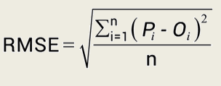
Root Mean-Squared Error
Measures differences between predicted values (by a model and the values actually observed (Oi), where n is the number of observation
Pi - predicted values
Oi - observed values
n - number of observations

Slide 50
Performance Measure - Classification
In a classification problem, you can represent the errors using “Confusion Matrix”
Confusion Matrix
Table with two dimensions viz. “Actual” and “Predicted”
It is the easiest way to measure the performance of a classification problem where the output can be of two or more type of classes.

Slide 51
Accuracy
Accuracy is the percent of predictions that were correct
For example consider 10,000 customer records
Action | Actually bought | Actually did not buy
Predicted(that there will be a buy) | TP : 500 | FP : 100
Predicted(that there will be no buy) | FN : 400 | TN : 9000
The "accuracy" is (9,000+500) out of 10,000 = 95%

Slide 52
Recall
Recall is the percent of positives cases that you were able to catch
For example consider 10,000 customer records
Action | Actually bought | Actually did not buy
Predicted(that there will be a buy) | TP : 500 | FP : 100
Predicted(that there will be no buy) | FN : 400 | TN : 9000
The "recall" is 500 out of 900 = 55.55%

Slide 53
Precision
Precision is the percent of positive predictions that were correct
For example consider 10,000 customer records
Action | Actually bought | Actually did not buy
Predicted(that there will be a buy) | TP : 500 | FP : 100
Predicted(that there will be no buy) | FN : 400 | TN : 9000
The "precision" is 500 out of 600 = 83.33%

Slide 54
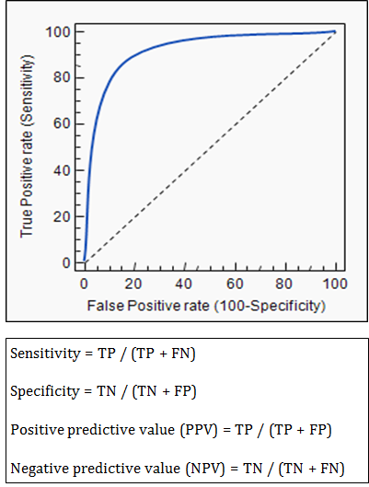
Receiver Operating Characteristics (ROC) Curve
Shows tradeoff between True Positive Rate(sensitivity) and False Positive Rate(1-specificity)
Closer the curve to left-hand border and top border of the ROC space, more accurate the test
Closer the curve to the 45-degree diagonal of the ROC space, the less accurate the test
The area under the curve is a measure of test accuracy

Slide 55
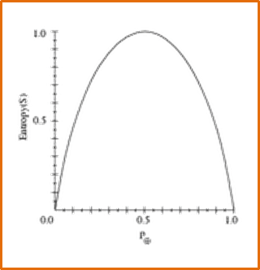
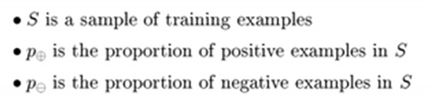

How to Measure Purity?
Entropy: Measure of impurities

Slide 56
Types of Error
Training Error
Fraction of training data misclassified
Test Error
Fraction of test data misclassified
Generalization Error
Probability of misclassifying new random data

Slide 57
The data used to train the machine learning model affects the correctness or predictions made by it. Sometimes inadequate data may result in inconsistent results. The more the data you have the more accuracy you will get.

Slide 58
Bias-Variance Tradeoff

Slide 59
Bias
Difference between the average prediction of a model and the correct value which it is trying to predict
Low Bias
Suggests less assumptions
For example k-Nearest Neighbours and Support Vector Machines
High-Bias
Suggests more assumptions
For examples Linear Regression, Linear Discriminant Analysis

Slide 60
Variance Error
Variance is the amount by which predicted value of the target function will change if training data is used
Low Variance
Suggests small change in predicted value
For examples Linear Regression, Linear Discriminant Analysis
High Variance
Suggests large changes in predicted value
For Examples k-Nearest Neighbors and Support Vector Machines

Slide 61
Irreducible error
Even from a perfect model, we might not be able to remove the errors completely made by it
This is because the training data itself may contain noise. This error is called Irreducible error or Bayes’ error rate or Optimum Error rate
While we cannot do anything about the Irreducible Error, we focus on reducing the errors due to bias and variance

Slide 62
Total Error
The prediction error for any machine learning algorithm can be broken down into three parts:
Bias Error
Variance Error
Irreducible Error
Total Error = Bias + Variance + Irreducible Error

Slide 63
Total Error
We can divide the received data into three parts:
Training Set: It is 60% of the data and used for training a model
Validation Set: It is typically 20% of the data and used to test the quality of the trained model
Test Set: It is typically 20% of the data and used is to report the accuracy of the final model

Slide 64
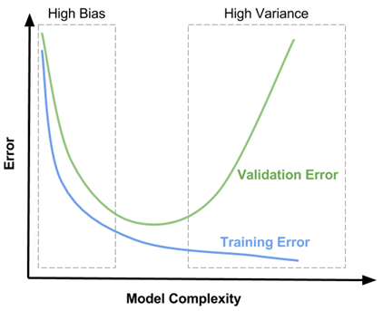
Effect of model complexity
If the model is not performing well, it is usually a high bias or a high variance problem
The figure below graphically shows the effect of model complexity on error due to bias and variance

Slide 65
Effect of model complexity
Increasing the complexity results into reduction in error due to lower bias in the model.
This happens till a particular point
As the complexity of model increases, variance increases and overfitting takes place

Slide 66
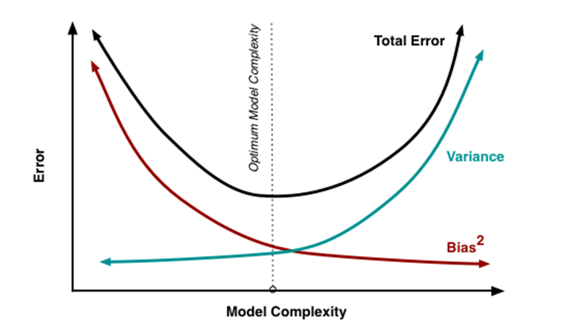
Bias-Variance Trade-Off
Trade-off is tension between the error introduced by the bias and the variance
A balance between these two types of errors is known as the trade-off management of bias-variance errors
For example Ensemble learning

Slide 67
Data Inconsistencies in Machine Learning

Slide 68
Data Inconsistencies in Machine Learning
Some Data Inconsistencies are:
Unpredictable Data Formats
Under Fitting
Over Fitting
Data Instability
There are some established processes to address these inconsistencies

Slide 69
Unpredictable Data Formats
Complexity will creep in when the new data entering the system comes in formats that are not supported by the machine learning system
Machine learning is meant to work with new data constantly coming into the system and learning from that data
It is now difficult to say if our models work well for the new data which has instability in the formats, unless there is a mechanism built to handle this

Slide 70
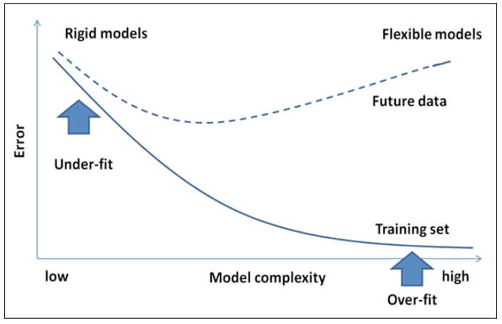
Under Fitting
A model is said to be under-fitting when it doesn't take into consideration enough information to accurately model the actual data

Slide 71
Over Fitting
The Statistical model is said be over fitted if it describes noise instead of the relationships
A large dataset also runs the risk of having the model overfit the data

Slide 72
Data Instability
Machine Learning Algorithms are usually robust to noise within the data
A problem will occur if the outliers are due to manual error or misinterpretation of the relevant data
This will result in a skewing of the data, which will ultimately end up in an incorrect model
There is a strong need to have a process to correct or handle human errors that can result in building an incorrect model

Slide 73
The difficult step in ML is transforming raw data.
Despite the popular misconception, machine learning is not about finding and adjusting algorithms, it is about selecting data and characteristic development – transforming raw characteristics into the set of features that represent the gist of the data.

Slide 74

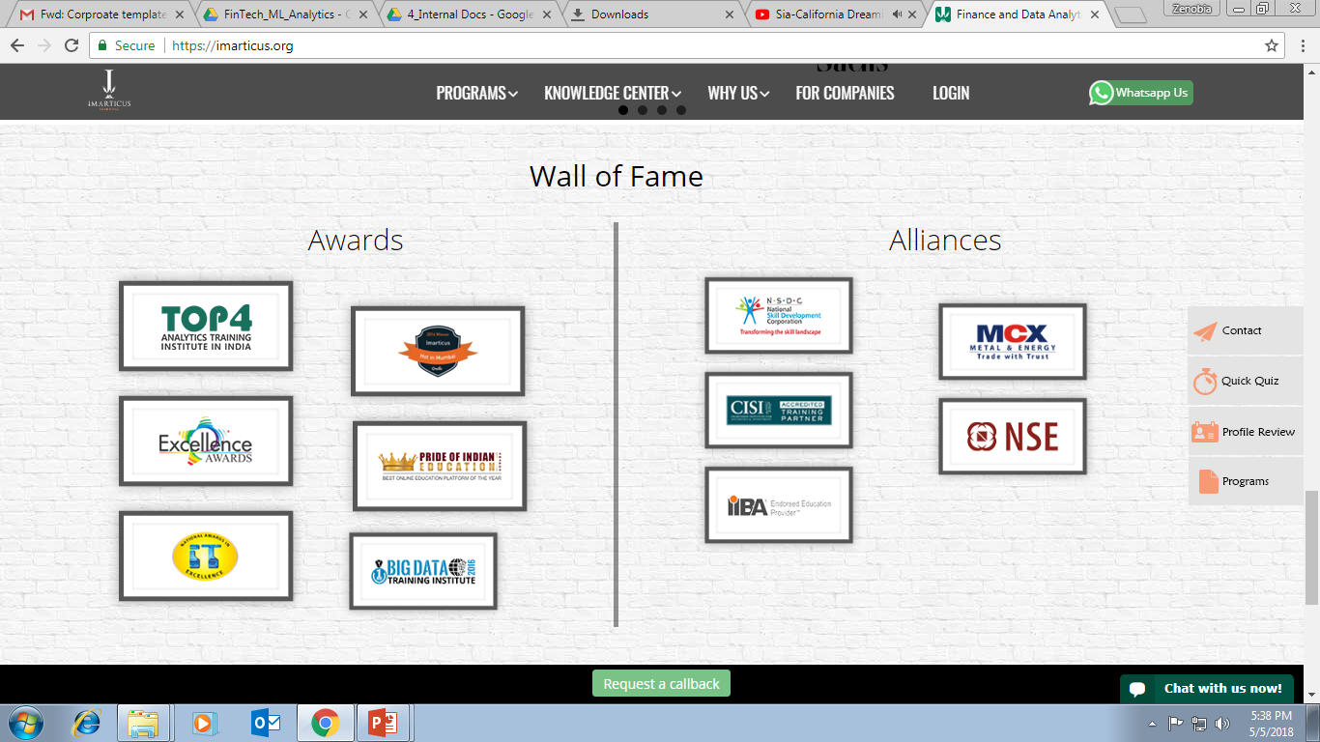



AWARDS:
Learn more:
https://imarticus.org/corporate/
Email us:
info@imarticus.com
Connect with us:
www.linkedin.com/company/imarticuslearning
ACCREDITED TRAINING PARTNER:
Watch us:
www.youtube.com/ImarticusLearninginstitute
Visit us:
Mumbai | Thane | Pune | Bangalore | Delhi - NCR | Hyderabad | Chennai | Coimbatore

